Slide 1
Face Recognition Attendance System
Dataset + model evaluation overview

Slide 2
Agenda
Problem & goals
Dataset & preprocessing
Model architecture
Evaluation results
Demo workflow
Future improvements

Slide 3
Dataset & Preprocessing
800 face samples across 8 people
Images stored as flattened 50x50 RGB pixels (7,500 features)
Face detection uses Haar cascade (OpenCV)
Labels stored in data/names.pkl

Slide 4
Model Architecture
KNN (k=5) + RandomForest (100 trees)
VotingClassifier (hard voting)
Trained on flattened face vectors
Predicts one of the known identities

Slide 5
Evaluation Results
Train/test split: 640 / 160 samples
Accuracy on test split: 95.62%
5-fold CV accuracy: 96.50% ± 0.75%
Real-world accuracy depends on lighting, pose, occlusion

Slide 6
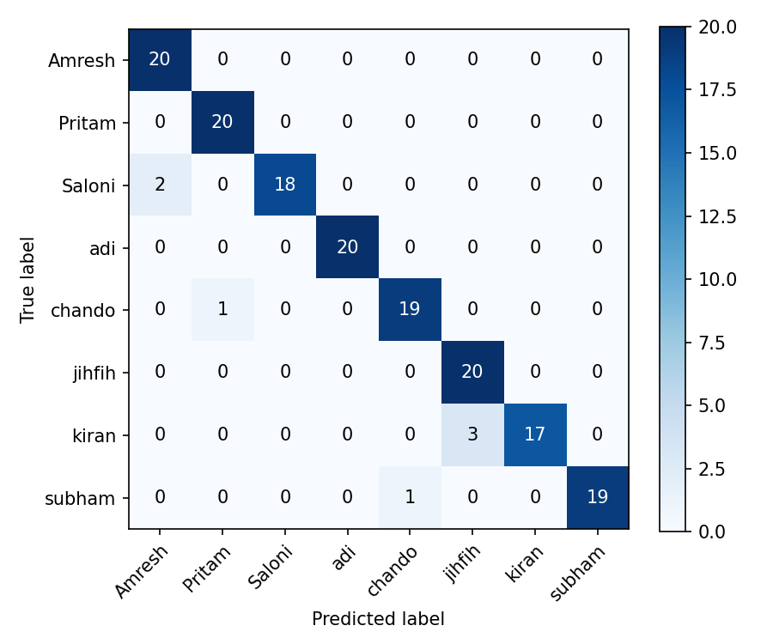
Confusion Matrix (Test Split)

Slide 7
Live Demo Workflow
Run test.py to start webcam attendance mode
Detect face, classify identity, then record attendance
Press 'o' to log attendance (skips duplicates)
Output: CSV file under Attendance/ folder

Slide 8
Future Improvements
Add data augmentation (lighting/rotation) to improve robustness
Use a deep learning model (e.g., FaceNet) for better accuracy
Store embeddings instead of raw pixels
Add GUI and better error handling

