Slide 1
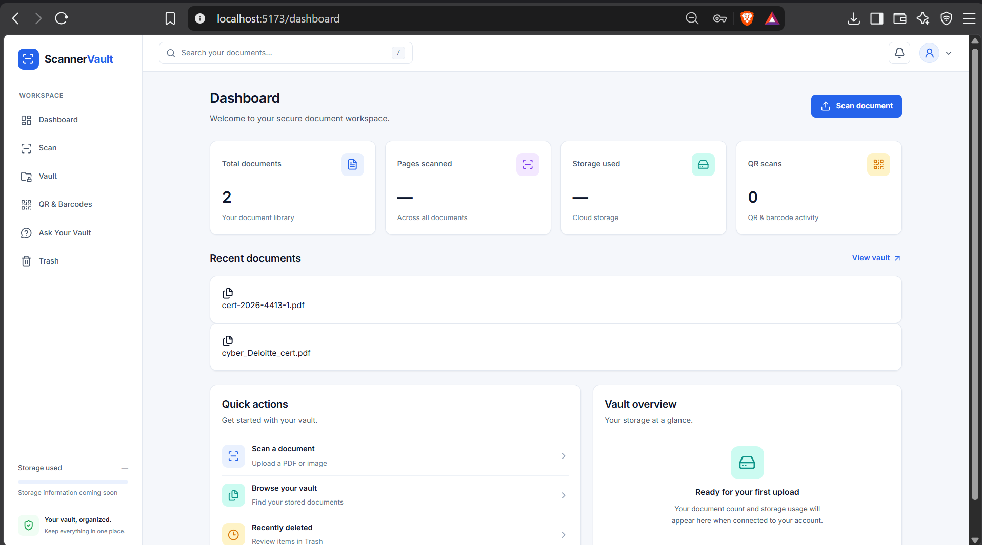
⌗
Scanner
Vault
Your documents.\nOrganized. Searchable. Secure.
An intelligent document vault with scanning, OCR, AI summaries, and conversational search.
PROJECT PRESENTATION
MERN Stack • OCR • Generative AI

Slide 2
The problem we solve
Documents are easy to collect—and surprisingly hard to manage.
Scattered files
Hard to find details
Manual effort
Certificates, invoices, and records get spread across folders and devices.
Opening files one by one to locate a date, name, or amount wastes time.
Organizing, extracting text, and summarizing documents can be repetitive.
ScannerVault brings the workflow into one place
Upload → Extract → Understand → Search → Organize
02

Slide 3
What ScannerVault can do
A single workspace for document storage and AI-powered understanding.
Secure account
Document scanning
Vault & folders
Register and sign in to access a personal vault.
Upload PDF and image files through a simple flow.
Browse documents and organize them into folders.
OCR extraction
AI summaries
Ask Your Vault
Turn document text into searchable content.
Get key points without reading every page.
Ask questions grounded in text from stored documents.
03

Slide 4
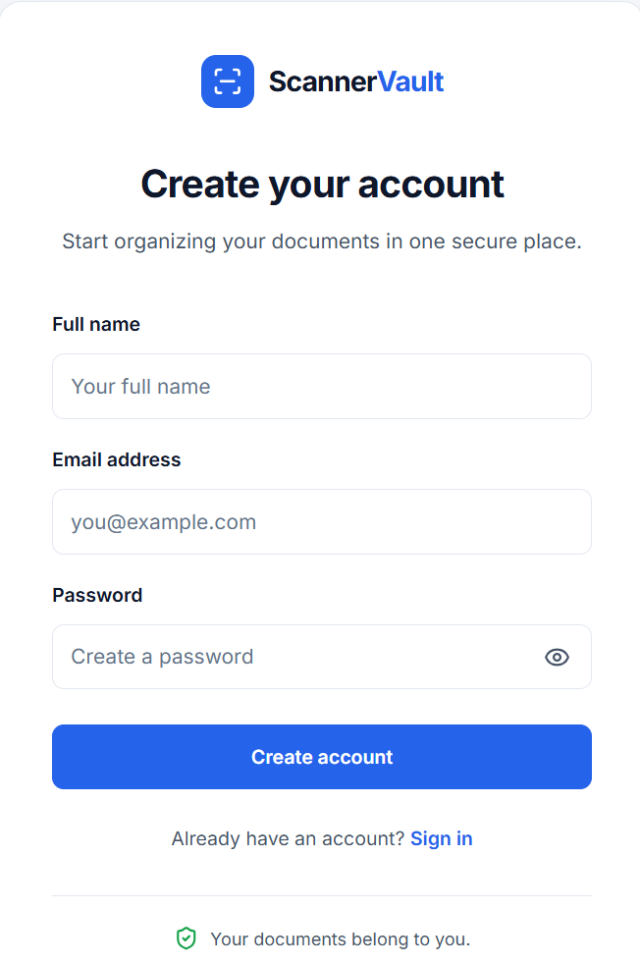
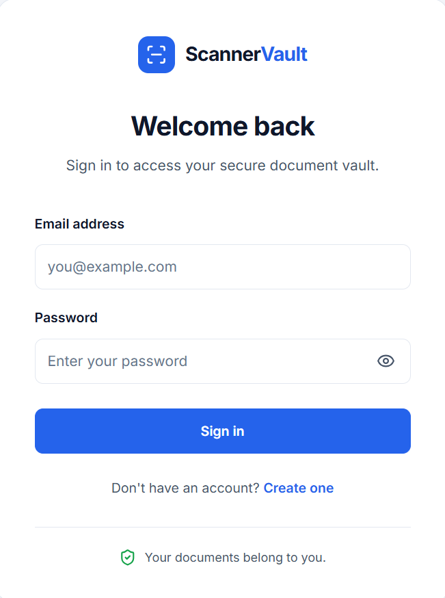
A clean, simple workspace
Account access and dashboard overview.
Registration
Sign in
Dashboard at a glance
04

Slide 5
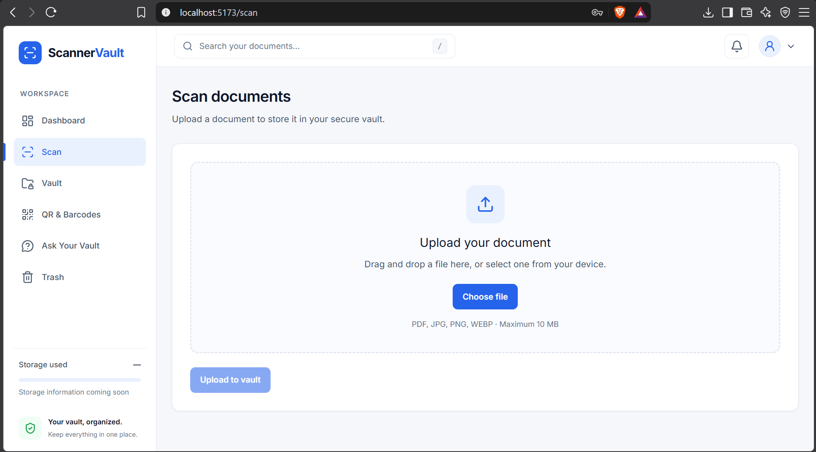
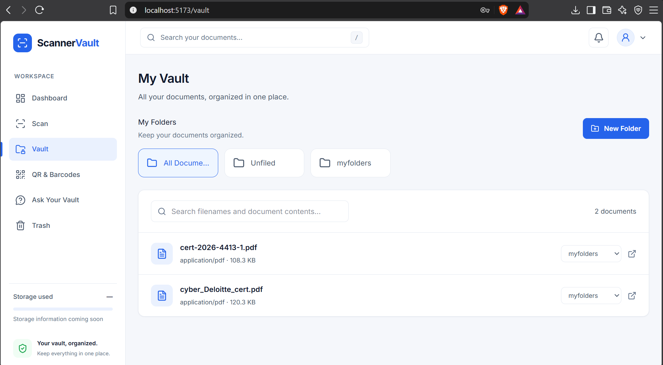
Upload and organize documents
The scan page gets files into the vault; folders keep them easy to find.
01 Upload a PDF or image
02 Browse, search, and assign folders
05

Slide 6
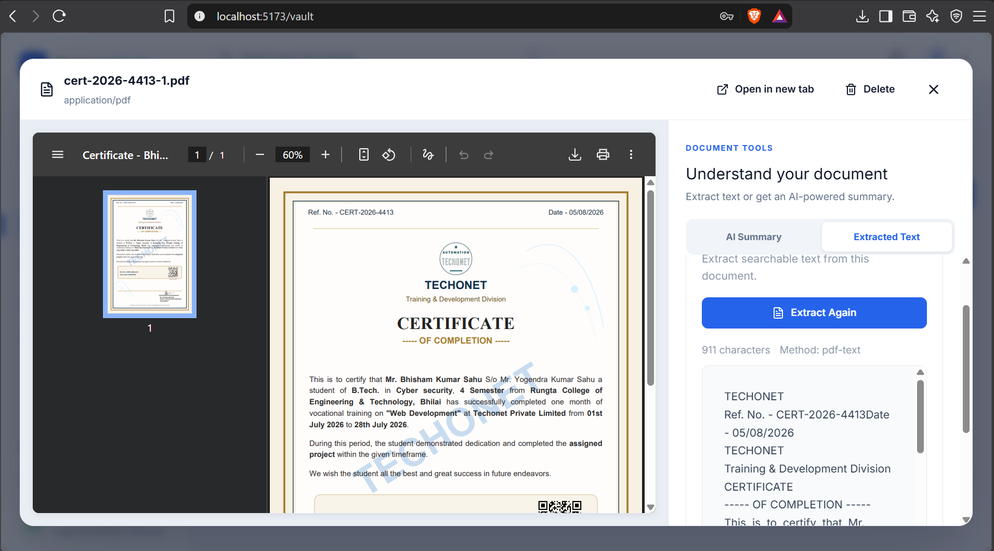
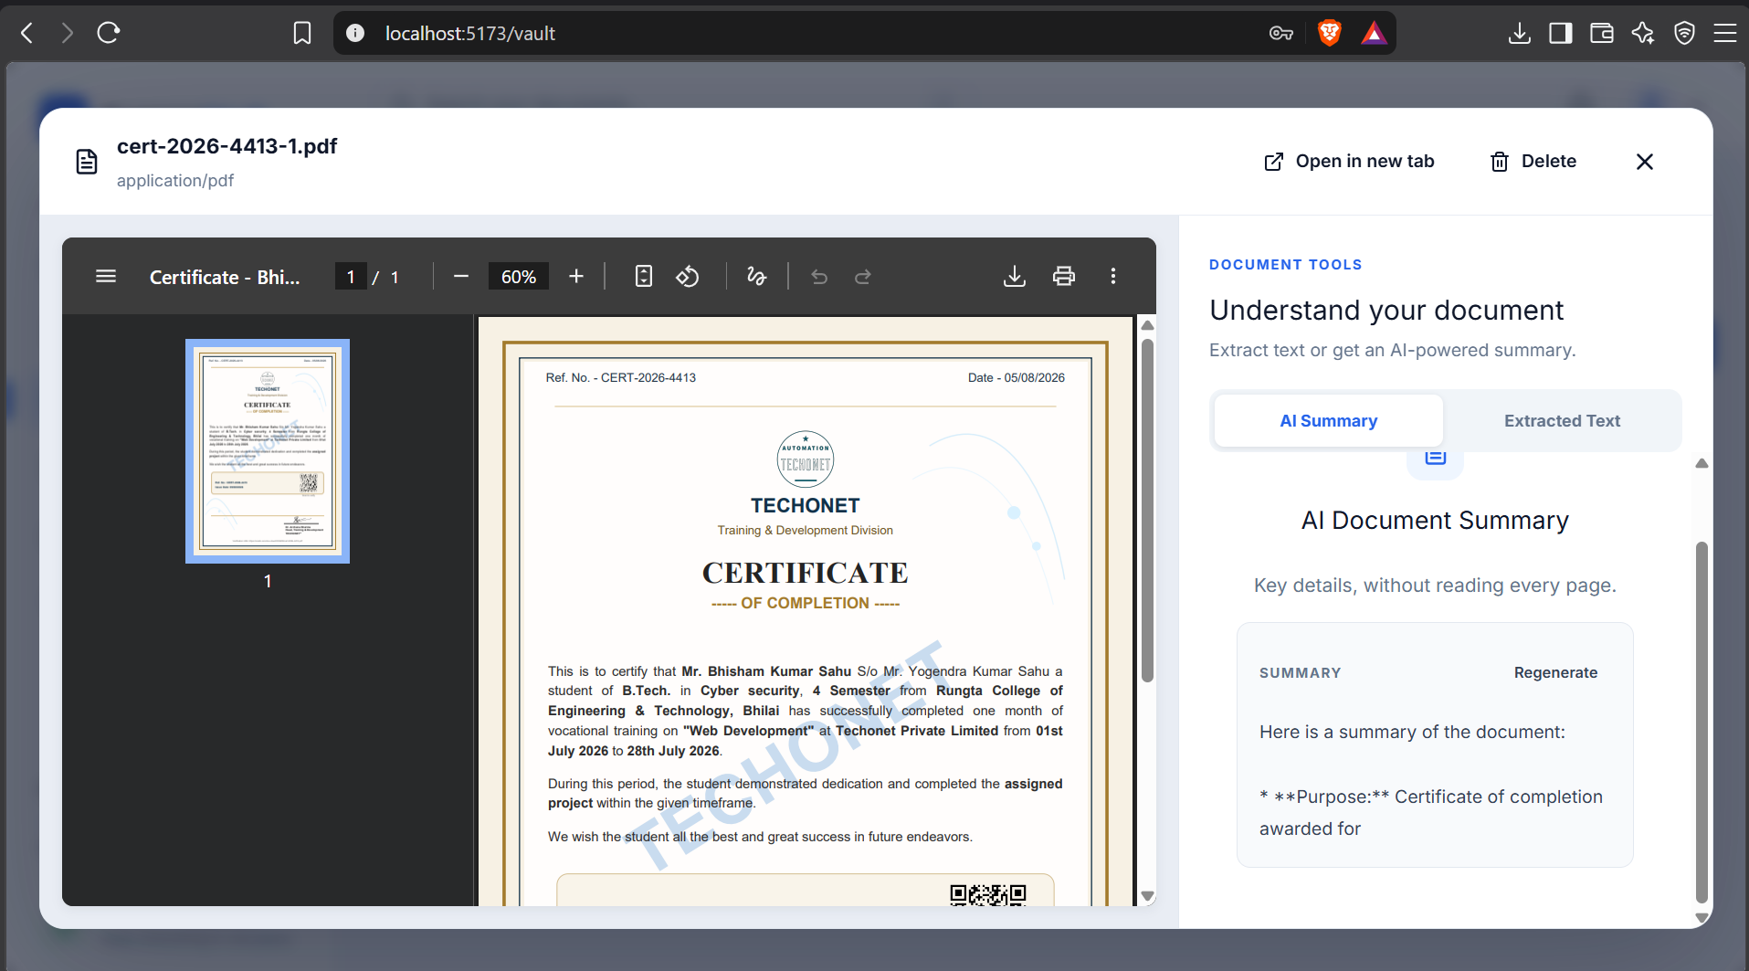
From raw files to useful information
OCR makes document content searchable; AI summaries make it quicker to understand.
OCR / extracted text
AI-generated document summary
06

Slide 7
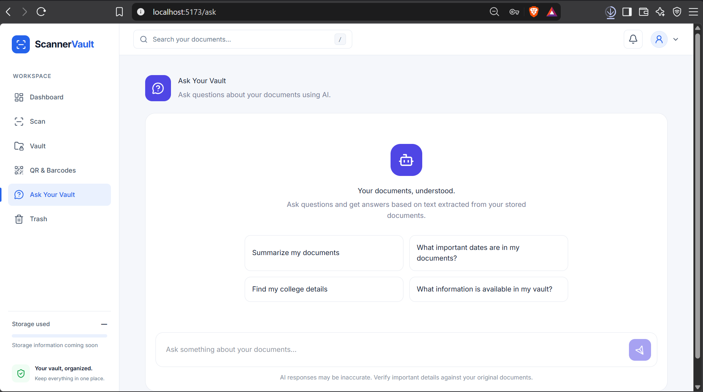
Ask Your Vault
A conversational way to retrieve information from your own document collection.
Example prompts
• Summarize my documents
• What important dates are in my documents?
• Find my college details
• What information is available in my vault?
Grounded answers
Answers use text extracted from stored documents.
07

Slide 8
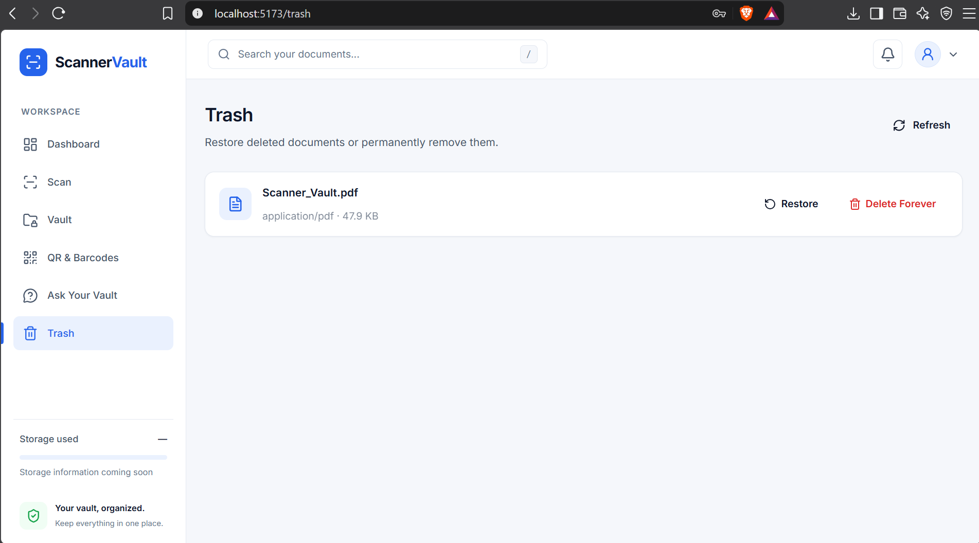
A safer document lifecycle
Accidental deletion does not have to mean losing a document forever.
Restore
Bring a deleted document back to the vault.
Delete forever
Permanently remove items when they are no longer needed.
The Trash page keeps recovery actions clear and explicit.
08

Slide 9
Technology stack & workflow
A modular architecture connects the interface, API, database, storage, and AI services.
Frontend
Backend API
Database
File storage
AI services
React • Tailwind CSS\nReact Router • Axios
→
Node.js • Express\nJWT authentication
→
MongoDB • Mongoose\nDocument metadata
→
Cloudinary\nUploaded documents
→
Tesseract OCR • FastAPI\nGemini API for summaries / Q&A
Typical workflow
Sign in
›
Upload
›
Extract text
›
Summarize / ask
›
Store & retrieve
09

Slide 10
ScannerVault
One vault. Smarter documents.
ScannerVault combines secure document storage with OCR and AI so users can organize files, understand their contents, and find details with natural-language questions.
Thank you
Questions?
MERN Stack • OCR • Generative AI

