Slide 1
Predicting Traffic Accident Severity
Applied Data Science Caption
Priti Pallabini Sarangi

Slide 2
Introduction
Road traffic injuries are currently estimated to be the eighth leading cause of death across all age groups globally, and are predicted to become the seventh leading cause of death by 2030.
Analyzing a significant range of factors, including weather conditions, special events, roadworks, traffic jams among others, an accurate prediction of the severity of the accidents can be performed.
These insights, could allow law enforcement bodies to allocate their resources more effectively in advance of potential accidents, preventing when and where a severe accidents can occur as well as saving both, time and money. In addition, this knowledge of a severe accident situation can be warned to drivers so that they would drive more carefully or even change their route if it is possible or to hospital which could have set everything ready for a severe intervention in advance.
Governments should be highly interested in accurate predictions of the severity of an accident, in order to reduce the time of arrival and thus save a significant amount of people each year. Others interested could be private companies investing in technologies aiming to improve road safeness.

Slide 3
Problem
Data that might contribute to determining the likeliness of a potential accident occurring might include information on previous accidents such as road conditions, weather conditions, exact time and place of the accident, type of ve-hicles involved in the accident, information on the users involved in the accident and o course the severity of the accident. This projects aims to forecast the severity of accidents with previous information that could be given by a witness informing the emergency services

Slide 4
Data source
The original data for this project comes from the following [Kaggle data set] Link
In a previous notebook feature selection i performed a selection of the most relevant features for the prediction of traffic accident severity
The features of the dataset resulting are the following:
Characteristics dataset
Place dataset
User dataset
Holiday dataset

Slide 5
Characteristics dataset
In the *characteristics* dataset, I will keep the features: "lighting", "localisation"(agg), "type of intersection", "atmospheric conditions", "type of collisions", "department", "adress", "time" and the coordinates. I added two new features from this original dataset: "date" and "weekend" indicating if the accident occurred during the weekend or not.
Place dataset
In the *characteristics* dataset, I will keep the features: "lighting", "localisation"(agg), "type of intersection", "atmospheric conditions", "type of collisions", "department", "adress", "time" and the coordinates. I added two new features from this original dataset: "date" and "weekend" indicating if the accident occurred during the weekend or not.

Slide 6
Users dataset
From the *users* dataset, I have created the following features:
+ num_us: total number of users involved in the accident.
+ ped: Wether there are pedestrians involved or not.
+ critic_age: If there is any user in between 17 and 31 y.o.
+ sev : maximum gravity suffered by any user involved in the accident:
+ 0 = Unscathered or Light injury
+ 1 = Hospitalized wonded or Death
Holiday dataset
I used the *holiday* dataset to craft a new feature indicating the accident accurred during a holiday.

Slide 7
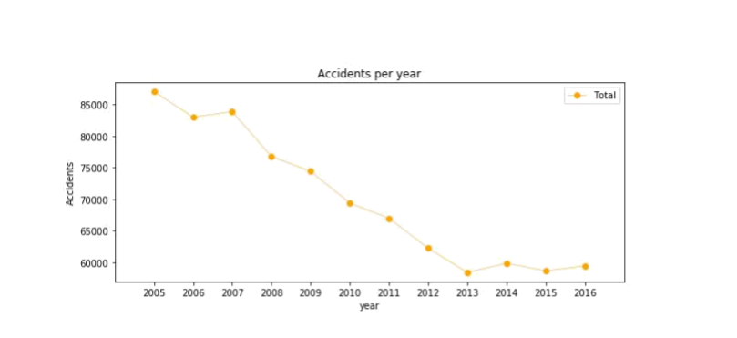
The number of traffic accidents decreased over the years from 2005 to 2013, after which the trend became stable.

Slide 8
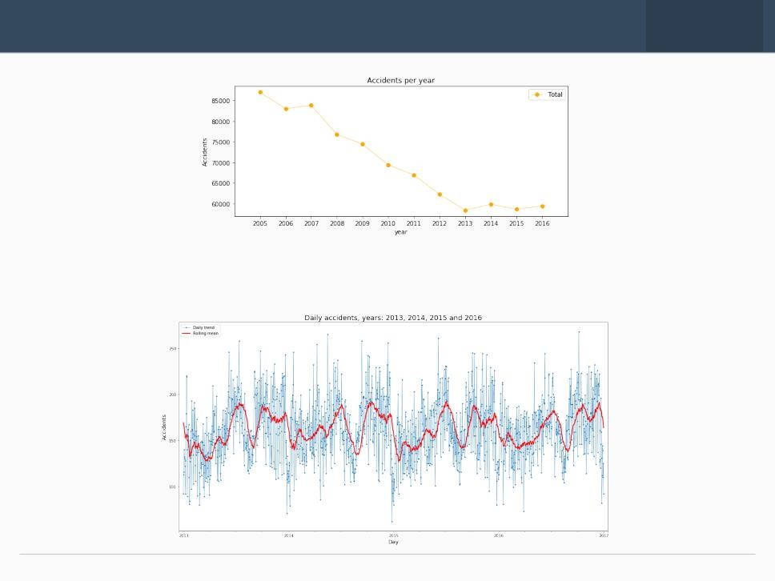

Slide 9
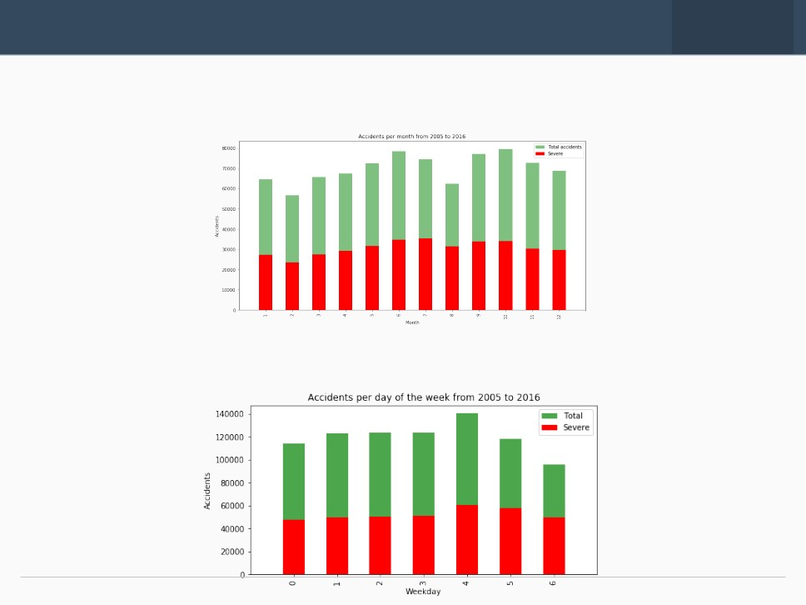
EDA
-
-
Accidents increase from March to June and then again in September, decreasing at the end of the year.
. More accidents on Friday and less on Sunday

Slide 10
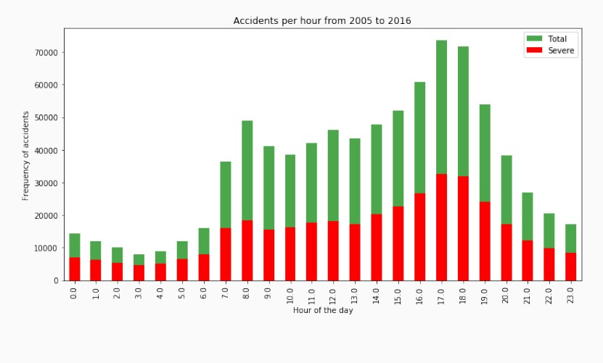
Spikes:
8am: people go to work
5-6pm: people return home.

Slide 11
Classification Model
Random Forcast:
10 decision trees maximum depth of 12 features
Logistic Regression
C=0.001
K-Nearest Neighbor
K=16
Supervised Vactor Machine
Due to computation inefficiency, training size was reduced to 75,000 samples.

Slide 12
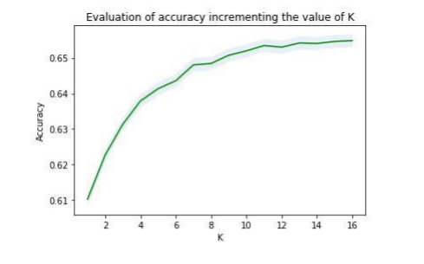
Accuracy of KNN models increasing the value of K.

Slide 13
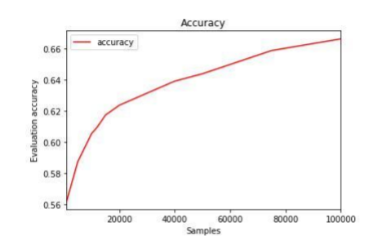
Accuracy of SVM increasing the training sample’s size.

Slide 14
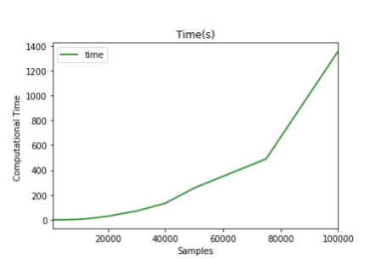
Computational time of SVM increasing the training sample’s size.

Slide 15
The table reports the result of the evaluation of each model
Results
Algorithm | Jaccard | f1-score | Precision | Recall | Time(s)
Random Forest | 0.722 | 0.72 | 0.724 | 0.591 | 6.588
Logistic Regression | 0.661 | 0.65 | 0.667 | 0.456 | 6.530
KNN | 0.664 | 0.66 | 0.652 | 0.506 | 200.58
SVM | 0.659 | 0.65 | 0.630 | 0.528 | 403.92
With no doubt Random Forest is the best model, in the same time as the log. res.it improves the accuracy from 0.66 to 0.72 and the recall from 0.45 to 0.59

Slide 16
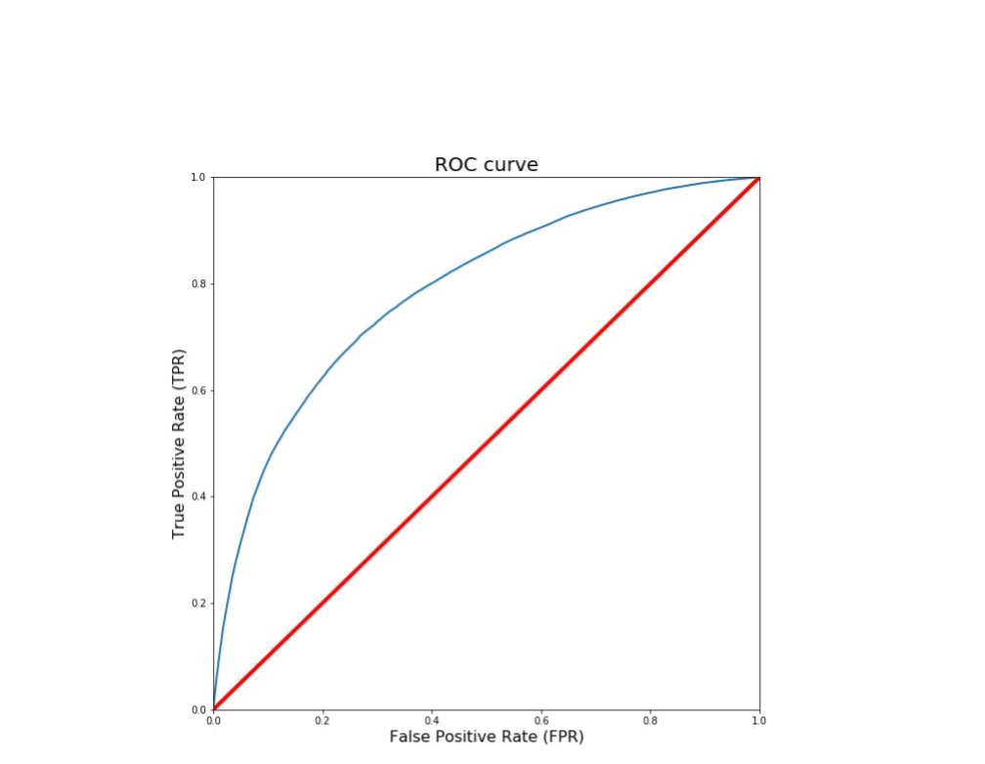
I also evaluated the best model using their ROC curves. In this particular problem, lower false positive rate is less important than higher true positive rate. In other words, it is more important to properly predict the high-severity accidents properly, if there is room for doubt it is better to prevent

Slide 17
Conclusion
In this study, I analyzed the relationship between severity of an accident and some characteristics which describe the situation that involved the accident. Initially I thought that features such as atmospheric conditions, the lighting or being a holiday would be the most relevant ones, yet I identified the department, the day and time of the accident, the road category and type of collision among the most important features that aced to the gravity of the accident. I built and compared 4 different classification models to predict whether an accident would have a high or low severity. These models can have multiple application in real life. For instance, imagine that emergency services have a application with some default features such as date, time and department/municipality and then with the information given by the witness calling to inform on the accident they could predict the severity of the accident before getting there and so alert nearby hospitals and prepare with the necessary equipment and strategies. Also by identifying the features that favor the most the gravity of an accident, these could be tackled by improving road conditions or increasing the awareness of the population.

Slide 18
Observation
I was able to achieve 68% accuracy in the. However, there was still significant variance that could not be predicted by the models in this study. I think other features like speed or uninterrupted time of traveling could be used to predict a more accurate classification. These are characteristics that my be impossible of knowing right now, but at the incredible peace that technology is evolving nowadays, soon cars will be able of track them so that the emergency services could use them.
One problem I think these features had is that the target of this classification problem was simplified to two different classes, low and high severity. Labeling severity with a range of punctuation from 0 to 100, for instance, could allow the possibility of developing regression model.
The next step on this problem could be to add a accident prediction model able to not just predict the accuracy but also the critical time and spots where potential accidents can occur in advance.

Slide 19
References
Alexander Popov. Road Traffic Injuries. WHO, Global Health Observation Data, 2016. https://www.who.int/health-topics/road-safety#tab=tab 1

Slide 20
Thank You
Priti Pallabini Sarangi

