Slide 1
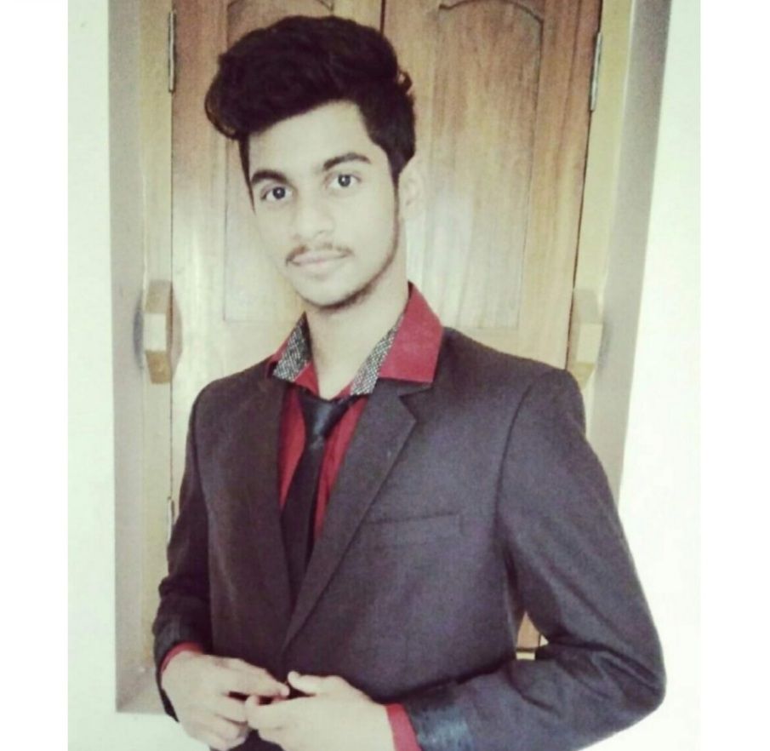



Subham Subhamaya Satpathy
Analyst/Software Engineer
Bachelor of Technology Computer Science (Gold Medalist) : 2017 - 2021
Skills Java 11
Spring Boot, MVC
Spring Security
JPA CRUD
Bootstrap
MERN Stack
Angular
NodeJS
MongoDB
Database
SQL database – MySQL
No SQL database – MongoDB
Web Technologies
HTML5 & CSS3
Javascript
Typescript
AddOns
Github
Maven
Postman
Additional Details
Leadership
Excellent Communication Skills
Team management
Mumbai
subham.satpathy@capgemin.com
+91 6370103951
A4
Software Engineer who is Strong in design and integration with intuitive problem-solving skills. Passionate about implementing and launching new projects.
Ready to learn new technologies and implement them to further improve my knowledge.
Eager to work in a team of dedicated people and serve a key role in the enhancement and development of the project.
Has working knowledge on ReactJS(Hooks, redux)and Java Microservice Development using Spring framework on an intermediate level.
1. Agro-based Farmer Dealer Web Application
Completed end to end case study of Dealer and Crops Application along with JWT authentication, Swagger and payment testing using Spring Boot and MERN Stack. Material-UI and Bootstrap used for user interface.
2. Online Restaurant Management Application
Developed Online Restaurant Management Application using Angular with JSON-Server as database in agile methodology of software component development model.
3. Backend (MongoDB), Midware (Spring Boot) and Frontend (Angular) at Capgemini Degreed Platform
Learned and recompiled all concepts of the backend, midware and frontend to polish my skills to work on real –time projects.

