Slide 1
HUFFMAN
CODING
OPTIMAL DATA COMPRESSION

Slide 2
Our Great
Team
Subhan Amjad
Muhammad Umer Riaz
Nabeel Ahmed

Slide 3
Overview of Data Compression
About The Idea
What is Data Compression?
Importance of Efficient Encoding Techniques

Slide 4
Data Structures
Priority Queues
Binary Trees

Slide 5
Let’s see an Example
Consider we are given the following data
character Frequency
a 5
b 9
c 12
d 13
e 16
f 45

Slide 6
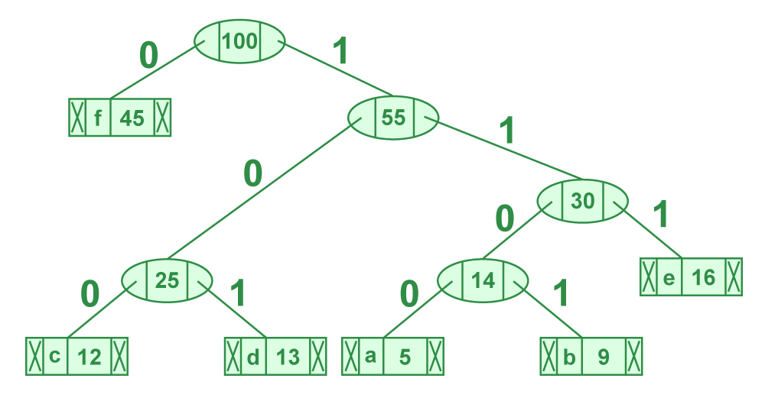
Huffman Tree Construction
Huffman Tree Decoding??

Slide 7
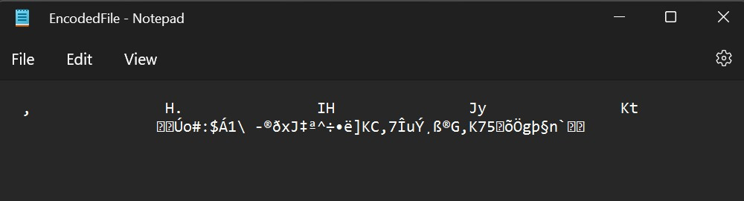
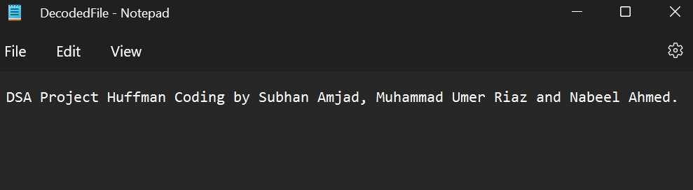
Encoded File
Original & Decoded File

Slide 8
main.cpp
#include <iostream>
#include "huffman.h"
using namespace std;
int main()
{
//________________________________________________________
//COMPRESSING
cout << "TAKING INPUT FILE..." << endl;
huffman h("E:\final\final\Files\decoded\DecodedFile.txt" , "E:\final\final\Files\test decode\Encoded FIle.txt");
cout << "Compressing..." << endl;
h.create_heap();
h.create_huffman_tree();
h.calculate_huffman_codes();
h.coding_save();
cout<<"Compressed Succesfully"<<endl;
cout << endl;
//________________________________________________________
//decoding
cout<<"Taking input for decompressing"<<endl;
huffman H("E:\final\final\Files\test decode\Encoded File.txt" , "E:\final\final\Files\test decode\Decoded File.txt");
cout<<"decoding"<<endl;
H.recreate_huffman_tree();
H.decoding_save();
cout << "decoding complete" << endl;
cout << endl;
return 0;
}

Slide 9
Applications of
Huffman Coding
Text Compression
Image Compression
Assigns shorter codes to frequently occurring characters.
Compact representation of text data
Assigns shorter codes to frequently occurring image patterns.
Optimizes Storage and Transmission

Slide 10
Time Complexity
Frequency Counting: O(n)
Priority Queue Construction: O(n log n)
Huffman Tree Construction: O(n log n)
Code Table Construction: O(n)
Encoding and Decoding: O(m)
Overall Dominant Term, O(n log n)

Slide 11
Q&A SESSION

