Slide 1

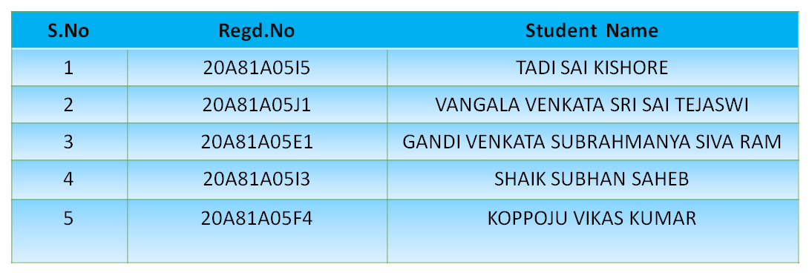
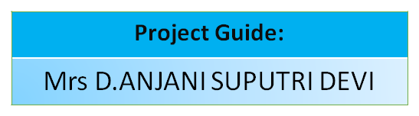
Main Project Review
Batch No: 48
Project Title: A DEEP LEARNING APPROACH TO DETECT DEEP FAKES

Slide 2
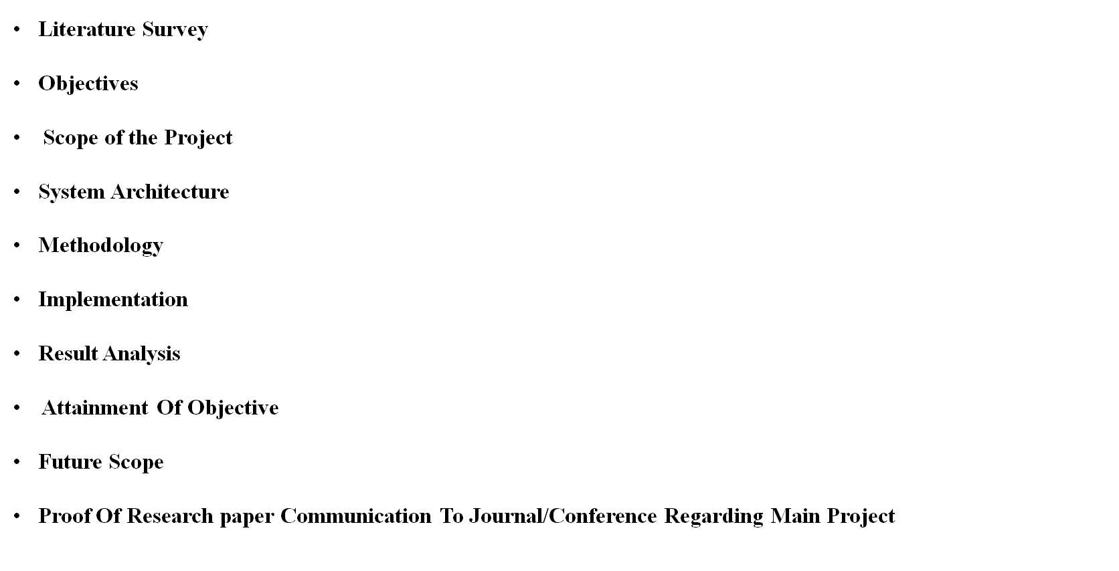
MAIN PROJECT REVIEW III-CONTENTS

Slide 3

Literature Survey
SNO | Authors | Research Paper | Publication | Methodology | Conclusion
1 | Afchar, Darius | Deepfake Detection Method Based on Cross-Domain Fusion | Hindawi Security and Communication Networks Volume 2021 | cross-domain fusion | we propose a new deepfake detection method based on cross-domain fusion. However, our method is less effective on Neural Textures dataset as it has less consideration on subtle features
2 | Gandhi, Apurva, and Shomik Jain | Adversarial Perturbations Fool Deepfake Detectors | 2020 International Joint Conference on Neural Networks (IJCNN) | Defenses against adversarial perturbations in deep fakes | This work uses adversarial perturbations to enhance deepfake images and fool common deepfake detectors.

Slide 4
Literature Survey
SNO | Authors | Research Paper | Publication | Methodology | Conclusion
3 | Li, Lingzhi | Face X-Ray for More General Face Forgery Detection | IEEE -2020 | Face X-ray by using CNN technique | This work introduces a novel face forgery evidence called "face X-ray," exploiting intrinsic discrepancies in blending boundaries often overlooked by advanced face manipulation detectors.
4 | Yang, Xin, Yuezun Li, and Siwei Lyu. | Exposing Deep Fakes Using Inconsistent Head Poses | ICASSP 2019 - 2019 IEEE International Conference on Acoustics, Speech and Signal Processing (ICASSP) | Head poses | Our method capitalizes on the splicing errors in Deep Fakes by exploiting discrepancies in 3D head pose estimation. We conduct experiments validating this approach and develop an SVM classifier using features derived from these cues, evaluated on real and Deep Fake face images.

Slide 5

Literature Survey
SNO | Authors | Research Paper | Publication | Methodology | Conclusion
5 | Guera, David, and ¨ Edward J. Delp | Deepfake Video Detection Using Recurrent Neural Networks | IEEE- 2018 | Passed through CNN for feature extraction | Our system uses a convolutional neural network (CNN) to extract frame-level features. These features are then used to train a recurrent neural network (RNN) that learns to classify if a video has been subject to manipulation or not.

Slide 6
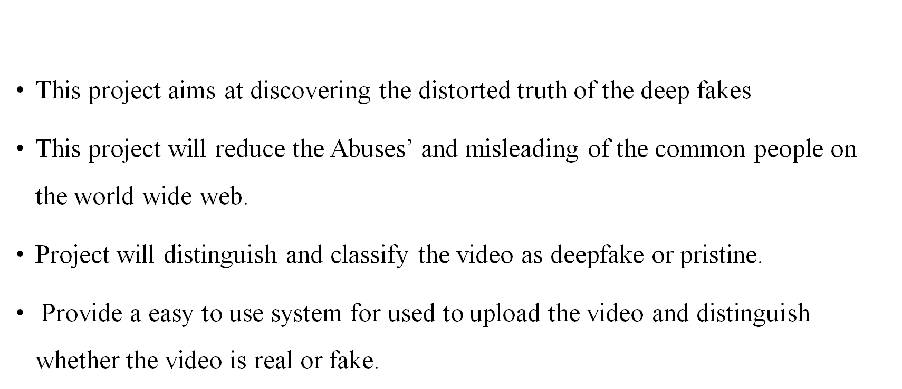
Objectives:

Slide 7
Scope Of the Project:
There are many tools available for creating the deep fakes, but for deep fake detection there is hardly any tool available. Our approach for detecting the deep fakes will be great contribution in avoiding the percolation of the deep fakes over the world wide web. We will be providing a web-based platform for the user to upload the video and classify it as fake or real. This project can be scaled up from developing a web-based platform to a browser plugin for automatic deep fake detection’s. Even big application like WhatsApp, Facebook can integrate this project with their application for easy pre-detection of deep fakes before sending to another user.

Slide 8
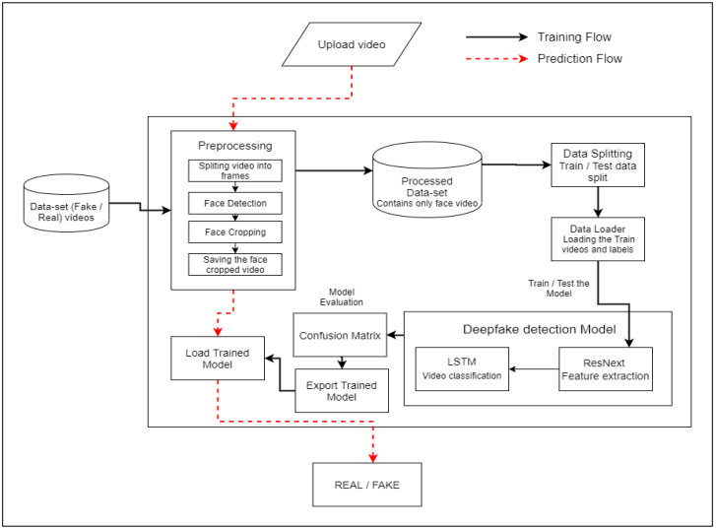
System Architecture

Slide 9
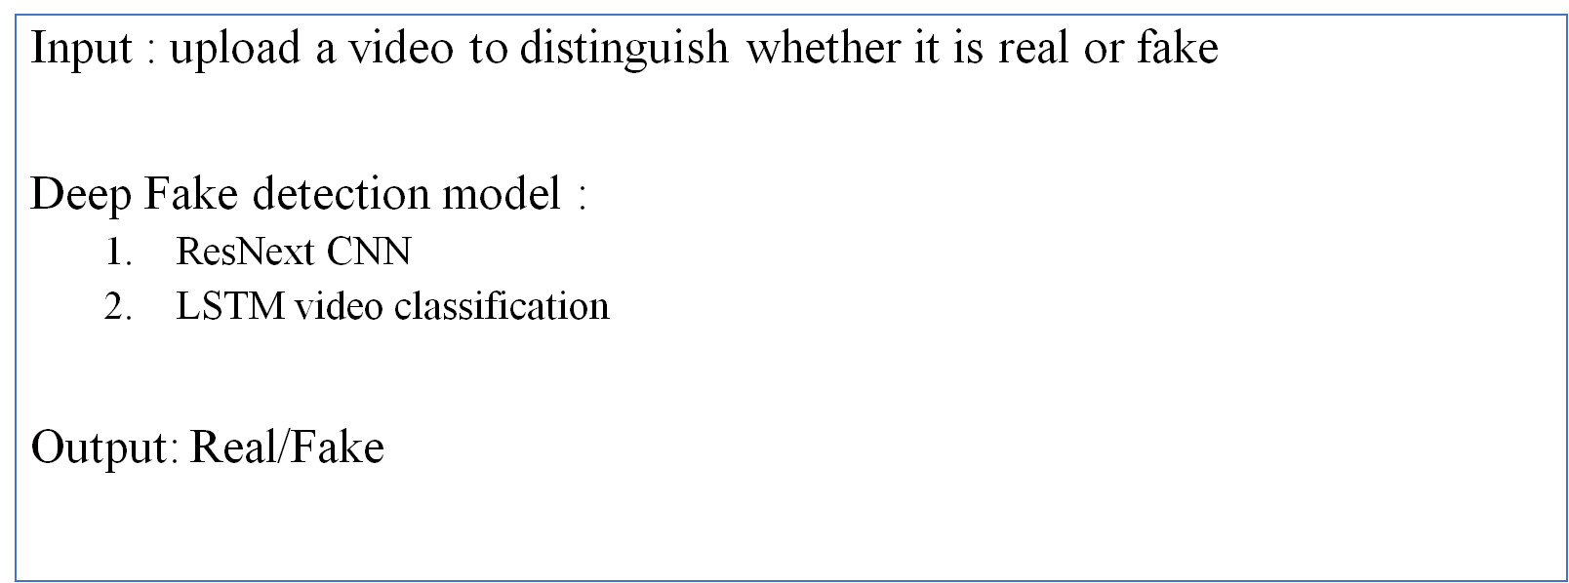
Methodology

Slide 10
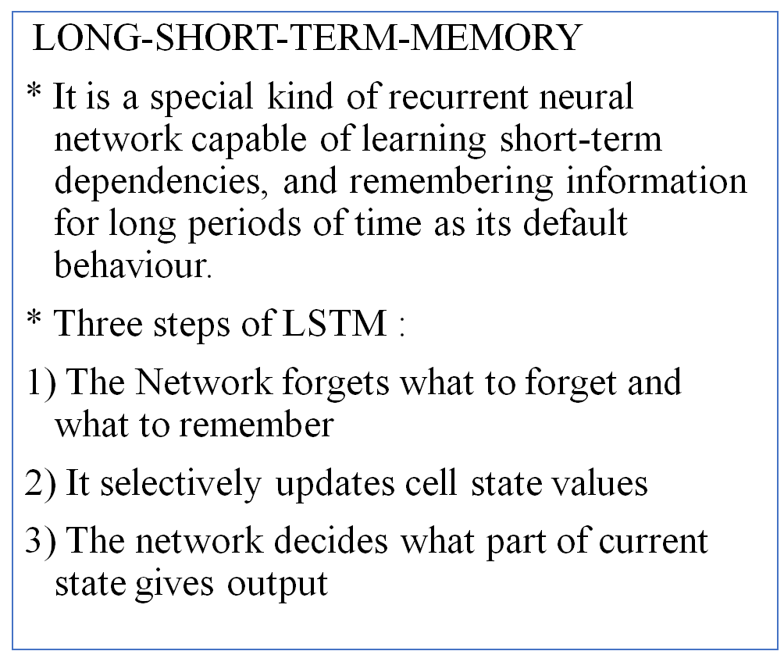
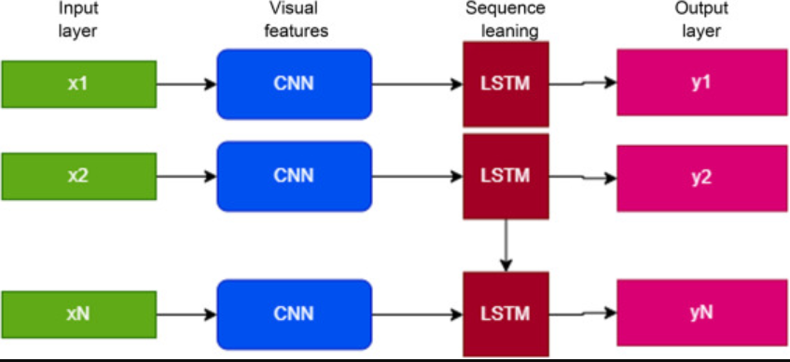
Methodology

Slide 11
Implementation
Dataset Details:
Gathered the data from different available data-sets like
Face Forensic++(FF)[1],
Deepfake detection challenge(DFDC)[2], and
Celeb-DF[3].
Further, mixed the collected datasets and created our own new dataset, to accurate and real time detection on different kind of videos. To avoid the training bias of the model, dataset is considered 50% Real and 50% fake videos.

Slide 12
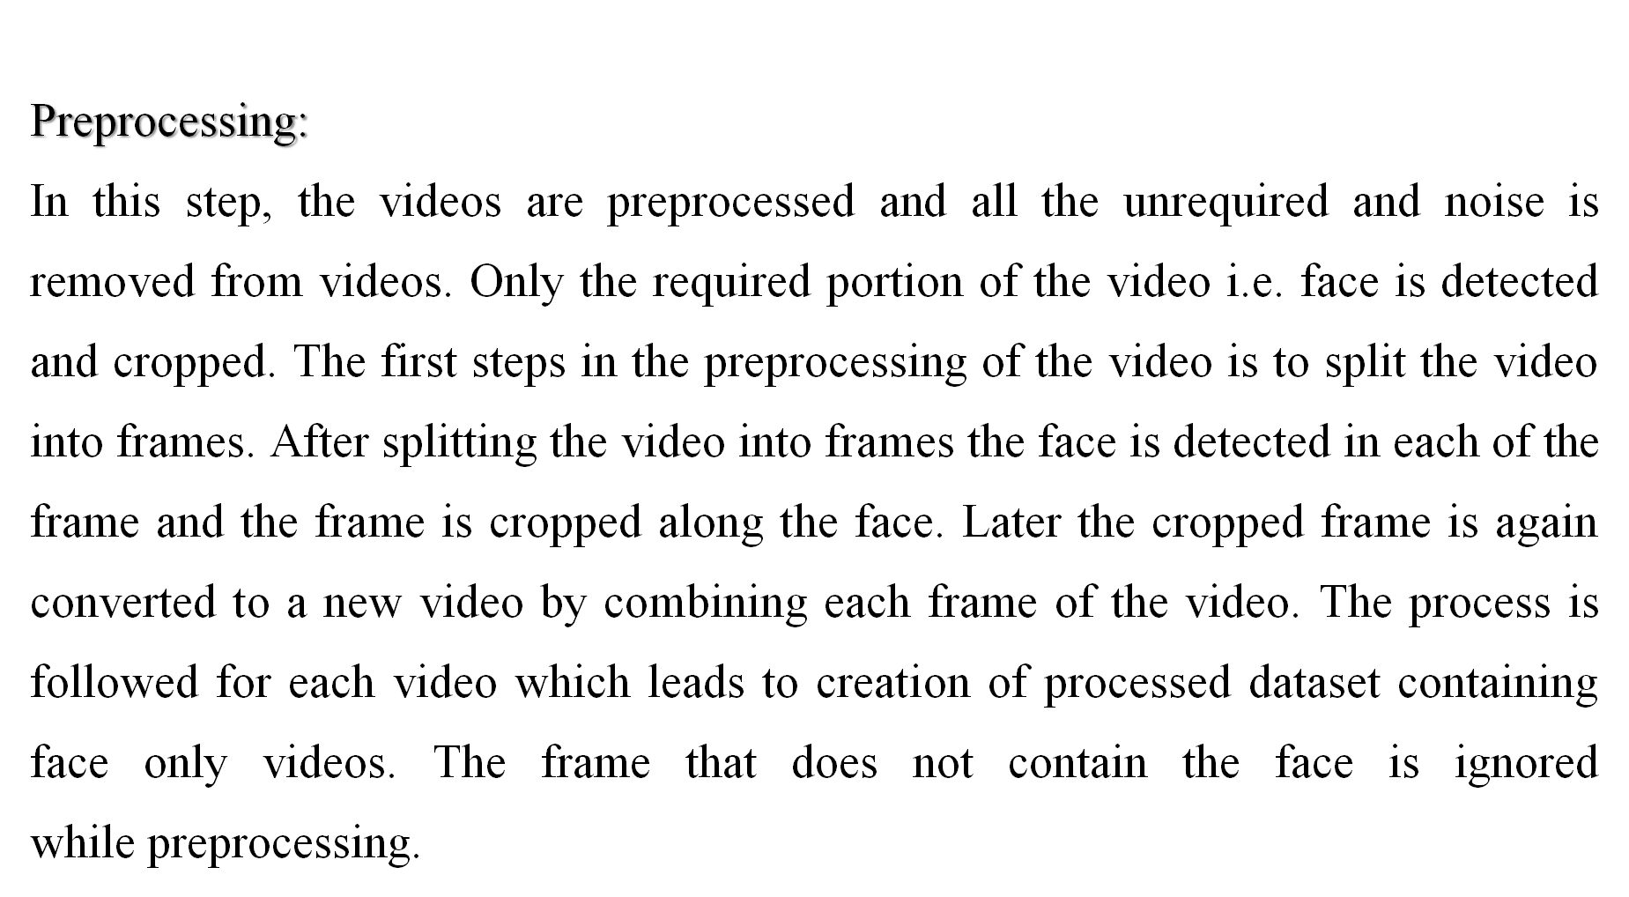
Implementation

Slide 13
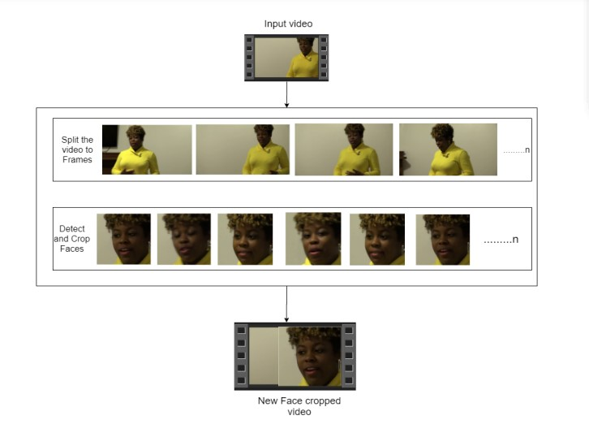
Implementation

Slide 14
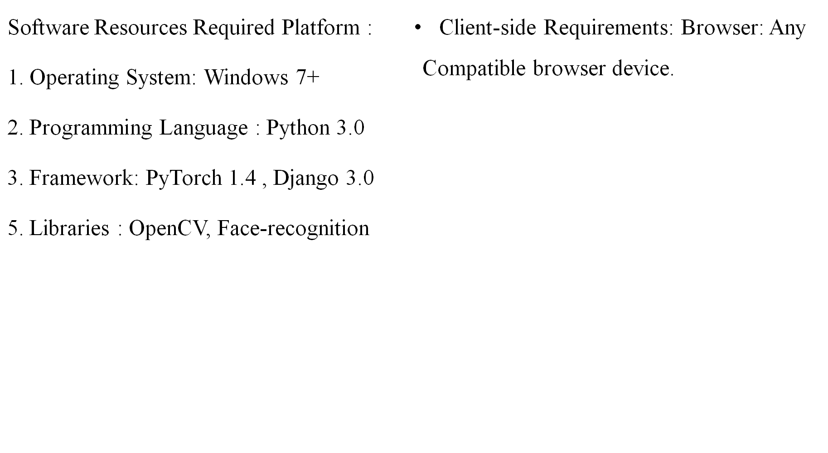
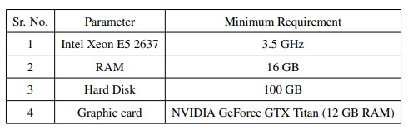
Requirements

Slide 15
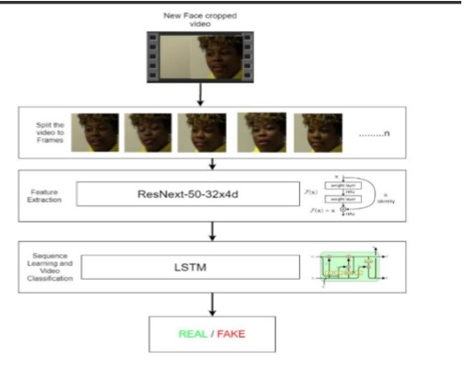
Implementation
Model Details:
This model is a combination of CNN and RNN. This project used the Pre- trained ResNext CNN model to extract the features at frame level and based on the extracted features a LSTM network is trained to classify the video as deepfake or pristine. Using the Data Loader on training split of videos the labels of the videos are loaded and fitted into the model for training.

Slide 16
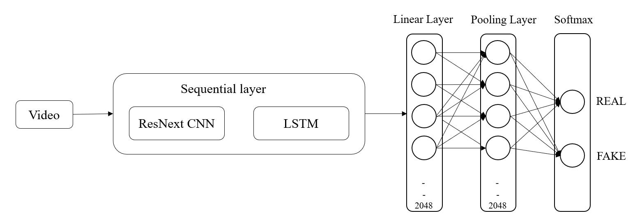
Implementation

Slide 17
Implementation
Model Prediction Details:
The trained model performs the prediction and return if the video is a real or fake along with the confidence of the prediction.
Also Confusion matrix is computed, Based on Confusion matrix is used to evaluate our model and calculate the accuracy.

Slide 18
Deepfake issues
Sachin Tendulkar’s deepfake case –FIR
Ram lalla’s deepfake
Actresses
Rashmika mandanna’s
katrina kaif’s
kajol’s deepfake videos
US ex president Donald trump deepfake
Meta CEO Markzukerberg’s deepfake video

Slide 19
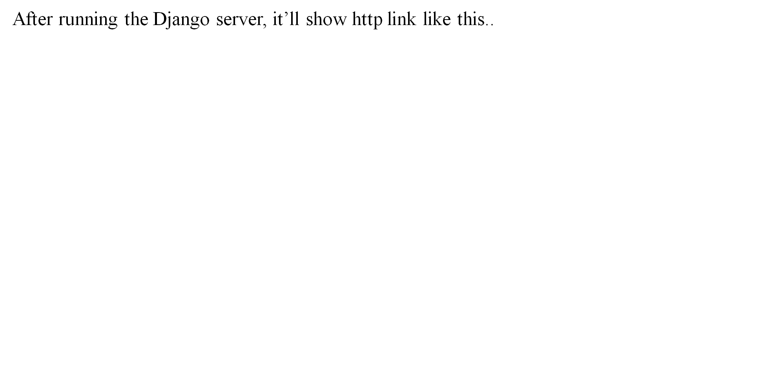
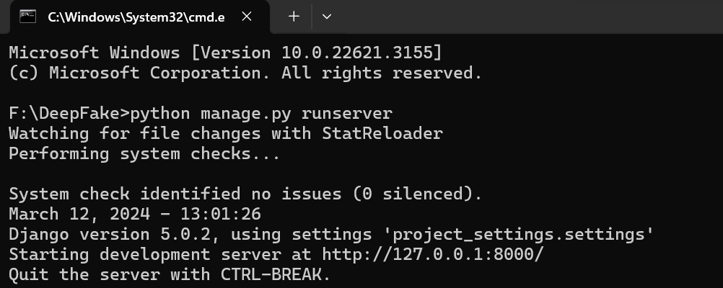
Result Analysis

Slide 20

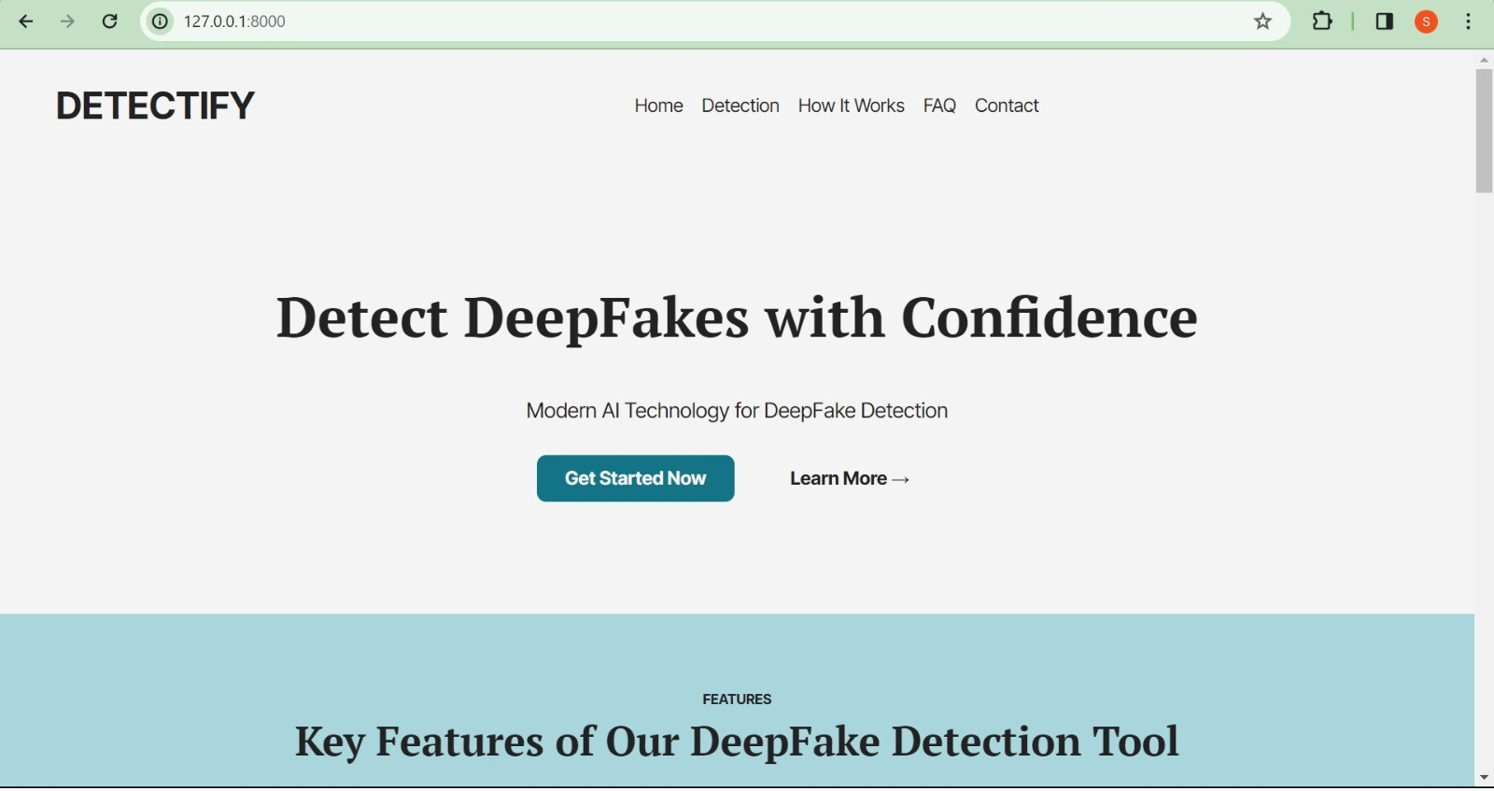
Result Analysis

Slide 21
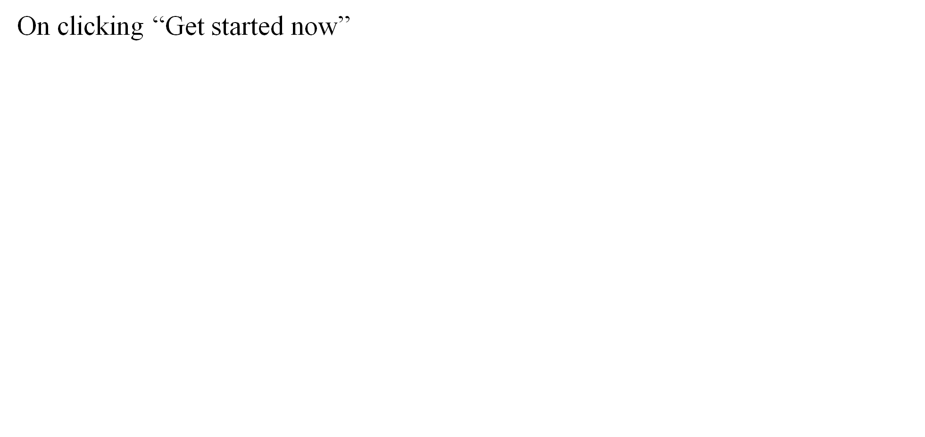
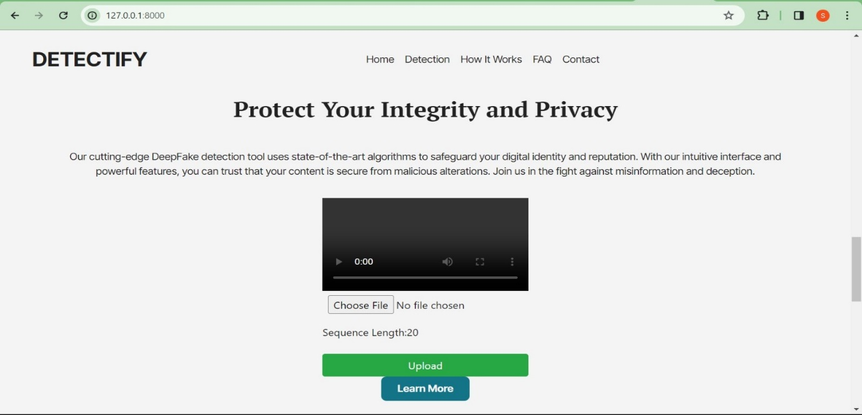
Result Analysis

Slide 22
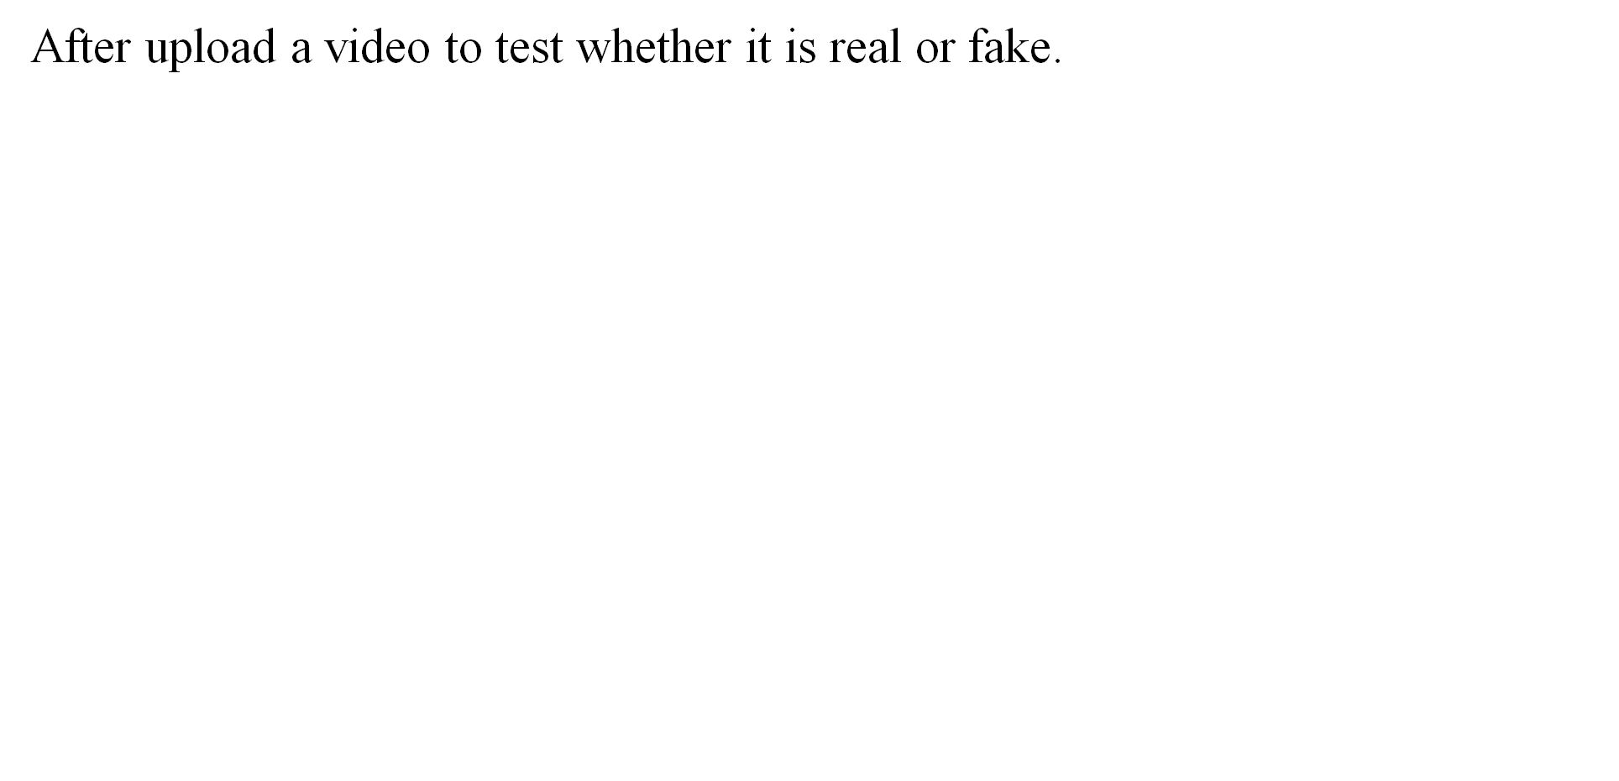
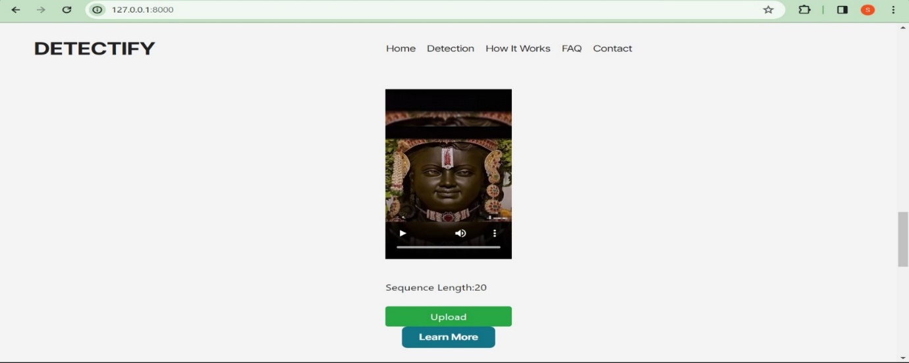
Result Analysis

Slide 23
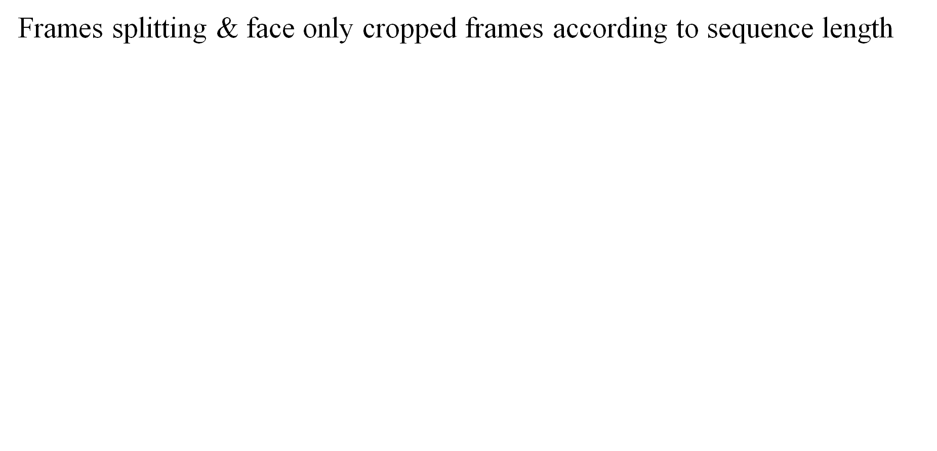
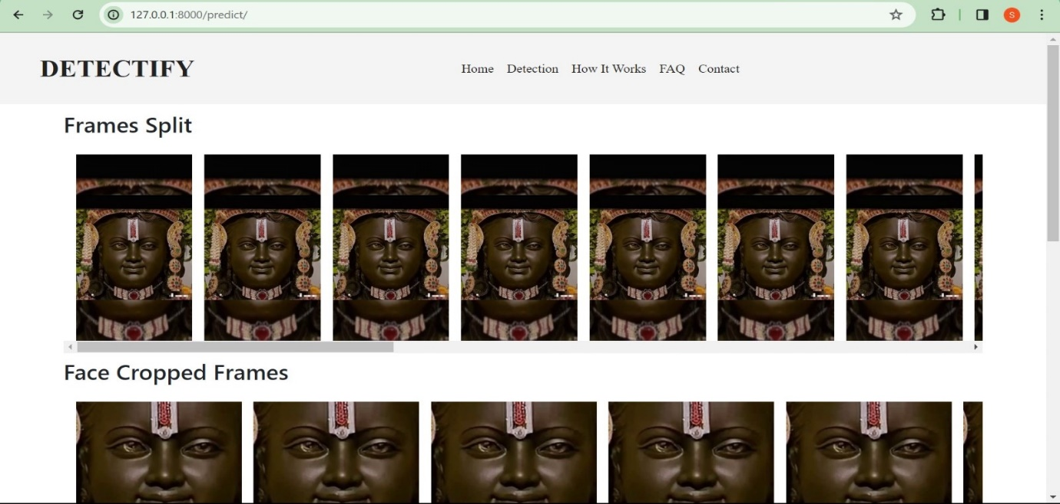
Result Analysis

Slide 24
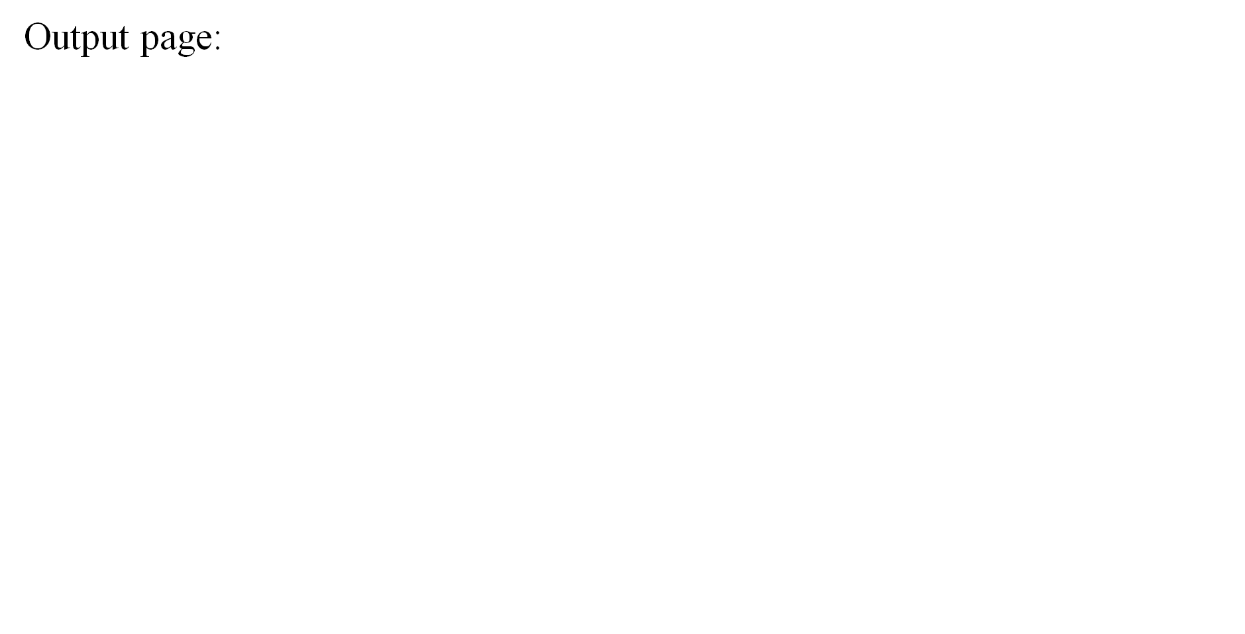
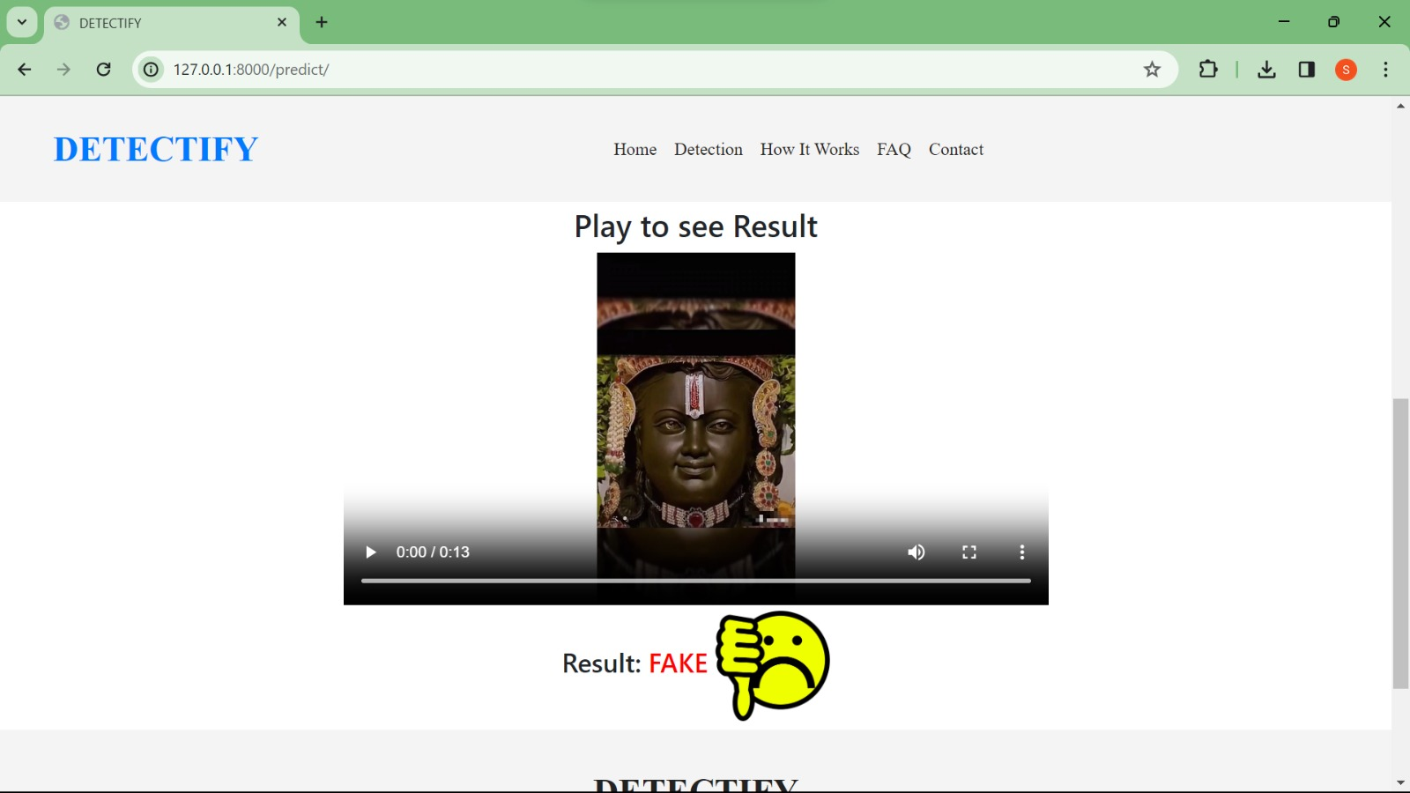
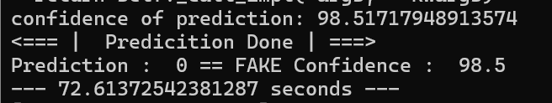
Result Analysis

Slide 25


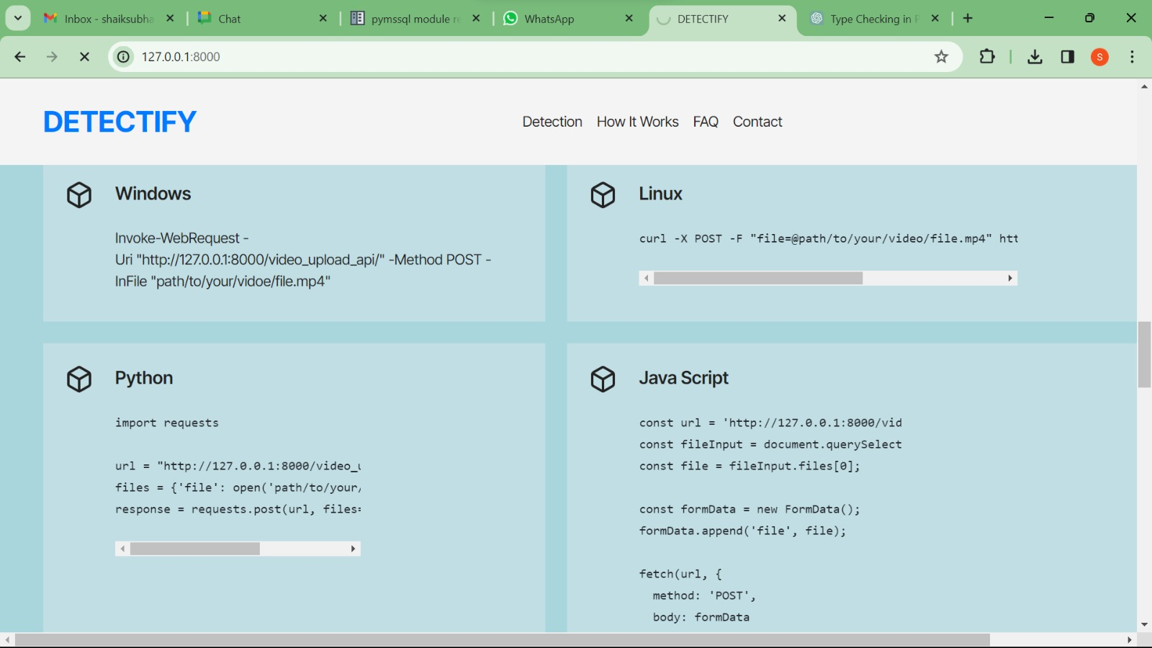
Result Analysis

Slide 26
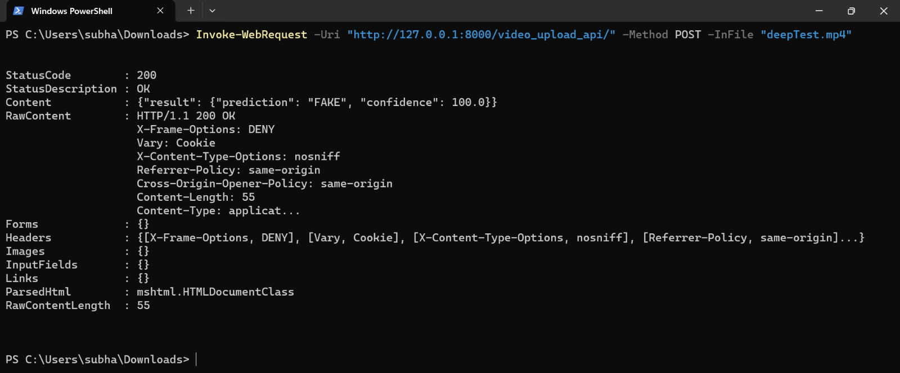
Result Analysis

Slide 27
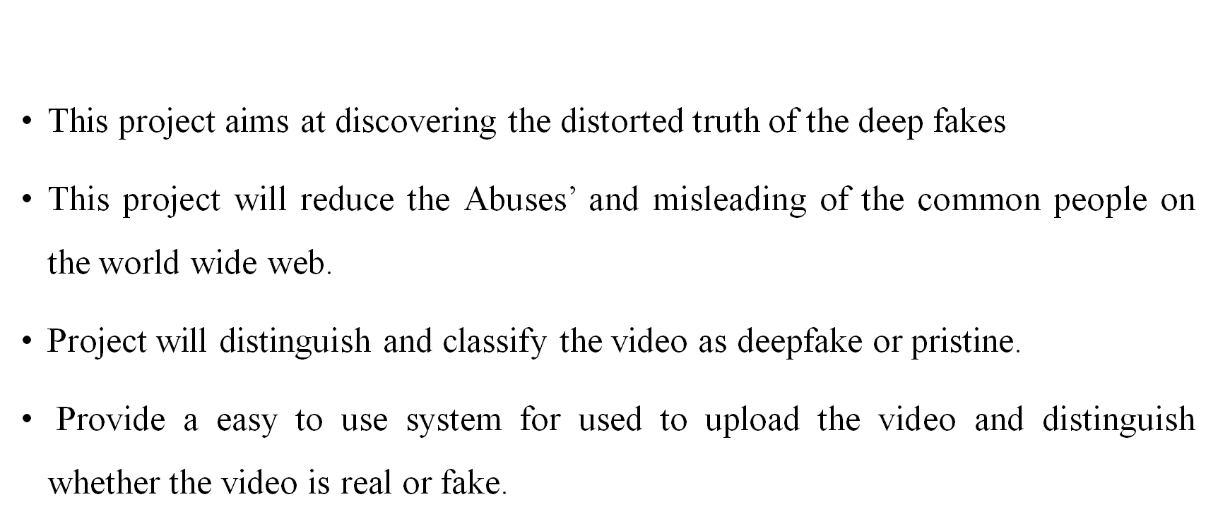
Objectives:

Slide 28
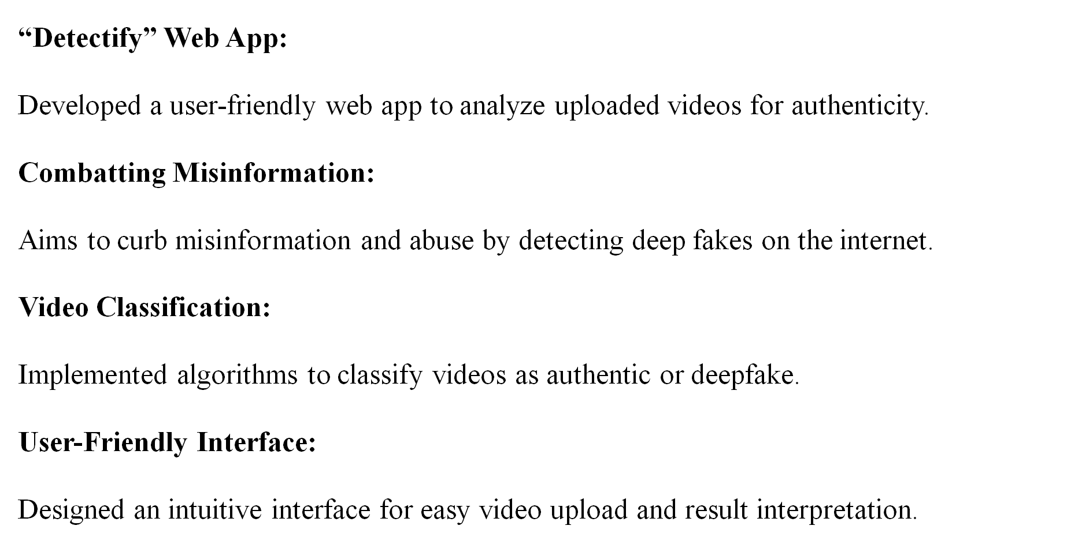
Attainment Of the Objective

Slide 29
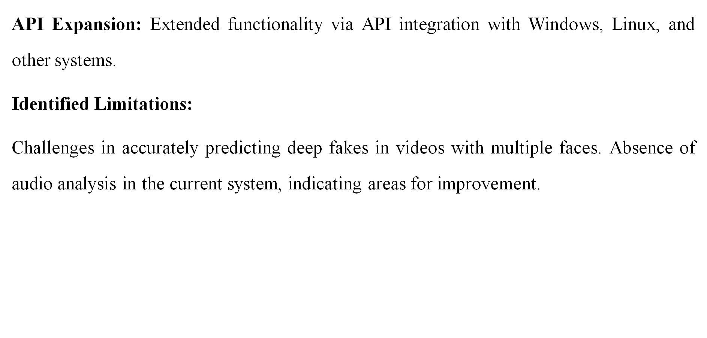
Attainment Of the Objective

Slide 30
Future Scope of the Project
There is always a scope for enhancements in any developed system, especially when the project build using latest trending technology and has a good scope in future.
• Web based platform can be upscaled to a browser plugin for ease of access to the user.
• Currently only Face Deep Fakes are being detected by the algorithm, but the algorithm can be enhanced in detecting full body deep fakes.
This algorithm does not take audio into account. For this reason, the audio deep fake will go undetected by this method. However, in the future, this project can be advanced to be able to detect audio deep fakes.

Slide 31
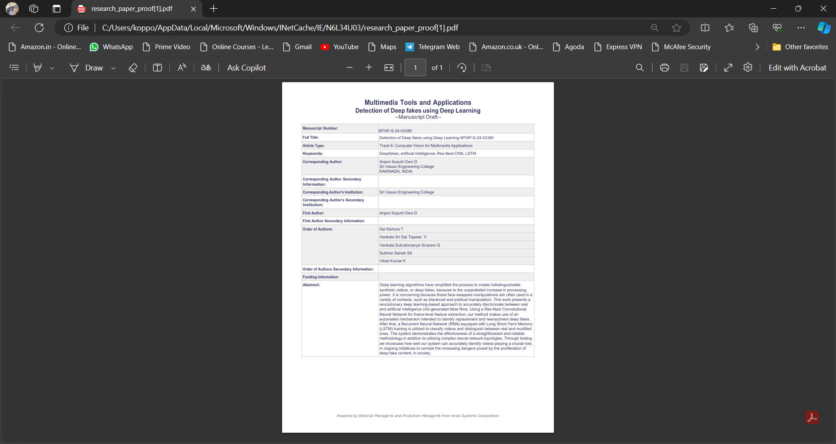
Proof Of Communication To Journal/Conference Regarding Main Project

Slide 32

Batch-48

