Slide 1
Smart Wellness with Data: Fitbit Insights for Bellabeat
Data Analysis Case Study – Executive Presentation

Slide 2
Business Task & Objectives
Business Task: Analyze Fitbit user data to uncover activity and lifestyle patterns that can guide Bella beat's marketing strategy.
Objectives:
Identify trends in daily activity, steps, calories, and sedentary behavior.
Understand user activity clusters
Translate insights into Bellabeat Leaf wellness tracker recommendations

Slide 3
Data Sources
Primary Dataset: Fitbit Fitness Tracker Data (30 users, Kaggle public dataset)
Includes: daily activity, steps, calories, heart rate, sleep, weight logs
Limitations: Small sample size, short tracking period, U.S.-centric

Slide 4
Data Cleaning & Preparation
• Removed duplicates & missing values
• Converted date/time columns
• Aggregated daily metrics for user-level insights

Slide 5
Distribution of Daily Steps
Average ~7,600 steps (below WHO’s 10,000 recommendation)
Large variation among users (sedentary vs. highly active)
[Insert Histogram/KDE plot of daily steps here]

Slide 6
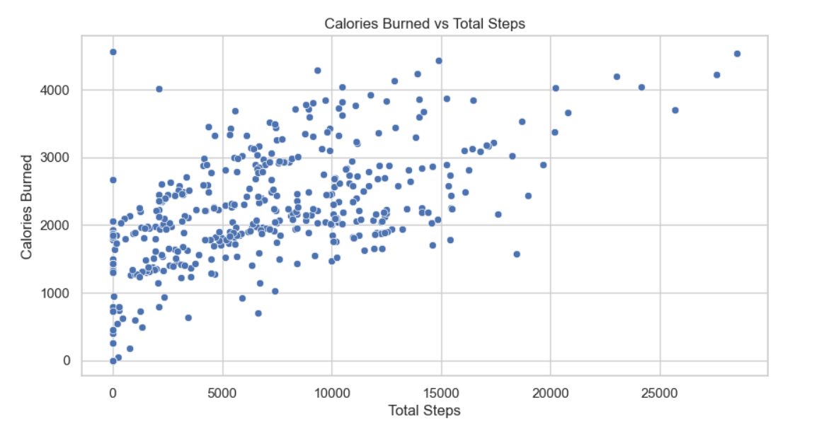
Steps vs. Calories Burned
Strong positive correlation (r ≈ 0.65)
More active users burn significantly more calories

Slide 7
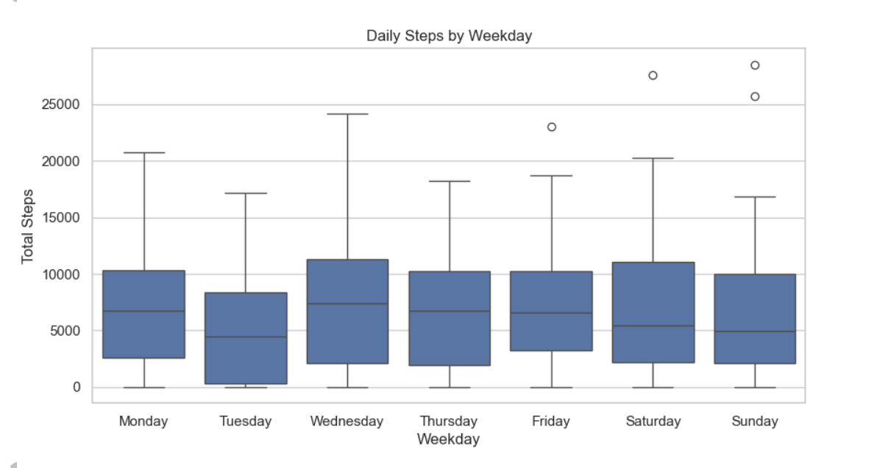
Activity Patterns by Weekday
Higher activity on weekdays (Mon–Fri)
Noticeable drop on weekends

Slide 8
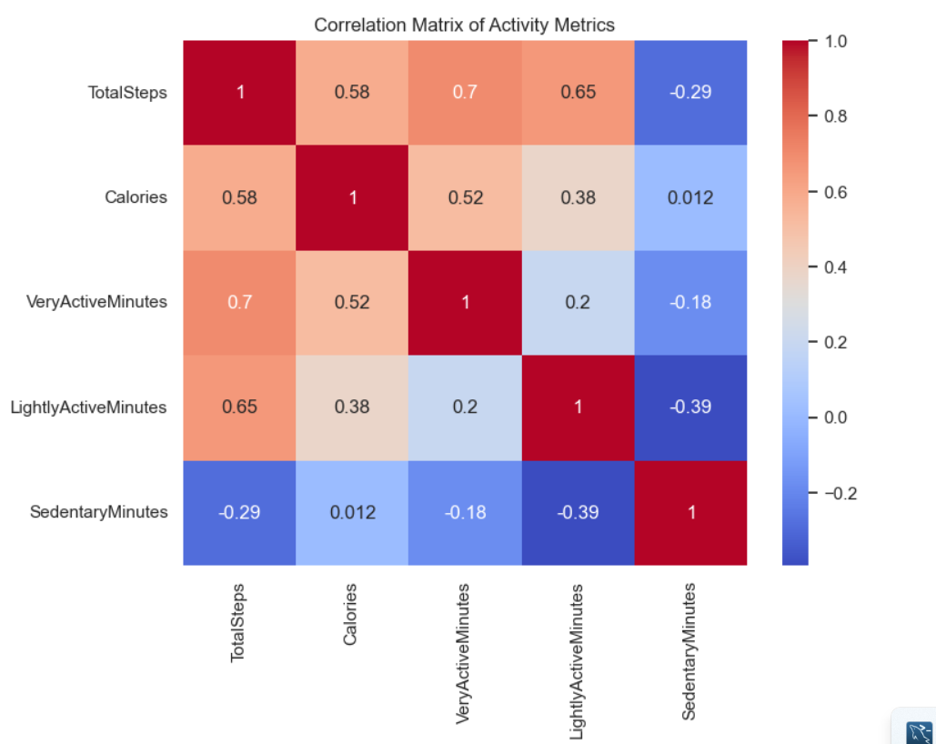
Correlation Analysis
Steps & Active Minutes → Strong positive correlation with Calories
Sedentary Minutes → Negative correlation with Calories

Slide 9
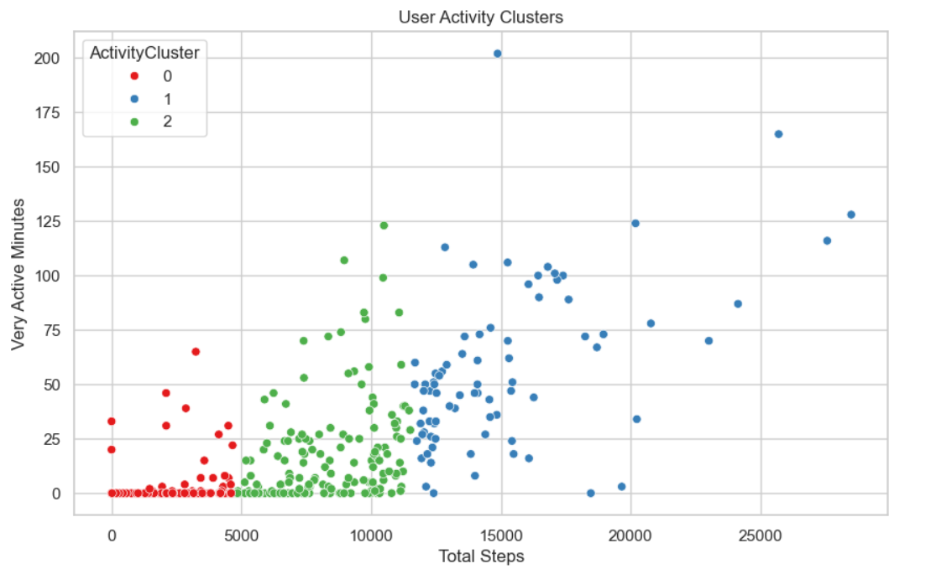
User Activity Clusters
Cluster 1: Sedentary (low steps, high sedentary minutes)
Cluster 2: Moderately active
Cluster 3: Highly active (fitness-focused)

Slide 10
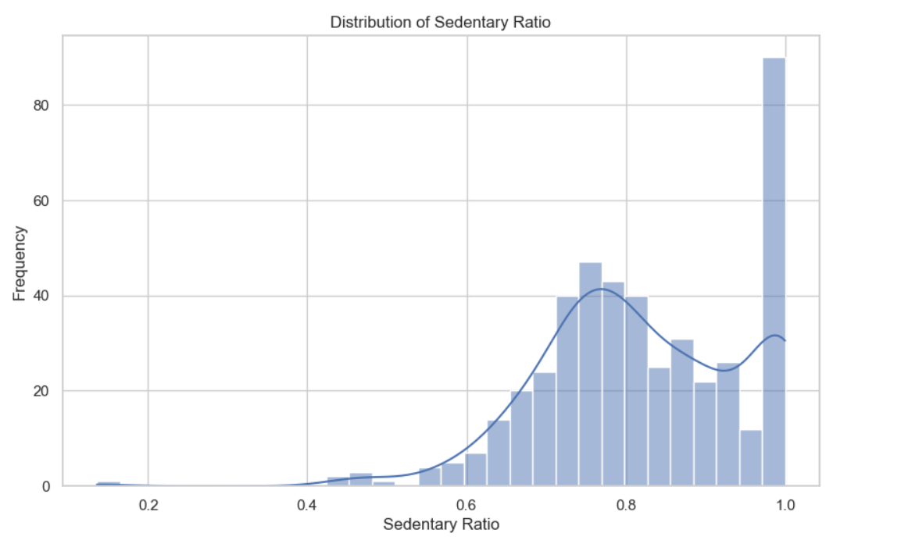
Trends in Sedentary Behavior
Users spend ~70% of waking hours sedentary
A few active users drive most of the activity

Slide 11
Key Business Insights
Most users fall short of activity goals
Sedentary behavior is persistent and widespread
Weekday vs. weekend activity gap = engagement opportunity
Distinct user clusters → segmentation opportunities
Strong activity-calorie link supports energy balance coaching

Slide 12
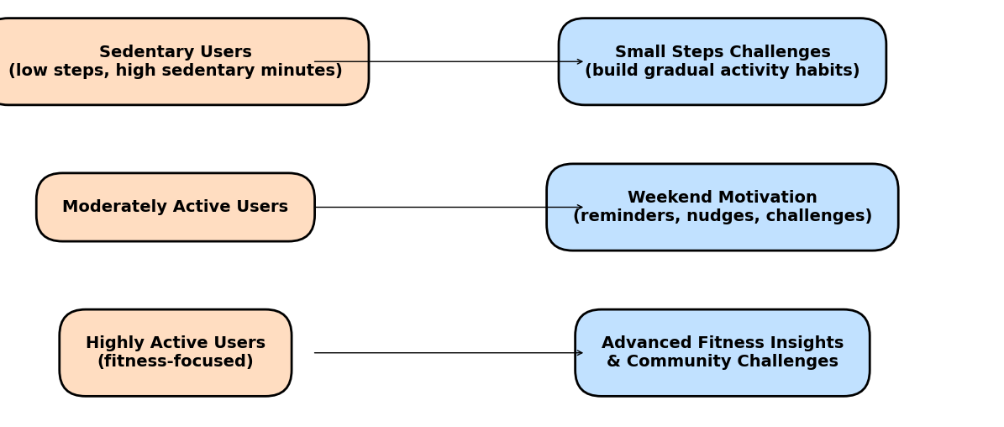
Marketing Recommendations (Leaf Tracker)
Personalization: Position Leaf as a holistic lifestyle coach
Weekend Motivation: Send nudges/challenges on weekends
Segmentation:
– Sedentary → small steps challenges
– Active → advanced fitness insights
Wellness Integration: Emphasize stress, sleep, mindfulness features
Community Engagement: Promote social challenges & badges

Slide 13
Elevator Pitch
"Our analysis of Fitbit user data revealed that most users fall short of daily activity goals and spend nearly 70% of their day sedentary. Activity peaks during weekdays but drops on weekends, and we identified clear user clusters—from sedentary individuals to fitness enthusiasts. These insights show a clear opportunity for Bellabeat’s Leaf wellness tracker to differentiate itself by offering personalized coaching, weekend motivation, and tailored engagement strategies. By positioning Leaf as a lifestyle companion that addresses activity, stress, and mindfulness together, Bellabeat can better engage users, encourage healthier habits, and strengthen its market presence in the growing wellness tech industry."

