Slide 1
Olist E-Commerce — Strategic Analysis
Data-driven recommendations & roadmap

Slide 2
Executive Summary
Key takeaways:
Revenue exhibits a strong upward trend, but month-to-month growth is volatile (seasonality & spikes).
Customer retention declines sharply after the first purchase, with high acquisition dependency.
Top product categories contribute the majority of revenue (concentration risk).
Delivery delays directly correlate with negative reviews. Logistics is the top lever for NPS improvement.
Payments dominated by a single method (credit card), diversify payments to improve reach & resilience.

Slide 3
Client Challenge
Olist seeks sustainable revenue growth while improving customer lifetime value and operational excellence.
Key asks: Improve retention, diversify revenue, reduce negative reviews from delivery issues, and expand payment options.

Slide 4
Project Approach (Consulting Methodology)
1) Data ingestion & validation
2) Descriptive analytics (KPIs, cohorts, categories)
3) Diagnostic analysis (delivery vs satisfaction)
4) Strategic recommendations & implementation roadmap

Slide 5
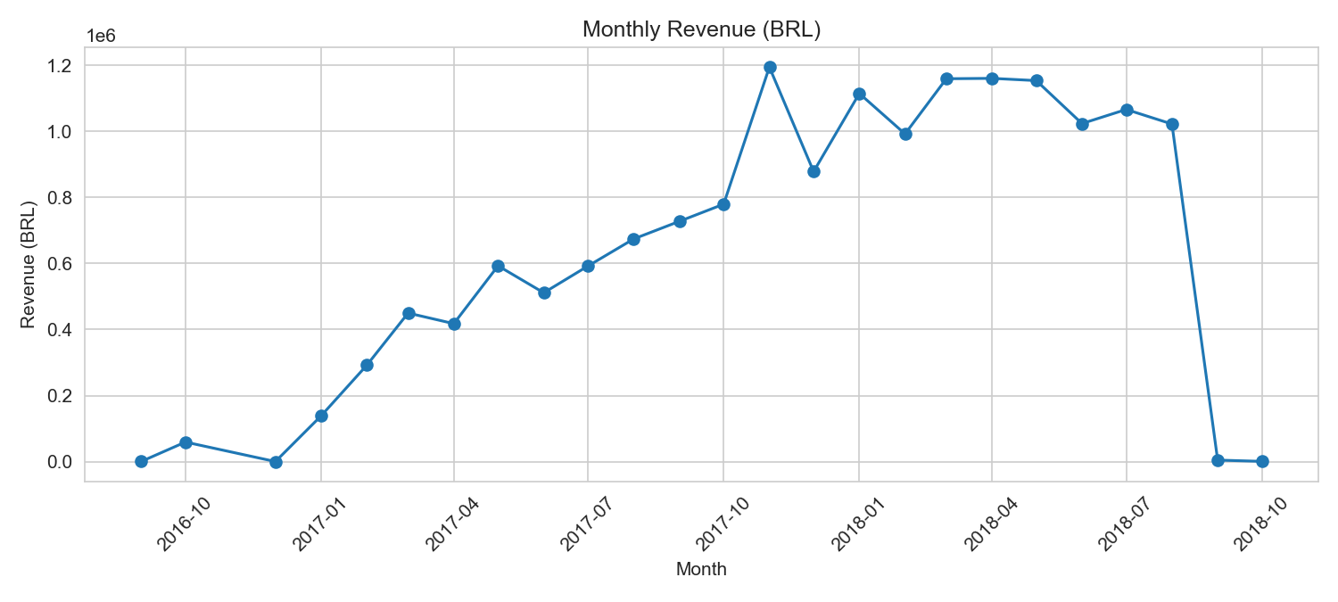
Revenue Trend
Analysis :
Revenue shows steady long-term growth with clear seasonal spikes (holiday peaks). Action: Smooth seasonality with off-peak demand programs and subscription offerings.

Slide 6
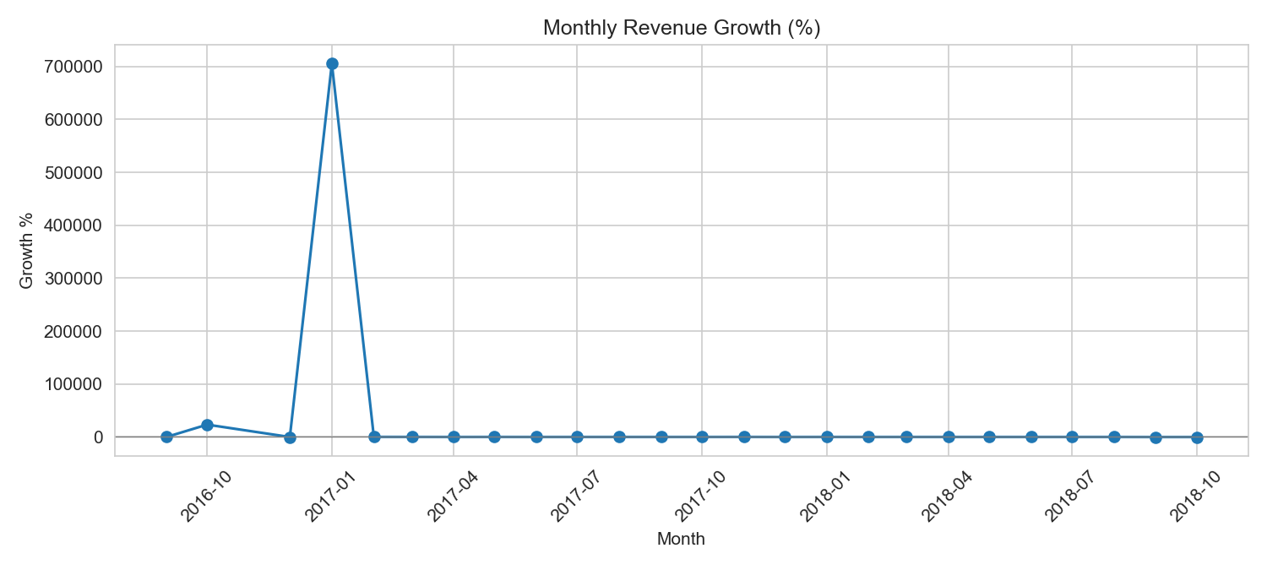
Revenue Growth % (MoM)
Growth % is volatile; months of strong growth follow by shallow months. Action: Focus on retention & continuous promotions to stabilize growth.

Slide 7
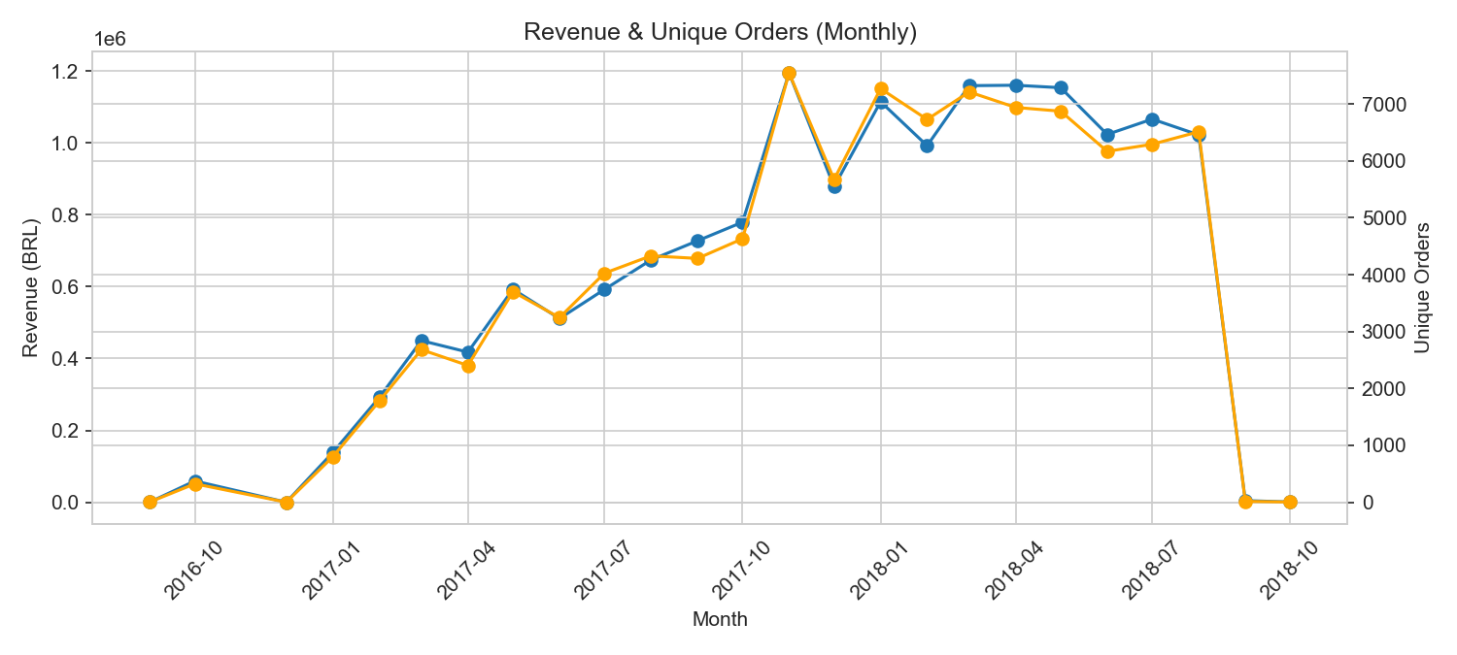
Revenue & Orders
Revenue and order counts move together; however, revenue per order can vary. Action: Upsell & cross-sell to increase AOV and revenue resilience.

Slide 8
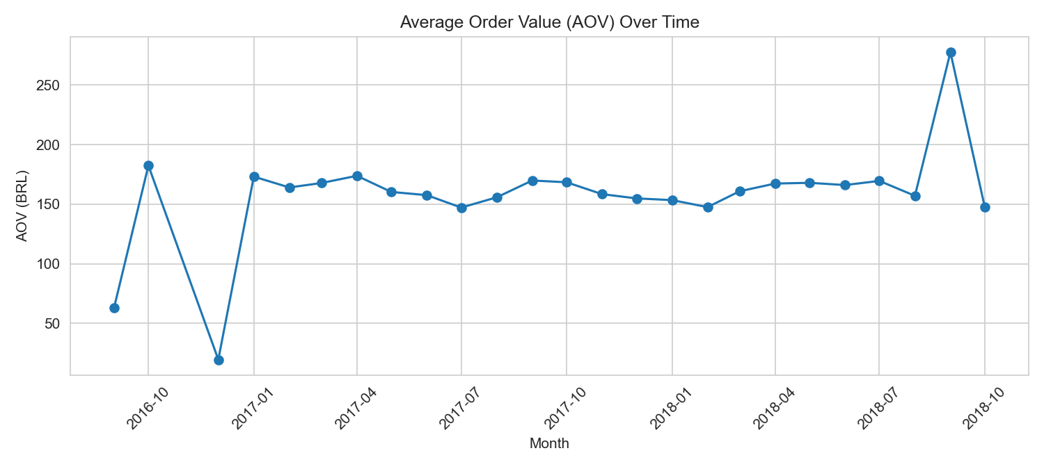
Average Order Value (AOV)
AOV is relatively stable. Driving AOV via bundles and recommendations increases short-term revenue without additional CAC.

Slide 9
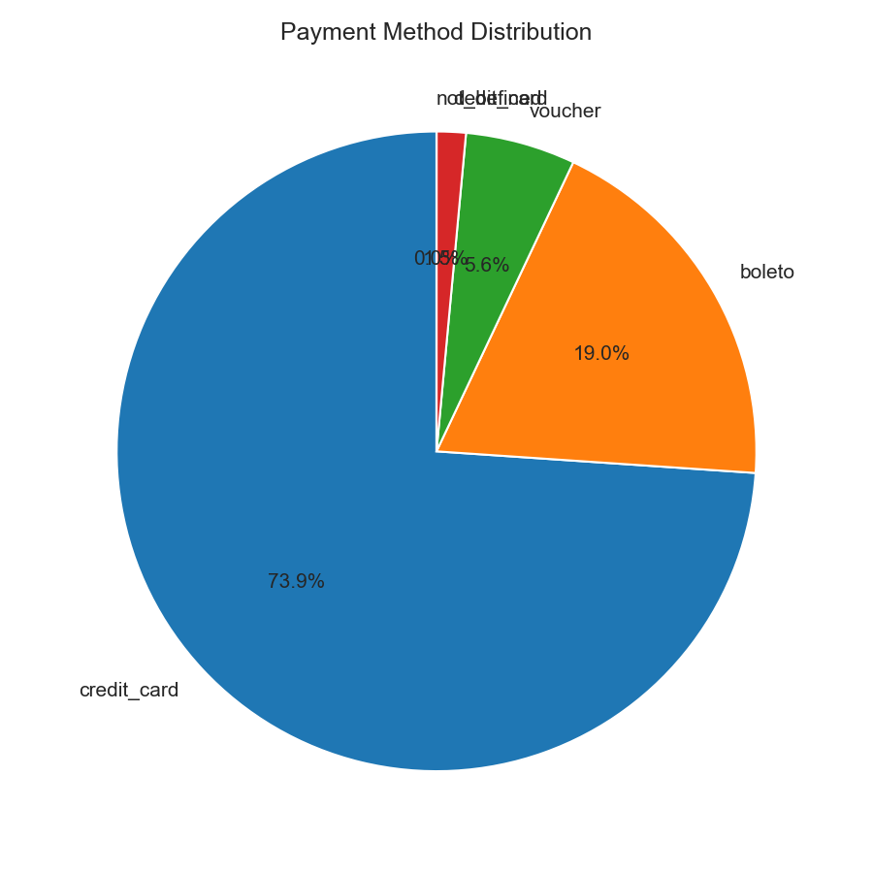
Payment Mix
High dependency on credit: consider PIX, wallets, BNPL to broaden access and reduce single-channel risk.

Slide 10
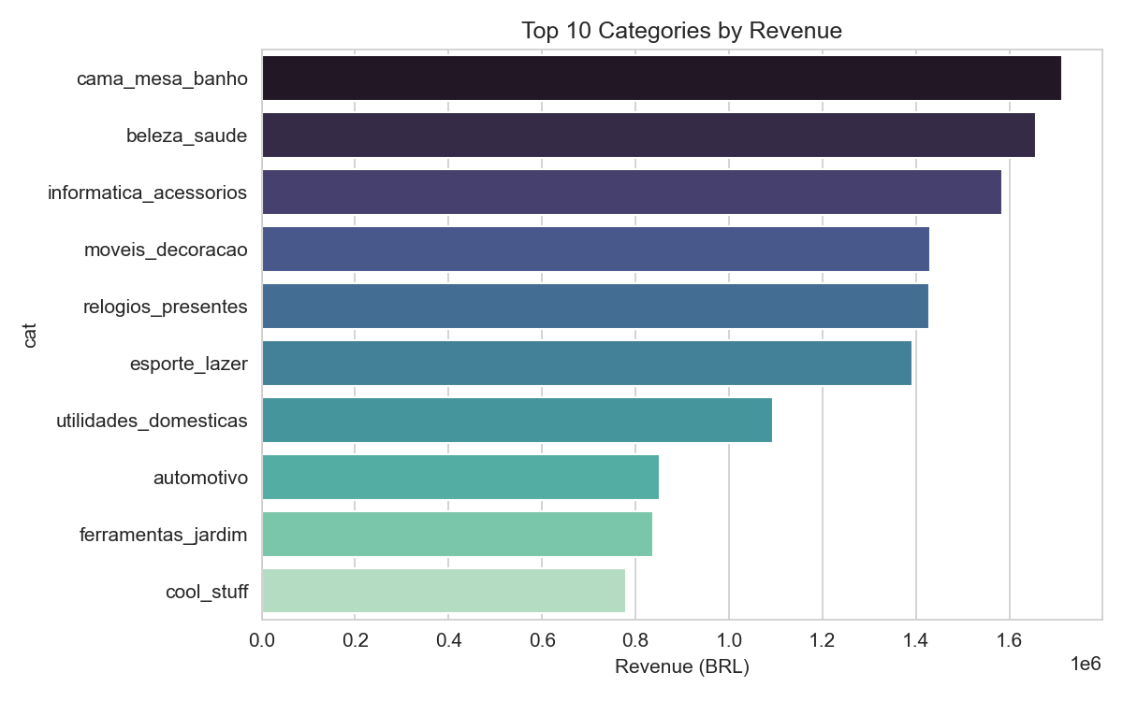
Top Categories by Revenue
Top categories account for the majority of revenue, diversify category mix and onboard sellers in long-tail categories to reduce concentration risk.

Slide 11
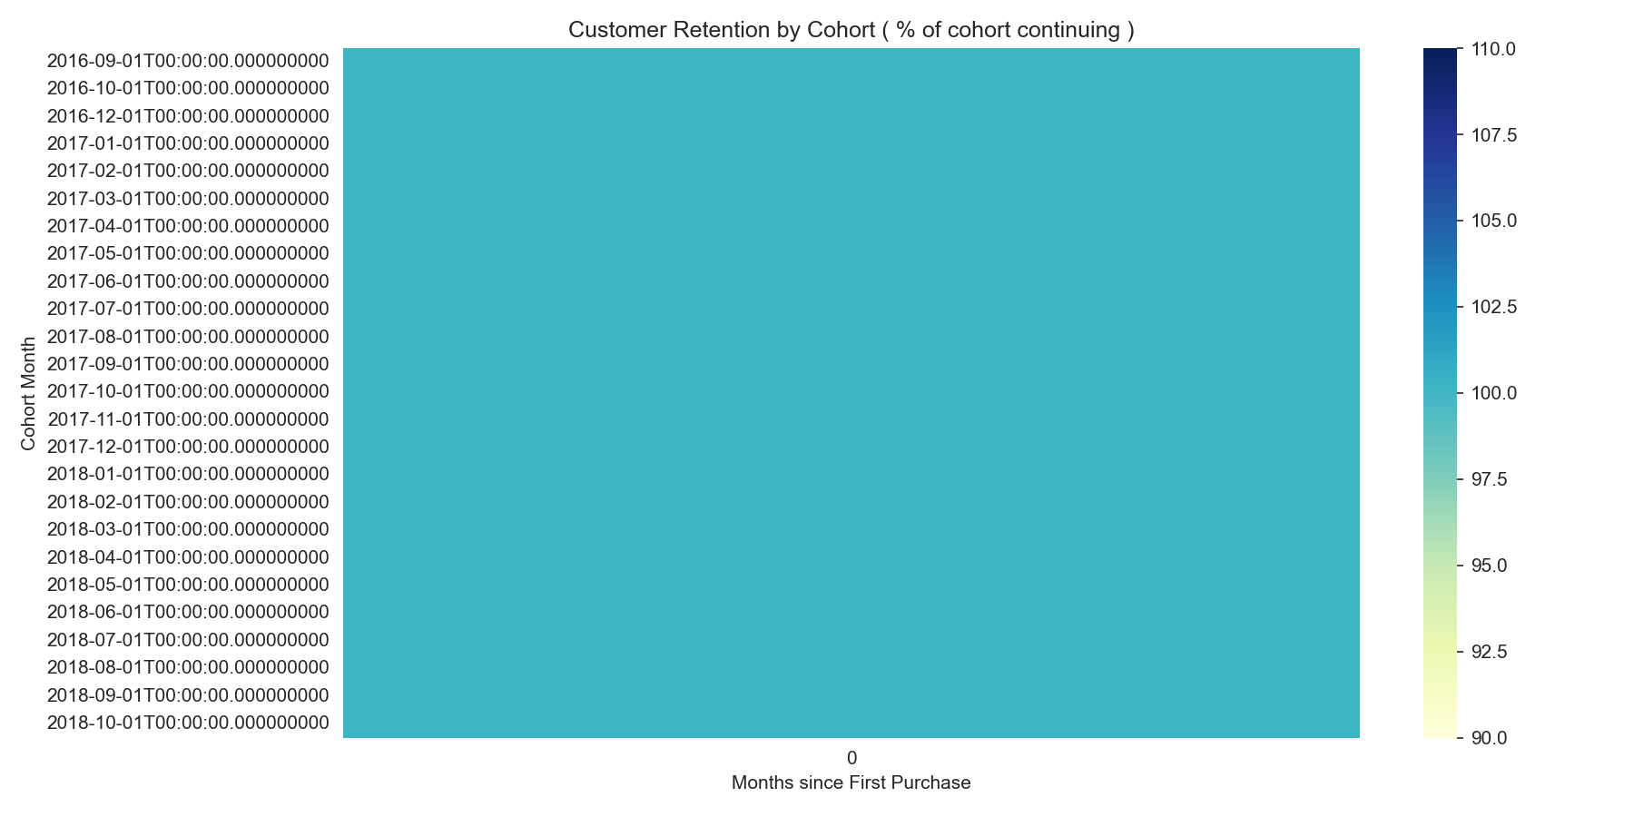
Cohort Retention Heatmap
Retention drops quickly after first purchase. Implement onboarding, next-purchase incentives and personalized re-engagement to lift repeat rates.

Slide 12
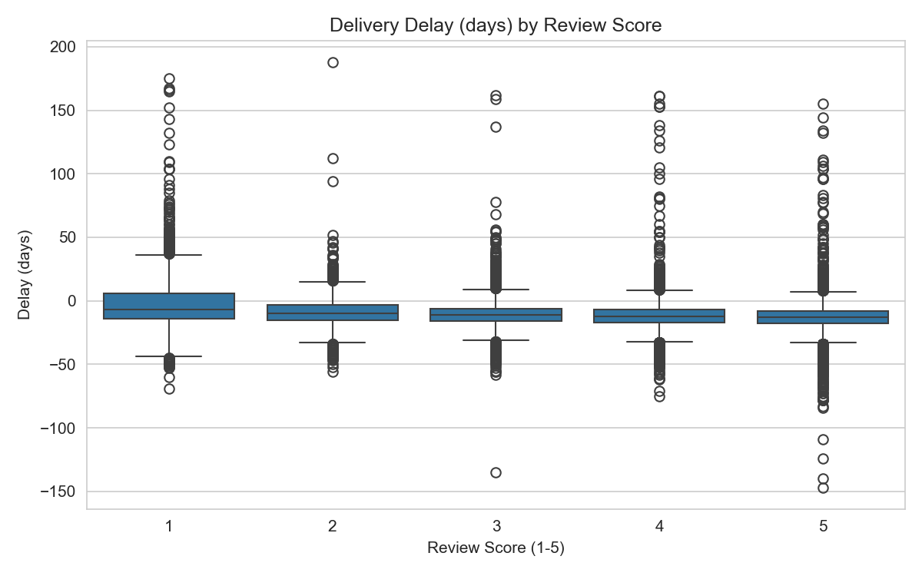
Delivery Delays vs Customer Ratings
Longer delivery delays heavily skew negative ratings. Invest in last-mile SLAs, partnerships, and tracking to reduce negative reviews and returns.

Slide 13
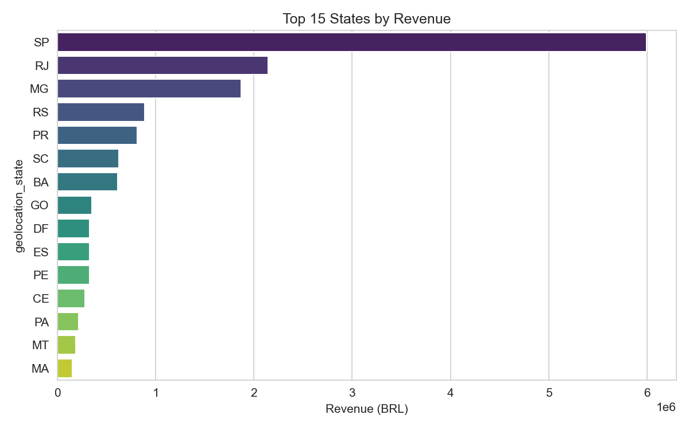
Revenue by State (Top 15)
Revenue concentration by state shows regional strengths. Use targeted logistics & marketing investments in high-potential regions.

Slide 14
Strategic Recommendations (By Segment)
Customer: Launch loyalty program (tiered rewards), personalized re-marketing, onboarding sequence for new customers.
Category: Incentivize seller acquisition in long-tail categories; curated bundles & category-specific promotions.
Logistics: Regional last-mile pilots, SLA-based carrier selection, delivery tracking & customer communication.
Payments: Integrate local payment methods (Pix), wallets, and BNPL to increase conversion & cashflow options.
Operations: Improve cancellation & refund workflows, reduce failed deliveries via address validation & pickup points.

Slide 15
Implementation Roadmap
Phase 1 (0-3 months): Retention campaigns, payments integration pilots, delivery KPI dashboard.
Phase 2 (3-6 months): Seller onboarding in priority categories, logistics partner pilots, BNPL pilot.
Phase 3 (6-12 months): Scale category diversification, platform-level loyalty, automate dispute resolution.

Slide 16
Projected Impact (Conservative Estimates)
Repeat rate +15-20% with targeted retention & loyalty.
Revenue +10-12% from category diversification and AOV initiatives.
Negative reviews -30% via delivery SLA improvements.
Improved conversion via payment diversification (est. +3-5%).

Slide 17
Appendix - Charts
Charts included in appendix (see slides):
revenue_trend
revenue_growth_pct
revenue_orders_dual
aov_trend
payment_distribution
top10_categories_revenue
cohort_retention_heatmap
delivery_delay_vs_reviews
revenue_by_state

