Slide 1

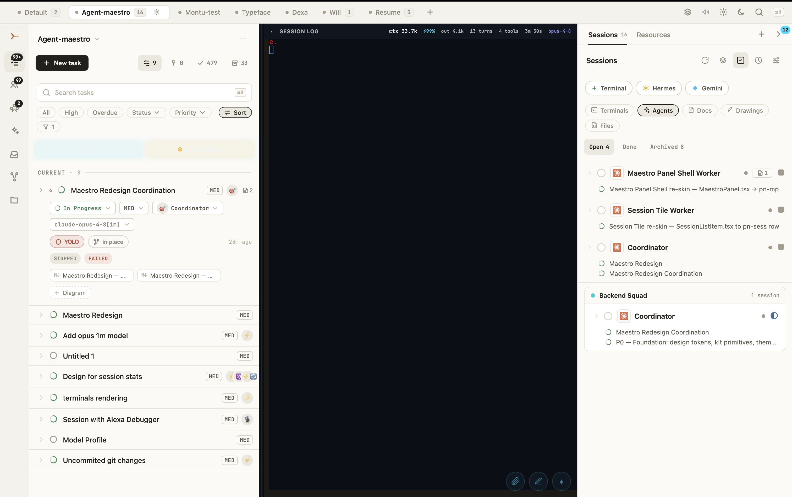
MAESTRO
STRATEGY · JULY 2026
The open control plane
for agentic product work
> ··· +
CAPTURE → ASSIGN → VERIFY
Turn ideas into owned, observable, verified outcomes across Claude, Codex, Hermes—and whatever comes next.
SYSTEMS TO BUILD SYSTEMS
Maestro strategy deck
Notes:
Open with the category thesis. Maestro is not another coding agent; it is the neutral work system around them.

Slide 2
01 · WHY THIS EXISTS
The models got agents. Work did not get a system.
The strongest wedge is lived pain—not an invented market problem.
01
You felt the pain
02
You built a working answer
FOUNDER TRANSFORMATION
Multiple agents improved output—but multiplied context switching, duplicated work, and review debt.
Maestro changed how ideas become tasks, how agents are assigned, and how progress stays visible.
Agent chaos was costing me
time, attention, and trust.
03
The product is the proof
04
The story is authentic
I built a shared workflow for defining, assigning, observing, and verifying work—and now I can move multiple products forward without losing ownership or context.
Maestro is being built through Maestro: task trees, specialist roles, artifacts, peer review, and iteration.
“My process stopped scaling. I built an operating system around it. Now I am opening it to other power users.”
STRATEGIC THESIS
Do not sell “more agents.” Sell control, continuity, and verified progress.
MAESTRO · STRATEGY
02
Notes:
This is the founder-market-fit slide. Keep the narrative in first person when presenting.

Slide 3
02 · PROBLEM
The visible problem is session chaos. The valuable problem is deeper.
Sell the surface pain. Solve the operating-system gap underneath it.
SURFACE PROBLEM
ROOT PROBLEM
Claude
working · auth refactor
No reliable system turns intent into
owned, verifiable, reusable work.
Codex
waiting · tests?
Hermes
done · where is output?
Ownership and dependencies stay implicit.
Claude
working · same files
“Agent finished” is confused with “work is correct.”
“I have too many agents and cannot keep track.”
Good prompts, feedback, and decisions disappear with the session.
TIME
Less context switching and rework
MONEY
Fewer duplicated runs and wasted tokens
CONTROL
Clear ownership, evidence, and continuity
MAESTRO · STRATEGY
03

Slide 4
03 · AUDIENCE
Start with the people who already feel the coordination pain.
The first 100–1,000 users are not “everyone who uses AI.”
PRIMARY BEACHHEAD
SECOND
EXPAND
Frontier-tool power users
Solo product builders
Free/local entrants
Daily users of Claude Code, Codex, and Hermes who already run several sessions, projects, and worktrees.
Indie hackers and tiny AI-native teams seeking leverage without coordination overhead.
Creators entering through Ollama and local models via mobile and short-form content.
Terminal + Git native
Model-switching by instinct
Many hats
Cost sensitive
Active on X, GitHub, Discord, Reddit
Outcome driven
Needs guided setup
Pain is immediate—not educational
Need repeatability
Broader audience
NOT NOW
Casual chatbot users · enterprise procurement-led buyers · teams seeking only a Jira replacement
MAESTRO · STRATEGY
04

Slide 5

04 · POSITIONING
Own the workflow layer—not the model layer.
Freedom of tools. Discipline of process.
CATEGORY
ONE-LINE POSITION
Agentic Product
Management
Maestro is the open control plane for agentic product work.
The system that coordinates intent, humans, agents, tools, code, evidence, and organizational memory in one delivery loop.
NOT
another model
a multi-terminal wrapper
Claude
Codex
Hermes
ANY NEXT RUNTIME
a generic autonomy framework
a replacement for GitHub review
MAESTRO · STRATEGY
05

Slide 6
05 · PRODUCT LOOP
The product is the closed loop—not the number of agents.
Software is built progressively. Maestro makes the progression explicit.
1
CAPTURE
2
DEFINE
3
ASSIGN
4
EXECUTE
THE REAL AHA
Idea becomes durable
Outcome + scope + proof
Owner + runtime + isolation
Local, remote, or parallel
“I left, came back, understood what happened—and trusted the result.”
8
SHARE
7
LEARN
6
VERIFY
5
OBSERVE
Spawning agents is an action. Closing the loop is the product.
Collab with provenance
Memory, template, skill
Evidence against acceptance
Progress, blockers, artifacts
MAESTRO · STRATEGY
06

Slide 7
06 · PRODUCT ARCHITECTURE
Two spaces. One shared work graph.
Execution and collaboration stay distinct—but exchange the same durable objects.
EXECUTION
COLLABORATION
Agentic Coding Space
SHARED CURRENCY
Collab Space
Projects, tasks, dependencies
TASK
Repo-scoped spaces + channels
TEAM MEMBER
Claude · Codex · Hermes · terminals
Shared tasks, personas, spells, docs
SKILL / SPELL
Sessions, logs, prompts, checkpoints
DOC / ARTIFACT
Push / pull / adopt / install
Git + worktree isolation
EVIDENCE
Visible provenance
Teams, skills, memory, permissions
Humans now; agents increasingly in the loop
The durable asset is not the chat transcript. It is the reusable work object—and the proof attached to it.
MAESTRO · STRATEGY
07

Slide 8
07 · PRODUCT PROOF
The MVP already has a meaningful strategic shape.
These are not roadmap slogans; they are visible product primitives.
01
Ideas → tasks
Durable capture, hierarchy, references, acceptance.
02
One workspace
Multiple tools, projects, terminals, and sessions.
03
Team members
Reusable identity, runtime, permissions, memory, skills.
04
Deliberate orchestration
Worker, queue, tree, batch, DAG, and teams.
05
Collab + Git
Shared work objects around the code system of record.
REAL PRODUCT SCREEN
BUILT NOW
MAESTRO · STRATEGY
08
Notes:
Screenshot from the current Maestro product. Make clear that capability depth varies, but the primitives exist.

Slide 9
08 · WORK PROTOCOL
A good task is a contract—not a prompt.
Make ownership, boundaries, dependencies, and proof visible before execution starts.
OUTCOME
OWNER
SCOPE
ANTI-DUPLICATION RULES
What must be true?
Who may act now?
Included—and excluded
Claim before execution.
One accountable owner; many contributors.
INPUTS
DEPENDENCIES
ISOLATION
Declare the edit and decision surface.
Context to read first
What blocks / unblocks
Tree, branch, worktree
Represent dependencies explicitly.
Label exploration separately from implementation.
ACCEPTANCE
EVIDENCE
REVIEWER
Attach artifacts to the task.
Observable success
Diff, test, screenshot
Independent check
Completion without evidence goes to review—not done.
STATE MODEL
PROPOSED → READY → CLAIMED → WORKING → IN REVIEW → VERIFIED → DONE
MAESTRO · STRATEGY
09

Slide 10
09 · CONTROL SYSTEM
Assignment routes the work. Verification earns “done.”
Do not ask one agent to be planner, implementer, and judge by default.
ASSIGNMENT PROTOCOL
VERIFICATION PROTOCOL
1
Classify the task
explore · design · build · debug · review
READ
INSPECT
Outcome + acceptance
Artifact, diff, or design
2
Match the specialist
identity · skills · permissions · memory
RUN
COMPARE
3
Choose the runtime
Named checks and tests
References + contract
best-fit capability—not favorite vendor
4
Choose isolation
RECORD
DECIDE
shared tree · worktree · sandbox · read-only
Findings as executable deltas
Approve · return · split follow-up
5
Set checkpoints
plan approval for risky or ambiguous work
DONE REQUIRES EVIDENCE.
A completion message is a claim. The evidence bundle is the proof.
MAESTRO · STRATEGY
10

Slide 11
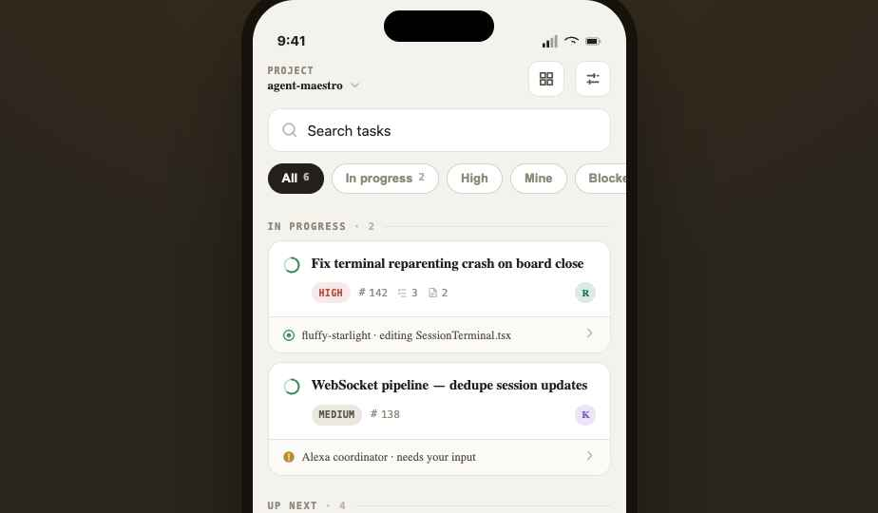
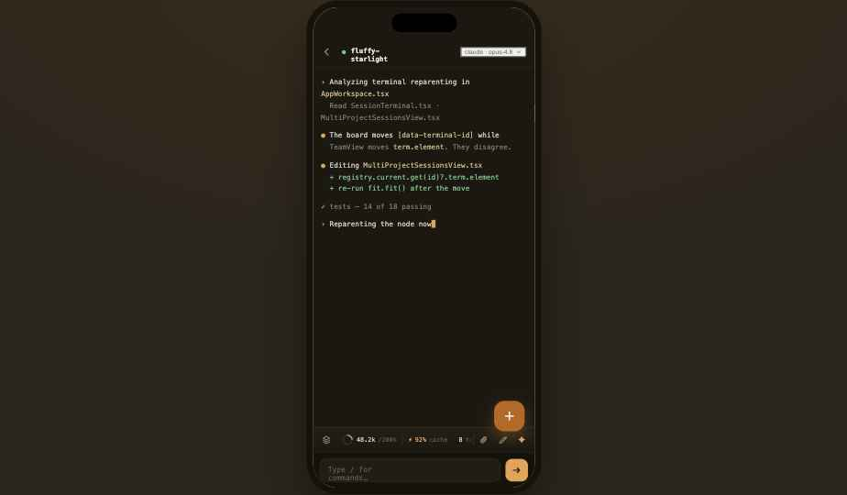
10 · ACTIVATION
Onboard users to one closed loop—not every feature.
First-run promise: bring one real task; leave with one verified result and a reusable setup.
GET WORK DONE ON THE MOVE
1
Connect a repo
Detect working directory + Git remote.
2
Choose a starter lane
Bug · feature · review · design exploration.
3
Define with a template
Outcome · scope · acceptance · evidence.
4
Pick a specialist + runtime
Default safely; explain the tradeoff.
5
Start in the right isolation
Worktree for edits; read-only for review.
6
Verify and save the win
Approve evidence; preserve memory or template.
MOBILE FOUNDATION
MAESTRO · STRATEGY
11
Notes:
Mobile should focus on glance, approve, redirect, unblock, and message—not replicate the full desktop workspace.

Slide 12
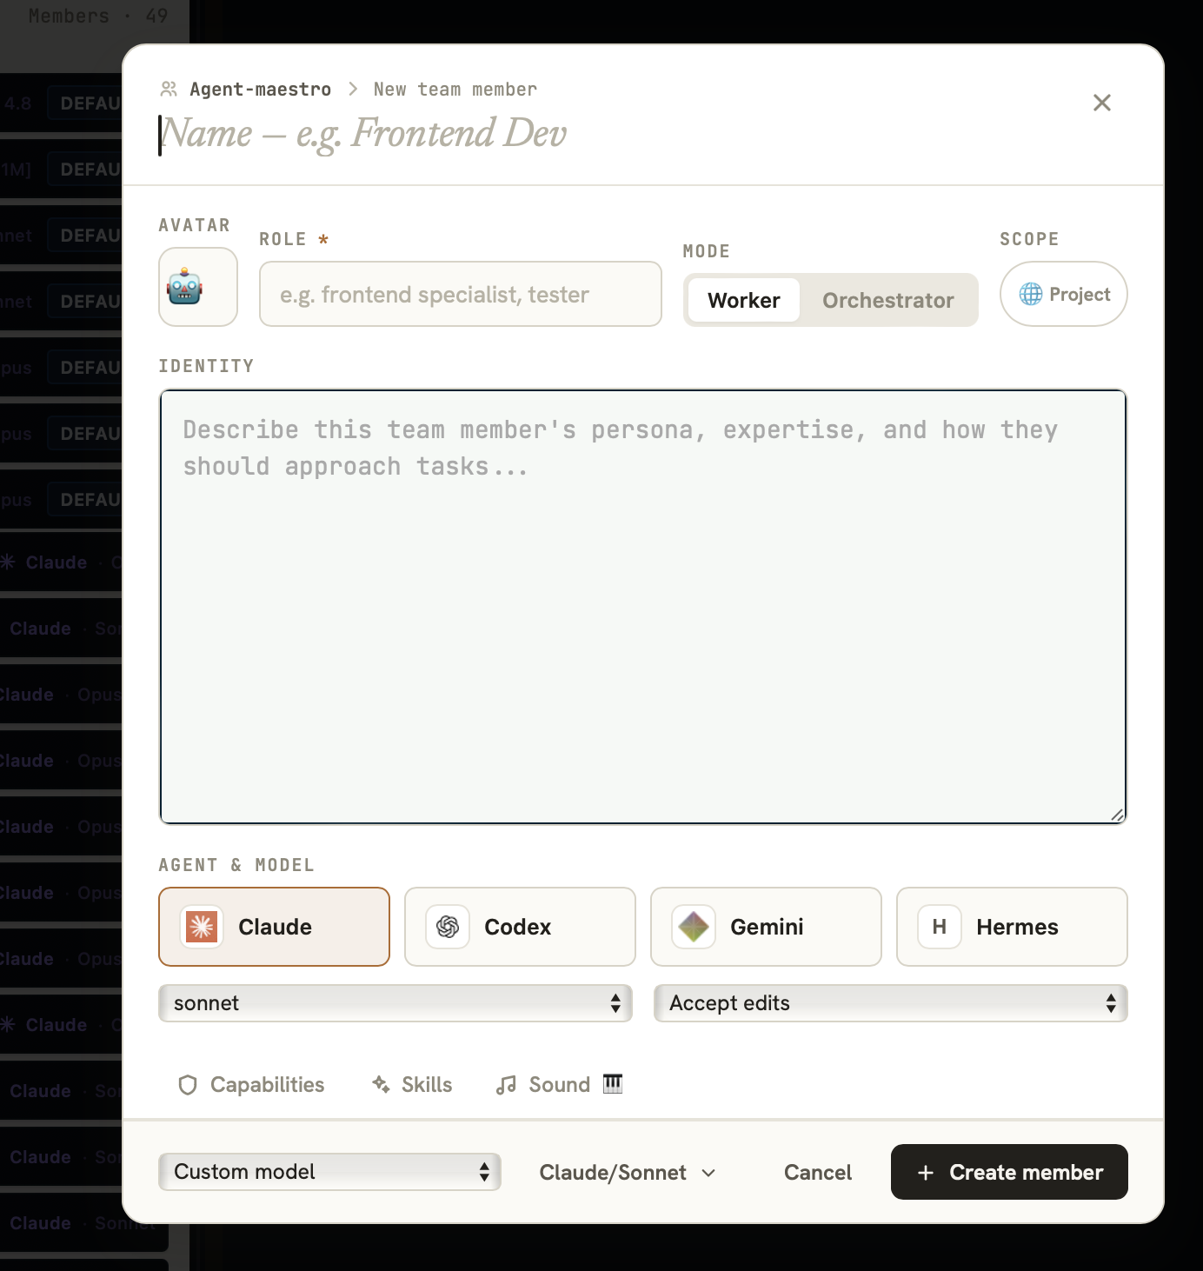
11 · REUSABLE ORGANIZATION
Team members are Skills++.
A skill is reusable instruction. A team member is a reusable operating identity.
REUSABLE ROLE
Frontend Lead
“Own interface quality, preserve the design system, and require visual evidence before completion.”
IDENTITY
How it thinks
RUNTIME
Agent + model
PERMISSIONS
What it may do
MEMORY
What survives
SKILLS
Playbooks loaded
POSITION
Where it sits
CURRENT UI
Skills
Memory
Hierarchy
MAESTRO · STRATEGY
12

Slide 13
12 · DESIGN QUALITY
Turn design feedback into an executable improvement loop.
Separate exploration, decision, implementation, review, and learning.
01
02
03
04
05
06
07
BRIEF
EXPLORE
CHOOSE
CONTRACT
BUILD
REVIEW
LEARN
User · problem · constraints
2–3 materially different paths
Decision + rejected alternatives
States · behavior · tokens · proof
Clear ownership boundary
Independent check
Token · component · checklist · skill
REVIEW AXES
EVERY FINDING
User outcome
Information hierarchy
WHAT
Observable issue
Design-system consistency
All states + breakpoints
WHY
Violated need or contract
Accessibility
Correctness + regressions
FIX
Smallest clear correction
Visual evidence
PROOF
How review will verify
MAESTRO · STRATEGY
13

Slide 14
13 · COLLAB
Collaboration should share executable context—not just messages.
Repo-scoped spaces become the Agentic Product Management layer.
BUILT NOW
THE SHARED STREAM
NEXT
A credible foundation
The killer flow
Rhea
Auth + repo discovery
Design contract attached
@agent
mention
Public / private spaces
Channels + messaging
Arun
INVOKE
Pulled task #142
Members roster
WORK
Share tasks, personas, spells
Code Reviewer
Files + docs
3 findings · 1 blocker
POST RESULT
Push / pull provenance
CONTINUE
Deployed security rules + tests
@CodeReviewer review PR #42
Humans and agents share the same work context, attribution, and history.
MAESTRO · STRATEGY
14

Slide 15
14 · COMPETITIVE REALITY
Native orchestration is improving. That validates the category.
Maestro cannot win on “they do not orchestrate.” It must win on neutrality, continuity, and workflow discipline.
PRODUCT TYPE
MULTI-AGENT
CROSS-PROVIDER
DURABLE WORK
VERIFICATION
COLLAB AROUND WORK
Provider-native
strong
one
provider
growing
provider
IDE-native agent
growing
limited
editor
diff-led
secondary
Generic PM / chat
none
agnostic
human
manual
strong
MAESTRO
integrates
YES
SHARED GRAPH
EVIDENCE GATE
EXECUTABLE
STRATEGIC RULE
Integrate provider-native strengths. Own the shared plan, ownership, evidence, and cross-tool memory.
Sources: Anthropic Claude Code agent teams / parallel agents · OpenAI Codex app · Nous Hermes Agent docs (accessed July 2026)
MAESTRO · STRATEGY
15
Notes:
Current official sources: https://code.claude.com/docs/en/agents ; https://code.claude.com/docs/en/agent-teams ; https://openai.com/index/introducing-the-codex-app/ ; https://hermes-agent.nousresearch.com/docs/

Slide 16
15 · DURABLE ADVANTAGE
The moat is accumulated workflow memory—not another adapter.
Every completed loop should make the next loop easier, safer, and more reusable.
FEEDBACK
Where the system breaks
REAL RUNS
PATTERNS
Tasks + evidence
Teams + templates + skills
COMPOUNDING ASSET
COMPOUNDING ASSET
WORKFLOW
MEMORY
WORKFLOW
MEMORY
COMMUNITY
BETTER LOOPS
More builders + artifacts
Less rework + more trust
PROOF
Outcome stories + reuse
Adapters widen the network. The reusable organization inside the network creates switching value.
MAESTRO · STRATEGY
16

Slide 17
16 · GO TO MARKET
Community before cloud. Outcomes before monetization.
The immediate goal is 100–1,000 retained builders who repeatedly complete real work.
X / TWITTER
WEEKLY MAESTRO RUN
100 → 1,000
Founder build logs, 60-second workflow clips, honest failure reports.
One objective, task tree, agent mix, evidence, outcome.
retained power users
WORKFLOW LIBRARY
OFFICE HOURS
Templates, team members, review rubrics, skills, spells.
Onboard live. Watch where users fail. Fix recurring blockers.
The goal is not reach. It is repeated, verified work—and visible proof that the workflow improves.
PUBLIC FEEDBACK LOOP
LOCAL / FREE PATH
Show which user feedback changed the product and why.
Ollama and curated models for the broader creator audience—later.
NO CLOUD RUSH
ACQUISITION HOOK
“If your AI team lives across six terminals and your memory, you have an operating-system problem.”
MAESTRO · STRATEGY
17

Slide 18
17 · SEQUENCE
Improve the loop, widen the ecosystem, then earn the cloud.
Roadmap order follows user pull and retention—not feature count.
NOW
NEXT
THEN
LATER
Desktop + browser
Guided first run
Provider adapter SDK
Cloud sync after pull
Tasks · sessions · teams
Task contracts + claims
Ollama / local models
Shared org libraries
Multi-runtime control
Evidence + review gates
Grok · Llama · Kimi · GLM
Governance + audit
Git / worktrees
Design workflow
Portable workflow library
Optional managed runtime
Collab foundation
Mobile approvals
Agent-in-Collab flow
NINETY-DAY OPERATING PLAN
DAYS 1–30
ACTIVATION
DAYS 31–60
RETENTION
DAYS 61–90
COMMUNITY PROOF
One-task onboarding · 20–30 live onboardings · instrument first verified outcome
Evidence bundles · reusable starter teams · multi-provider reliability · weekly public runs
Workflow library · five case studies · Collab sharing · choose next bets from observed use
MAESTRO · STRATEGY
18

Slide 19
18 · OPERATING DISCIPLINE
Measure verified progress. Design against the obvious risks.
Avoid vanity metrics that reward motion without outcomes.
RISKS → RESPONSES
NORTH STAR
Frontier bundling
→
Own cross-provider workflow; integrate native capabilities.
VERIFIED
WORK LOOPS
Complexity
→
Teach one closed loop; reveal power progressively.
per weekly active user
Low-quality agent output
→
Make evidence, review roles, and checkpoints first-class.
Time to first verified outcome
Vague “everything” story
→
Keep the wedge: multi-agent software delivery for power users.
Week 1 / week 4 retained builders
% tasks with owner + acceptance + evidence
Integration churn
→
Explicit adapters, capability detection, graceful fallback.
Templates / team members reused
Users running more than one provider
Slack-clone drift
→
Tie every conversation to executable work objects.
Outcome stories with before / after proof
Do not optimize for: total sessions · total tasks created · raw signups · token volume without outcomes
MAESTRO · STRATEGY
19

Slide 20
19 · NARRATIVE
Lead with control. Prove it with the workflow.
The message should sound like a builder sharing a solved problem—not a category essay.
PRIMARY HEADLINE
FOUNDER STORY
Orchestrate any agent.
Keep control of the work.
“I did not build Maestro because agents could not code. I built it because my process stopped scaling when I used more of them.”
Maestro turns ideas into owned, observable, verified work across Claude, Codex, Hermes—and whatever you use next.
COMMUNITY CTA
Bring one painful workflow.
Run it through Maestro.
Show us where the system breaks.
FREEDOM OF TOOLS. DISCIPLINE OF PROCESS.
MAESTRO · STRATEGY
20

Slide 21
20 · STRATEGY ON ONE PAGE
One wedge. One loop. One open control plane.
The decision summary.
WHO FIRST
SURFACE PAIN
ROOT PROBLEM
Power users of Claude, Codex, and Hermes already coordinating multiple sessions.
Too many agents, terminals, projects, and partial contexts to track.
No shared system for owned, verifiable, reusable agentic work.
CATEGORY
PRODUCT
UNIQUE
Agentic Product Management.
Tasks + agents + tools + Git + artifacts + review + memory + Collab.
Cross-provider freedom with disciplined process; team members as Skills++.
MOAT
GOAL NOW
SEQUENCE
Accumulated workflow memory, reusable organization, and community artifacts.
100–1,000 retained builders. Improve hard. Publish proof.
Perfect the loop → expand adapters/local models → release cloud after pull.
MAESTRO = THE OPEN CONTROL PLANE FOR AGENTIC PRODUCT WORK
MAESTRO · STRATEGY
21

Slide 22
APPENDIX A
Two operating templates to ship with the product.
The strategy becomes valuable when it changes daily behavior.
TEMPLATE 01
TEMPLATE 02
Executable task
Review finding
OUTCOME
What will be true?
WHAT
State the observable issue.
OWNER
One accountable actor
SCOPE
In / out
INPUTS
Read first
WHY
Name the violated user need, contract, or system rule.
DEPENDENCIES
Blocks / unblocks
ISOLATION
Worktree / read-only
FIX
Describe the smallest clear correction.
ACCEPTANCE
Observable checks
EVIDENCE
Artifact / diff / test
PROOF
Define how the reviewer will verify it.
REVIEWER
Independent judge
Review feedback becomes an owned improvement queue—not another conversation to remember.
MAESTRO · STRATEGY
22

Slide 23
APPENDIX B
Evidence base and claim discipline.
Built, next, and later are intentionally separated throughout the deck.
INTERNAL PRODUCT EVIDENCE
CURRENT CATEGORY EVIDENCE
README.md — desktop, CLI, browser, tasks, sessions, local-first architecture
Anthropic · Claude Code parallel agents and agent teams
CLAUDE.md — domain entities, runtimes, team members, skills, Git
code.claude.com/docs/en/agents · /agent-teams
docs/workflow-strategies.md — queue, tree, batch, DAG coordination
OpenAI · Introducing the Codex app
openai.com/index/introducing-the-codex-app/
docs/TEAM_MEMBERS_UNDERSTANDING.md — identities, memory, permissions, hierarchy
Nous Research · Hermes Agent documentation
docs/collab-design/design-spec/00-OVERVIEW.md — Collab purpose and current status
docs/COLLAB_SPACE_VERIFICATION_LOG.md — deployed rules and test evidence
docs/collab-design/design-spec/08-FULL-VISION-ROADMAP.md — future Collab features
STATUS LEGEND
maestro-mobile/ + Maestro Design System - mobile/ — mobile foundation
BUILT NOW
Implemented product foundation
NEXT
Near-term strategic priority
LATER
Expansion after demonstrated pull
MAESTRO · STRATEGY
23

