Slide 1
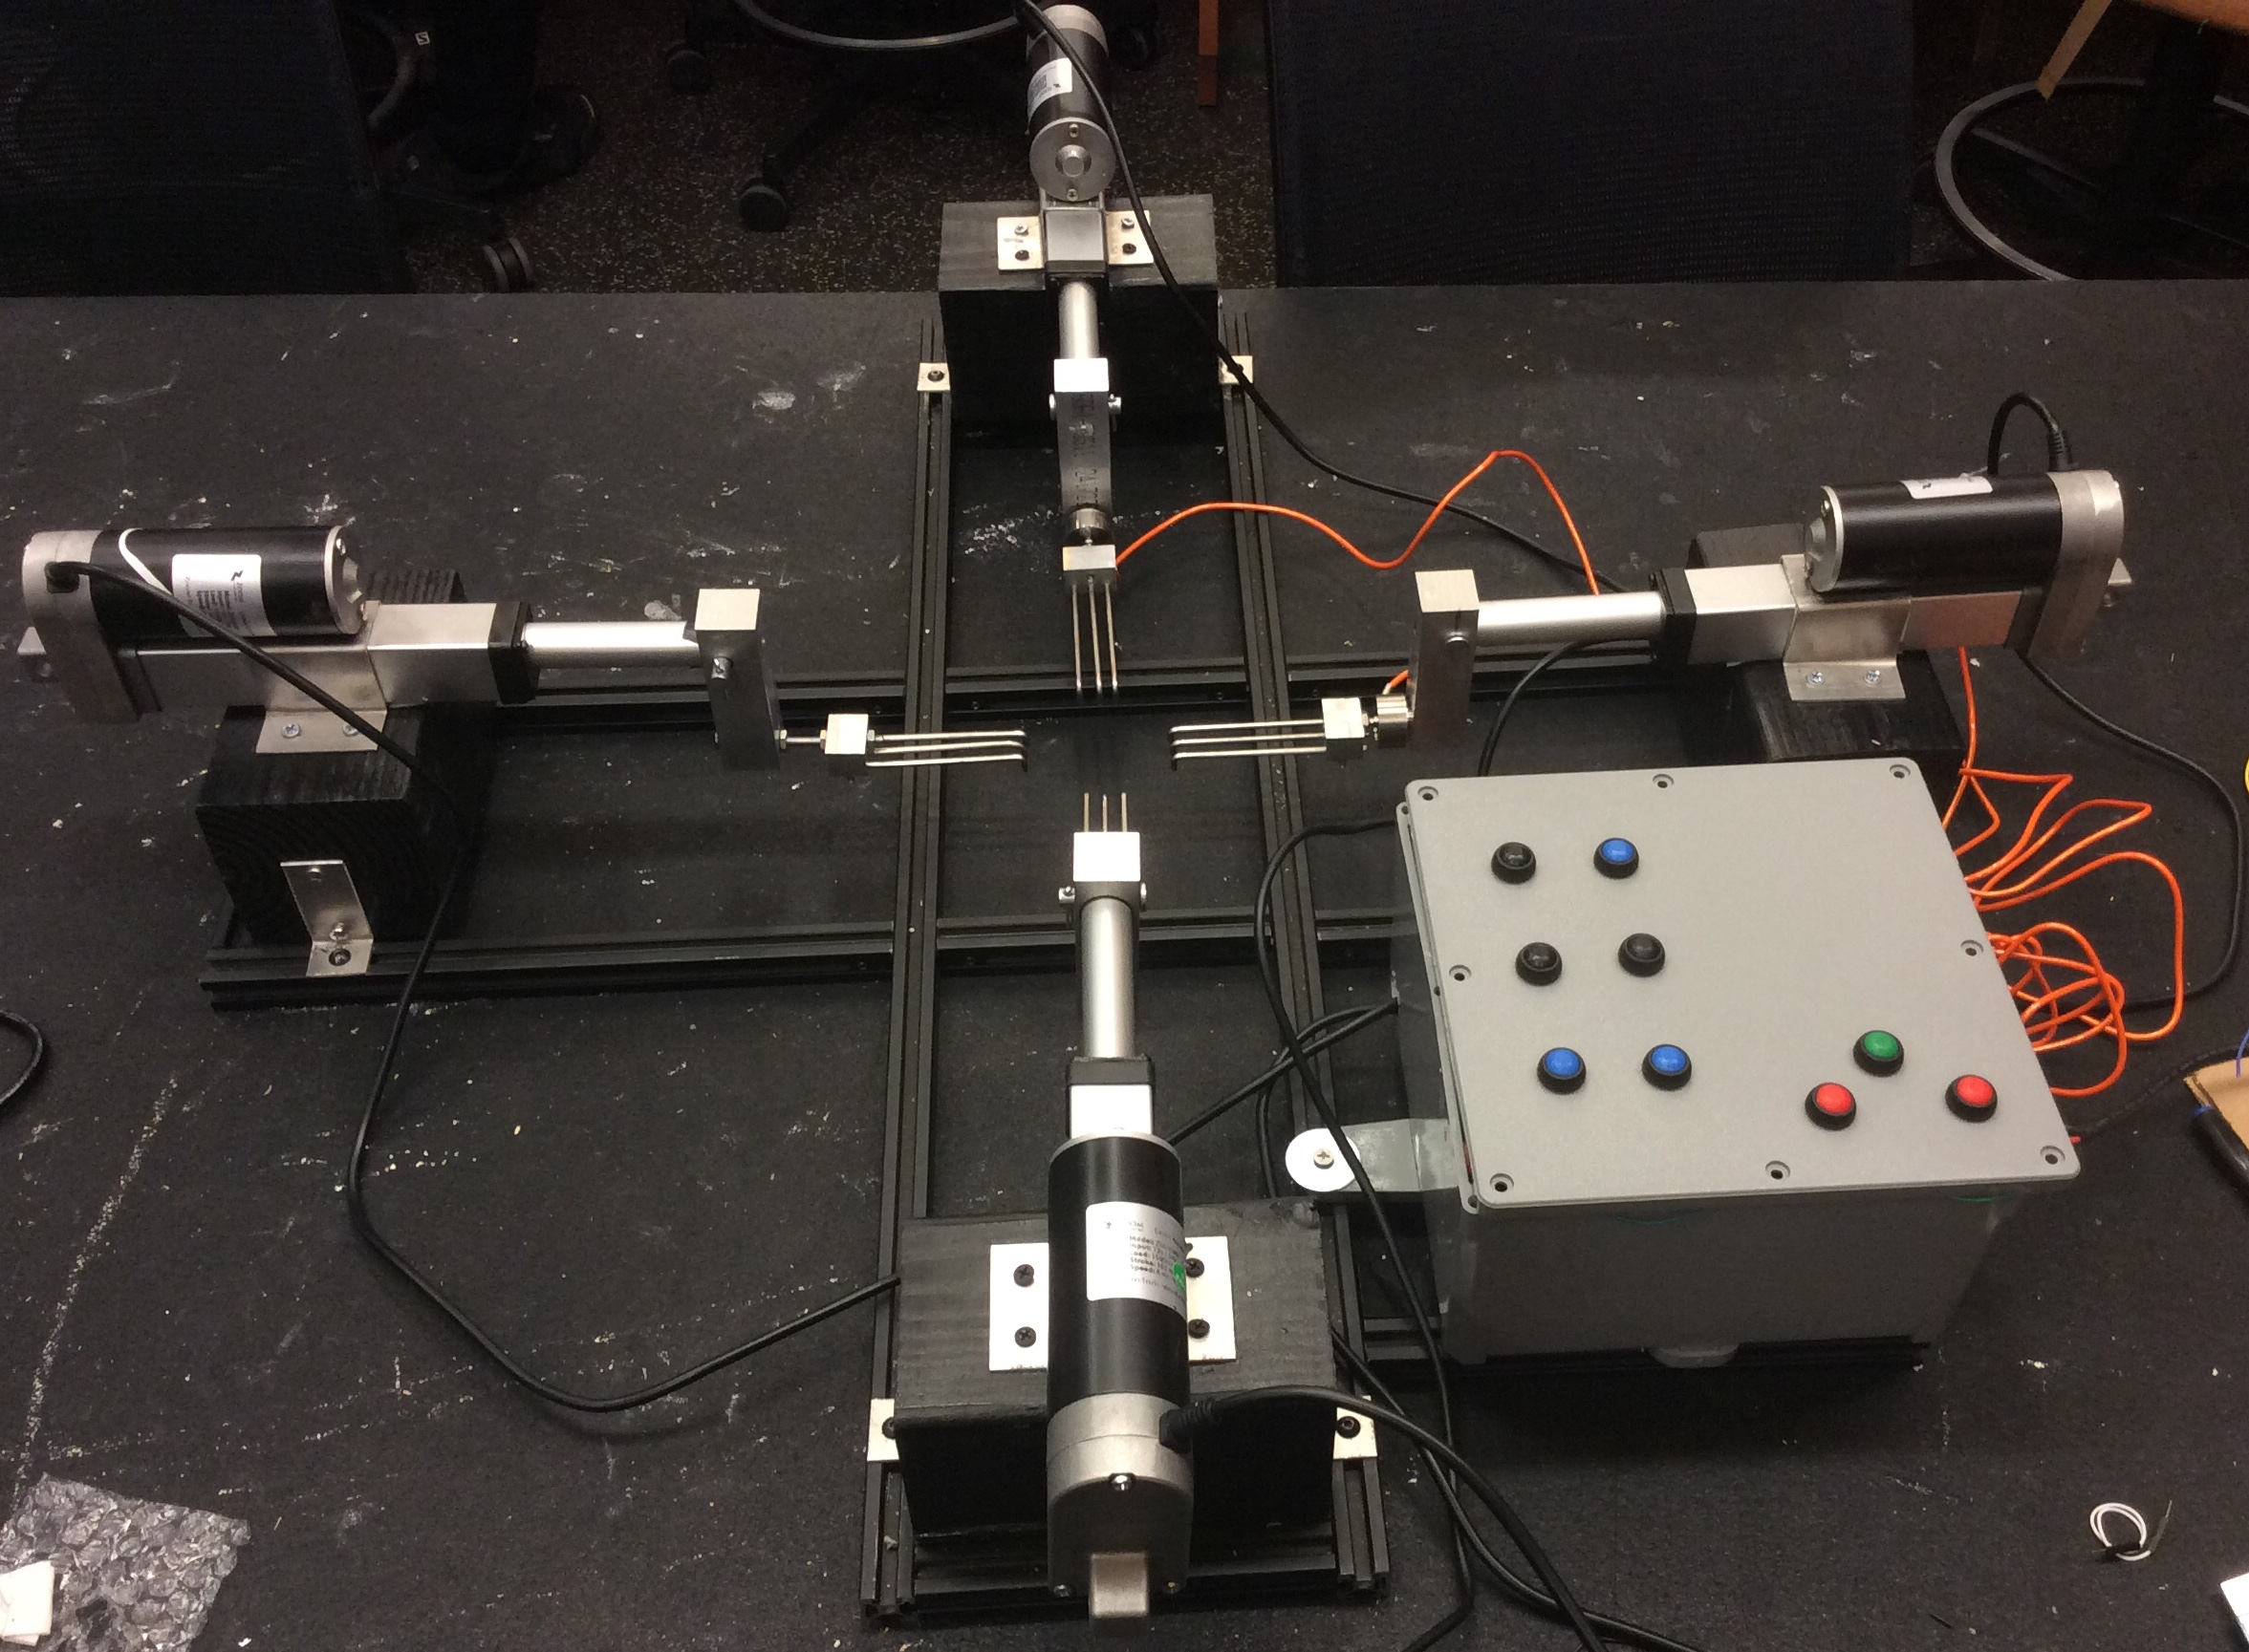
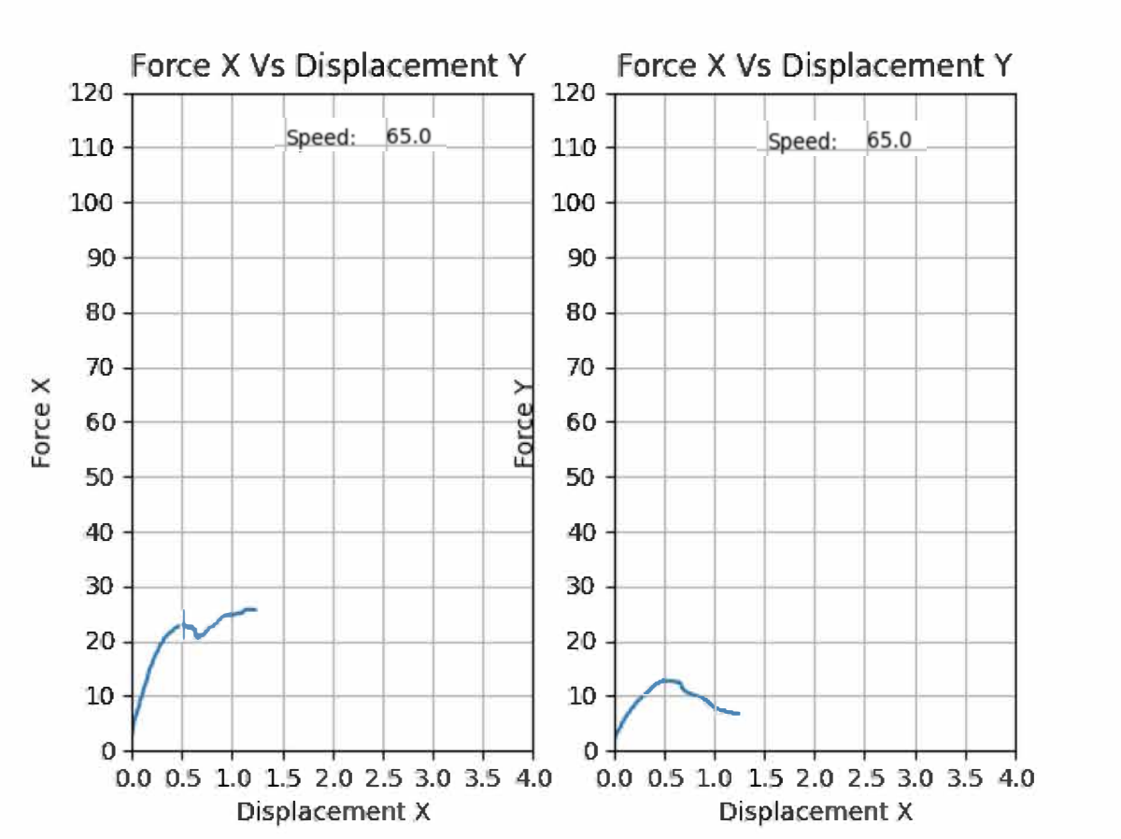
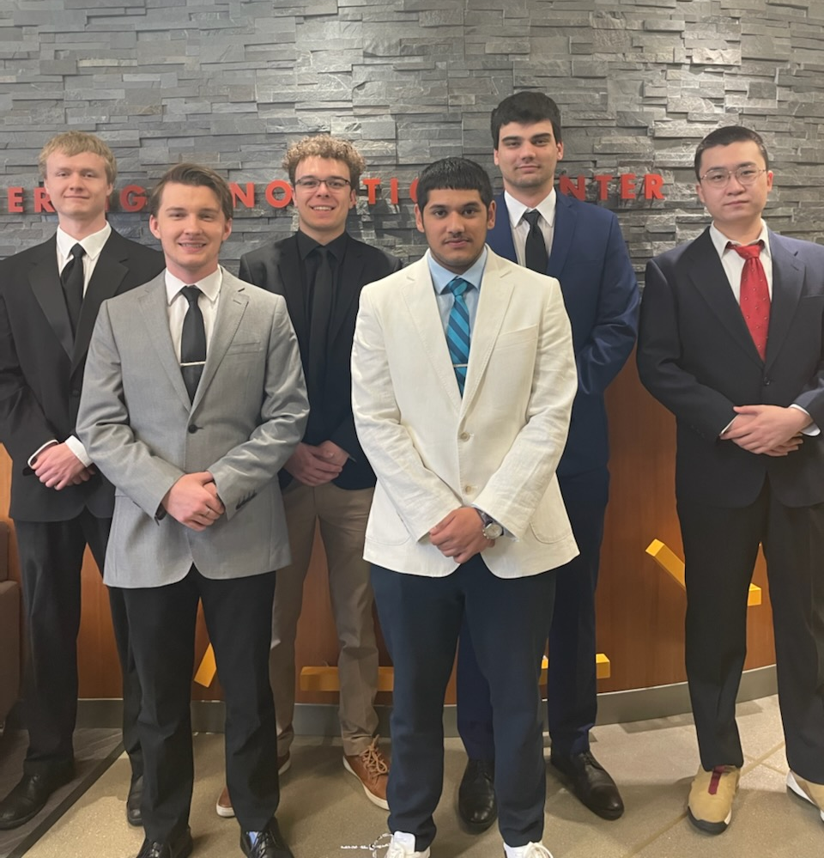

Biaxial Tensile Tester
Project Objective
To design a device that will test and record the strength and displacement of skin or organic tissue simultaneously in two orthogonal directions.
Project Requirements
Pull tissue at the same velocity in all 4 sides
Measure and record force and displacement
Easy to set up and operate
Portable
Technical Details
An Ardunio is used to drive the actuators and read the load cell data
Linear actuators drive at a speed of 50 mm/min
Load cells measure forces between 0.1 N and 100 N
Specimens of sizes 1x1 cm to 4x4 cm
Experiment data is saved as a .csv file
Platform independent application
Team Members:
Left to right: David Engstrom, Garret Brittingham, Michael Fermanis, Subhanga Ghimire, Michael Scarsella, Jing Qin
Customer: Advisor:
Bethany Luke Professor El-Howayek

