Slide 1



Breadth First Search
Subhan Shirinzade

Slide 2


What is BFS?
BFS is an algorithm for searching a tree data structure for node that satisfies a given property. It starts at the tree root and explores all nodes at the present depth prior to moving on to the nodes at the next depth level

Slide 3
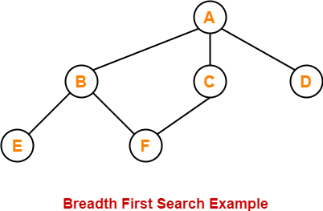
What is BFS?
Let’s select root first
For example: root A
We right A then we look at the neighbors of A. They are B,C and D.
We write them: A,B,C,D
After that we remove the A then we look up the neighbors of first (so it is B)
We write: A,B,C,D,E,F

Slide 4

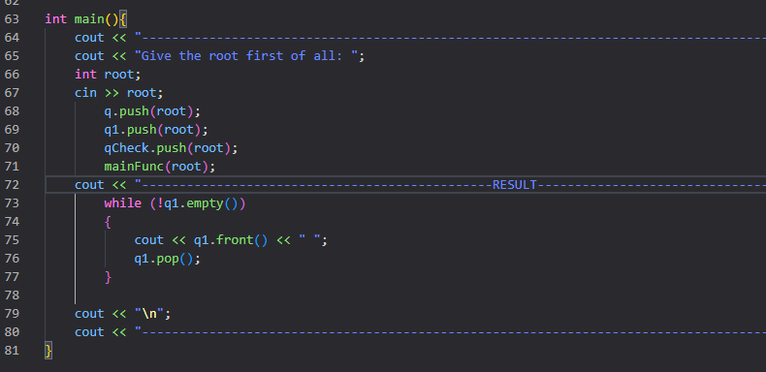
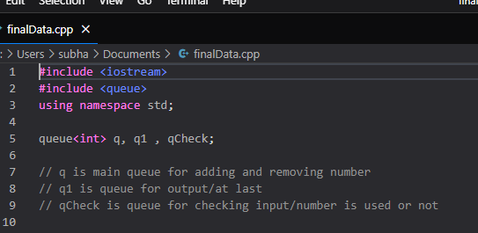
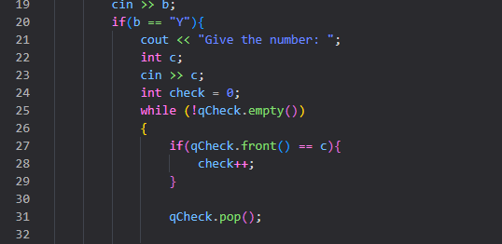
About my code
In my code at the main() function i did get the root from user. Then I wrote basic rules of BFS at the mainFunc() function. I’m using the rules of queue when doing this. (push, forward, empty and etc.)
There are three queue: q, q1, qCheck.

Slide 5
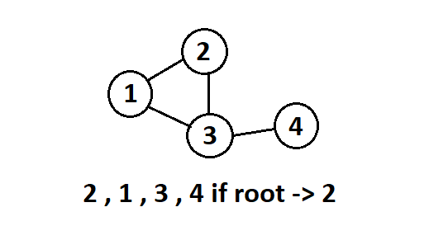
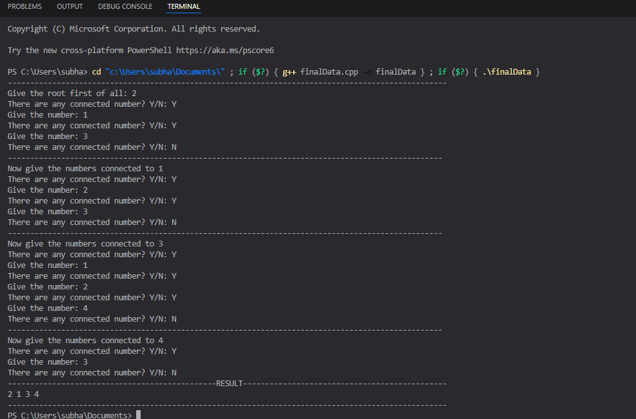
What is Output
First of all it will want root
Then it will ask if root has neighbors or not
User will have two option Yes or Not (Y/N)
After the user gives all the information according to the graph, it will give a result according to the BFS algorithm.

