Slide 1
🌾
Wheat Seeds Classification
Using CNN Architectures
Course: CSE366 — Artificial Intelligence Instructor: Dr. Raihan Ul Islam
Associate Professor
Department of Computer Science and Engineering
East West University
Nishat Subha Mithela • Nabiha Binte Nasher • Kaniz Fatema Tuli • Jannatul Ferdous Shanta
ID: 2023-1-60-248
ID: 2023-1-60-176
ID: 2023-1-60-192
ID: 2023-1-60-167
Group No: 03 | Spring 2026

Slide 2
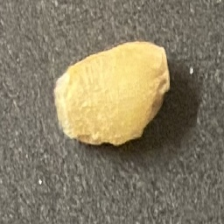
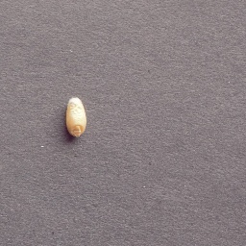
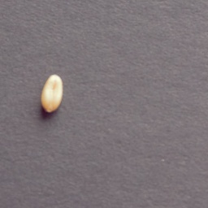
Dataset Overview
375
3
125
Total Images
Classes
Images/Class
High-resolution RGB
Wheat Varieties
Balanced Dataset
Source: Mendeley Data — High-resolution RGB images of wheat seeds | Captured: Canon 5D Mark III under controlled lighting & black background
Split: 70% Training | 10% Validation | 20% Testing | Image Size: 64 × 64 pixels (resized)
Sample Images from Each Class
Akbar
Dilkash
Urooj
Rounded, light-yellow
Elongated, tan-brown
Oval, pale-golden

Slide 3
Overall Methodology
Dataset
(375 images)
Preprocessing
& Augmentation
Model
Training
Evaluation
& Metrics
Best Model
Selection
▶
▶
▶
▶
5 Models Trained & Compared
EfficientNetB0
ResNet50
VGG16
Custom CNN
Attention CNN
Pre-trained
Pre-trained
Pre-trained
From Scratch
SE Block
Evaluation Metrics: Accuracy • Precision • Recall • F1-score • AUC • ROC Curve • Confusion Matrix • Paired t-test
Augmentation Applied: Horizontal Flip • Rotation ±20° • Zoom ±15% • Brightness ±20% • Width/Height Shift ±10%
Transfer Learning (Task 2) ImageNet weights → Freeze base → Fine-tune head
From Scratch (Tasks 3 & 4) Custom architecture + SE Attention Block

Slide 4
Models Applied
EfficientNetB0
ResNet50
VGG16
Task 2 — Pre-trained
Task 2 — Pre-trained
Task 2 — Pre-trained
Compound scaled CNN. ImageNet pre-trained. Base frozen, custom head added.
50-layer residual network with skip connections. ImageNet pre-trained.
Deep sequential 16-layer CNN. ImageNet pre-trained. Best among Task 2.
5.3M params • lr=0.0001 • Adam
25.6M params • lr=0.0001 • Adam
138M params • lr=0.0001 • Adam
Custom CNN
Attention CNN
Task 3 — From Scratch
Task 4 — SE Block
3× [Conv→BN→ReLU→MaxPool] + Dense(256) + Dropout(0.5). Trained from scratch with augmentation.
Custom CNN + Squeeze-and-Excitation (SE) blocks for channel-wise attention.
64×64 input • lr=0.0001 • EarlyStopping
SE ratio=8 • 64×64 • EarlyStopping
All models: Batch Size=16 • Max Epochs=60 • Optimizer=Adam • Loss=Categorical Cross-Entropy • Split=70/10/20

Slide 5
Results Summary
Model | Accuracy | Precision | Recall | F1-score | AUC | Train Time (s)
EfficientNetB0 | 33.33% | 0.1100 | 0.3300 | 0.1700 | 0.5831 | 727.5
ResNet50 | 47.62% | 0.5500 | 0.4800 | 0.4800 | 0.4966 | 1036.8
VGG16 | 55.65% | 0.6759 | 0.5565 | 0.5510 | 0.7990 | 783.0
Custom CNN | 77.68% | 0.8184 | 0.7768 | 0.7660 | 0.9020 | 715.2
Attention CNN ★ | 78.13% | 0.8146 | 0.7813 | 0.7768 | 0.9197 | 508.1
🏆 Best Model: Attention CNN Accuracy 78.13% • AUC 0.9197 • F1 0.7768
📈 Improvement over VGG16 (best pre-trained) +22.48% accuracy • +0.1207 AUC • +0.2258 F1

Slide 6
Model Performance Comparison
Attention CNN achieves highest accuracy (78.13%) and AUC (0.9197) among all 5 models

Slide 7
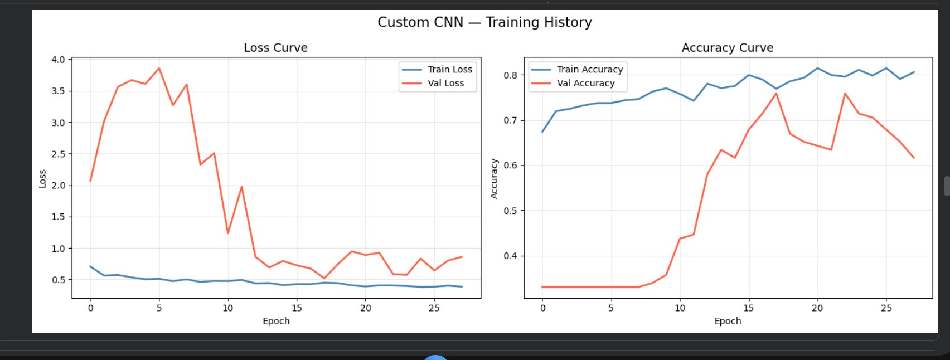
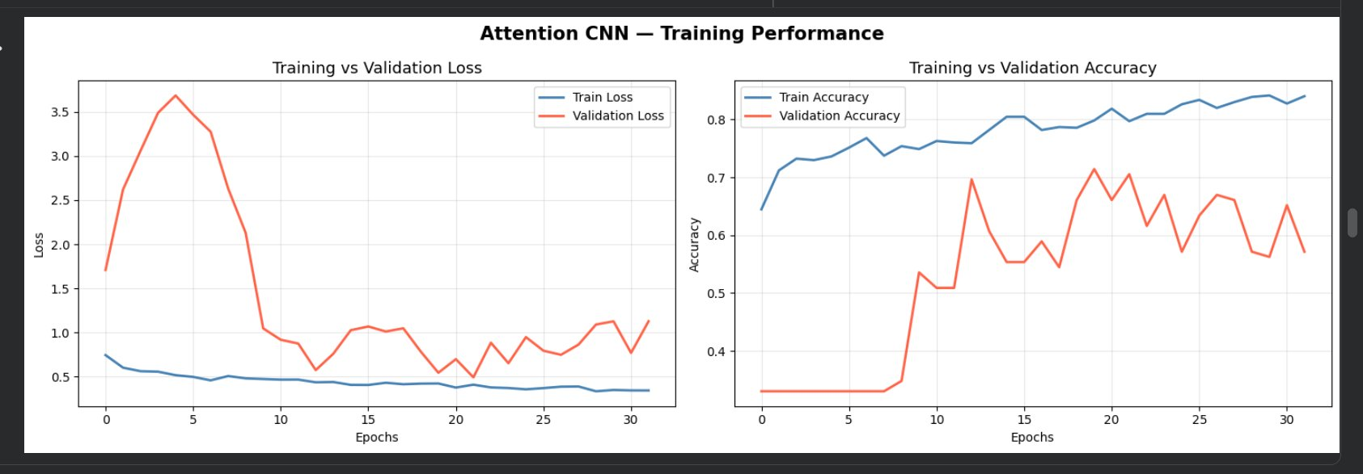
Training History
Task 3 — Custom CNN
Task 4 — Attention CNN
Key Observations
• Training loss decreases steadily in both models — learning is happening correctly • Validation loss initially high then decreases — small dataset causes instability (only ~25 val images) • Val accuracy reaches ~60-75% — reasonable given only 375 total images • EarlyStopping with patience=10 prevents severe overfitting

Slide 8
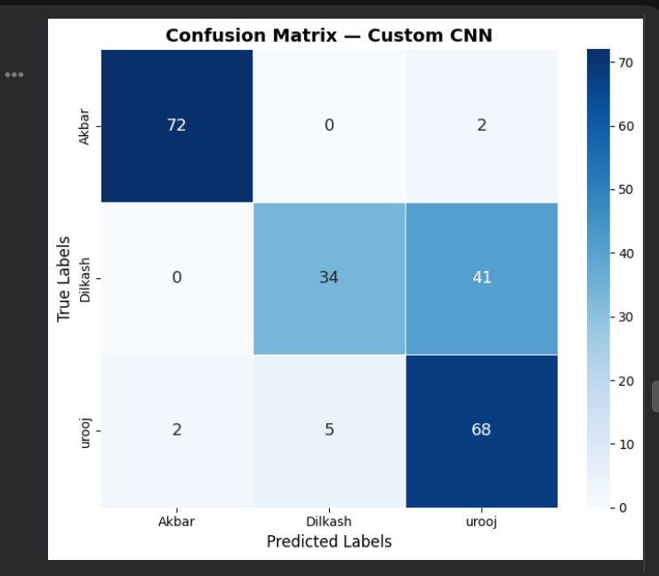
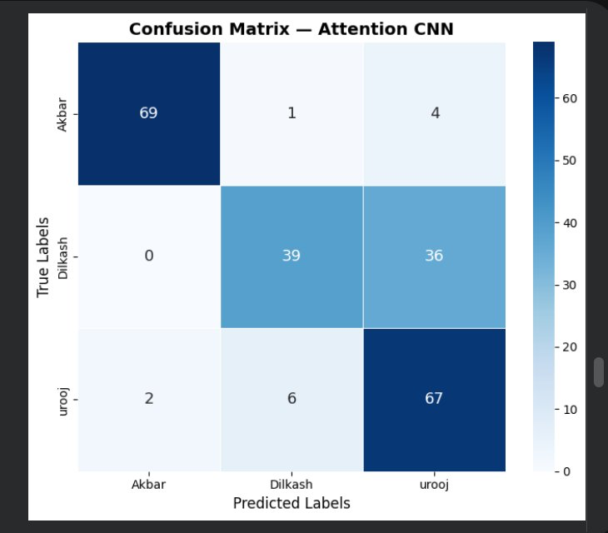
Confusion Matrices
Custom CNN | Accuracy: 77.68%
Attention CNN | Accuracy: 78.13%
Custom CNN: Akbar=97.3% ✓ | Dilkash=45.3% (confused with Urooj) | Urooj=91.9% ✓
Attention CNN: Akbar=93.2% ✓ | Dilkash=52.0% (still hardest) | Urooj=90.5% ✓
⚠ Dilkash is the hardest class — frequently confused with Urooj due to similar elongated shape in both models

Slide 9
Why Attention CNN Outperforms Others
SE Block (Squeeze-and-Excitation Attention)
vs Best Pre-trained (VGG16)
GlobalAvgPool → Reshape → Dense(filters/8, ReLU) → Dense(filters, Sigmoid) → Channel-wise Multiply
+22.5% Accuracy +22.6% F1-score +12.1% AUC
Recalibrates feature maps — tells the model WHICH channels matter most for classification
1. Channel Attention
2. Trained from Scratch
SE blocks learn to weight important feature channels — e.g., focusing on texture & color channels that differ between Akbar, Dilkash, and Urooj.
Pre-trained models (ResNet, VGG, EfficientNet) were trained on ImageNet (objects, not seeds). Custom models learn wheat-specific features directly.
3. Right-Sized Architecture
4. Data Augmentation
64×64 input + 3 conv blocks is appropriately scaled for 375 images. Pre-trained models with 224×224 and millions of params overfit on such small data.
Tasks 3 & 4 apply 6 augmentation techniques (flip, rotation, zoom, shift, brightness). Pre-trained models in Task 2 had no augmentation.
Conclusion: Attention CNN is the best model — combining the right architecture size, SE attention, and augmentation for this small wheat seed dataset.

Slide 10
🌾
Thank You
Wheat Seeds Classification — CSE366 AI Mini Project
GitHub: https://github.com/subhanishat89-spec/wheat-seed-classification

