Slide 1

ع ورت ک ا م

Slide 2
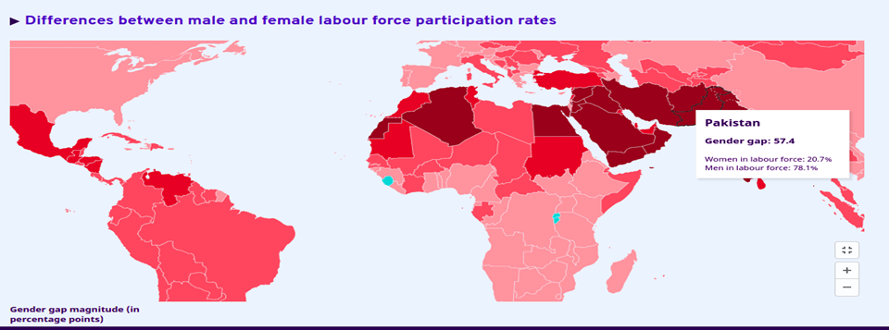
Gender gap in labor force
Source : ILOSTAT, ILO modelled estimates, November 2021

Slide 3
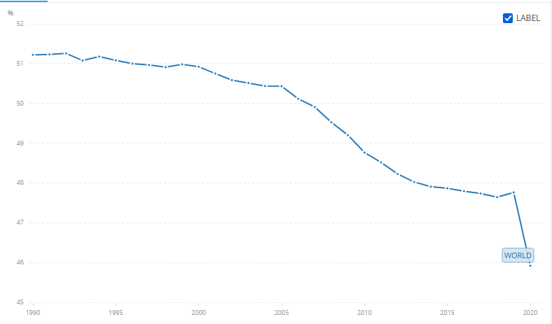
Percentage of female in labor force participation
Source: International Labour Organization, ILOSTAT database

Slide 4



Random User Survey
“There is a need to form a common workplace where women can benefit from their skills like tutoring.”-Person1
“Quick doctor female consultancy is hard to work “ - Person2

Slide 5
Problem #1: Gender gap in labor force
When women are employed, they tend to work in low-quality jobs in vulnerable conditions, and there is little improvement forecast in the near future.

Slide 6
Problem #2: Insecure working environment for skilled women.
Women’s participation in the labor market varies greatly.
Focusing on these issues is critical because female labor force participation is a key to promoting inclusive growth and achieving the Sustainable Development Goals.

Slide 7


Slide 8
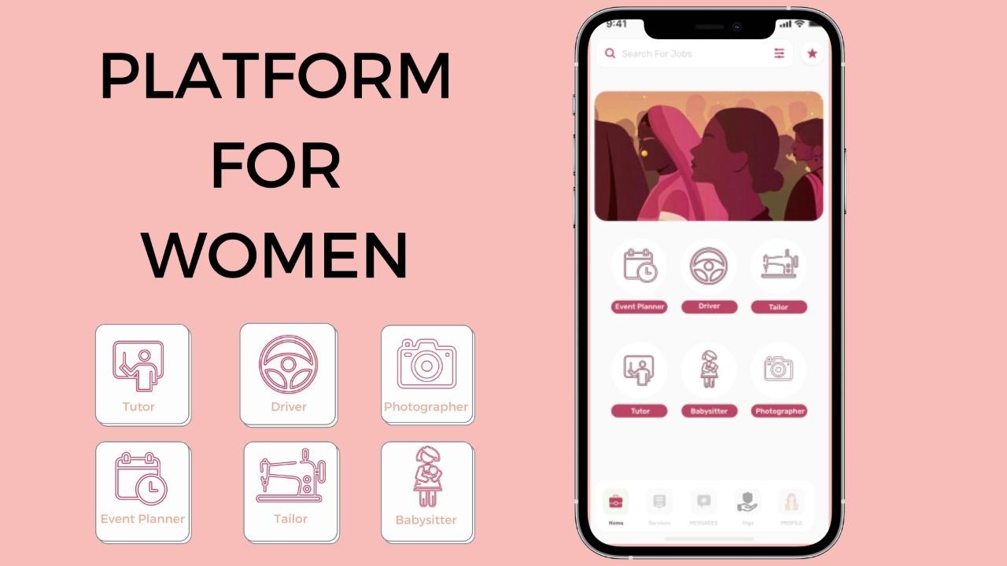

Slide 9


Slide 10




One stop solution for financial stability, opportunity building platform and secure marketplace for women
Sell your services and earn.
Work for what you love the most.
Get employed.
Connect with women and build a network.

Slide 11




Team
FindHer
Subhan Saleem
Ahsan Akhtar
Ahmed Raza
Mustafa Bawany

