Slide 1
Big Data Processing
Jiaul Paik
Lecture 10

Slide 2
Spark: Recap

Slide 3
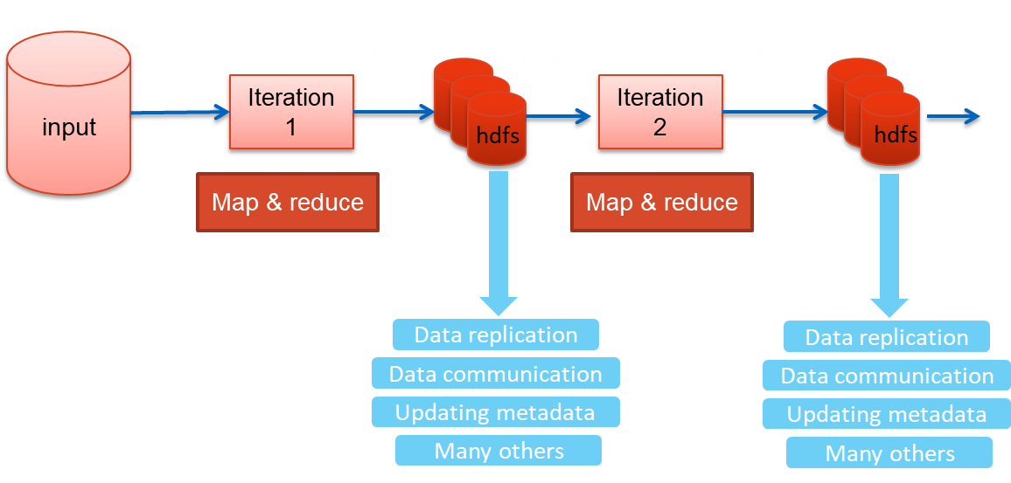
Iterative Algorithm in Map-reduce: Issues

Slide 4
Key Concept in Spark for Working with Data
Resilient Distributed Dataset (RDD)
Resilient: can re-compute missing or damaged partitions due to node failures
Distributed: data residing on multiple nodes in a cluster
Dataset: a collection of partitioned data with primitive values (e.g., int, string) or any user defined object (e.g., (word, count) pairs)
RDD of strings
RDD of pairs
(word, count)
am
am, 10
master
master, 5
natural
one element
natural, 7
student
student, 17

Slide 5
Main Steps of an RDD Processing
Create RDD from external data (from distributed file system or local file system)
Transform them to define new RDDs using transformations
map(), filter()
Store in memory any intermediate RDDs that will need to be reused.
persist()
Launch actions to kick off a parallel computation
count()

Slide 6
Creating an RDD
Two ways to do it
By loading an external dataset from disk
Parallelizing a collection in your driver (main) program
val rdd = sc.textFile(“inputFile”)
val lines = sc.parallelize(List("pandas", "i like pandas"))
sc denotes the spark context that calls the spark core and manages the cluster

Slide 7
RDD Operations
Two types of Operations
Transformations
Example: map(), filter()
Actions
Example: count(), saveAsTextFile()

Slide 8
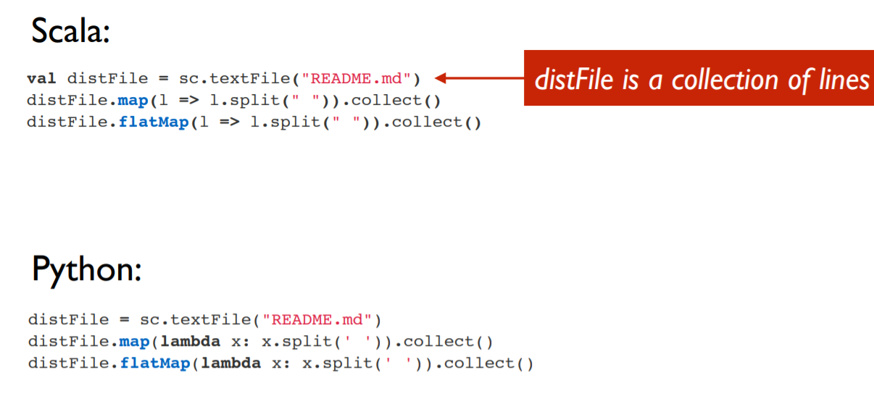
Transformations: Examples

Slide 9
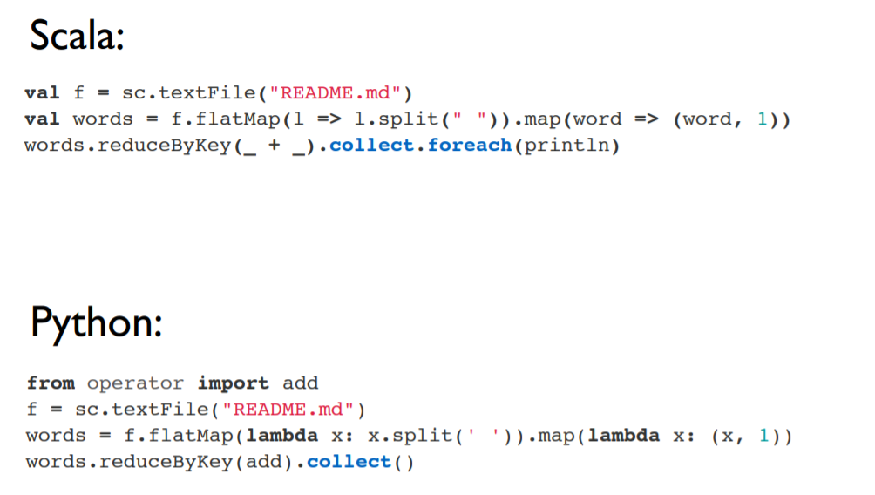
Actions: Examples

Slide 10
An Example Code
data.txt
-------------
I am here
She is there
You are here
val lines = sc.textFile("data.txt")
val lineLengths = lines.map(s => s.length)
val totalLength = lineLengths.reduce((a, b) => a + b)
action

Slide 11
RDD Persistence

Slide 12
Persistence (Caching)
Goal is to keep RDD in memory, distributed across machines
Important for iterative computation to increase efficiency
Storage Level | Description
MEMORY_ONLY | Stores RDD in memory
MEMORY_AND_DISK | Store RDD in memory. If RDD does not fit in memory, store the partitions that don't fit on disk, and read them from there when they're needed.
DISK_ONLY | Store the RDD partitions only on disk.
MEMORY_ONLY_2, MEMORY_AND_DISK_2 | Same as the levels above, but replicate each partition on two cluster nodes.
Usage: yourRdd.MEMORY_ONLY

Slide 13
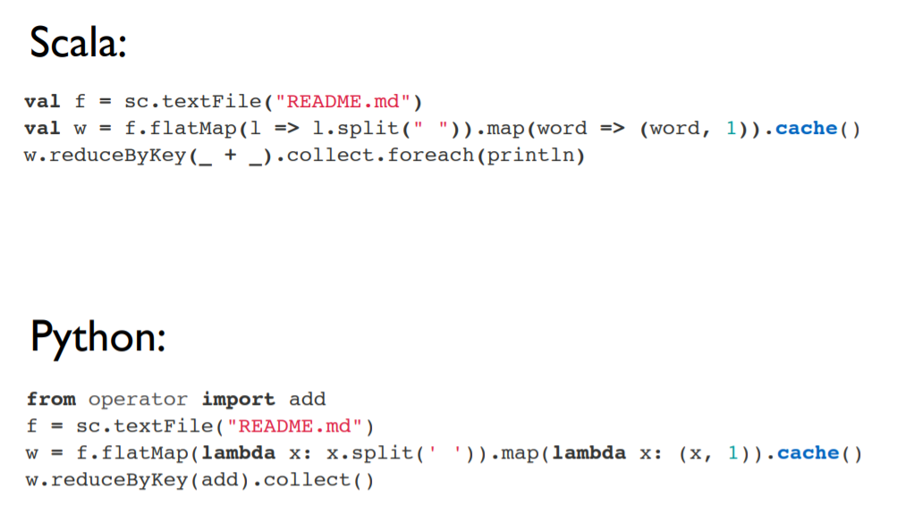
RDD Persistence: Example

Slide 14
Example of Basic RDD Transformations: Single RDD
RDD containing {1,2,3,3}
Function | Description | Example | Result
map() | Apply a function to each element in the RDD and return an RDD of the result | rdd.map(x => x + 1) | {2, 3, 4, 4}
flatMap() | Apply a function to each element in the RDD and return an RDD of the contents of the iterators returned. | rdd.flatMap(x => x.to(3)) | {1, 2, 3, 2, 3, 3, 3}
filter | Return an RDD consisting of only elements that pass the condition passed to filter(). | rdd.filter(x => x != 1) | {2, 3, 3}
distinct | Remove duplicates. | rdd.distinct() | {1, 2, 3}
sample(withRe placement, frac tion, [seed]) | Sample an RDD, with or without replacement. | rdd.sample(false, 0.5) | Nondeterministic

Slide 15
Example of Basic RDD Actions
RDD containing {1, 2, 3, 3}
Function | Description | Example | Result
collect() | Return all elements from the RDD. | rdd.collect() | {1, 2, 3, 3}
count() | Number of elements in the RDD. | rdd.count() | 4
top() | Return the top num elements the RDD. | rdd.top(2) | {3, 3}
countByValue() | Number of times each element occurs in the RDD. | rdd.countByValue() | {(1, 1), (2, 1), (3, 2)}
reduce() | Combine the elements of the RDD together in parallel (e.g., sum). | rdd.reduce((x, y) => x + y) | 9

Slide 16
Example of Basic RDD Transformations: Two RDD
Two-RDD transformations on RDDs containing {1, 2, 3} and {3, 4, 5}
Function | Description | Example | Result
union() | Produce an RDD containing elements from both RDDs. | rdd.union(other) | {1, 2, 3, 3, 4, 5}
intersection() | Common elements | rdd.intersection(other) | {3}
subtract() | Remove the contents of one RDD | rdd.subtract(other) | {1, 2}
Cartesian() | Cartesian product with the other RDD. | rdd.cartesian(other) | {(1,3), (1,4), …}

Slide 17
Paired RDD: Transformations
RDD containing key-value pairs
The fundamental concept behind original map-reduce model
Transformations on one paired RDD containing {(1, 2), (3, 4), (3, 6)}
Function | Description | Example | Result
reduceByKey(func) | Combine values with the same key. | rdd.reduceByKey( (x, y) => x + y) | {(1,2), (3,10)}
groupByKey() | Group values with the same key. | rdd.groupByKey() | {(1,[2]),(3, [4,6])}
mapValues(func) | Apply a function to each value of a pair RDD without changing the key. | rdd.mapValues(x => x+1) | {(1,3), (3,5), (3,7)}
keys() | Return an RDD of just the keys. | rdd.keys() | {1, 3,3}
values() | Return an RDD of just the values. | rdd.values() | {2, 4,6}
sortByKey() | Return an RDD sorted by the key. | rdd.sortByKey() | {(1,2), (3,4), (3,6)}

Slide 18
Paired RDD: Actions
RDD containing {(1, 2), (3, 4), (3, 6)}
Function | Description | Example | Result
countByKey() | Count the number of elements for each key. | rdd.countByKey() | {(1, 1), (3, 2)}
lookup(key) | Return all values associated with the provided key. | rdd.lookup(3) | {4,6}

Slide 19
Two Paired RDD: Transformations
Transformations on two paired RDDs: (rdd = {(1, 2), (3, 4), (3, 6)}, other = {(3, 9)})
Function | Description | Example | Result
join | Perform an inner join between two RDDs. | rdd.join(other) | {(3, (4, 9)), (3, (6, 9))}
cogroup | Group data from both RDDs sharing the same key. | rdd.cogroup(other) | {(1,([2],[])), (3, ([4, 6],[9]))}

Slide 20
Controlling Partitions in RDD (controlling parallelism)
One important thing in parallel programming is “How we can control the parallelism ?”
If rdd is not having enough number of partitions then parallelization wont be that efficient,
Suppose we have 2 rdd partitions so we cant run 4 executors on it., so its wastage of resources
So how can we control the parallelism depends on how we are partitioning our rdd.

Slide 21
Partitioning RDDs
Goal
control how data will be physically distributed across the cluster
You can reduce the number of partition
You can increase the number of partition

Slide 22
Partitioning RDDs
Suppose in the same worker node you have 3-4 partitions.
May be in some intermediate processing 3-4 partitions got created in single worker node,
In next step if I notice I have to run single worker node on it so we can coalesce it to 1 partition.
coalesce
collapses partitions on the same worker
Example:
words.coalesce(1) // # partition reduces to 1

Slide 23
Partitioning RDDs
repartition
Repartition can enhance the parallelization,
But repartitioning can result in the shuffling of data across nodes.
allows you to repartition your data up or down
but performs a shuffle across nodes in the process.
Increasing the number of partitions can increase the level of parallelism
Example:
words.repartition(10) // gives us 10 partitions

Slide 24
Partitioning RDDs
Inbuilt Partitioner
Spark supports two inbuilt partitioner
HashPartitioner (for discrete values like when keys are words)
RangePartitioner (for continuous values like when the key is blood pressure)

Slide 25
Important Spark Operations

Slide 26
map vs flatmap
map(f):
Return a new distributed dataset formed by passing each element of the source through a function f
data.txt
-------------
I am here
She is there
You are here
flatMap(f):
Similar to map, but each input item can be mapped to 0 or more output items (so f should return a Sequence rather than a single item)
Example: Counting number of letters in each lines
Example: getting words from each line

Slide 27
reduceByKey vs groupByKey
reduceByKey(f):
Aggregates data based on the common keys
It is done in each partition, before they are shuffled
groupByKey:
Returns the set of elements with common key

Slide 28
reduceBykey: Illustration
Find sum of values based on the common keys
(a,1)
(a,1)
(b,2)
(a,1)
(a,2)
(b,2)
(a,3)
(b,1)
(a,1)
(a,1)
(b,2)
(b,1)
(b,2)
(b,1)
(a,2)
(b,2)
(a,6)
(b,3)
(a,2)
(b,6)
LOCAL AGGREGATION and then GLOBAL AGGREGATION
(a,2)
(a,6)
(a,2)
(b,2)
(b,3)
(b,6)
Optimized Aggregation
The data is aggregated in each of the nodes to reduce the data size before sending it over the network which improves efiiciency.
Then final aggregation happens across partitions.
(a,10)
(b,11)

Slide 29
groupByKey: Illustration
Find sum of values based on the common keys
(a,1)
(a,1)
(b,2)
(a,1)
(a,2)
(b,2)
(a,3)
(b,1)
(a,1)
(a,1)
(b,2)
(b,1)
(b,2)
(b,1)
(a,1)
(a,1)
(a,1)
(a,2)
(a,3)
(a,1)
(a,1)
(b,2)
(b,2)
(b,1)
(b,2)
(b,1)
(b,2)
(b,1)
Groups the data without any local aggregation
All the values of the keys are collected and shuffled over the network.
Costlier than reduceByKey()
After grouping we can apply some function to process the values.
(a,10)
(b,11)

Slide 30
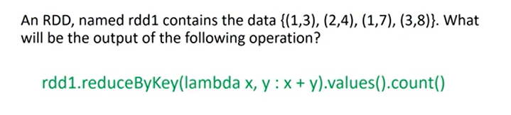
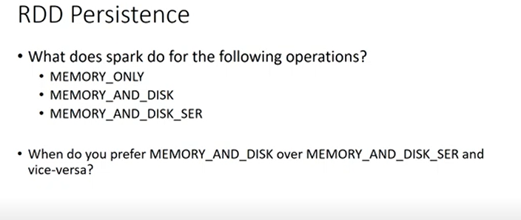
Answer : 3
MEMORY_ONLY:: It will store the content of the RDD into memory only if we don’t have enough memory then we would be having out of memory problem.
MEMORY_AND_DISK ::
MEMORY_AND_DISK_SER:: second one only but format is serialized Java object,
Serialization: converting data into byte stream
When we send data over the network then serialization takes less amount of space than raw data , lesser amount of data to be sent over the network,
Downside : u have send the data from one node to other node but when u process data on other node then u have to again deserialize to original objects, deserialization cost is the downside

Slide 31
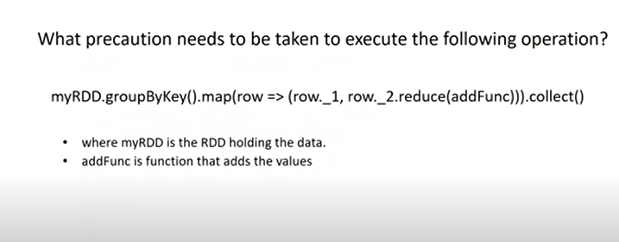
The major difficulty is data generated by the first 2 operations before .collect(), we are collecting the whole data in array-like structure in driver’s main memory,
If sz of data is very large then we may run out of memory since driver is just one single dedicated node in the cluster, so we have to make sure data which we are collecting should be smaller than the memory of the driver

Slide 32
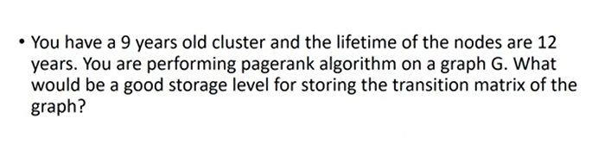
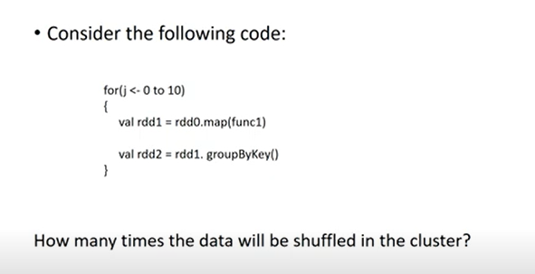
MEMORY_ONLY_2, if we have enough amount of memory
MEMORY_AND_DISK_2 if we don’t have enough memory
10 times

Slide 33
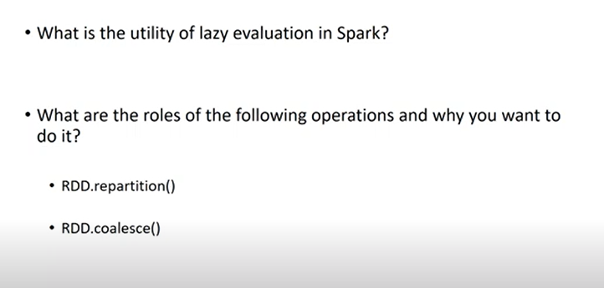
RDD.repartition() :: helps transformation operations like map() operation
reduceByKey() :: partitioning is done based on some Hash Function if we have repartitioned the data then obviously I wont be splitting the data corresponding to same key so it would create small - small parts where we have all the data for a particular key but we wont be data splitting in 2 regions for same key so “reduceByKey” will also get benefitted because of repartitioning.

