Slide 1
Big Data Processing
Jiaul Paik
Lecture 12

Slide 2
Graph (Network) Data Processing
Complete Graph:
A complete graph on n vertices has n(n-1)/2 edges, where all vertices are connected to each other.

Slide 3
Agenda
Basics of Graph Structure
Motivation
Algorithms
Graph Partitioning for community discovery

Slide 4
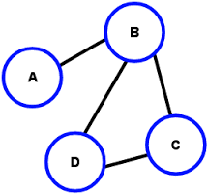
Graph Basics
A graph is composed of two things
Set of objects (called nodes of the graph)
Set of connections (called edges of the graph)
node
edge
Degree of a node = # adjacent nodes
Example: Degree(B) = 3

Slide 5
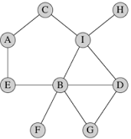
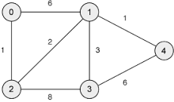
Types of Graph
Un-weighted
Edges do not have weight
Edges simply say whether two objects
are connected or not.
Weighted
Edges have weight
Examples:
Email communication network
How often two persons exchanging emails?
City and Road network
Edge weight: the distance between two cities

Slide 6
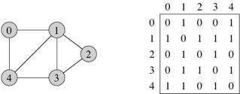
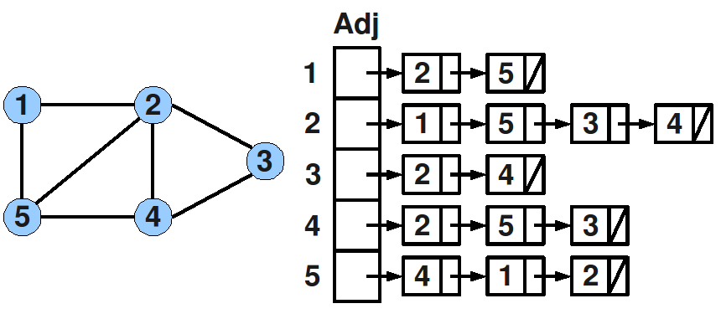
Representing Graph
Adjacency matrix:
Adjacency list:

Slide 7
Why Study Graphs?
Many real-life data and problems are modelled as graph structure
Facebook friendship network
Communities in question-answering website like Quora
And so on..
When we are posting a particular question and someone is trying to answer that question based on this, we can find out relevant communities on Quora so that we can throw our question to appropriate communities for getting better answers.

Slide 8
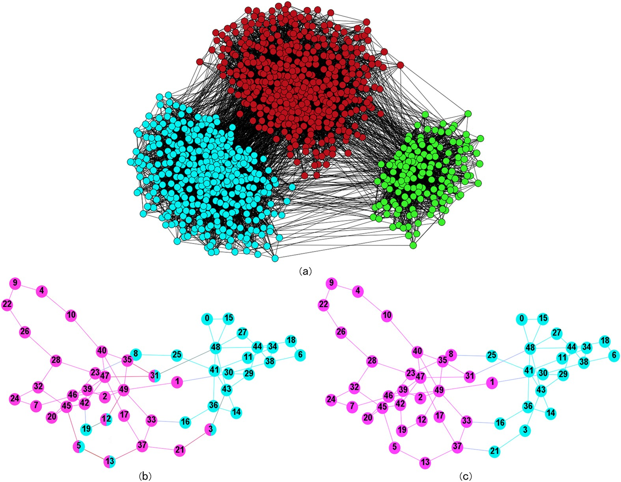
Graph and Communities
Communities mean connections b/w group of nodes dense in comparison to other regions.

Slide 9
Graph Partitioning for Community Discovery
How to partition a particular graph so that we can find out communities in the graph?

Slide 10
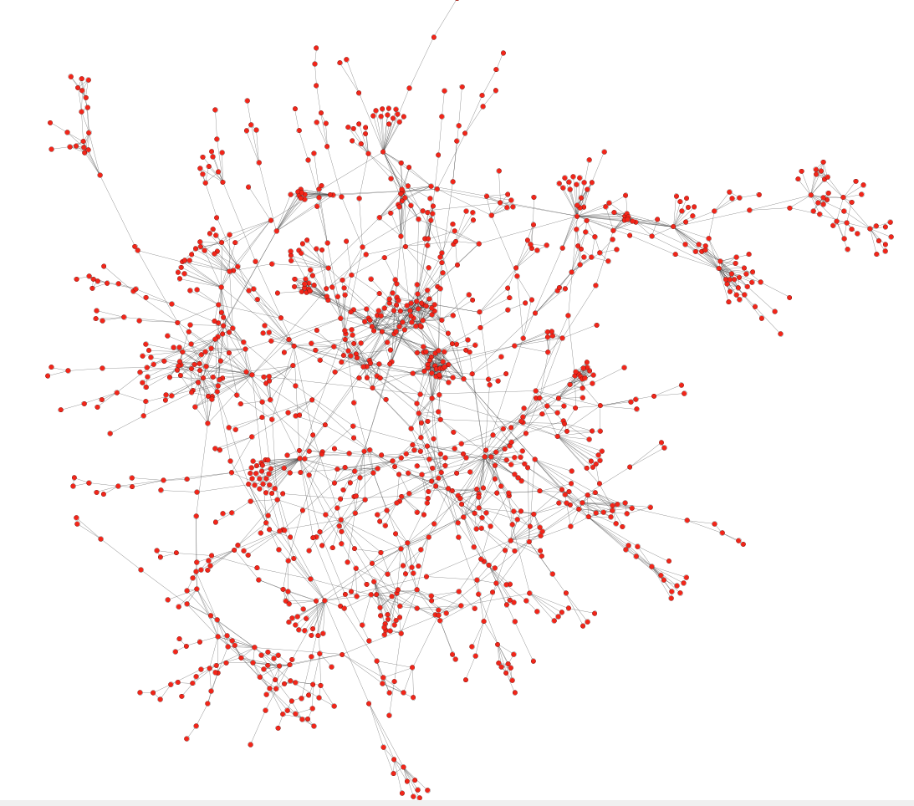
Protein-Protein interaction networks
Can we identify functional modules?
Protein- Protein interaction network
Graph has proteins as nodes and edges b/w proteins represent physical interactions b/w proteins.
This helps to understand the nature of a particular disease and we can also devise new medicines for a particular disease.
For all these cases, community discovery is very important i.e., figuring out groups of proteins that are interacting very closely.
Nodes: Proteins
Edges: Physical interactions
Source: Jure Leskovec, Stanford

Slide 11
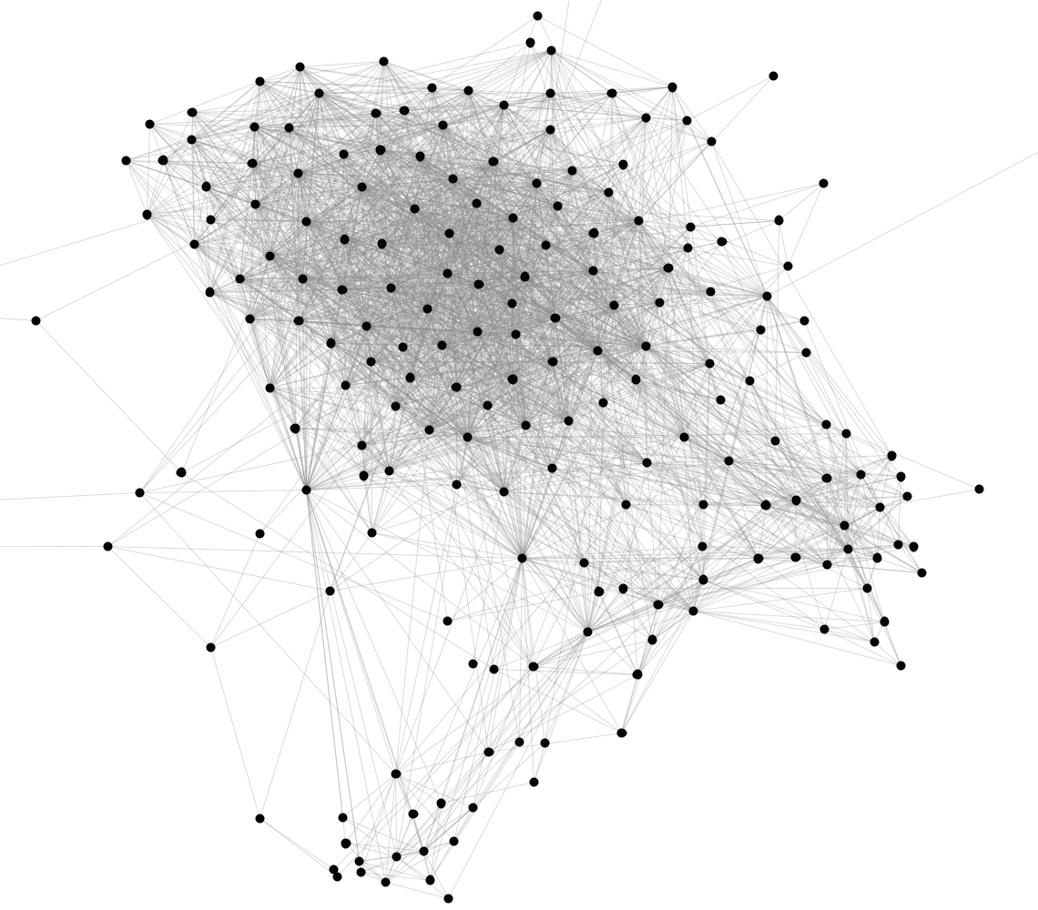
Facebook Network
Dense Regions means they are very densely connected individuals; connections b/w individuals in a particular group of people are very high, so they are closely connected communities. Based on this we can find out kinds of communities, how many communities are there.
Can we identify social communities?
In social network, we are very much interested in communities so that we can recommend sending friend request to an individual or show posts to set of people who are interested in a particular community.
Nodes: Facebook Users
Edges: Friendships
Source: Jure Leskovec, Stanford

Slide 12
Communities
Real-life graphs are not random
In social network people pick their friends based on their common interests and activities
Nodes in a graph are typically organized in communities
Groups of nodes which probably share common properties
Since the graph is not random so for non-random graphs, we can have underlying community structures in the graph. For all non-random graphs we can have such a structure and our job is to uncover the community structures in the non-random graph.

Slide 13
Community detection as clustering
Community detection is just clustering on graphs.
We can apply clustering algorithms on the adjacency matrix
(e.g., k-means)
We can define a distance or similarity measure between nodes in the graph and apply other algorithms (e.g., hierarchical clustering)
Graphs require specific algorithms
For k-means, we need to have fixed dimensional vectors for all elements. In this case nodes can be represented as fixed dimensional vectors, for every node we have an adjacency matrix, we have corresponding row for that node, we can treat this adjacency row from the adj mat as feature vector for that particular node and apply k-means to it. Issue : dim of vector is very large coz of large num of nodes and this representation is very sparse as most of the entries are 0.
Since graph is large, dimension is very large we can’t use k-means algorithm or hierarchical clustering algorithm coz they won’t be that efficient to find out the communities.
We need to have special algorithms for graphs to find out big communities.

Slide 14
How do we find communities?
Main Characteristics of a community
Within-community nodes are densely connected
Between-community nodes are sparsely connected
Objective while finding communities in the graphs: We need to maximize within community closeness and connections, and we have to minimize b/w community closeness and connections.

Slide 15
The Girvan-Newman Algorithm
Reference: Networks, Crowds, and Markets: Reasoning about a Highly Connected World, Easley and Kleinberg

Slide 16
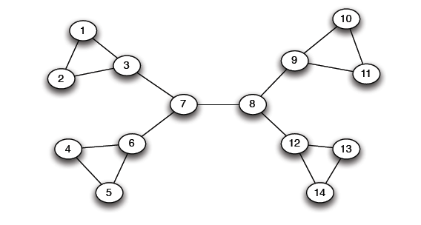
A Motivating Example
Which edge to remove?
If we want to find out the communities which edge to remove first?
:: 7 – 8 and this edge is bridge edge.
A bridge edge is an edge that connects 2 communities.
Find out potential bridge edges, break them and repeat this process to find out more and more communities, smaller communities more in number.
“bridge”

Slide 17
The Girvan-Newman method
Hierarchical divisive method
Start with the whole graph
Find edges whose removal “partitions” the graph
Repeat with each subgraph until single vertices
Stopping Criteria:
If we are satisfied with the number of communities we have got then we can stop.
Or
Density of connections inside the individual communities by measuring num of edges b/w them and we can stop it.
The most imp thing: Find out edges whose removal splits the graph into 2 parts such that the parts which we are getting are good communities.

Slide 18
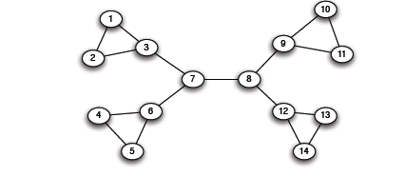
The Girvan-Newman method
Select bridge edges that when removed disconnect the graph
There may be many of those

Slide 19
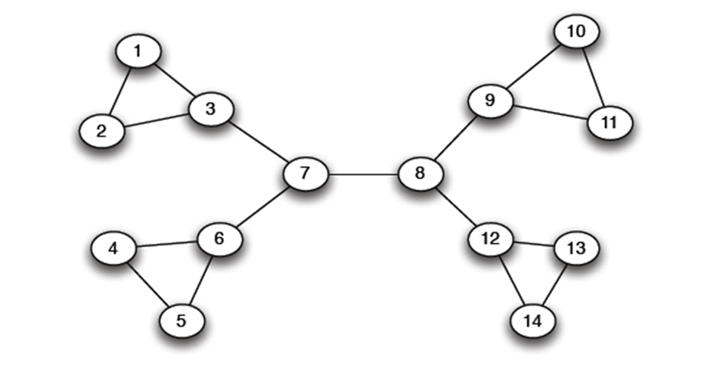
Edge importance
We need a measure of how important an edge is in keeping the graph connected
Edge betweeness: Number of shortest paths that pass through the edge
Edge importance helps to figure out the potential bridge edges.
Edge betweenness: Edge betweenness for a particular edge is the number of shortest paths which pass through the edge. Bridge edges by nature will have very high value of edge betweenness.

Slide 20
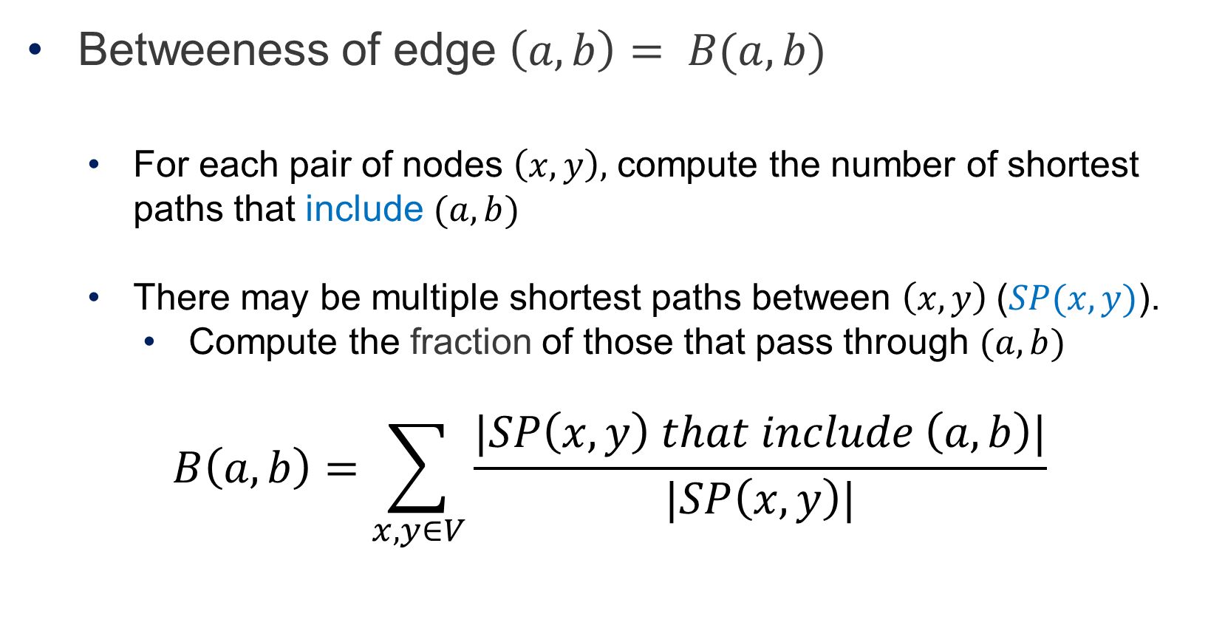
Edge Betweeness
Betweeness of edge $\left(a,b\right)= B(a,b)$
For each pair of nodes $\left(x,y\right),$ compute the number of shortest paths that include $(a,b)$
There may be multiple shortest paths between $\left(x,y\right) \text{(}SP(x,y)\text{)}$.
Compute the fraction of those that pass through $(a,b)$
$$B\left(a,b\right)=\sum_{x,y∈V}{\frac{|SP\left(x,y\right) that include \left(a,b\right)|}{|SP\left(x,y\right)|}}$$

Slide 21
Examples
3x11 = 33
1x12 = 12
7x7 = 49
1

Slide 22
The Girvan-Newman Algorithm
Given an undirected unweighted graph:
Repeat until no edges are left:
Compute the edge betweeness for all edges
Remove the edge with the highest betweeness
At each step of the algorithm, the connected components are the communities
We compute edge betweenness value for all edges in the graph and then remove the edge with highest betweenness value.
After removal of an edge the graph gets partitioned into 2 components. At each step each of the connected component is a community.
Then we need to take the subgraphs and split them further.

Slide 23
Girvan Newman method: An example
Betweenness(7, 8) = 7x7 = 49
Betweenness(1, 3) = 1X12=12
Betweenness(3, 7) = Betweenness(6, 7) = 33
Betweenness(8, 9) = Betweenness(8, 12)= 3X11=33

Slide 24
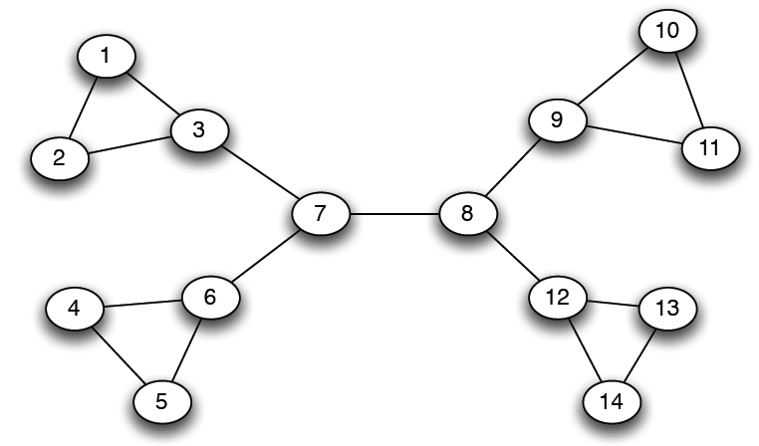
Girvan-Newman: Example
12
1
33
49
Need to re-compute betweenness at every step
Because in the previous step we computed the betweenness value of all the edges. The question is can we reuse those betweenness value again in second step to minimize the num of computations ?
Answer is No we can’t use the previously computed betweenness value. The moment we split the graph into 2 partitions the betweenness value of the existing edges will change; its not equal to what we had previously so we need to recompute the betweenness value for the graph components again.

Slide 25
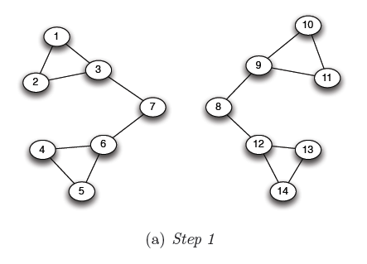
Girvan Newman method: An example
Betweenness(1, 3) = 1X5=5
Betweenness(3,7) = Betweenness(6,7) = Betweenness(8,9) = Betweenness(8,12) = 3X4=12
Break all the edges (3,7), (6,7), (8,9) , (8,12) which have betweenness value as 12 i.e. the highest value of betweenness here.

Slide 26
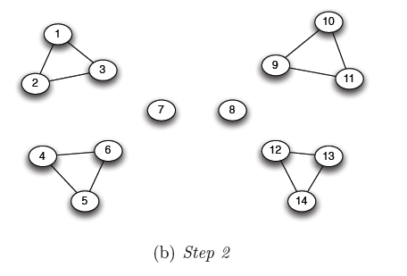
Girvan Newman method: An example
Betweenness of every edge = 1

Slide 27
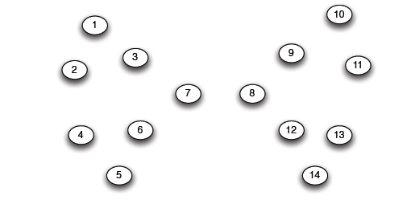
Girvan Newman method: An example
Getting singleton nodes is not our ultimate objective, its not helpful either so we need to remember the history of splitting from big graph to singleton nodes.

Slide 28
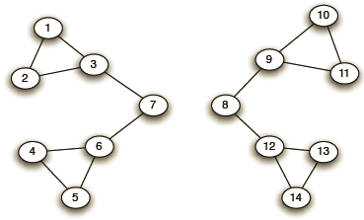
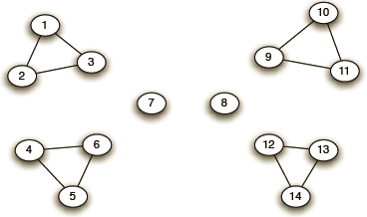
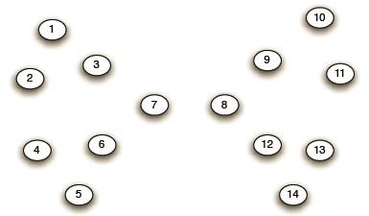
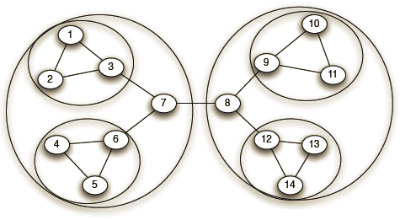
Girvan-Newman: Example
Step 1:
Step 2:
Step 3:
Hierarchical network decomposition:

Slide 29
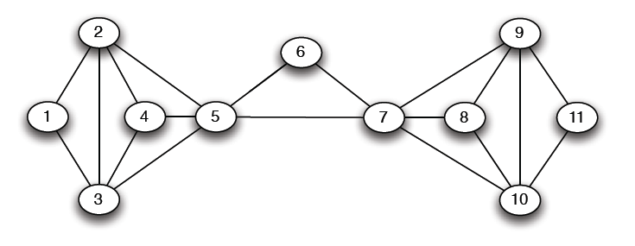
Another example
5X5=25
If we break the edge b/w 5 and 7 then we won’t be getting partitions. This only happens when there are multiple paths b/w 2 communities. As we can see even if we remove the edge (5,7) still b/w left and right community there is another path as 5 – 6 – 7, so just breaking the edge 5—7 won’t partition the given graph into subgraphs.

Slide 30
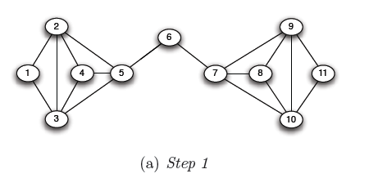
Another example
5X6=30
5X6=30

Slide 31
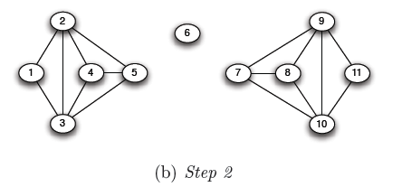
Another example

Slide 32
Computing Betweenness
Perform a Breadth-First-Search (BFS) starting from A
Determine the number of shortest path from A to each other node
Based on these numbers, determine the amount of flow from A to all other nodes that uses each edge

