Slide 1
Big Data Processing
Jiaul Paik
Lecture 14

Slide 2
Pagerank Analysing the Link Structure of the Web Iterative Algorithm in Spark
Web we can consider a very big graph; the webpages are the nodes and hyperlinks which are kind of directed edges

Slide 3
Introduction
Why is Page Importance Rating important?
New challenges for information retrieval on the World Wide Web. Its all about search engines , and it has already been challenging to extract the right info from web only based on content or keywords.
Huge number of web pages:
Diversity of web pages: different topics, different quality, etc. so we can’t have single strategy to deal with everything.
What is PageRank?
A method for rating the importance of web pages
It uses the link structure of the web. The nodes are the webpages and connections or hyperlinks are basically the edges from one page to another page.

Slide 4
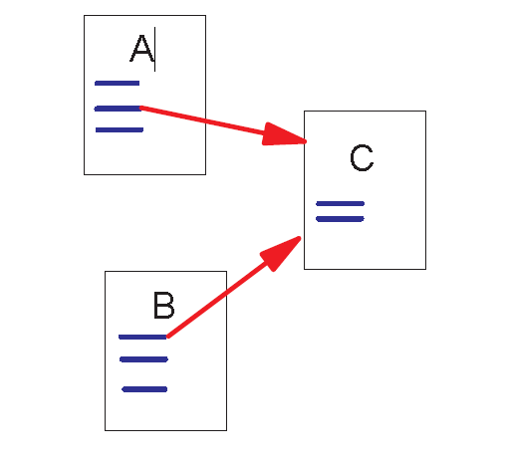
Link Structure of the Web
Backlinks and Forward links
A and B are C’s backlinks
C is A and B’s forward link
An arrow from A is pointing towards C and an arrow from B is pointing towards C so A and B are C’s Backlinks and C is Forward link of A and B
Intuitively, a webpage is important if
It has a lot of backlinks.
Importance of the page giving the backlink
what if the link is from www.google.com?
Two things to consider, the number of backlinks that u are getting and who is giving you the backlink.

Slide 5
A Simple Version of PageRank
backlink
$$R\left(u\right)=c \sum_{v∈B_{u}}{\frac{R\left(v\right)}{N_{v}}}$$
u
backlink
u: a web page
B_{u}: the set of u’s backlinks
N_{v}: the number of forward links of page v
c: the normalization factor
Page Rank Score of node ‘u’
= c * summation of (page rank score of node ‘v’ / num of forward links of node ‘v’ )
Where summation is over all nodes ‘v’ which are giving backlinks to ‘u’

Slide 6
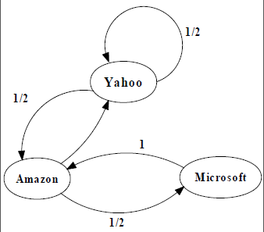
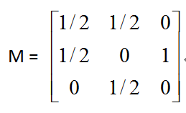
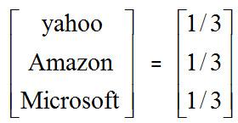
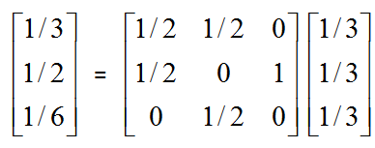
An example of Simplified PageRank
The numbers just beside the link represent the transition probability.
Going from Yahoo to Yahoo has the conditional probability
= ½
From Amazon we have 2 outlinks, so we divide it as ½ and ½
Microsoft just has 1 outlink pointing to Amazon.Once we are in Microsoft there is just one way to come out of Microsoft that is via a single outlink.
Once we have such a graph then we need to come up with
Transitional probability matrix.
Transitional Probability matrix is column wise, if we take summation of all elements lying along one particular column then it would sum up to 1. We want to figure out page rank score for Yahoo, Amazon and Microsoft.
This is Transitional Probability matrix which is column wise
1/2
Initially since we don’t have page rank values we will initialize values to be 1/3, 1/3 , 1/3
Idea behind initial guess :
Since we have 3 webpages in the webgraph, assuming total page rank score value = 1, so for 3 webpages we can uniformly distribute the page rank score, so after uniform distribution of page rank score to all the 3 pages we get the initial value of page rank score as 1/3 for each of the webpages.
PageRank Calculation: first iteration

Slide 7
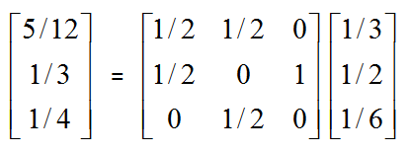
An example of Simplified PageRank
PageRank Calculation: second iteration

Slide 8
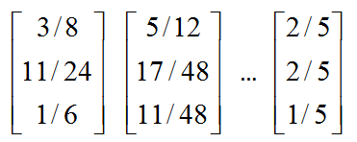
An example of Simplified PageRank
Convergence Criteria :
1> We run the iterative algorithm of page rank for a fixed number of epochs
2> R_(t+1) – R_t <= epsilon
where epsilon = 10^ (-6)
Convergence after some iterations

Slide 9
A Problem with Simplified PageRank: Loop issue
In simplified page rank the problem is
Just the self loop.
Self Loop is like if we follow a link structure then after some steps we land back to initial nodes.
Since this is an iterative algorithm the element serving as starting node of the loop will have rank scores accumulated
But, rank scores don’t get distributed to other pages.
During each iteration, the loop accumulates rank but does not distributes the rank to other pages!

Slide 10
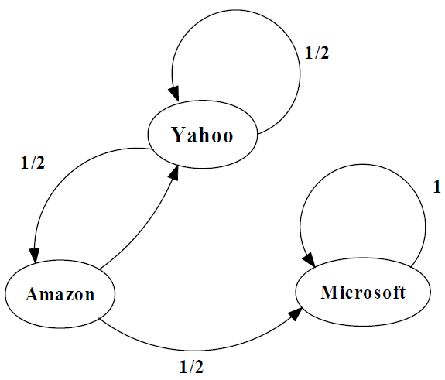
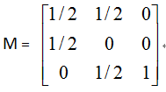
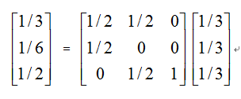
An example of the Problem

Slide 11
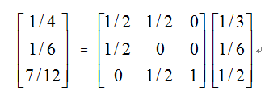
An example of the Problem

Slide 12
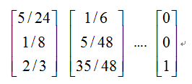
An example of the Problem
The page Microsoft has very high page rank score and other pages would get
0 scores simplify.

Slide 13
Random Walks in Graphs
The original model was we keep clicking on successive edges at random.
The Random Surfer Model
Simply keeps clicking successive links at random
The Modified Model
The “random surfer” simply keeps clicking successive links at random
But periodically “gets bored”
And jumps to a random page based on the distribution of E

Slide 14
The Random Surfer Model and Modified Model describe how a user (“surfer”) moves through a network of webpages, which is very important to understand algorithms like Google’s Page Rank.
Random Surfer Model :
Imagine a person/surfer who is randomly clicking links on the internet. They move from one page to another page purely at random without any preferences. There is no stopping condition or external influence, the surfer keeps clicking the links indefinitely. This Random Surfer model helps to analyse the structure of webpages but doesn’t capture the human behavior fully.
Modified Model :
In reality, users don’t keep clicking on links indefinitely; they sometimes get bored and click on a completely different page.
The user follows the successive links randomly most of the times but sometimes they stop following successive links and jump to a new page based on specific probability distribution.
This modification makes the model more realistic and helps the page rank algorithm to rank the pages more accurately.

Slide 15
Modified Version of PageRank
$$R\left(u\right)=c_{1} \sum_{v∈B_{u}}{\frac{R\left(u\right)}{N_{v}} +c_{2} E\left(u\right)}$$
a distribution of ranks of web pages that “users” jump to when they “gets bored” after clicking successive links at random.
E(u) is same for all pages typically depends on number of pages in the web graph.

Slide 16

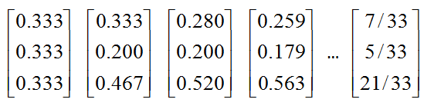
An example of Modified PageRank

Slide 17
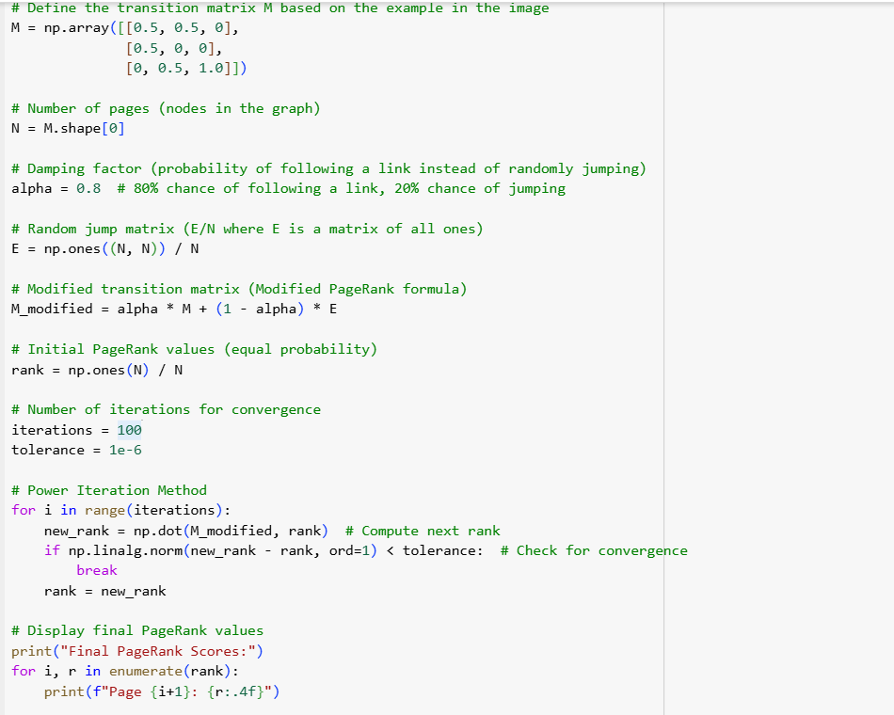
The transition matrix has been defined from the given graph, the transition matrix is column-wise i.e. if we sum the elements of a particular column, then those elements should sum up to 1.
alpha here is ‘c1’ which is probability of following the successive links randomly without any preference and without getting bored.
Note : c1 = alpha and c2 = (1-alpha)
So c1 + c2 = 1
E(u) = probability distribution of ranks of web pages that user / “surfer” jumps to when he gets bored after clicking on successive links at random. Now, when the user gets bored then he can jump to any of the pages, so landing on any of the webpages is equally probable.
So, E(u) = 1/(number of webpages)

Slide 18
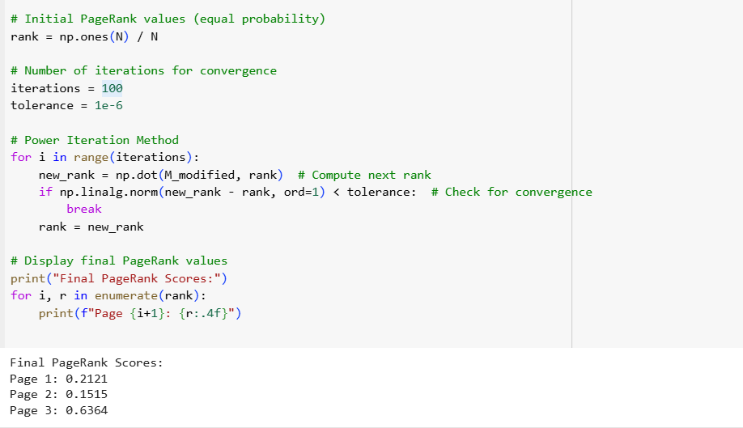
The summation of page rank scores for all the webpages is = 1
So, for initial guess of page rank scores we would be uniformly dividing the total value of “1” to all the webpages,
so the initial page rank score for each webpage will be = 1/(# of webpages)

Slide 19
PageRank in Spark

Slide 20


Slide 21
Pagerank in Spark: Steps
Part 1: Reading and storing data
Part 2: Populating the Initial pagerank values
Part 3: Looping
Calculating Contributions from individual pages
Re-calculating Ranks by aggregation

Slide 22
Data Format
From
page page
To
A B
B C
A D
D E

Slide 23
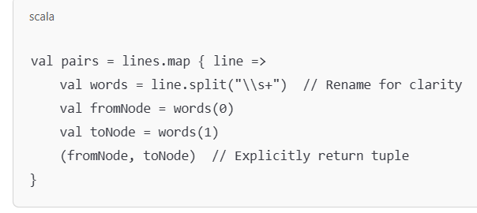
Reading and Storing data
// read file disk
val lines = sc.textFile(inputFile)
// create paired rdd (from node and to node)
val pairs = lines.map { s =>
val parts = s.split("\\s+")
(parts(0), parts(1))
}
// create adjacency list and store in memory
val links = pairs.distinct().groupByKey().cache()

Slide 24
“lines” RDD : each element is a single string
"A B"
"A C"
“A D "
“D E“
Inside .map :: s.split(\\s+) is basically converting each string into an array (parts)
.map function returns the tuple (parts(0),parts(1))
val pairs looks like :
("A", "B")
("A", "C")
("B", "C")
("C", "A")
val links = pairs.distinct().groupByKey().cache()
Here, pairs.distinct() will basically remove the duplicate edges from the RDD : pairs
groupByKey() will basically create the adjacency list for each element.
.cache() will store the adjacency list in memory to avoid recomputing it multiple times
Before distinct() (duplicates are present) : :
(A, B)
(A, C)
(A, B) // Duplicate
(B, C)
After distinct() ::
(A, B)
(A, C)
(B, C)
groupByKey() will create the adjacency list ::
Input: (A, B), (A, C), (B, C)
Output: (A -> [B, C]), (B -> [C])

Slide 25
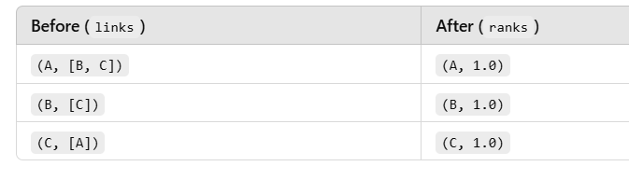
Initialize the pagerank score
// set pagerank values to 1.0 for all pages
var ranks = links.mapValues(v => 1.0)
“var” ranks is an RDD which can be reassigned in pageRank iterations.
“links” is an adjacency list and “mapValues” will apply transformations only to values in “links”, keeping the keys unchanged.
We initialize each node’s page rank to 1.0

Slide 26
Looping to re-calculate pagerank scores
for (i <- 1 to numIters) {
val joinedRDD = links.join(ranks)
val adjRankRDD = joinedRDD.values
// normalize
val indNormScore = adjRankRDD.flatMap{ case (urls, rank) =>
val size = url.size
urls.map(urls => (url, rank / size)) // the ranks are normalized
}
ranks = indNormScore.reduceByKey(_ + _).mapValues((1-p) + p * _) // ranks RDD
}

Slide 27
val joinedRDD = links.join(ranks) => this performs an internal join operation
joinedRDD looks like ::
(A, ([B, C], 1.0))
(B, ([C], 1.0))
(C, ([A], 1.0))
Next, we have
adjRankRDD = joinedRDD.values() : removes the node key and only keeps outgoing links and rank
adjRankRDD looks like ::
([B, C], 1.0)
([C], 1.0)
([A], 1.0)
\\ Normalizing ranks::
val indNormScore = adjRankRDD.flatMap {case(urls,rank) => val size = urls.size() urls.map(url => (url,rank/size))} //we distribute the rank equally to all the forward links of the particular node
indNormScore looks like :
(B, 0.5)
(C, 0.5)
(C, 1.0)
(A, 1.0)
ranks = indNormScore.reduceByKey(_+_).mapValues((1-p) + p*_)
After reduceByKey we have :
(B, 0.5)
(C, 1.5)
(A, 1.0)
.mapValues only transforms the values of the RDD without changing the keys , ‘p’ is a damping factor usually 0.85.

Slide 28
B = (1 - 0.85) + 0.85 * 0.5 = 0.15 + 0.425 = 0.575
C = (1 - 0.85) + 0.85 * 1.5 = 0.15 + 1.275 = 1.425
A = (1 - 0.85) + 0.85 * 1.0 = 0.15 + 0.85 = 1.0
Final RDD after mapValues::
(B, 0.575)
(C, 1.425)
(A, 1.0)

Slide 29
Pagerank in Spark: How it works
ranks
joinedRDD
adjRankRDD
indNormScore
ranks
4 | 1
3 | 1
2 | 1
1 | 1
4 | (3,1), 1
3 | (2,1), 1
2 | 1,1
1 | 4,1
(3,1), 1
(2,1), 1
1,1
4,1
3 | 0.5
1 | 0.5
1 | 1.0
2 | 0.5
1 | 0.5
4 | 1.0
values
flatmap
3 | 0.5
1 | 2.0
2 | 0.5
4 | 1.0
4 | 1.0
3 | 0.57
2 | 0.57
1 | 1.85
join
mapValues
itr
1
reduceByKey
links
4 | (3,1)
3 | (2,1)
2 | 1
1 | 4
for (i <- 1 to numIters) {
val joinedRDD = links.join(ranks)
val adjRankRDD = joinedRDD.values
// normalize
val indNormScore = adjRankRDD.flatMap{ case (urls, rank) =>
val size = url.size
urls.map(urls => (url, rank / size))
}
// final ranks
val ranks = indNormScore.reduceByKey(_ + _).mapValues((1-p) + p * _)
}
join
4 | (3,1), 1
3 | (2,1), 0.57
2 | 1,0.57
1 | 4,1.85
itr
2
……
For iteration 2 we again create a joinedRDD as : links.join(ranks)
And since the adjacency list ‘links’ was in memory .cache so we can directly do it easily

Slide 30
Thank you!

