Slide 1
Big Data Processing
Jiaul Paik
Lecture 9

Slide 2
Map-reduce Algorithm Design
Combiner
Fast Big Data Processing with Spark

Slide 3
Use of Combiner

Slide 4
Role of combiner
Combiners are mini-reducers
Reduces data from mappers before they are shuffled through the network

Slide 5
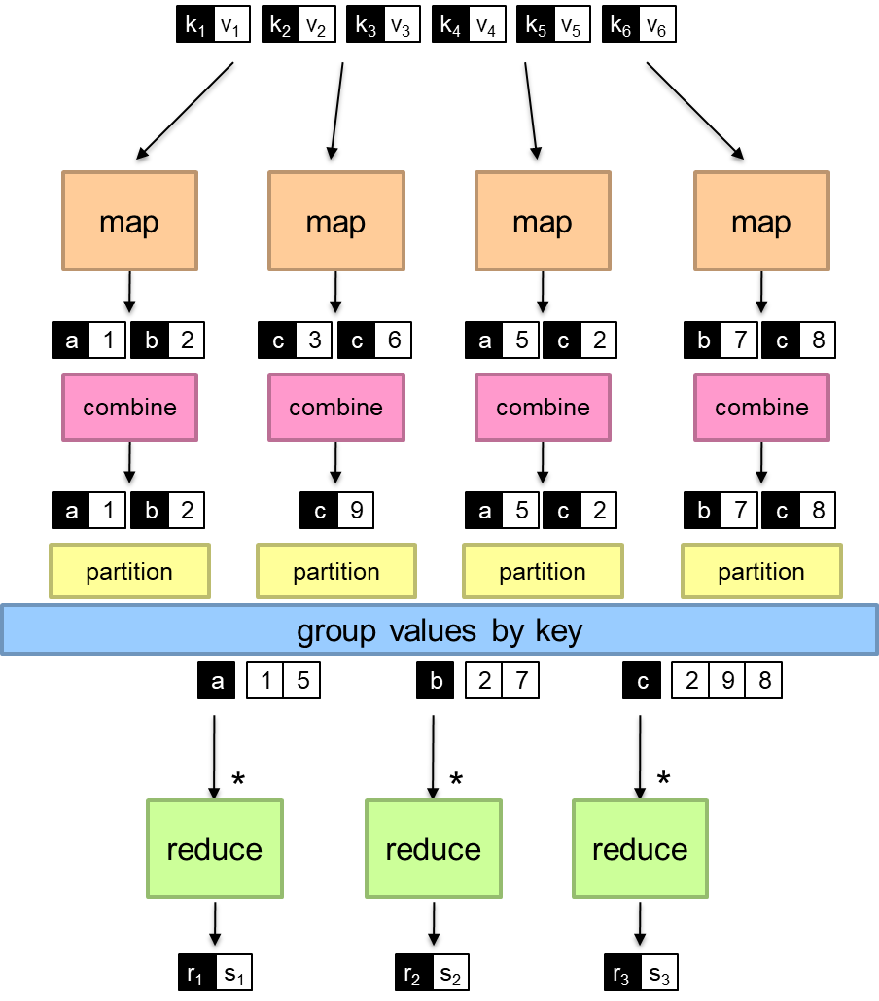
Splitting job
Intermediate combining
Final combining

Slide 6
Problem: Computing Mean
A shop has a database which contains the customer names and the time spent by the customer in the shop in each visit. Find the average time spent by each customer in the shop.
Name | Time spent on each visit
amar | 10
amar | 20
rakesh | 15
rakesh | 25
sanjib | 7
rakesh | 25
amar | 30
sony | 20
jiban | 15

Slide 7
Combiner: Warning!
class Combiner
method Combine(string t; integers [r1; r2; : : :])
sum = 0
count = 0
for all integer r in integers [r1; r2; : : :] do
sum = sum + r
count = count + 1
Emit(string t; pair (sum, count))
class Mapper
method Map(string t; integer r)
Emit(string t; integer r)
We need to pass (t,(r,1)) coz we also need to know how many times he is visiting as well.
Combiners are mini reducers and Hadoop framework may or may not execute the combiner so if combiner is skipped the reducer will directly get mapper’s o/p and hence input to reducer should be same irrespective of fact combiner is used or not hence combiners o/p must match with mappers o/p.
class Reducer
method Reduce(string t; pairs [(s1; c1); (s2; c2) : : :])
sum = 0
count = 0
for all pair (s; c) in pairs [(s1; c1); (s2; c2) : : :] do
sum = sum + s
count = count + c
avg = sum/count
Emit(string t; integer avg)
Combiner output must match with mapper output

Slide 8
Computing mean: Use of combiner
class Reducer
method Reduce(string t; pairs [(s1; c1); (s2; c2) : : :])
sum = 0
count = 0
for all pair (s; c) in pairs [(s1; c1); (s2; c2) : : :] do
sum = sum + s
count = count + c
avg = sum/count
Emit(string t; integer avg)
class Mapper
method Map(string t; integer r)
Emit(string t; pair (r, 1))
class Combiner
method Combine(string t; pairs [(s1; c1); (s2; c2) : : :])
sum = 0
count = 0
for all pair (s; c) in pairs [(s1; c1); (s2; c2) : : :] do
sum = sum + s
count = count + c
Emit(string t; pair (sum, count))

Slide 9
Spark Fast Big Data Processing

Slide 10
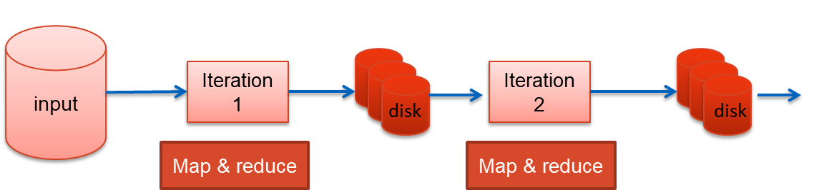
Iterative Algorithm in Map-reduce

Slide 11
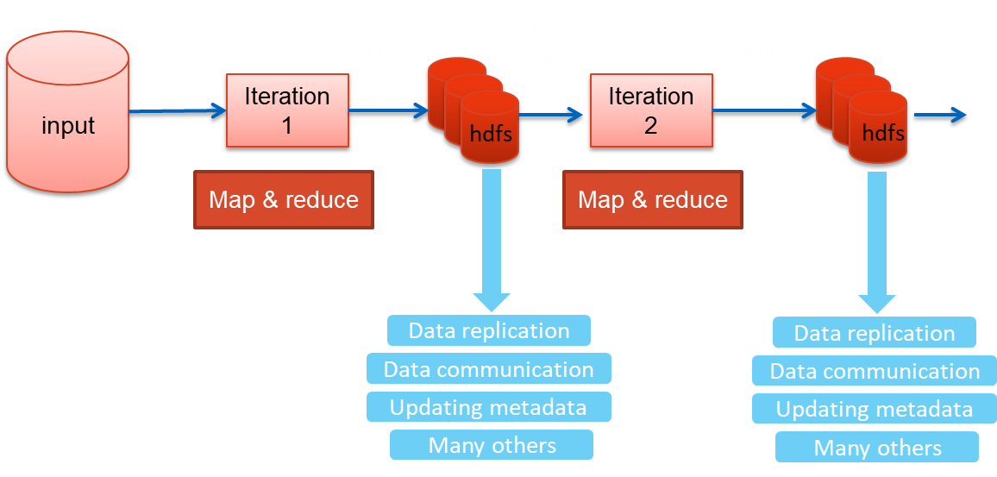
Iterative Algorithm in Map-reduce: Issues

Slide 12
Limitations of basic map-reduce
Good for one-pass computation
But inefficient for multi-pass algorithms
k-means, gradient descent
No efficient mechanism for data sharing. State b/w steps go to DFS. Slow due to replication, disk storage, 90% of doing I/O
Spark uses an in-memory distributed data structure to store the data that is repeatedly used
Read-only data structure (Fault tolerance)

Slide 13
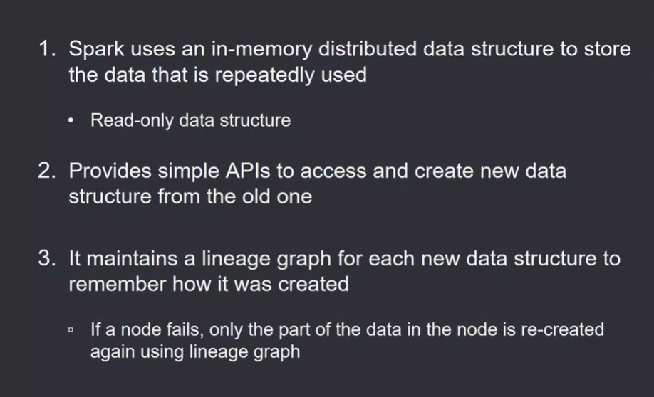

Slide 14
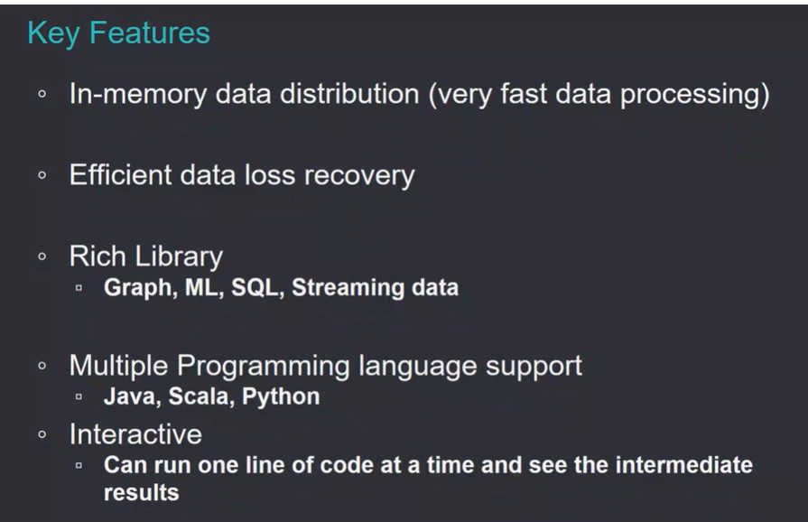

Slide 15
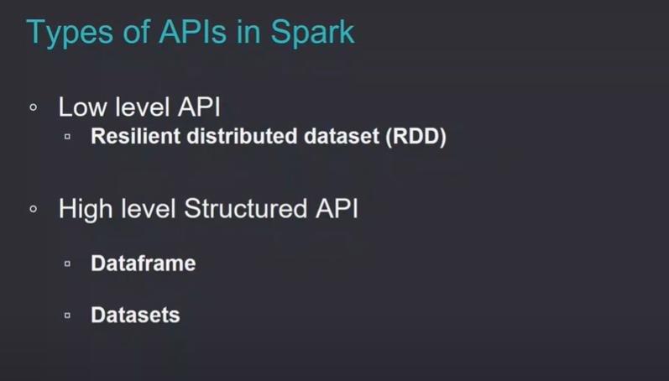
Low Level API : Highly flexible
High Level API : Nice Fixed structure, limited functionality / flexibility

Slide 16
Key Concept in Spark for Working with Data
Resilient Distributed Dataset (RDD)
Resilient: can re-compute missing or damaged partitions due to node failures
Distributed: data residing on multiple nodes in a cluster
Dataset: a collection of partitioned data with primitive values (e.g., int, string) or any user defined object (e.g., (word, count) pairs)
RDD of pairs
(word, count)
Distributed array of elements / objects sitting on different computers.
RDD of strings
am
am, 10
master
master, 5
natural
one element
natural, 7
student
student, 17

Slide 17
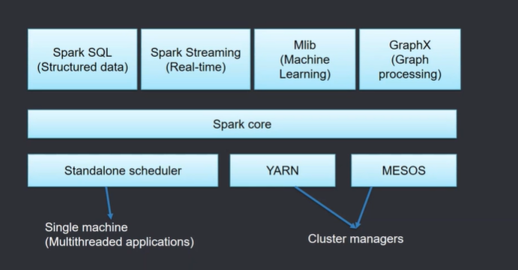
If we are running spark code in a single machine as in multithreaded applications then the manager is Standalone Scheduler.
If u run code on actual clusters then cluster manager is YARN or MESOS.
On top of cluster manager we have spark core , for RDD Manipulation etc. On top of spark core we have several libraries.

Slide 18
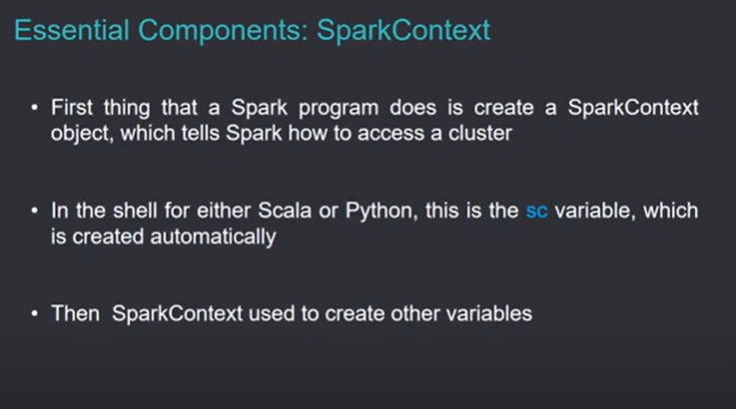

Slide 19
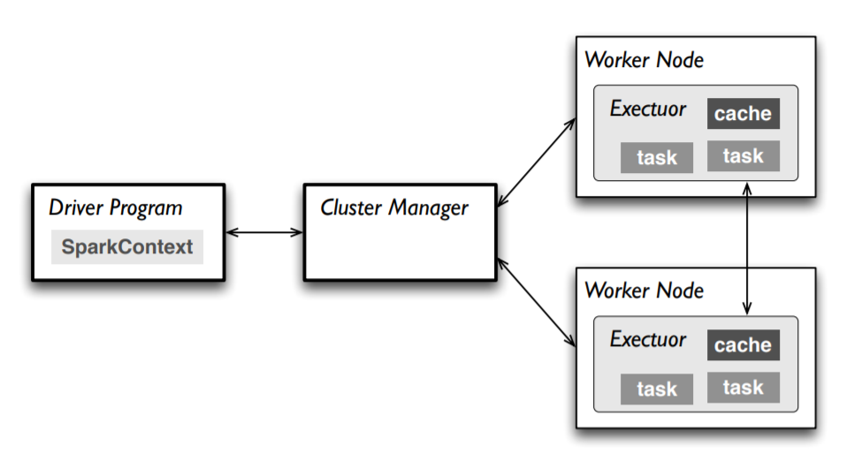
Master
Connects to a cluster manager that allocate resources across applications
Acquires executors on cluster nodes – worker processes to run computations and store data, master node will assign worker nodes to perform actual computation, executors are responsible for executing tasks and storing intermediate results
Send app code to the executors, Once executors are allocated, the Master node sends the Spark application (code) to them for execution.
Driver program is Spark Context which is starting point of the spark code, sc will interact with cluster manager then cluster manager will interact with worker nodes. Each worker node has its executor which will execute the task assigned, we have little bit of cache, and worker node can listen to each other, cluster manager will exchange things b/w nodes, and driver program can get to know things from cluster manager.
Spark context will kick off things for u.Thats known as driver program.

Slide 20
Main Steps of an RDD Processing
Create RDD from external data (from distributed file system or local file system)
Transform them to define new RDDs using transformations
map(), filter()
Store in memory any intermediate RDDs that will need to be reused.
persist()
Launch actions to kick off a parallel computation
count()

Slide 21
Main Steps of an RDD Processing
Create RDD from external data (from distributed file system or local file system) [ external data means data sitting in DFS or some file system]
Transform them to define new RDDs using transformations
map(), filter() [Do transform operations to define new rdds from old rdds,because u cant change an rdd so the only way to get changed things is create new rdd from old rdd]
Store in memory any intermediate RDDs that will need to be reused.
persist() [keep some part of data in distributed memory , the data can be reused multiple times ]
Launch actions to kick off a parallel computation
count() [ the real results which care about , Action operation will kick off parallel computation]

Slide 22
Creating an RDD
Two ways to do it
By loading an external dataset from disk
Parallelizing a collection in your driver (main) program
1> val is a qualifier like declaring a variable, rdd is a name here , sc is spark context which has lots of inbuilt functions. Sc.txtfile , func is txtfile which will read data from input file which is sitting in DFS or LFS ,and it will create a RDD.
val rdd = sc.textFile(“inputFile”)
2> To test our code. We are creating a list of 2 elements and u are parallelizing it to create an rdd.creating an rdd from an existing in memory collection.
val lines = sc.parallelize(List("pandas", "i like pandas"))
sc denotes the spark context that calls the spark core and manages the cluster
2> Instead of reading from a file or a database we are creating a small dataset (which is a list of 2 elements).This small dataset is then parallelized into an RDD using sc.parallelize(), allowing spark to process it in a distributed manner.

Slide 23
RDD Operations
Transformation operation means creating a new rdd from a old rdd, for intermediate processing .
But Action operations are ones which we really want to see results at the end of it.
Because spark follows policy of lazy evaluation. When we req for a transformation operation then spark will not execute it that time rather it will remember that it has to do those operations.
When u are typing an action operation then only it will go an kick off operations for you.
Becoz if after seeing a transformation operation u start doing things then there would be lots of internal things which needs to be managed and if something goes wrong then u need to do things again from scratch.
Two types of Operations
Transformations
Example: map(), filter()
Actions
Example: count(), saveAsTextFile()

Slide 24
RDD Operations
Transformations
Transformations create a new dataset from an existing one
All transformations in Spark are lazy:
they do not compute their results right away
they remember the transformations applied to some base dataset
the transformed RDD gets recomputed when an action is run on it
Optimizes the required calculations
Recover from the lost data partitions

Slide 25
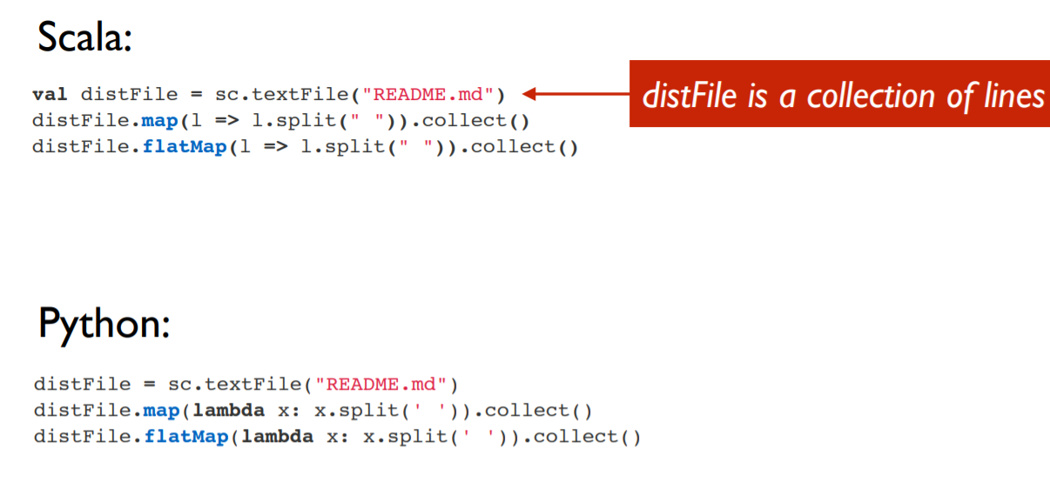
Transformations: Examples
Read file line by line from README.md and create an rdd named distFile
Apply map operation on it.it is taking one line and splitting that line based on blank spaces (“ “) and it is collecting it.
Map is one to one func and flatmap is one to many func.
These all are transformation operation nd not action operation

Slide 26
Assume Readme.md has ::
Hello Spark
Welcome to Big Data
Line 1: "Hello Spark".split(" ") → Array("Hello", "Spark")
Line 2: "Welcome to Big Data".split(" ") → Array("Welcome", "to", "Big", "Data")
Final o/p of map operation :
Array(Array("Hello", "Spark"), Array("Welcome", "to", "Big", "Data"))
.collect() : basically retrieves all the results
flatMap() operation basically flattens the o/p as ::
Array("Hello", "Spark", "Welcome", "to", "Big", "Data")
Map() operation returns rdd of arrays and FlatMap() operation returns rdd of elements.
.collect() is an action operation in spark, because it forces the computations to get executed and it retrieves the results and return it to the Driver Program.

Slide 27
RDD Operations
Actions
Operations that return a result
It kicks off a computation
This is when transformations of RDDs are applied

Slide 28
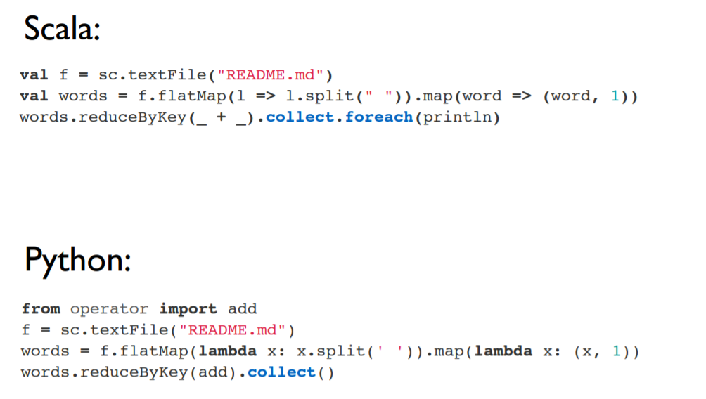
Actions: Examples
f is an rdd which is holding the elements like lines.one line is one element.for each element u have to produce words, flatmap will take one line as one element and it will split the line into words separated by blank spaces and each of the words will be sent to map function which will map each of the words to a pair (word,1). Then u are reducing by key , like add the freq count of each word and it will collect and print.
1st line is creation, 2nd line is transformation operation and 3rd line is action operation.
.flatMap(), .map() and .reduceByKey( _ + _ ) : transformation operation
.collect() , .show() and .foreach(println) : these are action operations

Slide 29
Anatomy of an RDD Operation
newRDD = oldRDD.map(….)
creates new RDD from old RDD
and saves in newRDD
User defined code/function

Slide 30
Lazy Evaluation
Spark does not immediately perform an operation
It simply remembers it
Uses a flow graph for memorizing
It kicks off computation if an action operation is requested

Slide 31
An Example Code
data.txt
-------------
I am here
She is there
You are here
val lines = sc.textFile("data.txt")
val lineLengths = lines.map(s => s.length)
val totalLength = lineLengths.reduce((a, b) => a + b)
action
Sum of length of lines in the file data.txt

Slide 32
RDD Persistence
Spark can persist or cache a dataset in memory across operations. In each node of the cluster u have some slice of data, and u can put that slice of data in memory of that node, so that whenever reqd u can quickly use it
This is fault tolerant. If a machine holding some data fails then ur spark knows how that data was created and hence it can recreate the lost data by consulting the lineage graph.

Slide 33
RDD Persistence
Spark can persist (or cache) a dataset in memory across operations
Each node stores in memory any slices of it that it computes and reuses them in other actions on that dataset
often making future actions more than 10x faster
The cache is fault-tolerant:
if any partition of an RDD is lost, it will automatically be recomputed using the transformations that originally created it

Slide 34
Persistence (Caching)
Goal is to keep RDD in memory, distributed across machines
Important for iterative computation to increase efficiency. The goal is for iterative computation we want to increase the efficiency. So, we want to keep the data in memory instead of hard disk. But depending on volume of data and capacity of clusters we may not have that much of space to keep everything in main memory .But spark gives lots of flexibility at storage levels.
Storage Level | Description
MEMORY_ONLY | Stores RDD in memory
MEMORY_AND_DISK | Store RDD in memory. If RDD does not fit in memory, store the partitions that don't fit on disk, and read them from there when they're needed.
DISK_ONLY | Store the RDD partitions only on disk.
MEMORY_ONLY_2, MEMORY_AND_DISK_2 | Same as the levels above, but replicate each partition on two cluster nodes. Data will be replicated in memory twice similarly for 2nd one data will be replicated in memory and disk twice TO enhance the fault tolerance
Usage: yourRdd.MEMORY_ONLY

Slide 35
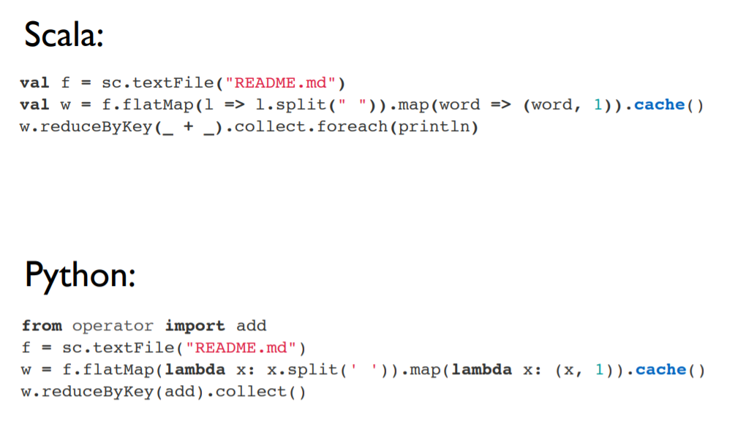
RDD Persistence: Example
We have sequence of operations, flatMap operation on rdd named ‘f’. Then output of it being fed to map func and map’s output to cache().This is other way of telling I want to keep it in memory.

Slide 36
Distributed Execution of RDD

Slide 37
Example
Error log mining
Search for various patterns in an error log.
Log file
======
ERROR: java lang.io problem
ERROR: insufficient memory
ERROR: array out of bound

Slide 38
Example
Error log mining
Search for various patterns in an error log.
// load data from file
val lines = sc.textFile("hdfs://...")
// apply transformations
val errors = lines.filter(_.startsWith(“ERROR"))
val messages = errors.map(_.split("\t")).map(r => r(1))
messages.cache()
// perform action 1
messages.filter(_.contains(“java")).count()
// perform action 1
messages.filter(_.contains(“memory")).count()

Slide 39
Example
Error log mining
Search for various patterns in an error log.
worker
// load data from file
val lines = sc.textFile("hdfs://...")
// apply transformations
val errors = lines.filter(_.startsWith(“ERROR"))
val messages = errors.map(_.split("\t")).map(r => r(1))
messages.cache()
// perform action 1
messages.filter(_.contains(“java")).count()
// perform action 2
messages.filter(_.contains(“memory")).count()
driver
worker
worker

Slide 40
RDD Operator Graph
// load data from file
val lines = sc.textFile("hdfs://...")
// apply transformations
val errors = lines.filter(_.startsWith(“ERROR"))
val messages = errors.map(_.split("\t")).map(r => r(1))
messages.cache()
HadoopRDD
FilteredRDD
MappedRDD
MappedRDD

Slide 41
Example
worker
// load data from file
val lines = sc.textFile("hdfs://...")
// apply transformations
val errors = lines.filter(_.startsWith(“ERROR"))
val messages = errors.map(_.split("\t")).map(r => r(1))
messages.cache()
// perform action 1
messages.filter(_.contains(“java")).count()
// perform action 2
messages.filter(_.contains(“memory")).count()
worker
driver
worker

Slide 42
Example
Worker
block 1
// load data from file
val lines = sc.textFile("hdfs://...")
// apply transformations
val errors = lines.filter(_.startsWith(“ERROR"))
val messages = errors.map(_.split("\t")).map(r => r(1))
messages.cache()
// perform action 1
messages.filter(_.contains(“java")).count()
// perform action 2
messages.filter(_.contains(“memory")).count()
Worker
block 2
driver
Worker
block 3

Slide 43
Example
Worker
block 1
// load data from file
val lines = sc.textFile("hdfs://...")
// apply transformations
val errors = lines.filter(_.startsWith(“ERROR"))
val messages = errors.map(_.split("\t")).map(r => r(1))
messages.cache()
// perform action 1
messages.filter(_.contains(“java")).count()
// perform action 2
messages.filter(_.contains(“memory")).count()
Read
hdfs block
Worker
block 2
Read
hdfs block
driver
Worker
block 3
Read
hdfs block

Slide 44
Example
Cache 1
Worker
block 1
// load data from file
val lines = sc.textFile("hdfs://...")
// apply transformations
val errors = lines.filter(_.startsWith(“ERROR"))
val messages = errors.map(_.split("\t")).map(r => r(1))
messages.cache()
// perform action 1
messages.filter(_.contains(“java")).count()
// perform action 2
messages.filter(_.contains(“memory")).count()
Process,
Cache data
Cache 2
driver
Worker
block 2
Process,
Cache data
Cache 3
Worker
block 3
Process,
Cache data

Slide 45
Example
Worker
block 1
// load data from file
val lines = sc.textFile("hdfs://...")
// apply transformations
val errors = lines.filter(_.startsWith(“ERROR"))
val messages = errors.map(_.split("\t")).map(r => r(1))
messages.cache()
// perform action 1
messages.filter(_.contains(“java")).count()
// perform action 2
messages.filter(_.contains(“memory")).count()
Cache 1
driver
Worker
block 2
Cache 2
Worker
block 3
Cache 3

Slide 46
Example
Worker
block 1
Cache 1
// load data from file
val lines = sc.textFile("hdfs://...")
// apply transformations
val errors = lines.filter(_.startsWith(“ERROR"))
val messages = errors.map(_.split("\t")).map(r => r(1))
messages.cache()
// perform action 1
messages.filter(_.contains(“java")).count()
// perform action 2
messages.filter(_.contains(“memory")).count()
driver
Worker
block 2
Cache 2
Worker
block 3
Cache 3

Slide 47
Example
Cache 1
Worker
block 1
Process from cache
// load data from file
val lines = sc.textFile("hdfs://...")
// apply transformations
val errors = lines.filter(_.startsWith(“ERROR"))
val messages = errors.map(_.split("\t")).map(r => r(1))
messages.cache()
// perform action 1
messages.filter(_.contains(“java")).count()
// perform action 2
messages.filter(_.contains(“memory")).count()
Cache 2
driver
Worker
block 2
Process from cache
Cache 3
Worker
block 3
Process from cache

Slide 48
RDD Operations: Examples

Slide 49
Example of Basic RDD Transformations: Single RDD (operations which are going to be performed on single rdd)
RDD containing {1,2,3,3}
Function | Description | Example | Result
map() | Apply a function to each element in the RDD and return an RDD of the result | rdd.map(x => x + 1) | {2, 3, 4, 4}
flatMap() | Apply a function to each element in the RDD and return an RDD of the contents of the iterators returned. | rdd.flatMap(x => x.to(3)) | {1, 2, 3, 2, 3, 3, 3}
filter | Return an RDD consisting of only elements that pass the condition passed to filter(). | rdd.filter(x => x != 1) | {2, 3, 3}
distinct | Remove duplicates. | rdd.distinct() | {1, 2, 3}
sample(withRe placement, frac tion, [seed]) | Sample an RDD, with or without replacement. | rdd.sample(false, 0.5) | Nondeterministic

Slide 50
Example of Basic RDD Actions
RDD containing {1, 2, 3, 3}
Function | Description | Example | Result
collect() | Return all elements from the RDD. | rdd.collect() | {1, 2, 3, 3}
count() | Number of elements in the RDD. | rdd.count() | 4
top() | Return the top num elements the RDD. | rdd.top(2) | {3, 3}
countByValue() | Number of times each element occurs in the RDD. | rdd.countByValue() | {(1, 1), (2, 1), (3, 2)}
reduce() | Combine the elements of the RDD together in parallel (e.g., sum). | rdd.reduce((x, y) => x + y) | 9

Slide 51
Example of Basic RDD Transformations: Two RDD
Two-RDD transformations on RDDs containing {1, 2, 3} and {3, 4, 5}
One rdd.operation_name(other_rdd)
Function | Description | Example | Result
union() | Produce an RDD containing elements from both RDDs. | rdd.union(other) | {1, 2, 3, 3, 4, 5}
intersection() | Common elements | rdd.intersection(other) | {3}
subtract() | Remove the contents of one RDD | rdd.subtract(other) | {1, 2}
Cartesian() | Cartesian product with the other RDD. | rdd.cartesian(other) | {(1,3), (1,4), …}

Slide 52
Paired RDD: Transformations
RDD containing key-value pairs
The fundamental concept behind original map-reduce model
Transformations on one paired RDD containing {(1, 2), (3, 4), (3, 6)} each element has 2 parts , one part is key and other part is value.
Function | Description | Example | Result
reduceByKey(func) | Combine values with the same key. | rdd.reduceByKey( (x, y) => x + y) | {(1,2), (3,10)}
groupByKey() | Group values with the same key. | rdd.groupByKey() | {(1,[2]),(3, [4,6])}
mapValues(func) | Apply a function to each value of a pair RDD without changing the key. | rdd.mapValues(x => x+1) | {(1,3), (3,5), (3,7)}
keys() | Return an RDD of just the keys. | rdd.keys() | {1, 3,3}
values() | Return an RDD of just the values. | rdd.values() | {2, 4,6}
sortByKey() | Return an RDD sorted by the key. | rdd.sortByKey() | {(1,2), (3,4), (3,6)}

Slide 53
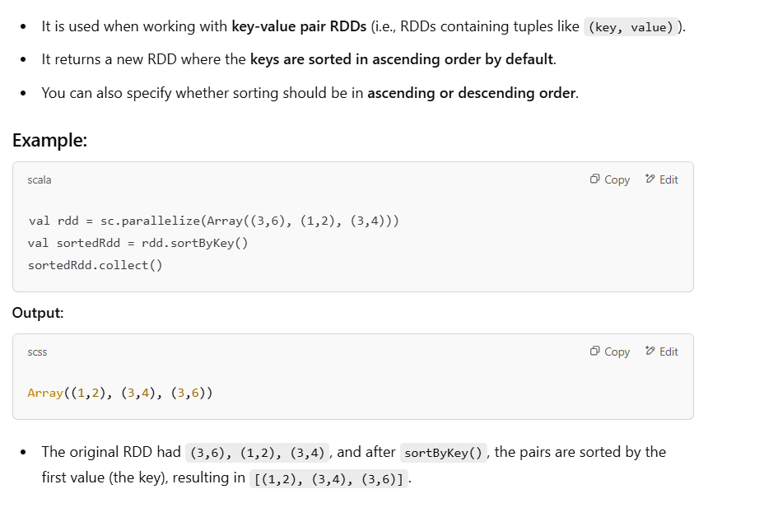

Slide 54
Paired RDD: Actions
RDD containing {(1, 2), (3, 4), (3, 6)}
Function | Description | Example | Result
countByKey() | Count the number of elements for each key. | rdd.countByKey() | {(1, 1), (3, 2)}
lookup(key) | Return all values associated with the provided key. | rdd.lookup(3) | {4,6}

Slide 55
Two Paired RDD: Transformations
Transformations on two paired RDDs: (rdd = {(1, 2), (3, 4), (3, 6)}, other = {(3, 9)})
Function | Description | Example | Result
join | Perform an inner join between two RDDs. | rdd.join(other) | {(3, (4, 9)), (3, (6, 9))}
cogroup | Group data from both RDDs sharing the same key. | rdd.cogroup(other) | {(1,([2],[])), (3, ([4, 6],[9]))}

