Slide 1
Big Data Processing
Jiaul Paik
Lecture 3

Slide 2

Parallel Processing for Big Data
BIG DATA
1. Split data into small chunks
2. Send different chunks to
different workers
3. Collect the results from
different workers and combine

Slide 3
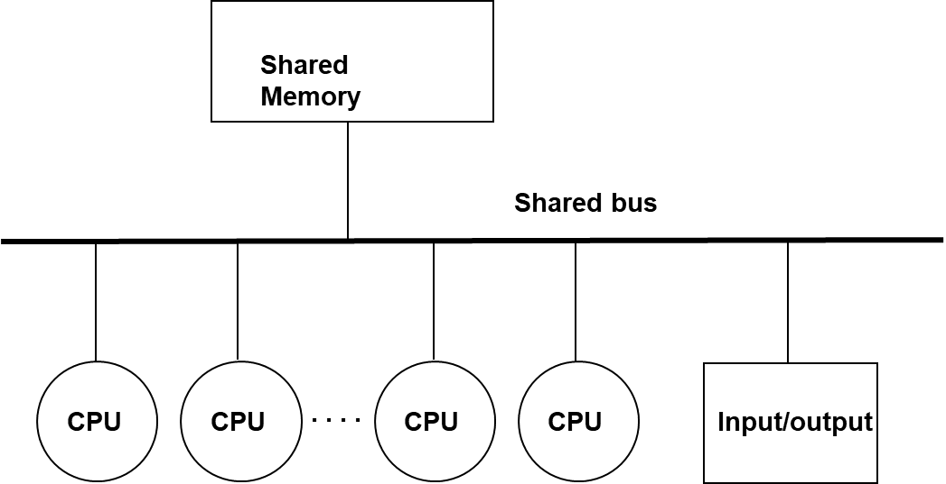
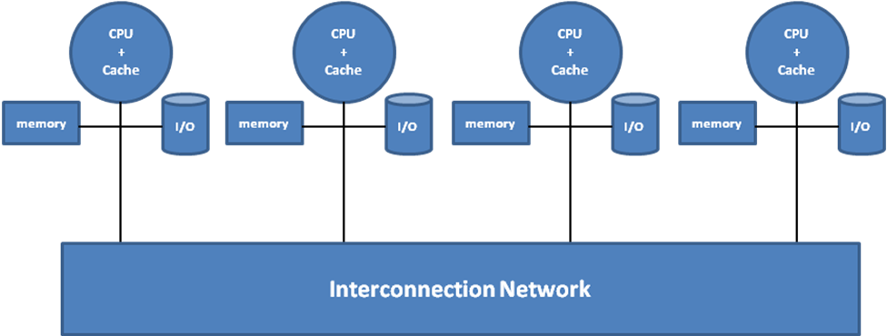

Parallel Programming
Cluster
Multi-processor
Distributed programming
Multi-threaded programming

Slide 4
Multithreaded Programming

Slide 5
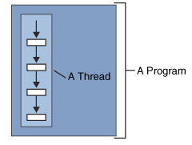
What is a thread?
A thread is a single sequential flow of control within a program
A thread can’t run on its own
It must run within a program

Slide 6
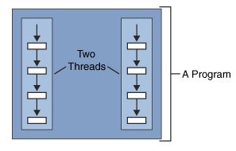
What is multithreading?
Multiple threads running at the same time and performing different tasks in a single program

Slide 7
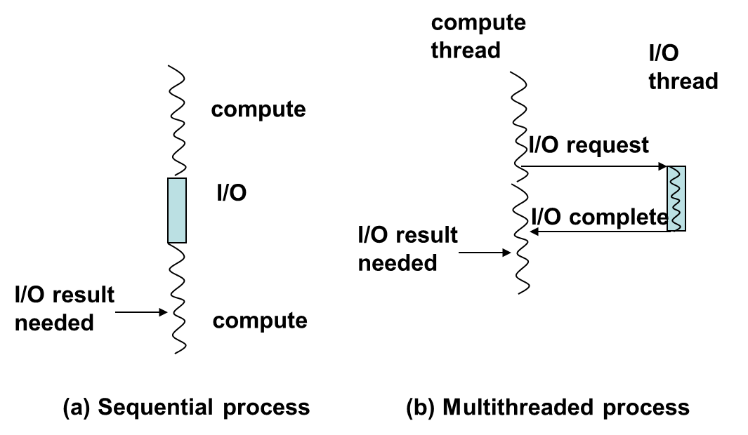
Why Multithreading?
Better, more modular way of solving a problem
Separate computation from I/O
Take advantage of multiprocessors
The term modular refers to a design principle where a system or problem is divided into smaller, self-contained, and independent units (called modules) that can work together to perform the overall task. Each module is designed to handle a specific functionality or task.

Slide 8
Multiprocessors
Shared Memory
Shared bus
CPU
CPU
. . . .
CPU
CPU
Input/output
Threads of same process have identical views of memory hierarchy despite being on different physical processors.

Slide 9
Programming support for threads
Threads as a programming abstraction.
Major operations
dynamically create threads
communicate among threads
synchronize activities of threads (If you don’t synchronize then I may be ending up changing some variable in a bad way which will dismantle the whole computation).
terminate threads

Slide 10
Thread creation and termination
A thread executes some portion of a program
Just like a program, it has an entry point where it begins execution
The entry point is defined as the address of some function

Slide 11
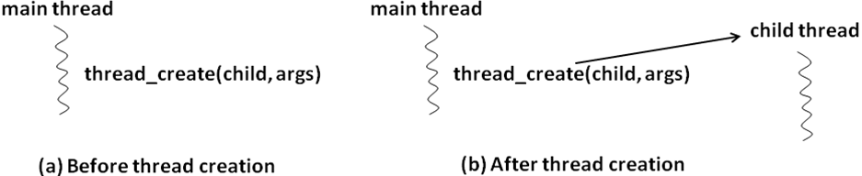
Thread creation and termination
tid_t thread_create (top-level procedure, args);
[you can create a thread by using thread_create command and it returns something called thread_id or tid_t] The top-level procedure refers to the function that will be executed by the newly created thread. This function defines the starting point of execution for the child thread.
Inside main thread you basically write the command to create a thread.
After the thread create command executes a new branch comes out which is called child_thread. You always create a
Thread from some main thread and new branch starts executing sequence of instructions which you want.

Slide 12
Processes are Protected
Process
Process
Process
Process
Process

Slide 13
Multiple Threads Can Exist in a Single Process Space
Process
Thread
Process
Thread
Thread
Thread
Thread
Thread
Thread
Thread
Process
Process
Thread
Thread
Thread
Process
Thread

Slide 14
Thread creation and termination
Thread automatically terminates when it exits the top-level function it was created from
We can explicitly terminate a thread
thread_terminate (tid);
tid is the system-supplied identifier of the thread we wish to terminate.

Slide 15
Communication among threads
Threads share the same address space
sharing memory is simple
Appropriately qualified static variables can be visible to multiple threads

Slide 16
Data race and Non-determinism
Data Race:
A condition in which multiple concurrent threads are simultaneously trying to access a shared variable
and at least one threads trying to modify the shared variable.
What my threads will do will depend on this variable ‘flag’. Data race is a catastrophic condition in which all threads are racing for that particular piece of data.
int flag = 0; /* shared variable
initialized to zero */
Thread 1 Thread 2
while (flag == 0) { .
/* do nothing */ .
} .
if (flag == 0) flag = 1;
.
.

Slide 17
Data race and Non-determinism
int flag = 0; /* shared variable
initialized to zero */
Thread 1 Thread 2
while (flag == 0) { .
/* do nothing */ .
} .
if (flag == 0) flag = 1;
.
.
Here, flag is a shared variable by both the threads and the shared variable flag has been initialized to 0. Thread 1 continuously checks for the value of flag till it becomes non zero , if value of flag is 0 then it is stuck in infinite loop. But thread 2 is just reading the value of flag and if it is 0 at that time then T2 modifies it to 1. since there is no synchronization so the order of execution of read and write is unpredictable which results in NON DETERMINISM. But if T1 reads the value of flag to be 0 and at the same time Thread 2 modifies its value to be 1 then it can result in some unusual catastrophic result.

Slide 18
Data race and Non-determinism
int count = 0; /* shared variable initialized to zero */
Thread 1 (T1) Thread 2 (T2) Thread 3 (T3) Thread 4 (T4)
. . .
. . .
count++; count++; count++; printf(count)
. . . .
. . . .
What will it print will depend on order of execution of threads.

Slide 19
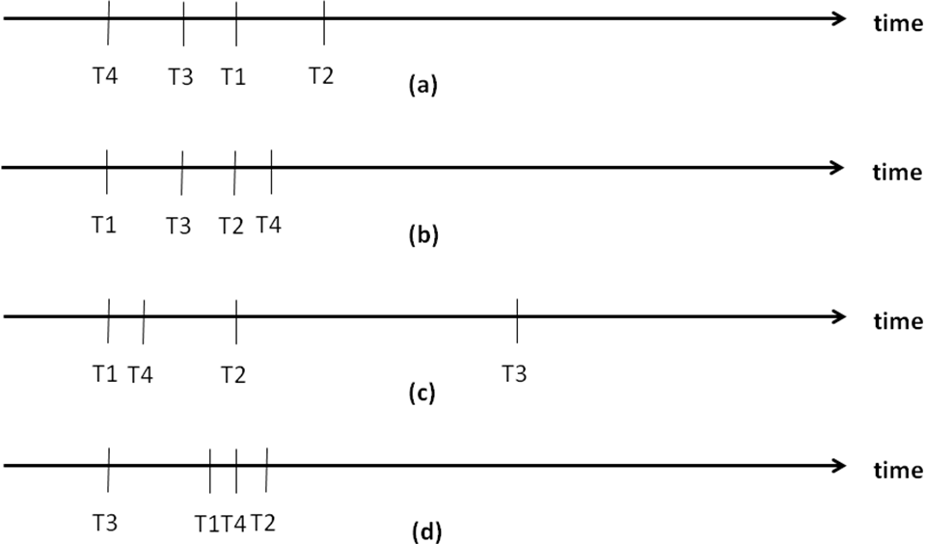
Data race and Non-determinism
We want deterministic output
Given an input no matter how many times I run the code the output should be same
Output depends on the order of execution
Non-deterministic!

Slide 20
Data race and Non-determinism
Sequential Programming
Program Order
Deterministic
Parallel Programming
Within a thread execution is program order
Order of execution of threads determined by a thread scheduler
Non-deterministic
Results may vary
If you have shared variables then you have to take care of the Data race condition. The thread scheduler will decide the order of execution of threads based on the available resources and all and programmer has no control on this thread scheduler.

Slide 21
Synchronization among threads
Critical Sections
Sections of code in different threads (or processes) which access the same shared variable(s)
Need to avoid any two critical sections from being active simultaneously. if one thread is executing its critical section you let it execute and you force other threads to wait for executing their critical sections
Mutual Exclusion
if one is in a critical section it must exclude the other and vice versa.
Variables used for this purpose are called mutex

Slide 22
Synchronization among threads by locking
while(MUTEX == LOCKED)
do nothing;
MUTEX = LOCKED;
operations involving shared variables
MUTEX = UNLOCKED;
// Only one thread is allowed to take this lock.

Slide 23
Synchronization among threads
T1
T2
T3
T4
Critical section
Critical section
Critical section
Critical section

Slide 24
Synchronization among threads
T1
T2
T3
T4
Critical section
Critical section
Critical section
Critical section
T1 is active and executing code inside its critical section.
T2 is active and executing code outside its critical section.
T3 is active and executing code outside its critical section.
T4 is blocked and waiting to get into its critical section. (It will get in once the lock is released by T1).
When T1 is done it will UNLOCK the critical section and then T4 will take the lock and get into its critical section.

Slide 25
Multithreading programming libraries
In C (POSIX): pthread library
In python: threading module

Slide 26
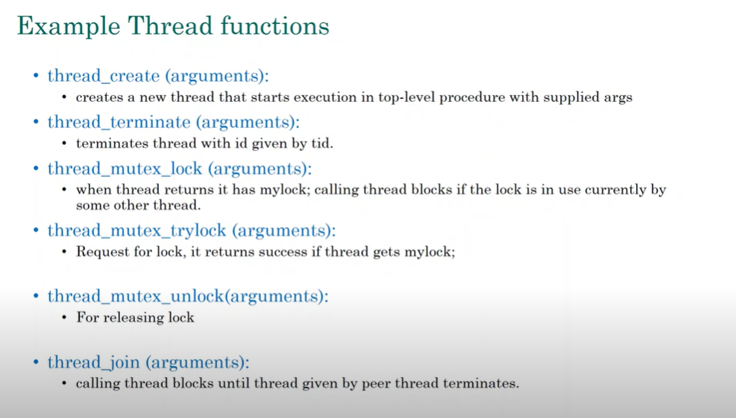
Thread_mutex_lock :- Block the execution if MUTEX is already locked so thread has to wait and sit idle until MUTEX becomes available
Thread_mutex_trylock :- It will try for the lock ,if lock is available it will take the lock and proceed but if lock is not available then it will return back and continue with its execution so here the thread is not blocked if lock is unavailable.

Slide 27
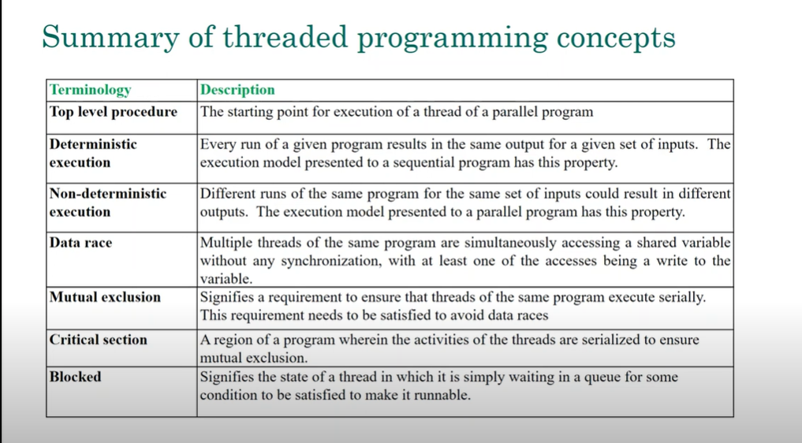

Slide 28
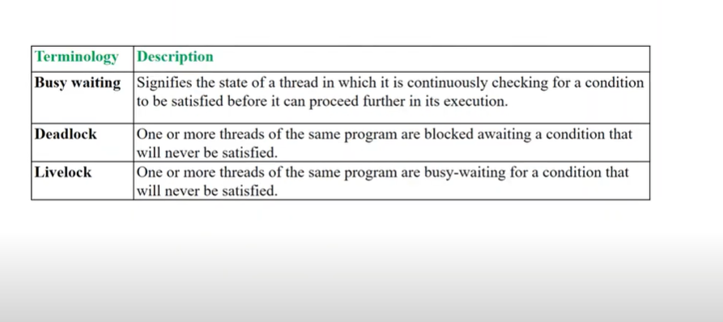
Deadlock : You are waiting for me and I am waiting for you nothing moves on.
Livelock: They are busy doing something but they are not able to break the lock.

Slide 29
Deadlock :
Deadlock occurs when two or more threads are waiting for each other to release resources, and as a result, none of them can proceed. This leads to a situation where the threads are stuck indefinitely.
Example of Deadlock:
Imagine two threads (Thread A and Thread B) and two resources (Resource 1 and Resource 2):
Thread A locks Resource 1 and needs Resource 2 to continue.
Thread B locks Resource 2 and needs Resource 1 to continue.
Both threads are waiting for the other to release the resource, causing a deadlock.
Livelock :
Livelock occurs when two or more threads keep responding to each other in such a way that they are unable to make progress. Unlike deadlock, the threads are not stuck but keep changing states, continuously adjusting to each other without making any progress.
Example:
Suppose there is a narrow corridor, two people are coming from different sides.First person moves left to right to give space to second person and the 2nd person also moves left to right in same way. Now again when first person moves right to left , the 2nd person does the same, so both are busy doing something but none of them proceed to move ahead.
Thread A tries to lock a resource, but notices Thread B might also need it, so it steps back (releases it).
Thread B then notices the same and steps back too.
This goes on repeatedly, so neither thread progresses.

Slide 30
Python Examples

Slide 31
Finding sum of numbers
Here, all threads are executing same function on different chunks of data.
def partSum(data, result, id, start, end):
sum = 0
for i in range(start, end):
sum = sum+data[i]
result[id] = sum
from threading import Thread
threads = [None] * 5
results = [None] * 5
data = [2, 3, 5, 8, 10, 12, 14, 17, 20, 25, 12, 16, 17, 17, 19]
size = int(len(data)/len(threads))
for i in range(len(threads)):
start = i*size
end = (i+1)*size
threads[i] = Thread(target=partSum, args=(data, results, i, start, end))
threads[i].start()
for i in range(len(threads)):
threads[i].join()
# final sum
finalsum=0
for i in results:
finalsum = finalsum+i
print(finalsum)
Same function on different chunk of data
‘results’ is an array to store intermediate results
Thread creation by OS
Start the ith thread, start computing
I am joining all threads to the main thread. Before adding up the results we need to have the results from all child threads. We want to ensure that all child threads have finished their jobs before main thread starts proceeding for adding all the results to get ‘finalsum’ value.

Slide 32
Finding variance of a set of numbers
def calSumOfSquare(data, res, i):
sum = 0
for n in data:
sum = sum + n*n
res[i] = sum
def calMean(data, res, i):
sum = 0
for n in data:
sum = sum + n
res[i] = sum/len(data)
import threading
data = [2, 3, 5, 8]
results = [None] * 2
sosThread = threading.Thread(target=calSumOfSquare, args=(data, results, 0))
meanThread = threading.Thread(target=calMean, args=(data,results, 1))
sosThread.start()
meanThread.start()
sosThread.join()
meanThread.join()
var = results[0]/len(data) - results[1]*results[1]
print(var)
Different functions in different threads

Slide 33
An Example Problem Top k Similarity Search

Slide 34
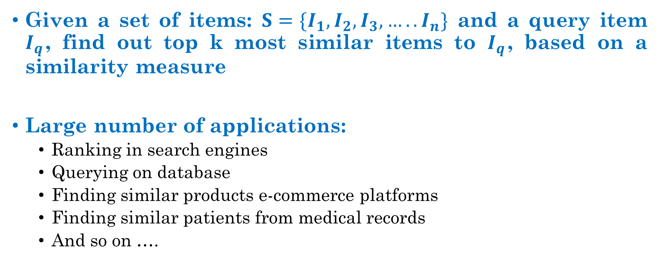
Top k Similarity Search
Given a set of items: $S=\{I_{1}, I_{2}, I_{3}, ….. I_{n}\}$ and a query item $I_{q}$, find out top k most similar items to $I_{q}$, based on a similarity measure
Large number of applications:
Ranking in search engines
Querying on database
Finding similar products e-commerce platforms
Finding similar patients from medical records
And so on ….
How do we solve it?

