Slide 1
Big Data Processing
Jiaul Paik
Lecture 4

Slide 2
Multithreading Python Examples

Slide 3
Finding sum of numbers
def partSum(data, result, id, start, end):
sum = 0
for i in range(start, end):
sum = sum+data[i]
result[id] = sum
from threading import Thread
threads = [None] * 5
results = [None] * 5
data = [2, 3, 5, 8, 10, 12, 14, 17, 20, 25, 12, 16, 17, 17, 19]
size = int(len(data)/len(threads))
for i in range(len(threads)):
start = i*size
end = (i+1)*size
threads[i] = Thread(target=partSum, args=(data, results, i, start, end))
threads[i].start()
for i in range(len(threads)):
threads[i].join()
# final sum
finalsum=0
for i in results:
finalsum = finalsum+i
print(finalsum)
Same function on different chunk of data

Slide 4
Finding variance of a set of numbers
def calSumOfSquare(data, res, i):
sum = 0
for n in data:
sum = sum + n*n
res[i] = sum
def calMean(data, res, i):
sum = 0
for n in data:
sum = sum + n
res[i] = sum/len(data)
import threading
data = [2, 3, 5, 8]
results = [None] * 2
sosThread = threading.Thread(target=calSumOfSquare, args=(data, results, 0))
meanThread = threading.Thread(target=calMean, args=(data,results, 1))
sosThread.start()
meanThread.start()
sosThread.join()
meanThread.join()
var = results[0]/len(data) - results[1]*results[1]
print(var)
Different functions in different threads

Slide 5
An Example Problem Top k Similarity Search

Slide 6
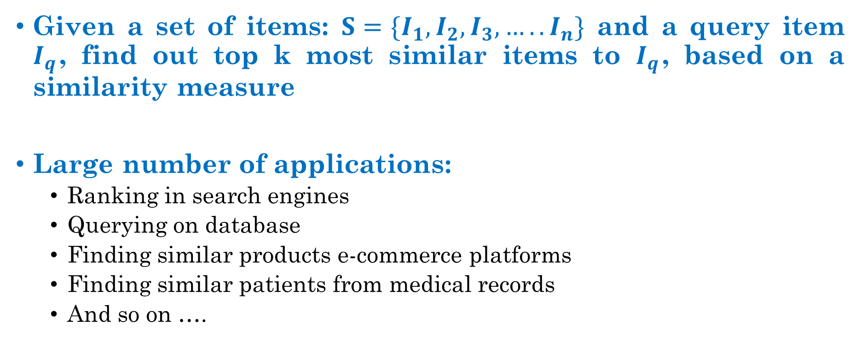
Top k Similarity Search
Given a set of items: $S=\{I_{1}, I_{2}, I_{3}, ….. I_{n}\}$ and a query item $I_{q}$, find out top k most similar items to $I_{q}$, based on a similarity measure
Large number of applications:
Ranking in search engines
Querying on database
Finding similar products e-commerce platforms
Finding similar patients from medical records
And so on ….
How do we solve it?

Slide 7
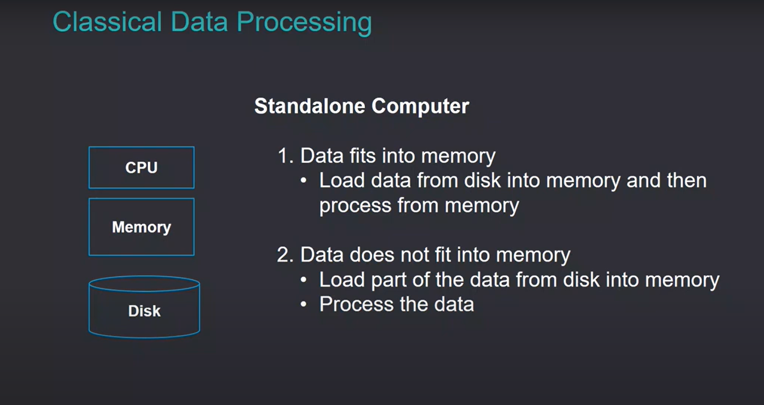

Slide 8
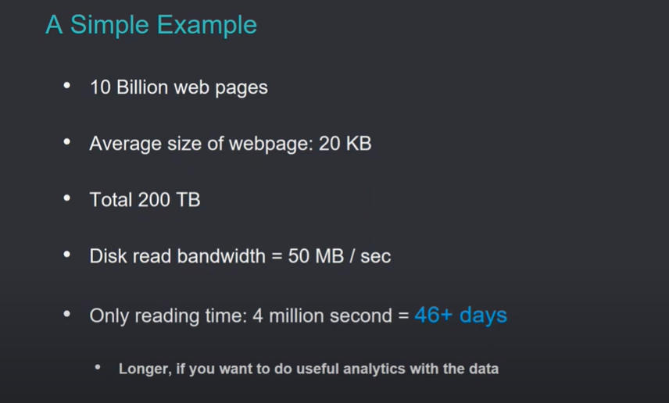
Limitations of Classical Data Processing Framework

Slide 9
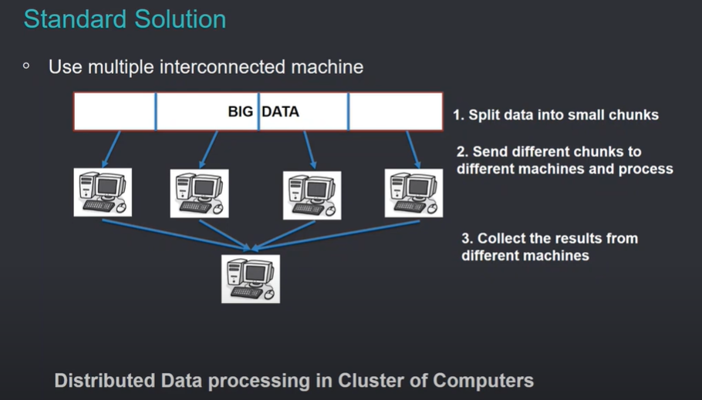
Solution :

Slide 10
Cluster Computing for Big Data

Slide 11
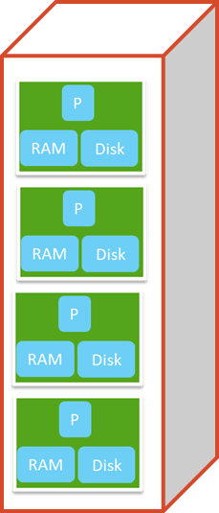
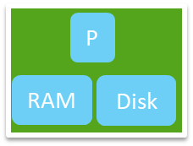
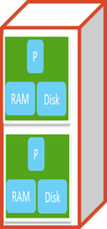
Compute Cluster Components
Rack
switch
server
Rack of servers
Data centre

Slide 12
How to Organize Cluster of Computers?

Slide 13
Cluster Architecture: Rack Servers
This is a hierarchical structure or tree-like structure.
First-level switches have much lesser capacity, but backbone switches have much higher capacity because the number of communications required through the backbone switch is much higher.
Backbone switch
(typically 2-10 gbps)
switch
1 gbps between any pair of nodes
switch
switch
computer
computer
computer
computer
Rack 1
Rack 2
Each rack typically contains 16-64 commodity computers (nodes)
We have first level switches responsible for data exchange b/w 2 nodes of same rack. On top of this we have second level switch which are backbone switches ,backbone switches communicate with the first level switches to exchange data from one rack to other rack.

Slide 14
Key challenges in Cluster Computing

Slide 15
Challenge # 1
Node failures
Single server lifetime: 1000 days
1000 servers in a cluster => 1 failure/day
1M servers in clusters => 1000 failures/day

Slide 16
Consequences of Node Failure
Data loss
Node failure in the middle of long and expensive computation
Need to restart the computation from scratch

Slide 17
Challenge # 2
Network bottleneck
Computers in a cluster exchange data through network
Moving 10TB of data through 1 gbps network bandwidth takes 1 day

Slide 18
Challenge # 3
Distributed Programming is hard!!!
Why?
The programmer has to manage too many low-level things apart from writing code for the task. The programmer has to ensure that data distribution across machines is fine but in reality data distribution is non-trivial.
Avoid Race conditions.(the order of execution in diff machines should be in right order).

Slide 19
ADDRESSING DIFFICULTIES (MAP-REDUCE FRAMEWORK)

Slide 20
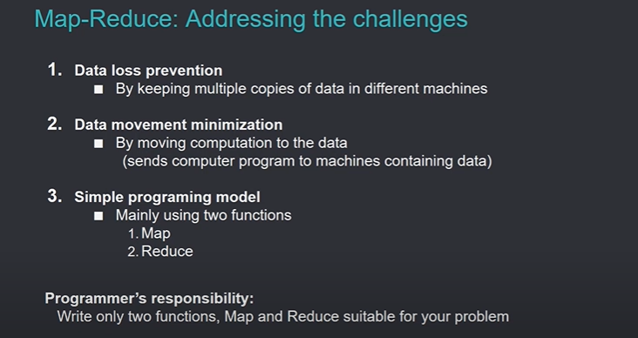

Slide 21
Stands on the Key Ideas
The datacenter is the computer
Computers holding data will compute (NOT the central server)
Bring computation to the data
Reduce data communication
Programming: Divide and Conquer approach
Break into independent sub-problems
Solve them parallelly
Combine the results
Simple programming model
Map-reduce framework does all other things for the programmer
The traditional idea before map-reduce was that I have a big, powerful server, and my data is sitting somewhere else. Whenever I need to compute I will transfer my data to high-computing server and I will process data in the central server and write it back.
In map-reduce, since in a data center, multiple computers are storing data so I will move computation to data so as to save cost of data transfer.

Slide 22
Programming Model Overview (Map-reduce)

Slide 23
Simple Programming Model: Map-reduce
Simple programing model
Mainly using two functions (map-reduce)
Map
Reduce
Programmer’s responsibility:
define only two functions, Map and Reduce suitable for your problem

Slide 24
Map-Reduce is a simple programming model.
Map-Reduce uses a cluster of low-cost computers.
Map-Reduce is remarkably scalable for batch-processing tasks.

Slide 25
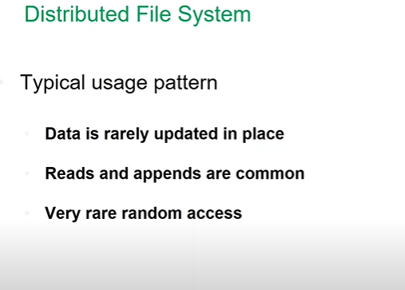
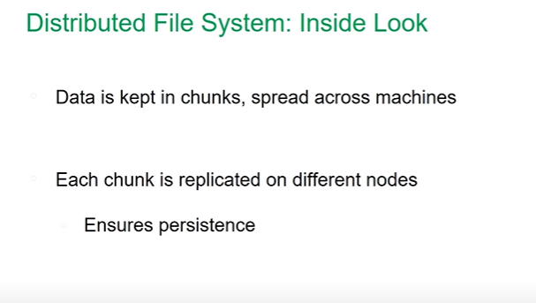
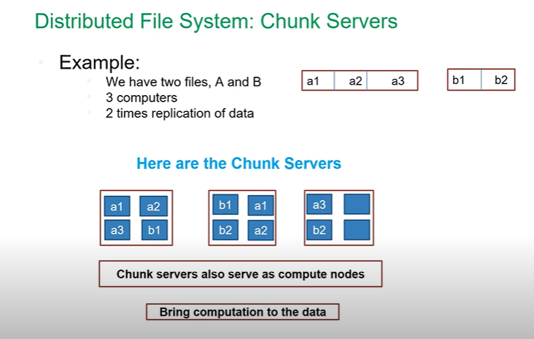
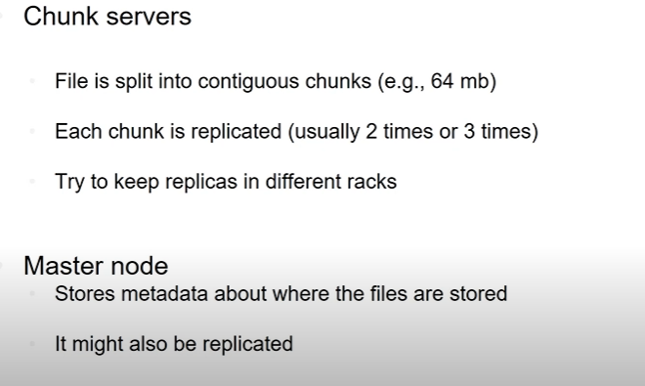

Slide 26
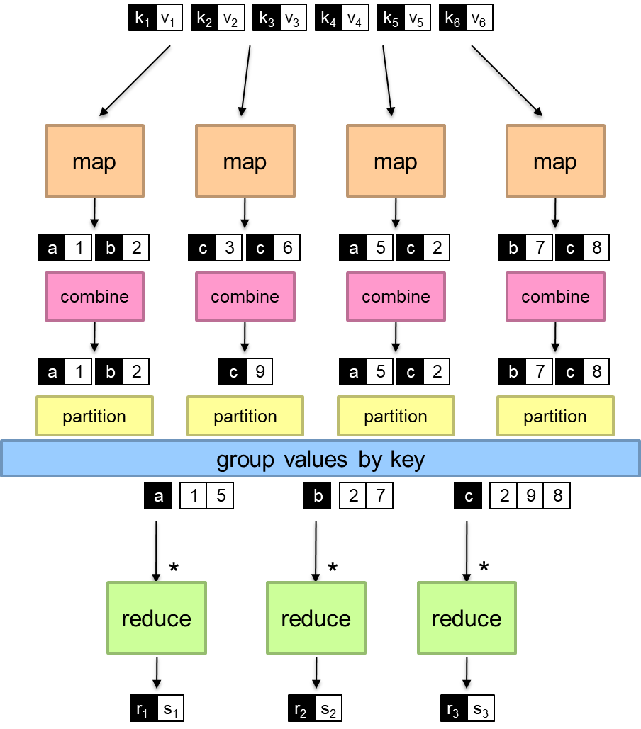
Map-reduce Programming Model
In the map-reduce programming model, we have input data in the form of key-value pairs.
k1 , k2 …. are the file names
v1 , v2 ….. are the corresponding contents of the file.
Individual map functions will work on individual files to give intermediate results in key-value pair form.
These map functions process different files in parallel computers.
Splitting
Combine the values present in one computer based on the same key and intermediate combined results are still in the same computer.
Intermediate combining
The partition function will take the keys and decide to which machine the values of a particular key should go.
After the partition function, all the data of a particular key will be on a particular machine decided by the hash function.
Then we will group values by key because you want to perform operations based on keys.
Shuffling and grouping
The partition function will send the values of the keys here and there based on a hash function.
Hash_val(key) = machine_id
Partition func is applied only on keys. But due to hash collisions data for diff keys can also be on same machine
Final combining
Then we apply the reduce function to combine the results produced by each worker to get the final output

Slide 27
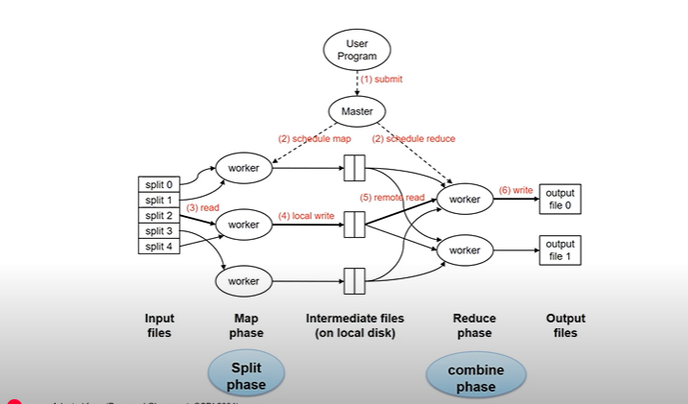
3> map func is writing data in LFS
4> then it comes to reduce fun and every reduce func will produce one separate file. Reduce phase writes o/p on DFS
2>Then we apply map func on each of the splits
1>We have small small files , chunks of files

Slide 28
Storing Big Data in Cluster Hadoop Distributed Filesystem
A File System is nothing but the organization of files and folders in a nice way so that we can do most of the regular things efficiently.
File system helps us to store data efficiently and retrieving those files is also very easy.

Slide 29
Why distributed filesystem (DFS)?
When data is very large, single machine can’t store
Need to store the data in many machines
Data needs to be partitioned and stored
Filesystem that manages the storage across a network of machines
We use DFS when we have to handle large volumes of data.

Slide 30
Design Principles of DFS
Very large files
Hundreds on terabytes or even petabytes
Streaming data access
Basic idea: write once, but read many times
Commodity hardware
Uses cluster of commodity hardwares
chance of node failure is high
DFS is designed to handle such failures

Slide 31
Distributed File System: Data persistence
Data is kept in chunks, spread across machines
Each chunk is replicated on different nodes
Ensures persistence
Suppose you break the data in 5 chunks and you replicate each chunk twice so now you have 10 chunks to store.
We won’t put a chunk & its replica together in same machine.

Slide 32
Distributed File System: Chunk Servers
Example:
We have two files, A and B
3 computers
2 times replication of data
a1 a2 a3
b1 b2
A
B
The Chunk Servers
a1
a2
b1
a1
a3
a3
b1
b2
a2
b2
Chunk servers also serve as compute nodes
Bring computation to the data

Slide 33
HDFS (Hadoop) Architecture
Master Node stores the metadata about where the files are stored.
Master Node is the manager who will know which all machines are alive, and which all machines are dead, it will maintain the lists and tables about which particular data is stored in which machine
In-order to ensure reliability you can also replicate the master node.
In HDFS Architecture we have HDFS Datanode and each HDFS Datanode has a Linux File system(i.e. local file system).
On top of this we have a HDFS namenode, namenode is kind of organizer of all the file chunks in DFS.
namenode = master node
HDFS namenode
Application
/foo/bar
(file name, block id)
File namespace
HDFS Client
block 3df2
HDFS DataNode will store the data and the computation which you will be performing will be there.
Namenode manages the file system Namespace.
It holds file/directory structure, file-to-block mapping, metadata(ownership, access permission) etc.
Namenode will coordinate the file operations. It will direct the clients to the datanodes for read and write operation. But no data flows through the namenode.
Namenode maintains the communication with the datanodes, Block re-replication on node failure , rebalancing if some node is not responding
(block id, block location)
instructions to datanode
(block id, byte range)
datanode state
HDFS datanode
HDFS datanode
block data
Linux file system
Linux file system
…
…
(Ghemawat et al., SOSP 2003)

Slide 34
HDFS
Daemon means background processes.
Jobtracker is where you submit a job and it will track the progress of the job(finished,continuing,killed ?)
You have lots of worker nodes
,each worker node is having Local File
systemLinux file system.Each worker
Node is running tasktracker , which
keeps Track of progress of the work
running in that particular
Node.Namenode daemon and
Jobtracker daemon interact
with all the tasktracker of all
the nodes.
namenode
job submission node
namenode daemon
jobtracker
tasktracker
tasktracker
tasktracker
datanode daemon
datanode daemon
datanode daemon
Linux file system
Linux file system
Linux file system
…
…
…
slave node
slave node
slave node
NN : Master of HDFS
JT : Coordinator for map-reduce jobs.
On each of the worker machines we have :
TaskTracker(TT) : Contains multiple tasks slots
DataNode(DN) : Serves as HDFS datablocks.

Slide 35
Namenode
Maintains the filesystem tree and the metadata for all the files and directories
This information is stored on the local disk in two files:
the namespace image and the edit log.
Knows the datanodes on which all the blocks for a given file are located
But, it does not store block locations persistently,
this information is reconstructed from datanodes when the system starts.
Through name node no data transfer happens,data transfer will be through the cables b/w different datanodes.

Slide 36
Datanode
Datanodes are the workhorses of the filesystem.
They store and retrieve blocks when they are told to (by clients or the namenode)
They report back to the namenode periodically with lists of blocks that they are storing.

Slide 37
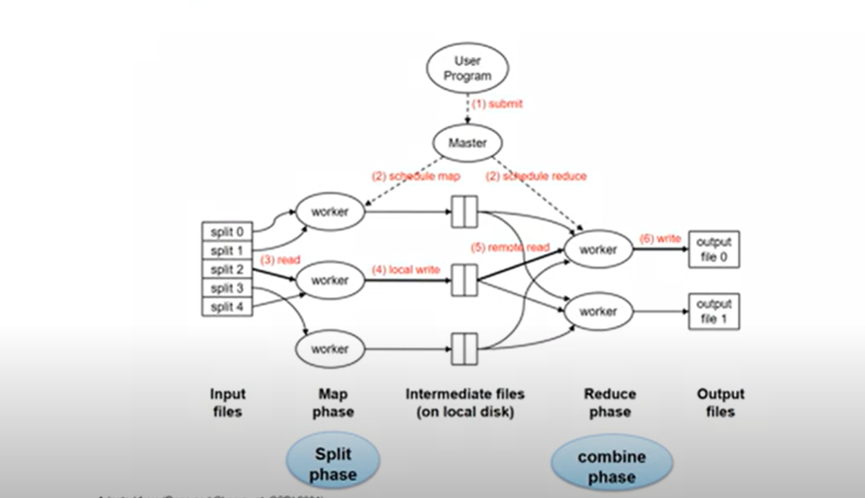
Physical View
You have 2 kinds of file systems in Cluster Computing Framework, one is Distributed File system and other is local file system which every node a cluster has. LFS is accessible by local machine only but DFS is accessible by all the nodes of the cluster.
Intermediate files(on local disk), intermediate files means the output produced by map tasks you write on local disk.
When map phase is done all map tasks are writing their o/p on LFS but in reduced phase all reduce workers are writing o/p on DFS.

Slide 38
HDFS Blocks
Blocks
Disk block size: minimum amount of data it can read and write
Typical size: 128 MB
Why HDFS blocks are larger?
Goal is to minimize the cost of seek
The time it takes to transfer the data from the disk can be significantly longer than the time to seek to the start of the block.
My note: In HDFS we have relatively larger blocks (128 MB) for 2 reasons :
Minimizing the seek cost: - Hard drives take time to move the read write head to correct location (seek time) and By having a larger block size we can minimize the number of seeks because we can read larger data in one go
Optimizing the data transfer: - Once the read/write head is pointed we can read large amount of data or write large amount of data efficiently. Since seek time is costly we prioritize reading/ writing larger blocks rather than going for multiple smaller blocks.

Slide 39
HDFS Blocks
A file is made of a number of blocks
Command to know the list of blocks for each file in HDFS
hdfs fsck / -files -blocks

