Slide 1
Big Data Processing
Jiaul Paik
Lecture 5

Slide 2
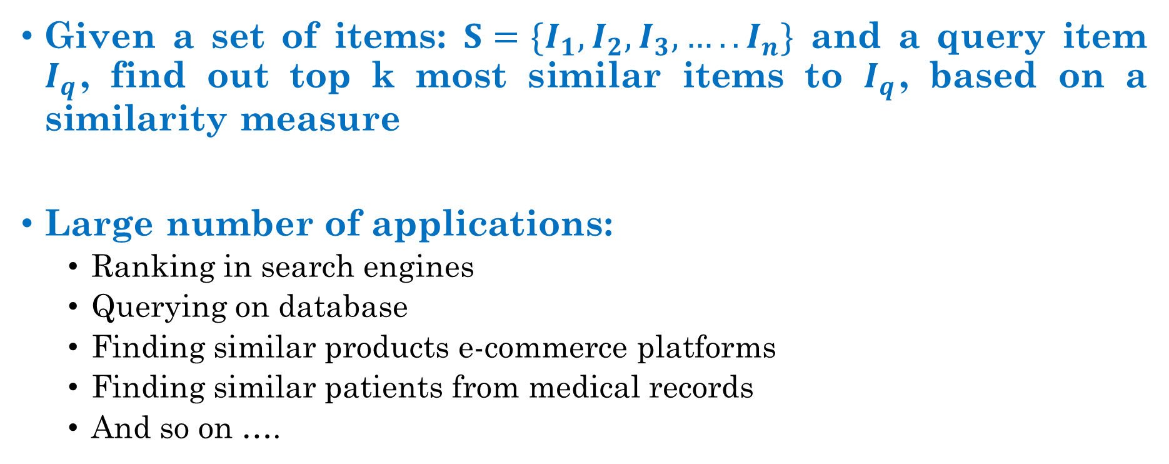
Exercise: Top k Similarity Search
Given a set of items: $S=\{I_{1}, I_{2}, I_{3}, ….. I_{n}\}$ and a query item $I_{q}$, find out top k most similar items to $I_{q}$, based on a similarity measure
Large number of applications:
Ranking in search engines
Querying on database
Finding similar products e-commerce platforms
Finding similar patients from medical records
And so on ….

Slide 3
HDFS
namenode
job submission node
namenode daemon
jobtracker
tasktracker
tasktracker
tasktracker
datanode daemon
datanode daemon
datanode daemon
Linux file system
Linux file system
Linux file system
…
…
…
slave node
slave node
slave node

Slide 4
Network Topology in Hadoop
Node distance
d=6
d=4
n1
n3
n4
node
d=0
d=2
n2
r1
r2
r3
r4
d1 (data center)
d2 (data center)
Adapted from: Hadoop the definitive Guide, 4th ed, Tom white

Slide 5
Replica Placement
Tradeoff between reliability and write bandwidth and read bandwidth
Placing into single node is bad idea
The first replica is placed in random
Second replica is placed on different rack
The third replica is placed on the same rack as the second, but on a different node
After locations are fixed, replica pipeline is built
node
rack
Data center
Adapted from: Hadoop the definitive Guide, 4th ed, Tom white

