Slide 1
Big Data Processing
Jiaul Paik
Lecture 6

Slide 2
Programming on Hadoop Map-reduce Model
Map-reduce : Programming model for cluster computing
HDFS : Storage model for Cluster Computing

Slide 3
Example Problem: Counting Words
Sample application
Result ranking, Language model
How can you solve this using a single machine?
We have a huge collection of text document and count the number of times each distinct word appears in the file

Slide 4
Word Count
Case 1:
Files too large for memory, but all <word, count> pairs fit in memory
You can create a big string array OR you can create a hash table

Slide 5
Word Count
Case 2: All <word, count> pairs do not fit in memory, but fit into disk
A possible approach (write computer programs/functions for each step)
Break the text document into sequence of words
Sort the words
(this will bring the same words together)
3. Count the frequencies in a single pass
This captures the essence of Map-Reduce model
getWords(textFile)
sortWords(list)
countWords(sorted list)

Slide 6
Map-Reduce: In a Nutshell
getWords(dataFile) sort count
Map
extract something you care about (here word and count)
Group by key
(sort and shuffle)
Reduce
Aggregate, summarize
Summary
Structure remains the same
Map and Reduce to be defined by the user to fit the problem

Slide 7
Map-Reduce: Map Step
In map-reduce framework everything is handled by simple data structure called key-value pair.
In this case also input data is in key-value pair format, key here is the file name and the value is the content of the file. These ‘c1’, ‘c2’ …. are the small chunks, the files are split into small chunks, and ‘f1’ , ‘f2’ are file names like ‘c1’, ‘c2’ … from which file it is coming.
This is input to our model. This is how we store data in DFS.
On every chunk, we apply a map function, map function will take file name and content of the file and will produce a set of key-value pairs. A particular chunk may have different kinds of words and with some frequency. So, k1 is the word and v1 is value i.e. count of that word , similarly k2 is another word and v2 is the frequency of that word in chunk c1.So map function is one to many function, it takes one key-value pair and produces many key-value pairs so you have to apply the same map function on every chunk of data.
Input key-value pairs
(file name and its content)
Intermediate key-value pairs
(word and count)
k1
v1
map
f1
c1
k2
v2
map
f2
c2
k3
v3
…
…
map
k4
v4
f3
c3

Slide 8
MapReduce: Reduce Step
Now, we have key-value pairs produced by the map function. Next, we have a group by key. For a particular key, we need to combine the values from different machines.so, ‘v1’’, ‘v3’, …. are the values associated with key ‘k1’ coming from different machines.
Next, the Reduce step will take a key and list of values associated with that particular key, and apply the operation you have defined in the reduce function on the list of values associated with the key ‘k1’. Here, the operation will be summing ‘v1’, ‘v3’, ‘v6’, and so on, summing a list of values. So, reduce operation will work on the lists associated with all the keys and will produce the final value for each of the keys. So, ‘k1’ and ‘v’’, ‘k2’ and ‘v’’’ …. these are the final outputs produced by the framework and final output key-value pairs will be stored in DFS because if one machine fails you don’t want the final processed results to get lost.
key-value pairs
(produced by Map step)
Output
key-value pairs
Key-value groups
k1
v1
reduce
k1
v1
v3
v6
k1
$$v′$$
k2
v2
Group
by key
reduce
k2
v2
v5
k2
$$v′′$$
k1
v3
…
k3
v4
…
…
k2
v5
k1
v6
k3
v4
reduce
k3
$$v′′′$$

Slide 9
Map-reduce: Word Count
Say, you have a big doc, when u copy the data in DFS then in all clusters you have chunks. In the map module that you have written, you feed chunks of data as input and the map function will output a set of key-value pairs for each of the chunks. Here, it produces key-value pairs where the key is the word and the value is the count of that word. Then we have Group by keys, which Produces list of values for distinct keys from different machines. In which machine a particular key along with its associated list of values will go will be decided by the hash function.’ Deep’ and ‘Networks’ are in the same machine because of hash collisions. Then Reduce operation will work on the list of values of each of the keys and will produce final value for each key.
Provided by the programmer
Handled by MR system
Provided by the programmer
MAP:
Read input and produces a set of key-value pairs
Group by key:
Collect all pairs with the same key
Reduce:
Collect all values belonging to the key and output
deep learning architectures such as deep neural networks, deep belief networks,
deep reinforcement learning, recurrent neural networks and
convolutional neural nets have been applied to fields including computer vision
(deep, 1)
(learning, 1)
(architectures, 1)
(such, 1)
(as, 1)
(…., 1)
(….., 1)
(…., 1)
(networks, 1)
(deep, 1)
(reinforcement , 1)
(…., 1)
(and, 1)
….
(vision, 1)
……..
(deep, 1)
(deep, 1)
(networks, 1)
(networks, 1)
(networks, 1)
(the, 1)
(the, 1)
(the, 1)
(reinforcement, 1)
(vision, 1)
…
(deep, 2)
(networks, 3)
(the, 3)
(reinforcement, 1)
(vision, 1)
…
Big document
(key, value)
(key, value)
(key, value)

Slide 10
Word Count Using MapReduce: Pseudocode
map(key, value)
// key: document name; value: text of the document
for each word w in value
emit(w, 1)
reduce(key, values)
// key: a word; value: set of counts values for a word
result = 0
for each count v in values:
result += v
emit(key, result)

Slide 11
Map-Reduce Execution Detailed Look

Slide 12
Map-reduce System: Inside Look
We have chunks of data on each machine. In each machine, we apply a map task on each of the chunks of data and it produces a set of key-value pairs. Now, the key-value pairs produced by the map task will come to the partition function. The partition function will send the key-value pairs to some set of nodes. So here the shuffling will take place. So, in machine 1 we have key k1 with value v1 and in machine 3 we again have k1 with value v5. So, in order to process we have to bring all values associated with key k1 in a single machine. So, that is the reason we need to shuffle the data because we have to produce output for a particular key. Partition function is hash function so it may end up sending data of diff keys in same machine so we need to sort by keys and then Group because data for diff keys can be in same machine. After sort and Group you have a key and list of values associated with that key. Then we apply reduce operation on the list associated with each of the keys to get final output.
Machine - 1
Machine - 2
map task 3
map task 1
map task 2
Machine - 3
data | data | data
data | data | data
data | data | data
M
M
M
M
M
M
M
M
M
($k_{1}, v_{1}$) ($k_{2}, v_{2}$) | ($k_{3}, v_{4}$) | ($k_{4}, v_{4}$)
($k_{2}, v_{1}$) | ($k_{1}, v_{4}$) ($k_{2}, v_{2}$) | ($k_{3}, v_{5}$)
($k_{2}, v_{6}$) | ($k_{3}, v_{7}$) | ($k_{1}, v_{5}$)
partition function
partition function
partition function
SORT and GROUP
$$k_{1}:{ v}_{1},v_{4},v_{5}$$ | $$k_{4}:v_{4}$$
SORT and GROUP
$$k_{2}:v_{2},v_{1},v_{2},v_{6}$$ | $$k_{3}:v_{4},v_{5},v_{7}$$
All phases are distributed with many tasks running in parallel
R
R
R
R
Final output | Final output
Final output | Final output
reduce task 1
reduce task 2

Slide 13
Partitioning
Output files
(partition by keys)
Output from mappers
(on multiple machines)
Partition function
0
$$k_{1},v_{1}$$
$$k_{1},v_{1}$$
$$k_{1},v_{1}$$
$$k_{2},v_{2}$$
$$k_{3},v_{3}$$
We schedule the reduce operation for a particular key in that particular machine which holds the max amount of data for that key so that You won’t have to transfer large amounts of data to some other machine through network cables.
1
$$k_{2},v_{2}$$
$$k_{2},v_{1}$$
$$k_{5},v_{10}$$
$$k_{2},v_{1}$$
$$k_{3},v_{4}$$
$$H\left(key\right)=b$$
$$0≤b<m$$
$$k_{1},v_{19}$$
$$k_{2},v_{6}$$
$$k_{7},v_{7}$$
……
‘b’ is some number and ‘m’ is the number of machines you have available for running the reduce function. The job of the partition function is to group the key-value pairs generated from mappers into m buckets. In 0th bucket you have values associated with the key k1. The data corresponding to a particular key will be in the same bucket but data corresponding to diff keys can be in same bucket due to hash collisions.
m-1
$$k_{m},v_{m}$$
$$k_{m},v_{c}$$
$$k_{3},v_{9}$$
$$k_{2},v_{6}$$
$$k_{3},v_{7}$$

Slide 14
Shuffle and Sort
IMPORTANT and EXPENSIVE OPERATION
MapReduce guarantees input to every reducer is sorted by key
The heart of mapreduce is the shuffle operation
Shuffle does the following
performs the sort
transfers the map outputs to the reducers as inputs

Slide 15
Shuffle and Sort: the map side
partition, sort and
spill to disk
map
merge on disk
Buffer in memory
on local disk
Input data
(chunk)
partitions
Every map function have a buffer, which is fixed chunk of space in main memory. When map function is doing its operation the it is writing its output in the main memory. When buffer is full it will spill out the data in hard disk which is the local file system, because map writes output in LFS.

Slide 16
Shuffle and Sort: the reduce side
map
merge
reduce
merge
output
map
merge
map
reduce
output
map
reduce
output
map phase

Slide 17
Map-Reduce Internals Additional Details

Slide 18
What Map-Reduce Framework Does for You?
Partitioning the input data
Scheduling the program`s execution across a set of machines
Performing the group by key step
Handling machine failures
Inter-machine communication

Slide 19
Data Flow
Input and final output are stored on a distributed file system
Scheduler tries to schedule map tasks “close” to storage location of input data
This minimizes data movement through the network
Intermediate results are stored on local file system of Map and Reduce workers (if a data node running map task fails then the data can be recomputed because we already have the copy of the original data in other nodes , so we can run the map task again on the 2nd copy and recover the map’s output for that particular data chunk , if u put it in DFS then u have to do replica and communication of data from one machine to several machines, and master node will have to create metadata for intermediate files as well)
Output can be input to another Map-reduce task

Slide 20
Coordination by Master
Master node takes care of coordination:
Task status: (idle, in-progress, completed)
Idle tasks get scheduled as workers become available
When a map task completes, it records the location and sizes of the intermediate files
Master pings periodically to detect failures

Slide 21
Dealing with Failures
Map worker failure
Map tasks completed or in-progress at worker are reset to idle
Why?
Reduce workers are notified when task is rescheduled on another worker
Even if map task was finished and that node fails then we have to reset the task to idle. Because o/p of map task was in LFS of that node which failed so we don’t have any more access to the LFS of the failed node so we have to re-assign that in-progress/completed map task to some other machine.

Slide 22
Dealing with Failures
Reduce worker failure
Only in-progress tasks are reset to idle
Why?
Reduce task is restarted
If a in-progress reduce task failed then u have to reset the task to idle. But if completed reduce task fails then u don’t have to worry because o/p produced by completed reduce task will be in DFS so u still have access to the output as its in DFS an multiple copies of it will be in DFS which is accessible.

Slide 23
Dealing with Failures
Master failure
Map-reduce task is aborted and client is notified

Slide 24
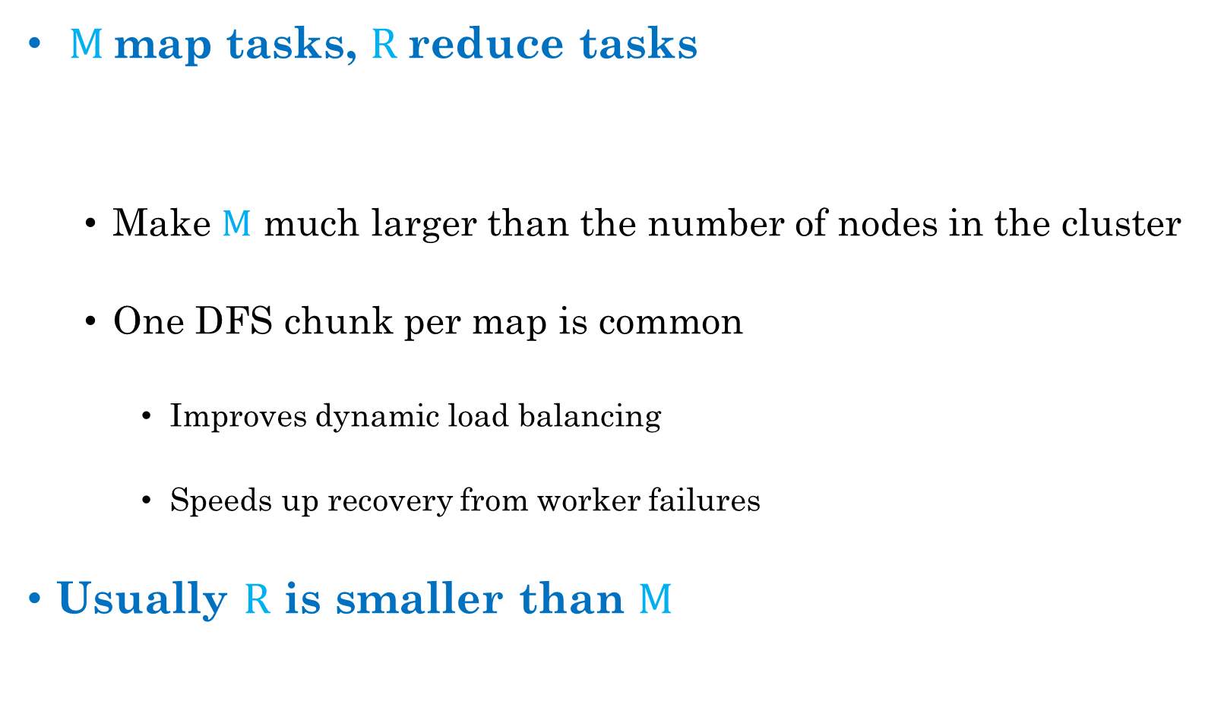
How many Map and Reduce jobs?
$M$map tasks, $R$reduce tasks
General Rule:
Make $M$ much larger than the number of nodes in the cluster
One DFS chunk per map is common
Improves dynamic load balancing
Speeds up recovery from worker failures
Usually $R$ is smaller than $M$
Make M much larger than the num of nodes in the cluster so that each node can run multiple map task so that you can do multithreading and all.
One map task for one DFS Chunk, DFS Chunk means the original chunk not the replica , replicas are in HDFS just for fault tolerant or if task couldn’t be assigned on the node containing the original data then that task can be rescheduled on some other node containing the replica of that data.

