Slide 1
Big Data Processing
Jiaul Paik
Lecture 7

Slide 2
Map-reduce System: Inside Look
map task 1
map task 2
map task 3
data | data | data
data | data | data
data | data | data
M
M
M
M
M
M
M
M
M
($k_{1}, v_{1}$) ($k_{2}, v_{2}$) | ($k_{3}, v_{4}$) | ($k_{4}, v_{4}$)
($k_{2}, v_{1}$) | ($k_{1}, v_{4}$) ($k_{2}, v_{2}$) | ($k_{3}, v_{5}$)
($k_{2}, v_{6}$) | ($k_{3}, v_{7}$) | ($k_{1}, v_{5}$)
partition function
partition function
partition function
All phases are distributed with many tasks running in parallel
SORT and GROUP
$$k_{1}:{ v}_{1},v_{4},v_{5}$$ | $$k_{4}:v_{4}$$
SORT and GROUP
$$k_{2}:v_{2},v_{1},v_{2},v_{6}$$ | $$k_{3}:v_{4},v_{5},v_{7}$$
R
R
R
R
Final output | Final output
Final output | Final output
reduce task 1
reduce task 2

Slide 3
Map-Reduce Algorithm Design

Slide 4
Problems Suitable for Map-reduce
Map-reduce is suitable for batch processing
Updates are made after whole batch of data is processed
The mappers and reducers do not need large volume of data from one another while they are running
In general, map-reduce is suitable:
When the problem can be broken into independent components

Slide 5
Problems NOT Suitable for Map-reduce
Large shared data with frequent updates
Online algorithms
Quick response time
In milliseconds

Slide 6
Map-Reduce Algorithm Template
Main Components
Mapper
Reducer
Optional Components (need based and for optimized execution)
Combiner
Partitioner
If mapper is producing diff outputs for same key then before sending it to partition you basically want to reduce it a bit so you can minimize data communication.
The number of reducers which we want to run will be determined by the partitioner.

Slide 7
Mapreduce Types
map function
K1 -> input key
V1 -> input value
K2 -> output key
V2 -> output value
map: (K1, V1) → list(K2, V2)

Slide 8
Mapreduce Types
reduce function
K2 -> input key
list(V2) -> list of values associated with a key K2
K3 -> output key
V3 -> output value
reduce: (K2, list(V2)) → list(K3, V3)

Slide 9
Problems

Slide 10
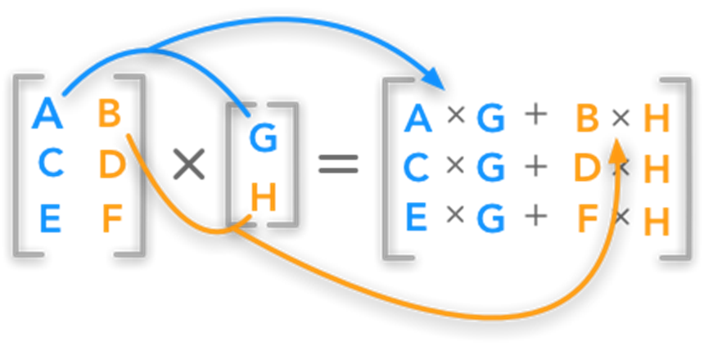
Word Count
Matrix Vector Product

