Slide 1
Big Data Processing
Jiaul Paik
Lecture 8

Slide 2
Map-Reduce Algorithm Design

Slide 3
Joining Tables in Database

Slide 4
Database Table Join
Compute the natural join: T1(A,B) ⋈ T2(B,C)
(combine rows from T1 and T2 s.t rows have common value in column B)
T1
A | B
a₁ | b₁
a₂ | b₁
a₃ | b₂
a₄ | b₃
T2
B | C
b₂ | c₁
b₂ | c₂
b₃ | c₃
A | B | C
a₃ | b₂ | c₁
a₃ | b₂ | c₂
a₄ | b₃ | c₃
⋈
=
⋈
=

Slide 5
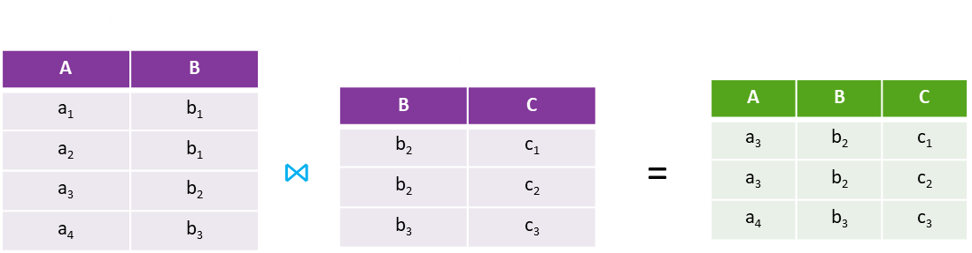
Map-Reduce Join
Map process
Each row (a,b) from T1 into key-value pair (b,(a,T1))
Each row (b,c) from T2 into (b,(c,T2))
Reduce process
Each reduce process matches all the pairs (b,(a,T1)) with all (b,(c,T2)) and outputs (a,b,c)

Slide 6
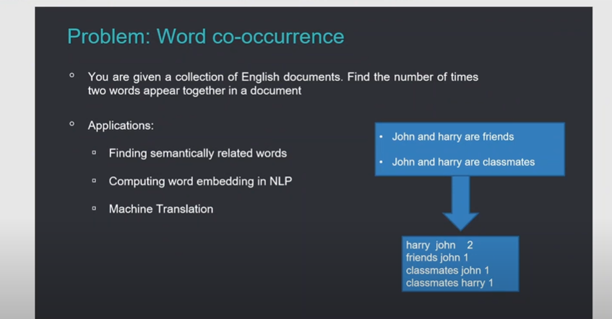

Slide 7
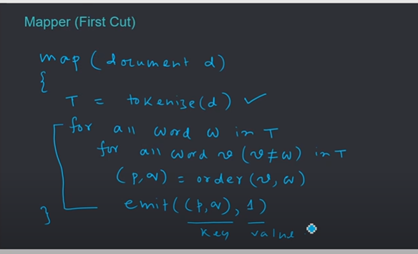

Slide 8
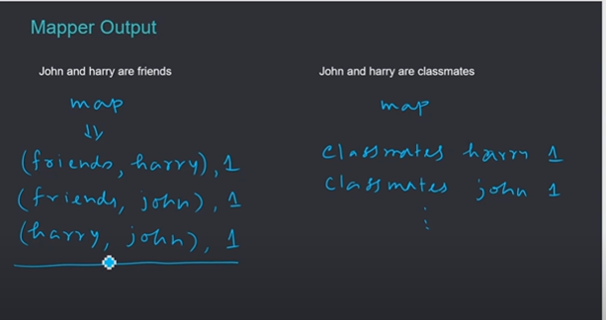

Slide 9
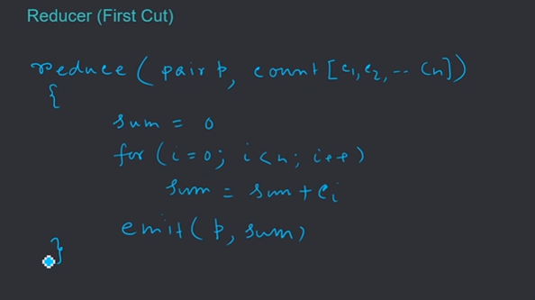

Slide 10
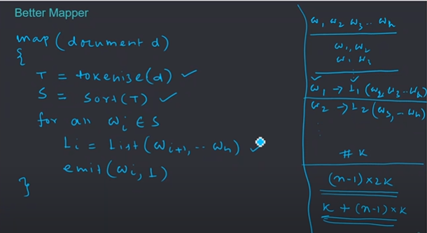

Slide 11
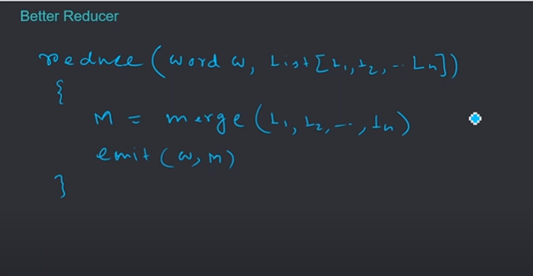

Slide 12
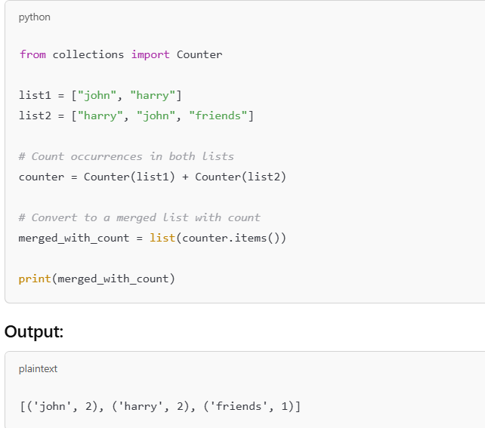

Slide 13
Increasing Scalability of MR Algorithm Value-to-Key Design Pattern

Slide 14
Why Google had to Invent Map-Reduce?

Slide 15
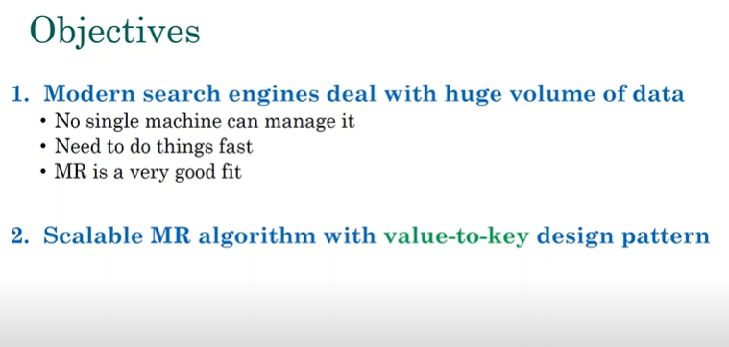

Slide 16
Search Engine Architecture
query
Documents
online
offline
Representation
Function
Representation
Function
Retrieval
Indexing
Query Representation
Document Representation
Index
Ranking
Function
Results
Source: Jimmy Lin

Slide 17
Creating Index
Inverted Index Structure
Doc 1
Blue -> num_of_docs_where_it appears -> (which doc, freq cnt in that doc)
one fish, two fish
Doc 2
blue
1
2
1
Index structure is in dictionary order, words sorted based on dictionary structure
Posting list is list of documents for a particular word where u can find that word.
Posting list is sorted based on doc id.
The first green box is len of posting list
red fish, blue fish
cat
1
3
1
Doc 3
egg
1
4
1
cat in the hat
fish
2
1
2
2
2
Doc 4
green
1
4
1
green eggs and ham
ham
1
4
1
hat
1
3
1
one
1
1
1
red
1
2
1
two
1
1
1

Slide 18
Inverted Index Structure (with positions)
Doc 1
1
one fish, two fish
blue
2
1
[3]
cat
1
3
1
[1]
Doc 2
egg
1
4
1
[2]
red fish, blue fish
fish
2
1
2
[2,4]
2
2
[2,4]
Doc 3
green
1
4
1
[1]
cat in the hat
ham
1
4
1
[3]
Doc 4
hat
1
3
1
[2]
green eggs and ham
one
1
1
1
[1]
red
1
2
1
[1]
two
1
1
1
[3]

Slide 19
Creating Inverted Index
Doc 1
one fish, two fish
Doc 2
blue
1
2
1
red fish, blue fish
cat
1
3
1
Doc 3
egg
1
4
1
cat in the hat
fish
2
1
2
2
2
Doc 4
green
1
4
1
green eggs and ham
ham
1
4
1
hat
1
3
1
one
1
1
1
red
1
2
1
two
1
1
1

Slide 20
MapReduce: Index Construction
Map over all documents and map on a particular doc will emit term as key and (doc_id,tf) as the value.
Then sort and shuffle,
group postings by term :- group the values for the particular key from all the docs and create the postings list.for one key, get all the values
In reduce step , u collect the list and sort it based on doc id and write postings to disk. In reduce step u take a word as a key and the list of values corresponding to that key and then you sort the list of values based on doc id to get the final fully processed postings list.
Map over all documents
Emit term as key, (docid, tf) as value
Sort/shuffle: group postings by term
Reduce
Gather and sort the postings (by docid)
Write postings to disk

Slide 21
Inverted Index: Basic MapReduce Algorithm
Doc 1
Doc 2
Doc 3
one fish, two fish
red fish, blue fish
cat in the hat
one
1
1
red
2
1
cat
3
1
Map
two
blue
hat
1
1
2
1
3
1
fish
1
2
fish
2
2
Shuffle and Sort: aggregate values by keys
cat
3
1
Reduce
blue
2
1
fish
1
2
2
2
hat
3
1
one
1
1
two
1
1
red
2
1

Slide 22
Inverted Indexing: Pseudo-Code
class Mapper
{
map(docid, doc)
{
counts = new HashMap()
for (term in tokenize(doc)) {
counts(term) += 1 // counting freq
}
for ((term, tf) in counts) {
emit(term, (docid, tf))
}
}
}
class Reducer
{
reduce(term, postings: list[(docid, tf)])
{
p = new List()
for ((docid, tf) in postings)
p.append((docid, tf))
p.sort()
emit(term, p)
}
}

Slide 23
Where is the trouble?
class Mapper
{
map(docid, doc)
{
counts = new HashMap()
for (term in tokenize(doc)) {
counts(term) += 1
}
for ((term, tf) in counts) {
emit(term, (docid, tf))
}
}
}
class Reducer
{
reduce(term, postings: list[(docid, tf)])
{
p = new List()
for ((docid, tf) in postings)
p.append((docid, tf))
p.sort()
emit(term, p)
}
}
The p which u get is not in sorted order so u do p.sort() in reduce phase. But this is in memory sorting and length of postings list for a popular word like education is extremely large and hence in memory sorting wont work, so we need to tackle this by value to key design pattern.
In memory sorting

Slide 24
Scalable MR Indexing: Value-to-Key
We will add one part from value and add it to key.
Now key is (term,doc_id) so its composite key and val is tf.
MR has inbuilt sorting so it will be sorted in doc_id order.
(key)
(values)
(keys)
(values)
fish
1
2
fish, 1
2
34
1
fish, 9
1
21
3
fish,21
3
35
2
fish,34
2
80
3
fish,35
3
9
1
fish,80
1
MR framework does the sorting!

Slide 25
Inverted Indexing: Pseudo-Code
class Mapper {
map(docid, doc)
{
counts = new HashMap()
for (term in tokenize(doc)) {
counts(term) += 1
}
for ((term, tf) in counts) {
emit((term, docid), tf)
}
}
}
class Reducer {
prev = null
postings = new PostingsList()
reduce(key, tf)
{
if (key.term != prev & prev != null) {
emit(prev, postings)
postings.reset()
}
postings.append(key.docid, tf)
prev = key.term
}
}

Slide 26
Inverted Indexing: Pseudo-Code
After mapper and shuffle and sort, we get :
(w1,id1) , f1
(w1,id2) ,f2
(w2,id2) ,f3
So, we have to get both of the above together coz its for same term.
After value to key design we don’t need to do in-memory sorting, when map reduce will send o/p of mappers to the reducers then it will send it in sorted order of key.
class Mapper {
map(docid, doc)
{
counts = new HashMap()
for (term in tokenize(doc)) {
counts(term) += 1
}
for ((term, tf) in counts) {
emit((term, docid), tf)
}
}
}
class Reducer {
prev = null
postings = new PostingsList()
reduce(key, tf)
{
if (key.term != prev & prev != null) {
emit(prev, postings)
postings.reset()
}
postings.append(key.docid, tf)
prev = key.term
}
}

Slide 27
Custom Partitioner
By default, MR does not ensure data for the same word will come to the same reducer
(keys)
(values)
fish, 1
2
X
reducer
fish, 9
1
You need to define your own partition function
fish,21
3
fish,34
2
fish,35
3
fish,80
1

Slide 28
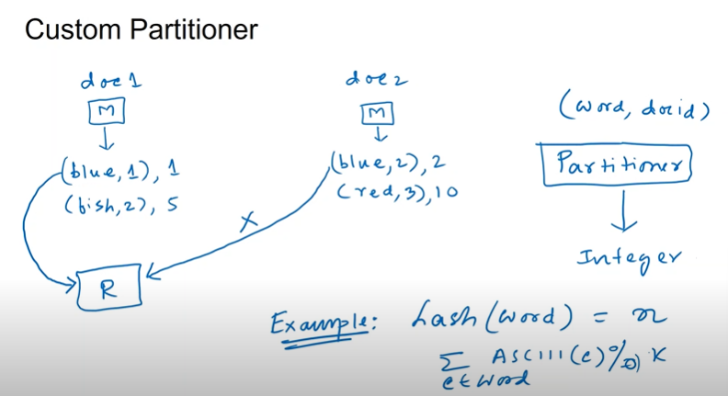

Slide 29
Custom Partitioner
By default, MR does not ensure data for the same word will come to the same reducer
You need to define your own partition function
Because now u have composite key structure :
so, h(fish,5) = a1 and h(fish,2) = a2 now a1 may not be equal to a2 because key structures are diff AND (fish,5) and (fish,2) are diff things so we need to define our own partitioner function. The objective of it is that data corresponding to same word should go to same reducer otherwise you won’t be able to do anything.
Partitioner will take a key : (word, id) and it will generate an integer but this integer value should be same for same word.
Example : hash(word) = n :: (summation of ASCII(c))%k
(keys)
(values)
fish, 1
2
X
reducer
fish, 9
1
fish,21
3
fish,34
2
fish,35
3
fish,80
1

Slide 30
Data Communication in Map-Reduce A Case Study of Bad Map-reduce code
Source: Jeffrey Ullman - Algorithm Design for MapReduce
Credit: Jeff Ullman, Stanford University

Slide 31
Drug-Interaction
Data on 3000 drugs
List of patients taking the drug, the date, and diagnosis
Average 1 MB/drug
Objective
Find drug interaction: If two drug taken together, does this increase heart attack
Run Chi-square test between every pair of drugs
Total volume of data: 3 GB

Slide 32
Map-Reduce Program
Mapper
Key = pair of two drugs $(i,j)$
Value = Record $(R)$ of any one of these drugs
Reducer
Receives the key $(i,j)$ and the list of two values for the key $[R_{i}, R_{j}]$

Slide 33
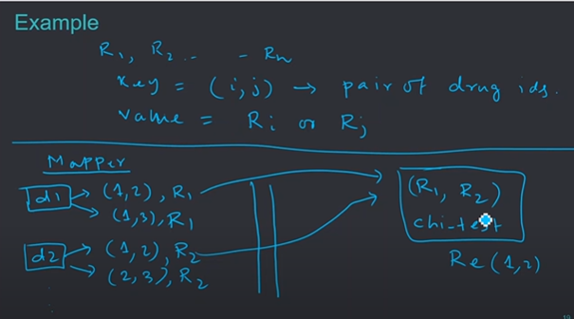
Map-Reduce Program

Slide 34
What is wrong with this Algorithm?
Mapper generates 2999 key-value pairs for each drug.
= $1 MB×2999=3 GB (approx)$
For 3000 drugs
$3 GB×3000=9 TB$
9 TB data communication over 1 gb ethernet = 25 hours
But originally we had only 3 GB of data

Slide 35
How do we design a better MR algorithm?

Slide 36
Hint : - In current case we are trying to produce all pairs of possibility which is creating issue. Since every chunks is containing record so can we make use of that?

