Slide 1
Big Data Processing
Jiaul Paik
Lecture 9

Slide 2
Map-reduce Algorithm Design
Combiner
Fast Big Data Processing with Spark

Slide 3
Use of Combiner

Slide 4
Role of combiner
Combiners are mini-reducers
Reduces data from mappers before they are shuffled through the network

Slide 5
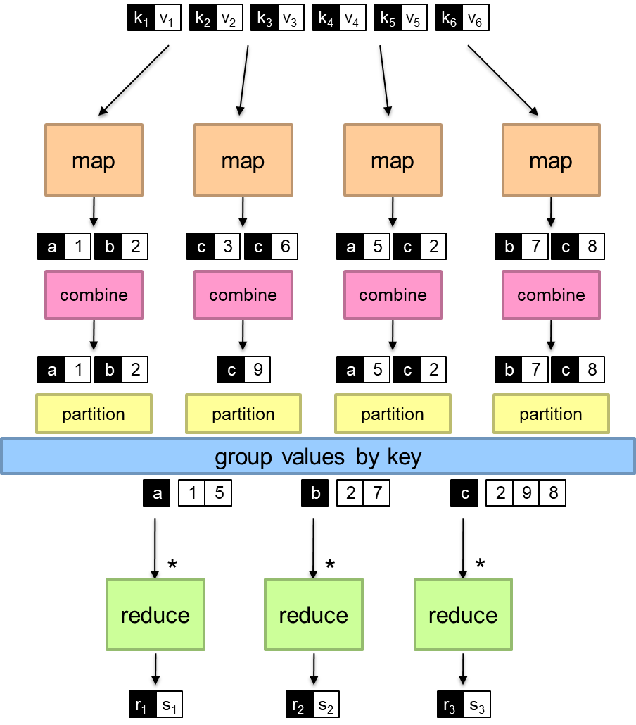
Splitting job
Intermediate combining
Final combining

Slide 6
Problem: Computing Mean
A shop has a database which contains the customer names and the time spent by the customer in the shop in each visit. Find the average time spent by each customer in the shop.
Name | Time spent on each visit
amar | 10
amar | 20
rakesh | 15
rakesh | 25
sanjib | 7
rakesh | 25
amar | 30
sony | 20
jiban | 15

Slide 7
Computing mean: Use of combiner
class Reducer
method Reduce(string t; pairs [(s1; c1); (s2; c2) : : :])
sum = 0
count = 0
for all pair (s; c) in pairs [(s1; c1); (s2; c2) : : :] do
sum = sum + s
count = count + c
avg = sum/count
Emit(string t; integer avg)
class Mapper
method Map(string t; integer r)
Emit(string t; pair (r, 1))
class Combiner
method Combine(string t; pairs [(s1; c1); (s2; c2) : : :])
sum = 0
count = 0
for all pair (s; c) in pairs [(s1; c1); (s2; c2) : : :] do
sum = sum + s
count = count + c
Emit(string t; pair (sum, count))

Slide 8
Combiner: Warning!
class Combiner
method Combine(string t; integers [r1; r2; : : :])
sum = 0
count = 0
for all integer r in integers [r1; r2; : : :] do
sum = sum + r
count = count + 1
Emit(string t; pair (sum, count))
class Mapper
method Map(string t; integer r)
Emit(string t; integer r)
class Reducer
method Reduce(string t; pairs [(s1; c1); (s2; c2) : : :])
sum = 0
count = 0
for all pair (s; c) in pairs [(s1; c1); (s2; c2) : : :] do
sum = sum + s
count = count + c
avg = sum/count
Emit(string t; integer avg)
Combiner output must match with mapper output

Slide 9
Spark Fast Big Data Processing

Slide 10
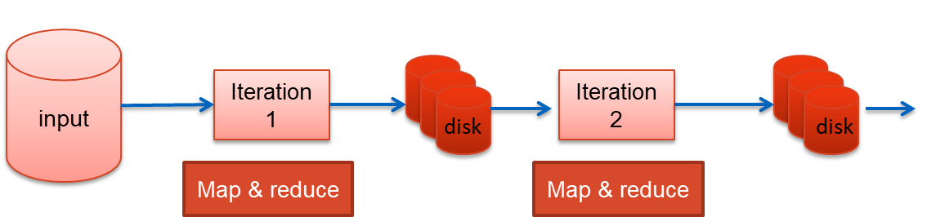
Iterative Algorithm in Map-reduce

Slide 11
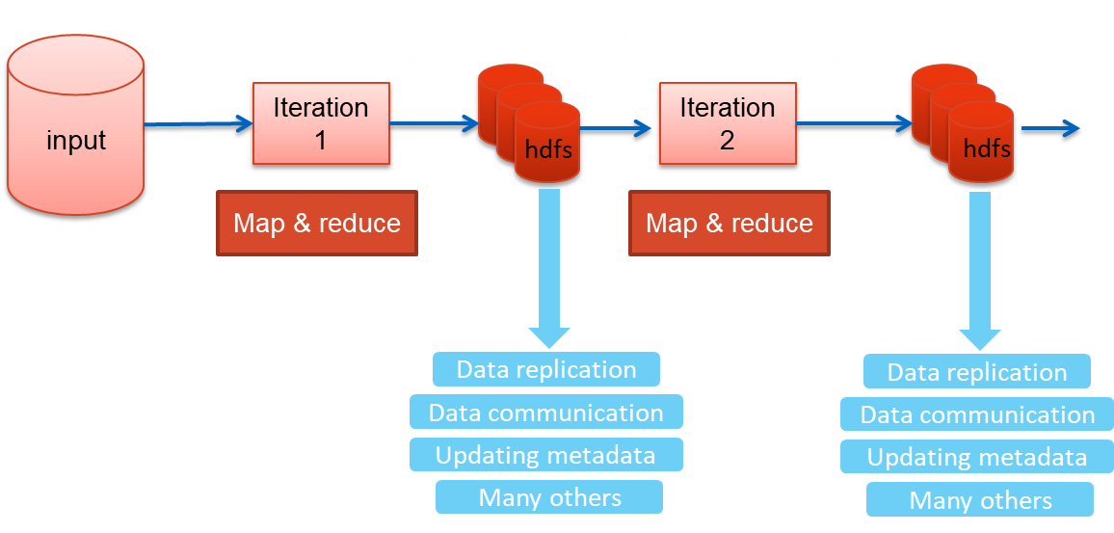
Iterative Algorithm in Map-reduce: Issues

Slide 12
Limitations of basic map-reduce
Good for one-pass computation
But inefficient for multi-pass algorithms
k-means, gradient descent
Spark uses an in-memory distributed data structure to store the data that is repeatedly used
Read-only data structure

Slide 13
Key Concept in Spark for Working with Data
Resilient Distributed Dataset (RDD)
Resilient: can re-compute missing or damaged partitions due to node failures
Distributed: data residing on multiple nodes in a cluster
Dataset: a collection of partitioned data with primitive values (e.g., int, string) or any user defined object (e.g., (word, count) pairs)
RDD of strings
RDD of pairs
(word, count)
am
am, 10
master
master, 5
natural
one element
natural, 7
student
student, 17

Slide 14
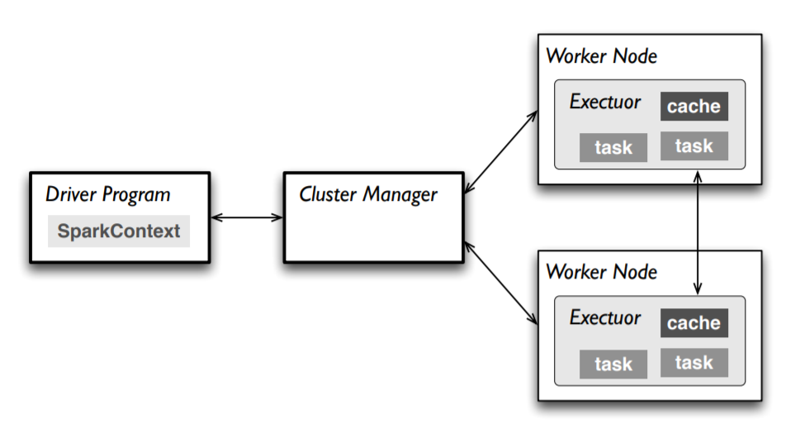
Master
Connects to a cluster manager which allocate resources across applications
Acquires executors on cluster nodes – worker processes to run computations and store data
Sends app code to the executors

Slide 15
Main Steps of an RDD Processing
Create RDD from external data (from distributed file system or local file system)
Transform them to define new RDDs using transformations
map(), filter()
Store in memory any intermediate RDDs that will need to be reused.
persist()
Launch actions to kick off a parallel computation
count()

Slide 16
Creating an RDD
Two ways to do it
By loading an external dataset from disk
Parallelizing a collection in your driver (main) program
val rdd = sc.textFile(“inputFile”)
val lines = sc.parallelize(List("pandas", "i like pandas"))
sc denotes the spark context that calls the spark core and manages the cluster

Slide 17
RDD Operations
Two types of Operations
Transformations
Example: map(), filter()
Actions
Example: count(), saveAsTextFile()

Slide 18
RDD Operations
Transformations
Transformations create a new dataset from an existing one
All transformations in Spark are lazy:
they do not compute their results right away
they remember the transformations applied to some base dataset
the transformed RDD gets recomputed when an action is run on it
Optimizes the required calculations
Recover from the lost data partitions

Slide 19
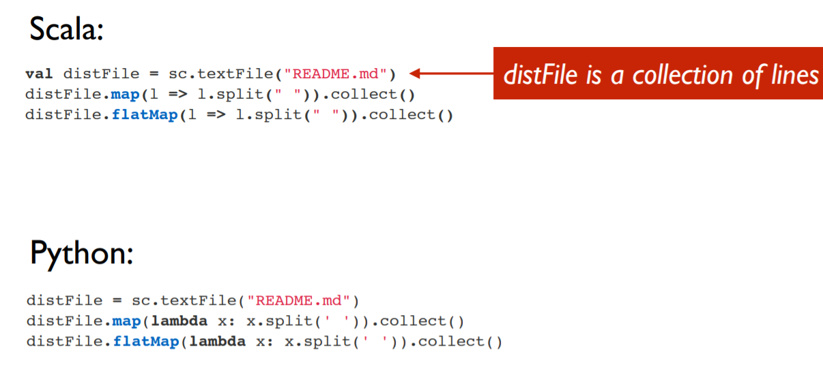
Transformations: Examples

Slide 20
RDD Operations
Actions
Operations that return a result
It kicks off a computation
This is when transformations of RDDs are applied

Slide 21
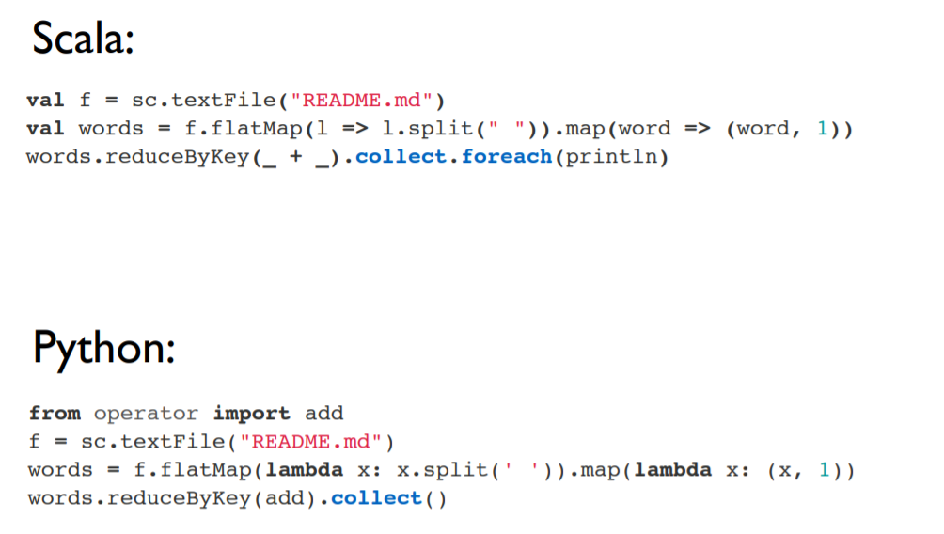
Actions: Examples

Slide 22
Anatomy of an RDD Operation
newRDD = oldRDD.map(….)
creates new RDD from old RDD
and saves in newRDD
User defined code/function

Slide 23
Lazy Evaluation
Spark does not immediately perform an operation
It simply remembers it
Uses a flow graph for memorizing
It kicks off computation if an action operation is requested

Slide 24
An Example Code
data.txt
-------------
I am here
She is there
You are here
val lines = sc.textFile("data.txt")
val lineLengths = lines.map(s => s.length)
val totalLength = lineLengths.reduce((a, b) => a + b)
action

Slide 25
RDD Persistence

Slide 26
RDD Persistence
Spark can persist (or cache) a dataset in memory across operations
Each node stores in memory any slices of it that it computes and reuses them in other actions on that dataset
often making future actions more than 10x faster
The cache is fault-tolerant:
if any partition of an RDD is lost, it will automatically be recomputed using the transformations that originally created it

Slide 27
Persistence (Caching)
Goal is to keep RDD in memory, distributed across machines
Important for iterative computation to increase efficiency
Storage Level | Description
MEMORY_ONLY | Stores RDD in memory
MEMORY_AND_DISK | Store RDD in memory. If RDD does not fit in memory, store the partitions that don't fit on disk, and read them from there when they're needed.
DISK_ONLY | Store the RDD partitions only on disk.
MEMORY_ONLY_2, MEMORY_AND_DISK_2 | Same as the levels above, but replicate each partition on two cluster nodes.
Usage: yourRdd.MEMORY_ONLY

Slide 28
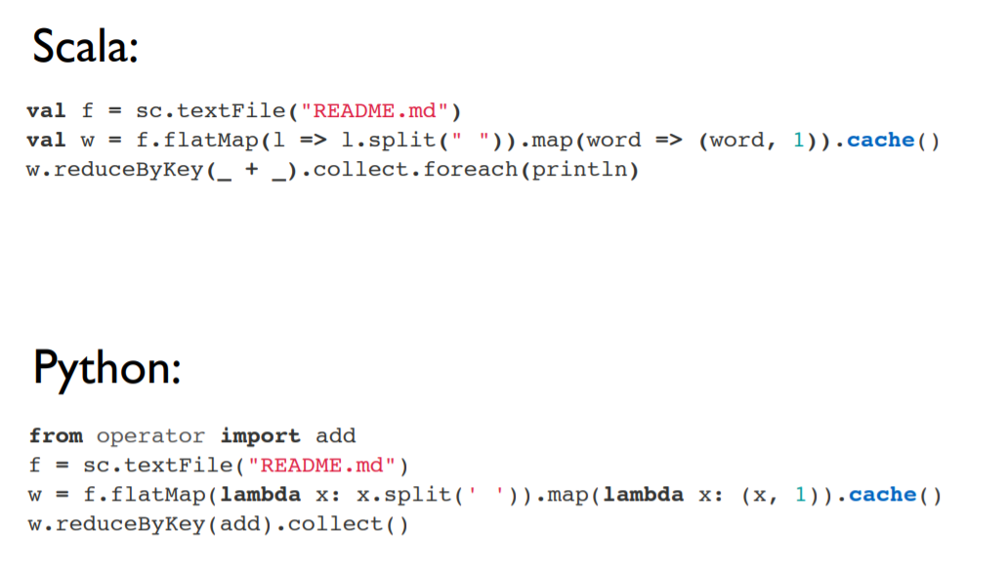
RDD Persistence: Example

Slide 29
Distributed Execution of RDD

Slide 30
Example
Error log mining
Search for various patterns in an error log.
Log file
======
ERROR: java lang.io problem
ERROR: insufficient memory
ERROR: array out of bound

Slide 31
Example
Error log mining
Search for various patterns in an error log.
// load data from file
val lines = sc.textFile("hdfs://...")
// apply transformations
val errors = lines.filter(_.startsWith(“ERROR"))
val messages = errors.map(_.split("\t")).map(r => r(1))
messages.cache()
// perform action 1
messages.filter(_.contains(“java")).count()
// perform action 1
messages.filter(_.contains(“memory")).count()

Slide 32
Example
Error log mining
Search for various patterns in an error log.
worker
// load data from file
val lines = sc.textFile("hdfs://...")
// apply transformations
val errors = lines.filter(_.startsWith(“ERROR"))
val messages = errors.map(_.split("\t")).map(r => r(1))
messages.cache()
// perform action 1
messages.filter(_.contains(“java")).count()
// perform action 2
messages.filter(_.contains(“memory")).count()
driver
worker
worker

Slide 33
RDD Operator Graph
// load data from file
val lines = sc.textFile("hdfs://...")
// apply transformations
val errors = lines.filter(_.startsWith(“ERROR"))
val messages = errors.map(_.split("\t")).map(r => r(1))
messages.cache()
HadoopRDD
FilteredRDD
MappedRDD
MappedRDD

Slide 34
Example
worker
// load data from file
val lines = sc.textFile("hdfs://...")
// apply transformations
val errors = lines.filter(_.startsWith(“ERROR"))
val messages = errors.map(_.split("\t")).map(r => r(1))
messages.cache()
// perform action 1
messages.filter(_.contains(“java")).count()
// perform action 2
messages.filter(_.contains(“memory")).count()
worker
driver
worker

Slide 35
Example
Worker
block 1
// load data from file
val lines = sc.textFile("hdfs://...")
// apply transformations
val errors = lines.filter(_.startsWith(“ERROR"))
val messages = errors.map(_.split("\t")).map(r => r(1))
messages.cache()
// perform action 1
messages.filter(_.contains(“java")).count()
// perform action 2
messages.filter(_.contains(“memory")).count()
Worker
block 2
driver
Worker
block 3

Slide 36
Example
Worker
block 1
// load data from file
val lines = sc.textFile("hdfs://...")
// apply transformations
val errors = lines.filter(_.startsWith(“ERROR"))
val messages = errors.map(_.split("\t")).map(r => r(1))
messages.cache()
// perform action 1
messages.filter(_.contains(“java")).count()
// perform action 2
messages.filter(_.contains(“memory")).count()
Read
hdfs block
Worker
block 2
Read
hdfs block
driver
Worker
block 3
Read
hdfs block

Slide 37
Example
Cache 1
Worker
block 1
// load data from file
val lines = sc.textFile("hdfs://...")
// apply transformations
val errors = lines.filter(_.startsWith(“ERROR"))
val messages = errors.map(_.split("\t")).map(r => r(1))
messages.cache()
// perform action 1
messages.filter(_.contains(“java")).count()
// perform action 2
messages.filter(_.contains(“memory")).count()
Process,
Cache data
Cache 2
driver
Worker
block 2
Process,
Cache data
Cache 3
Worker
block 3
Process,
Cache data

Slide 38
Example
Worker
block 1
// load data from file
val lines = sc.textFile("hdfs://...")
// apply transformations
val errors = lines.filter(_.startsWith(“ERROR"))
val messages = errors.map(_.split("\t")).map(r => r(1))
messages.cache()
// perform action 1
messages.filter(_.contains(“java")).count()
// perform action 2
messages.filter(_.contains(“memory")).count()
Cache 1
driver
Worker
block 2
Cache 2
Worker
block 3
Cache 3

Slide 39
Example
Worker
block 1
Cache 1
// load data from file
val lines = sc.textFile("hdfs://...")
// apply transformations
val errors = lines.filter(_.startsWith(“ERROR"))
val messages = errors.map(_.split("\t")).map(r => r(1))
messages.cache()
// perform action 1
messages.filter(_.contains(“java")).count()
// perform action 2
messages.filter(_.contains(“memory")).count()
driver
Worker
block 2
Cache 2
Worker
block 3
Cache 3

Slide 40
Example
Cache 1
Worker
block 1
Process from cache
// load data from file
val lines = sc.textFile("hdfs://...")
// apply transformations
val errors = lines.filter(_.startsWith(“ERROR"))
val messages = errors.map(_.split("\t")).map(r => r(1))
messages.cache()
// perform action 1
messages.filter(_.contains(“java")).count()
// perform action 2
messages.filter(_.contains(“memory")).count()
Cache 2
driver
Worker
block 2
Process from cache
Cache 3
Worker
block 3
Process from cache

Slide 41
RDD Operations: Examples

Slide 42
Example of Basic RDD Transformations: Single RDD
RDD containing {1,2,3,3}
Function | Description | Example | Result
map() | Apply a function to each element in the RDD and return an RDD of the result | rdd.map(x => x + 1) | {2, 3, 4, 4}
flatMap() | Apply a function to each element in the RDD and return an RDD of the contents of the iterators returned. | rdd.flatMap(x => x.to(3)) | {1, 2, 3, 2, 3, 3, 3}
filter | Return an RDD consisting of only elements that pass the condition passed to filter(). | rdd.filter(x => x != 1) | {2, 3, 3}
distinct | Remove duplicates. | rdd.distinct() | {1, 2, 3}
sample(withRe placement, frac tion, [seed]) | Sample an RDD, with or without replacement. | rdd.sample(false, 0.5) | Nondeterministic

Slide 43
Example of Basic RDD Actions
RDD containing {1, 2, 3, 3}
Function | Description | Example | Result
collect() | Return all elements from the RDD. | rdd.collect() | {1, 2, 3, 3}
count() | Number of elements in the RDD. | rdd.count() | 4
top() | Return the top num elements the RDD. | rdd.top(2) | {3, 3}
countByValue() | Number of times each element occurs in the RDD. | rdd.countByValue() | {(1, 1), (2, 1), (3, 2)}
reduce() | Combine the elements of the RDD together in parallel (e.g., sum). | rdd.reduce((x, y) => x + y) | 9

Slide 44
Example of Basic RDD Transformations: Two RDD
Two-RDD transformations on RDDs containing {1, 2, 3} and {3, 4, 5}
Function | Description | Example | Result
union() | Produce an RDD containing elements from both RDDs. | rdd.union(other) | {1, 2, 3, 3, 4, 5}
intersection() | Common elements | rdd.intersection(other) | {3}
subtract() | Remove the contents of one RDD | rdd.subtract(other) | {1, 2}
Cartesian() | Cartesian product with the other RDD. | rdd.cartesian(other) | {(1,3), (1,4), …}

Slide 45
Paired RDD: Transformations
RDD containing key-value pairs
The fundamental concept behind original map-reduce model
Transformations on one paired RDD containing {(1, 2), (3, 4), (3, 6)}
Function | Description | Example | Result
reduceByKey(func) | Combine values with the same key. | rdd.reduceByKey( (x, y) => x + y) | {(1,2), (3,10)}
groupByKey() | Group values with the same key. | rdd.groupByKey() | {(1,[2]),(3, [4,6])}
mapValues(func) | Apply a function to each value of a pair RDD without changing the key. | rdd.mapValues(x => x+1) | {(1,3), (3,5), (3,7)}
keys() | Return an RDD of just the keys. | rdd.keys() | {1, 3,3}
values() | Return an RDD of just the values. | rdd.values() | {2, 4,6}
sortByKey() | Return an RDD sorted by the key. | rdd.sortByKey() | {(1,2), (3,4), (3,6)}

Slide 46
Paired RDD: Actions
RDD containing {(1, 2), (3, 4), (3, 6)}
Function | Description | Example | Result
countByKey() | Count the number of elements for each key. | rdd.countByKey() | {(1, 1), (3, 2)}
lookup(key) | Return all values associated with the provided key. | rdd.lookup(3) | {4,6}

Slide 47
Two Paired RDD: Transformations
Transformations on two paired RDDs: (rdd = {(1, 2), (3, 4), (3, 6)}, other = {(3, 9)})
Function | Description | Example | Result
join | Perform an inner join between two RDDs. | rdd.join(other) | {(3, (4, 9)), (3, (6, 9))}
cogroup | Group data from both RDDs sharing the same key. | rdd.cogroup(other) | {(1,([2],[])), (3, ([4, 6],[9]))}

