Slide 1
ASANSOL ENGINEERING COLLEGE · ALUMNI TALK, PART 2
Build a Tiny Captioning VLM
A frozen vision encoder, a learned adapter, and a small decoder -- trained live, on a laptop.
“From scratch” only for the two pieces that actually train here.
1

Slide 2
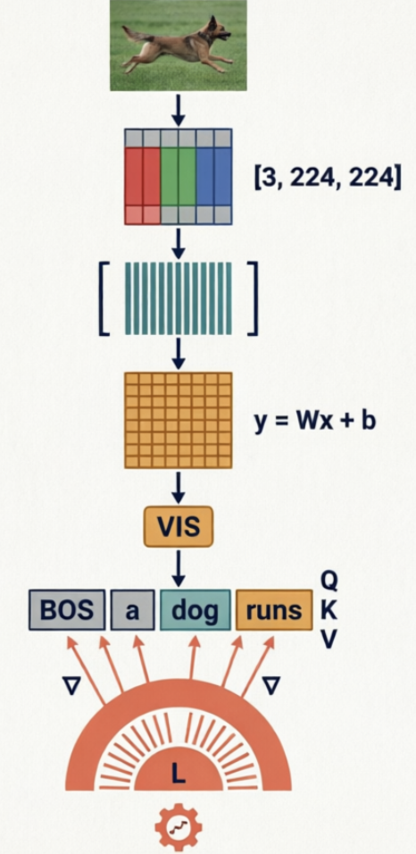
LEARNING OUTCOMES
One tensor's journey, start to finish
By the end of this talk you should be able to trace one image, as a tensor, through every stage below -- and connect each stage back to Part 1's mathematics.
Part 1 concept | Where it shows up today
y = Wx + b | The two linear layers inside the projector
Embeddings | CLIP's pooled vector; the decoder's token embeddings
Attention | Causal self-attention over [visual token, caption tokens]
Loss minimization | Cross-entropy on the next caption token
Backpropagation | loss.backward()
Adam | torch.optim.AdamW
2

Slide 3
STEP 0 · BEFORE ANYTHING ELSE
Start training now. We'll watch it while we talk.
$ ./hardware.sh
tinyVLM hardware + environment check
------------------------------------------------------------
OS : Darwin 25.6.0 arm64
CPU : Apple M4
CPU cores : 10 physical / 10 logical
RAM total : 32 GB
-- RAM mostly matters for image decoding + CLIP feature caching, not
model size: the trainable parameters here fit in a few hundred MB.
GPU / accel :
Chipset Model: Apple M4
Metal Support: Metal 4
$python3 trainVLM.py --config config.demo.yaml
# THE exact command timed for this talk: 350 steps, batch size 16,
# a fixed 1,500-image training subset (repeated ~3.7x) -- see config.demo.yaml
Dataset, CLIP weights, and the holdout demo images are already cached on this machine.
3

Slide 4
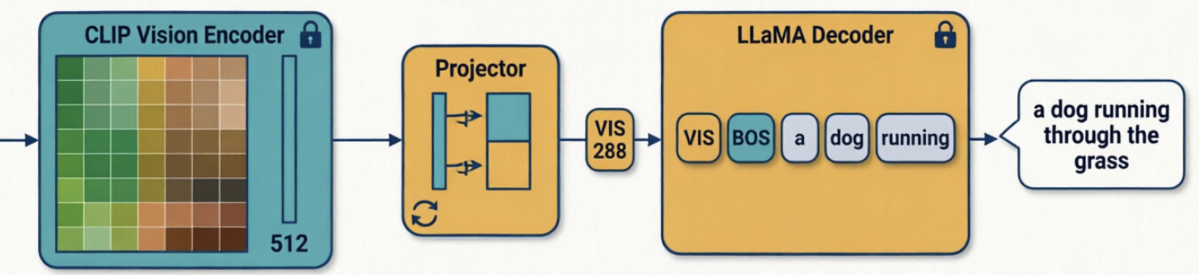


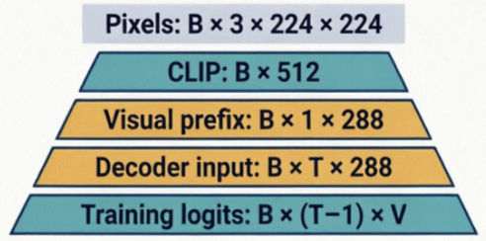
THE WHOLE MODEL, WITH SHAPES
Image in, sentence out
pixels [B, 3, 224, 224] <- one photo, batch of B
CLIP embedding [B, 512] <- pooled, frozen, cached per image
visual token [B, 1, 288] <- projector output
text embeddings [B, T-1, 288] <- BOS + caption so far
decoder input [B, T, 288] <- concat(visual token, text embeddings)
logits [B, T-1, V] <- see 'teacher forcing' slide for the T-1
Gray = input, not a model. Teal = frozen. Amber = the two things that train. This is visual-PREFIX self-attention, not cross-attention -- there's one sequence, no separate image keys/values.
3

Slide 5
STAGE 1 · DATA
Split by image, not by caption
image : 1000268201_693b08cb0e.jpg
caption_0 : a child in a pink dress is climbing up a set of stairs
caption_1 : a girl going into a wooden building
caption_2 : a little girl climbing into a wooden playhouse
caption_3 : a little girl climbing the stairs to her playhouse
caption_4 : a little girl in a pink dress going into a wooden cabin
Five captions, one photo. They're near-duplicates of each other -- which is exactly why the split has to happen at the IMAGE level, before any caption is picked.
TRAIN
~6,000 images official
(1,500-image subset for this demo)
VALIDATION
~1,000 images
picks best.pt
TEST / HOLDOUT
~1,000 images
never trained on
5

Slide 6
Configuration parameters : data
Field | Meaning
dataset | HuggingFace dataset id (jxie/flickr8k), passed to load_dataset()
cache_dir | Where the downloaded images/captions get cached locally
image_size | Documents CLIP's expected input size (224×224); the actual resizing happens inside CLIPImageProcessor, not read directly from here
max_caption_len | Caption token cap, including <bos>/<eos> — longer captions get truncated
seed | Used for the train-subset shuffle and the holdout-image selection, so both are reproducible run to run
train_subset_size | The lecture-specific trick: train on only this many images (1,500) instead of the full ~6,000, so the CLIP feature cache actually gets reused within 350 steps (see the file header comment)
export_holdout | Whether to write demo images + references + manifest to disk on each run
holdout_dir | Where those go (inferVLM.py --holdout-index reads from here)
holdout_n | How many holdout images to export

Slide 7
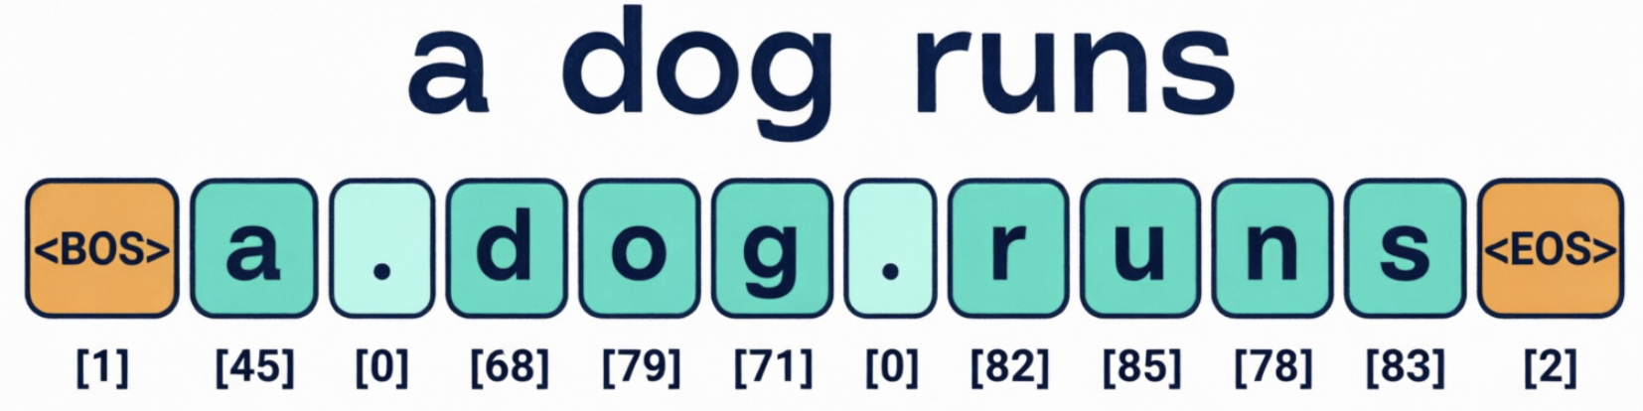
STAGE 2 · TOKENIZATION & BATCHING
Turning text into padded integer tensors
1
Character-level tokenizer, by default
no additional tokenizer model download; vocab built from the training captions themselves (~75 symbols).
2
One caption sampled per image per epoch
a different one of the five each epoch -- free augmentation, no expanded dataset.
3
Pad to the longest caption in the batch
no attention mask needed: right-padding + causal attention can't leak, and the loss ignores pad positions directly.
Sample | Original caption | Character tokens | Padded tensor row | Loss evaluated on
A | a dog | <bos> a d o g <eos> | <bos> a d o g <eos> <pad> <pad> <pad> | a d o g <eos>
B | two cats | <bos> t w o c a t s <eos> | <bos> t w o c a t s <eos> | t w o c a t s <eos>
6

Slide 8
Configuration parameters : projector
Field | Meaning
freeze_decoder | false = decoder trains too (the default);
batch_size | Images per gradient step (16)
epochs / max_iters | max_iters is what actually stops the run (350);
lr | Peak learning rate for AdamW
weight_decay | AdamW's L2-like regularization strength
grad_clip | Max gradient norm before clipping, for stability
warmup_iters | Steps over which lr ramps up linearly before the cosine decay (see get_lr())
log_every | How often to print/log a training-loss row
eval_every | How often to run validation and possibly save best.pt
ckpt_every | How often to save a numbered checkpoint + last.pt
out_dir | Where checkpoints go
metrics_csv | Where the CSV visualize.py reads gets written; blank = <out_dir>/metrics.csv
device | auto picks cuda > mps > cpu
dtype | Documented but not currently switched on (training always runs in float32)
num_workers | DataLoader worker processes for image loading

Slide 9
Configuration parameters : decoder
Field | Meaning
dim | Embedding/hidden dimension (288)
n_layers | Transformer blocks stacked (6)
n_heads / n_kv_heads | Attention heads; equal here means ordinary multi-head attention (grouped-query attention only kicks in if n_kv_heads < n_heads)
max_seq_len | Longest sequence the rotary position embeddings are precomputed for
multiple_of | Rounds the SwiGLU MLP's hidden size up to a multiple of this, matching llama2.c's convention
dropout | 0 here — no regularization needed at this scale/step count
init_checkpoint | Blank by default (random init); optionally a path to a llama2.c stories15M.bin for the opt-in comparison experiment
tokenizer | Blank by default; optionally a SentencePiece tokenizer.model path, required if you use init_checkpoint
fallback_tokenizer | What to use when tokenizer is blank — the character-level tokenizer

Slide 10
STAGE 3 · FORWARD PASS
TinyVLM.forward(), line by line
img_feat = clip_features or self.encode_image(pixel_values) # [B, 512]
visual_tok = self.projector(img_feat) # [B, 1, 288]
tok_embeds = self.decoder.tok_embeddings(caption_ids[:, :-1]) # [B, T-1, 288]
x = cat([visual_tok, tok_embeds], dim=1) # [B, T, 288]
logits = self.decoder(x, is_embeds=True) # [B, T, V]
return logits[:, 1:, :] # <- aligned with caption_ids[:, 1:]; see next slide
Sequence fed to the decoder: [visual, BOS, tok_1, ..., tok_{T-2}]. Decoder position i predicts sequence position i+1 --
7

Slide 11
STAGE 5 · BACKPROPAGATION & ADAMW
Three lines most of the mathematics lecture was about
loss.backward() # backprop: d(loss)/d(every trainable weight)
torch.nn.utils.clip_grad_norm_(trainable, 1.0)
optim.step() # AdamW: adaptive per-parameter updates
[model] parameters --
frozen: 88,000,000
decoder: 5,995,872
projector: 410,400
trainable total: 6,406,272
What's actually trainable?
Decoder: ~6.0M params (char tokenizer)
Projector: 410,400 params
Both computed by build_model() at startup
9

Slide 12
STAGE 6 · WATCHING IT LEARN
Training loss going down is necessary. Not sufficient.
step 150/350 | loss 3.21 | lr 2.9e-04 | 41.2 examples/s | 58.1s elapsed | ETA 78s
step 160/350 | loss 3.09 | lr 2.8e-04 | 42.0 examples/s | 61.5s elapsed | ETA 70s
[eval] val_loss 3.34 (val feature cache: 320 images cached)
[ckpt] new best -- saved checkpoints/best.pt
Plot both curves, not just training loss: smoothed train loss, validation loss at each eval point, and a marker for whichever checkpoint is currently best.pt. This demo trains on a fixed 1,500-image subset for ~3.7 passes -- watch for validation loss stalling or rising while training loss keeps falling, the expected sign of overfitting on a small, repeated subset.
10

Slide 13
MID-TALK CHECK-IN
Let's flip back to that terminal
step 240/350 | loss 2.51 | lr 1.9e-04 | 43.8 examples/s | 92.3s elapsed | ETA 25s
[eval] val_loss 2.88
[ckpt] saved checkpoints/step200.pt
Loss trending down, a best.pt on disk, an ETA in the tens of seconds -- that's everything the rest of the talk needs to be true. Back to the slides.
11

Slide 14
STAGE 7 · AUTOREGRESSIVE GENERATION
Training sees the whole caption. Inference doesn't.
Training | Inference
Whole caption available at once | Only the generated prefix so far
Teacher forcing | Autoregressive feedback, one token back in
Cross-entropy loss | Greedy (default) or temperature/top-k sampling
Many positions scored in parallel | One new token computed at a time
This asymmetry is exactly why the teacher-forcing alignment bug mattered: training could look fine while inference -- which never gets the luxury of the true next token -- produced nonsense.
12

Slide 15
STAGE 8 · LIVE DEMO
One test-split photo, greedy decoding, reproducible
$ python3 inferVLM.py --config config.demo.yaml --checkpoint checkpoints/best.pt --holdout-index 0
image : demo/holdout_0000.jpg
decoding : greedy (reproducible)
caption : a dog running through the grass
references :
- a brown dog runs through the green grass
- a dog is running in a field
An unseen image tests generalization -- one plausible caption next to the five human references is qualitative evidence, not proof. Greedy decoding is the default here specifically so this exact command reproduces this exact caption every time.
13

Slide 16
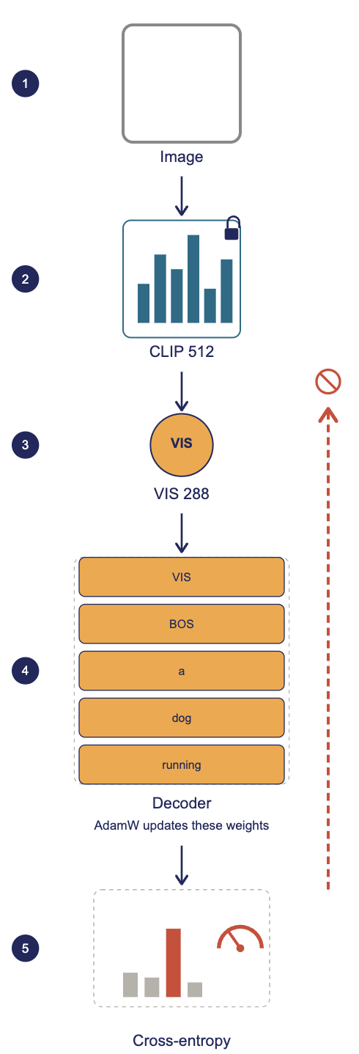
RECAP
The tensor's whole journey, in five steps
1
CLIP represents the image
a 512-dim vector, computed once, cached, never updated.
2
The projector produces a visual prefix
the only new, from-scratch idea in this build.
3
The decoder predicts caption tokens
causal self-attention over [visual, caption-so-far], random init.
4
Cross-entropy measures the error
correctly aligned: logits[:, 1:] against caption_ids[:, 1:].
5
Backprop updates decoder + projector
CLIP stays frozen throughout -- including through model.train().
14

Slide 17
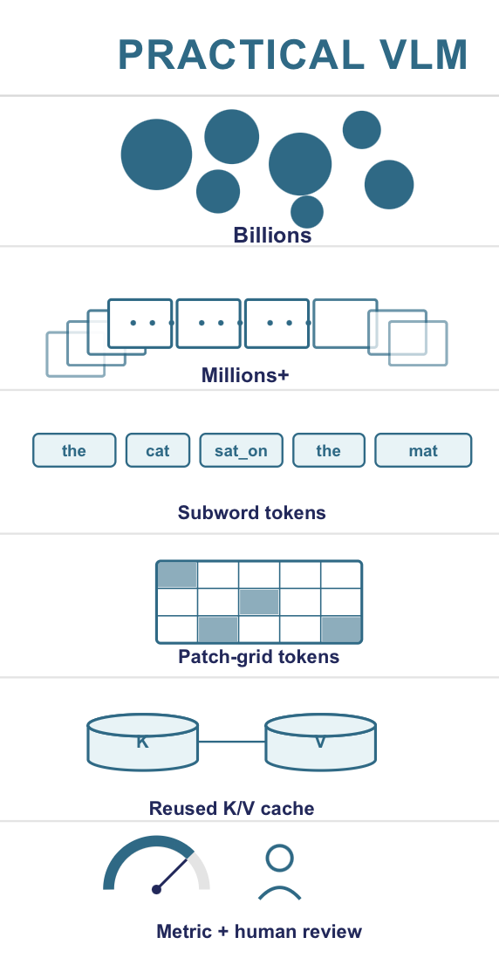
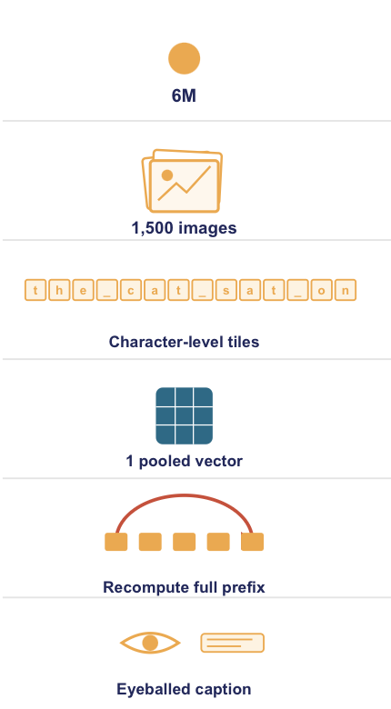
SCOPE, HONESTLY
This is a toy. Here's exactly why.
THIS EXAMPLE
!
Scale
6-15M decoder params vs. billions in a real VLM
!
Data
1,500 training images (this demo) vs. hundreds of millions of pairs
!
Tokenization
character-level, not a trained subword vocabulary
!
Visual detail
one pooled embedding, not per-patch cross-attention
!
No KV-cache
generation recomputes attention over the whole prefix each step
!
No formal metric
no BLEU/CIDEr -- judged by reading captions, not scoring them
15

Slide 18
EXTENDING THIS · SCALE & DEPLOYMENT
From lecture demo toward something real
1
Bigger data needs a dataset-specific adapter
COCO/LAION aren't drop-in -- tinyvlm_data.py assumes Flickr8k's exact column names and official splits.
2
A real multimodal pretrained checkpoint
swap in an open small VLM's weights where freezing the decoder actually makes sense.
3
Exporting the decoder isn't exporting the model
llama2.c's run.c handles the decoder alone -- CLIP and the projector still need their own export path (e.g. ONNX/Core ML).
4
A real GPU box
same trainVLM.py, pointed at cuda instead of cpu/mps -- device is a speed knob here, not a correctness one.
17

Slide 19
EXTENDING THIS · FUNCTIONALITY
Same recipe, more capable -- with the caveats included
1
Run the stories15M comparison
seed the decoder from Karpathy's text-only checkpoint (tokenizer.model, not tokenizer.bin) and compare its loss curve to random init -- measure it, don't assume it.
2
Project more visual tokens
CLIP's patch-level features as a longer prefix -- still self-attention over a longer sequence, NOT automatically cross-attention.
3
Turn captioning into VQA
needs a real input/target convention and loss masking on the question tokens, not just a prepended question.
4
Freeze the decoder -- once it has a prior worth freezing
a standard alignment pattern: freeze a language-capable decoder (text-pretrained or multimodal), train only the projector. Freezing the default RANDOM decoder trains nothing useful.
16

Slide 20
THE STRONGEST DEMO YOU CAN RUN
Does it use the image, or recite a common sentence?
Condition | Visual token fed to the decoder
(a) Matched | this photo's real CLIP embedding
(b) Shuffled | a different photo's CLIP embedding
(c) Image-independent | no visual token at all
Same decoder, same checkpoint, same decoding settings -- only the visual token changes. If (a)'s caption differs meaningfully from (b) and (c), that's evidence the model is conditioning on the actual image, not just generating a generic Flickr-style sentence.
18

Slide 21
TAKE-HOME EXERCISES
Layered by year, so everyone has something to do
2
Annotate every tensor shape in tinyvlm_model.py
and calculate iterations-per-epoch for a batch size of your choice.
3
Find and re-fix the two bugs this talk covered
from a deliberately-reintroduced-bug copy of the code -- alignment and split leakage.
4
Run one ablation from the earlier slide
random vs. text-pretrained init, pooled vs. patch features, or frozen vs. trainable decoder -- bring a loss curve.
19

Slide 22
BACK TO THAT TERMINAL, ONE LAST TIME
Is it done? Take it home and break it.
[train] done. final checkpoint: checkpoints/last.pt
best val_loss checkpoint: checkpoints/best.pt
$ python3 trainVLM.py --config config.demo.yaml --smoke-test
$ python3 inferVLM.py --config config.demo.yaml --checkpoint checkpoints/best.pt --holdout-index 0
20

