Slide 1
Buzzwords from Oracle Code One - 2019
GraalVM
Quarkus/Micronaut/Helidon
Evolution of Server Side Java – Java EE
Microprofile
JDK 13 . Features overview – JDK 9,10,11,12,13
Cloud Native Architectures with Service Mesh
Contributing to Opensource

Slide 2
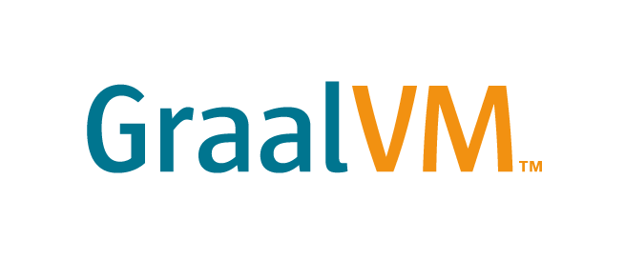
Graal VM – What is it ?
Universal
Virtual
Machine
Start your programs
Blazing fast
Written in
Java and is Opensource
Very low memory foot print
Polyglot VM that can run
Java, Javascript, Python, Ruby, R , Scala, Kotlin etc
Native Image builder

Slide 3
Graal VM – How does it work ?
Traditional JIT compilation at a high-level
Java Hello
Javac Hello.java
Byte Code Interpreter
JIT Compiler
Hello.class ( Byte Code )
Native Machine Code
Compile Time
Run time

Slide 4
Graal VM – How does it work ?
Graal Compilation at a high-level
Javac Hello.java
Java –XX AOTLibrary=Hello
Byte Code Interpreter
Hello.class ( Byte Code )
JIT Compiler
Jaotc Hello.class
( AOT compilation )
Execute Native Machine Code
Compile Time
Run time

Slide 5
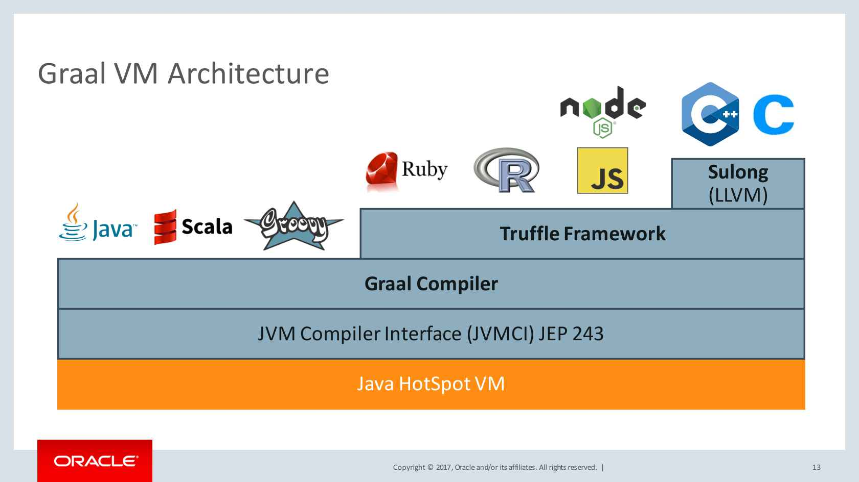
Graal VM – Architecture

Slide 6

Graal VM – Demo Hello World

Slide 7



Quarkus/Micronaut/Helidon – What are they ?
Light weight Frame works
Built to apply the benefits of GraalVM
Helidon is Oracle’s and Quarkus is Redhat’s
All these projects are intended for micro service development using light weight micro profile .
Anything extra can be added or configured to the project using extensions

Slide 8
Quarkus/Micronaut/Helidon – Startup Time graph
Native Image
10.5ms
Quarkus
JDK 8
983ms
30ms
Micronaut
1967ms
Helidon
25ms
979ms
500ms
1000ms
1500ms
2000ms

Slide 9
Quarkus/Micronaut/Helidon – Memory Footprint graph
Native Image
16MB
Quarkus
JDK 8
160MB
37MB
Micronaut
198MB
Helidon
26MB
107MB
50MB
100MB
150MB
200MB

Slide 10

Quarkus/Micronaut/Helidon – Why care about startup and memory footprint
Efficient On
Demand
Scaling of the applications
Low Down time
During the scaling process
Low compute costs that can be saved on Memory and CPU

Slide 11
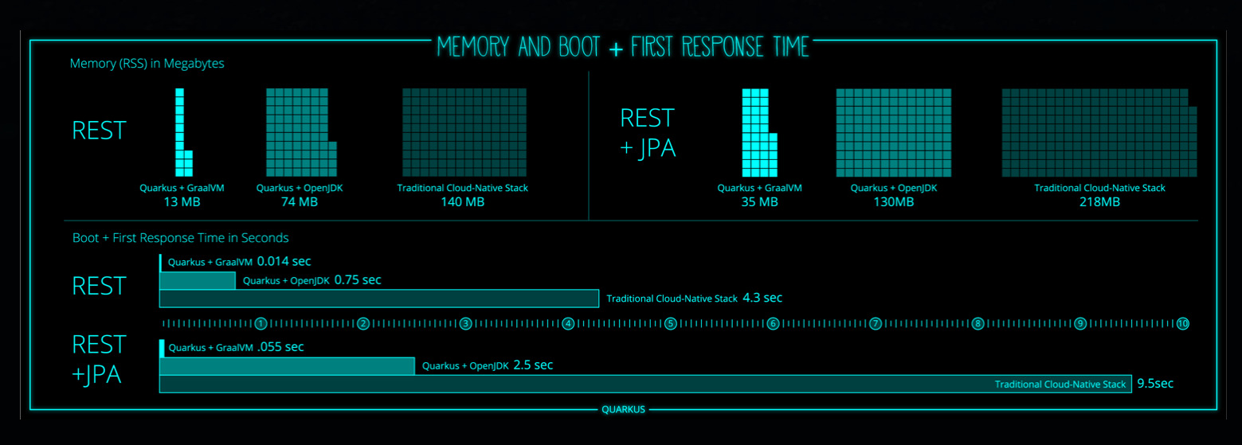
Quarkus – Supersonic Subatomic Java from Redhat

Slide 12
Quarkus/Micronaut/Helidon - Challenges for adoption
Not Supported
OK with Caveats
Dynamic Class loading
InvokeDynamic & method handles
Finalizer
Security Manager
JMX, native VM interfaces
Reflection(Manual List)
Dynamic Proxy ( Manual list)
JNI ( manual list )
Static initializers ( eager )

Slide 13
Quarkus – Demo
- Quarkus – getting started – REST and REST+JPA
- Show Native Image generation and Openshift scaling

Slide 14


