Slide 1

Buzzwords from Java One- 2015
Migrating to Cloud
Dev Ops
MicroServices
MicroServices
Modularization/Java-9
OSGI
Internet Of Things
Containerization
Spring Boot
- presented by
Subhash Koganti

Slide 2
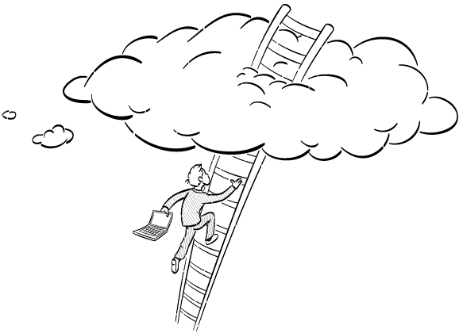
Migrating to Cloud Native Architectures
Why Move to Cloud ?
Cheaper
Easy to Scale
Faster
Application High Availability
Easy to reach global customers
Application Monitoring Services

Slide 3

Migrating to Cloud Native Architectures
Are there any risks ?
Adopting Maturing Technology
Vendor Dependency
Security
Lack of Direct Control on Infrastructure

Slide 4

Migrating to Cloud Native Architectures
Pain Points of traditional Architectures
Maintaining state in the memory
Monolithic
Shared FileSystems
Complex/Centralized Service oriented Middleware
Fat Complex Objects

Slide 5
Migrating to Cloud Native Architectures
Cloud Native Architectures / Twelve Factor Apps
CodeBase
Port Binding
Dependencies
Concurrency
Config
Disposability
Backing Services
Dev/Prod Parity
Build, Release, Run
Logs
Processes
Admin processes

Slide 6
Migrating to Cloud Native Architectures
Cloud Services Offered by different Vendors
Code
Data
Middleware
OS
Virtualization
Servers
Storage
Networking
SAAS
PAAS
IAAS

Slide 7

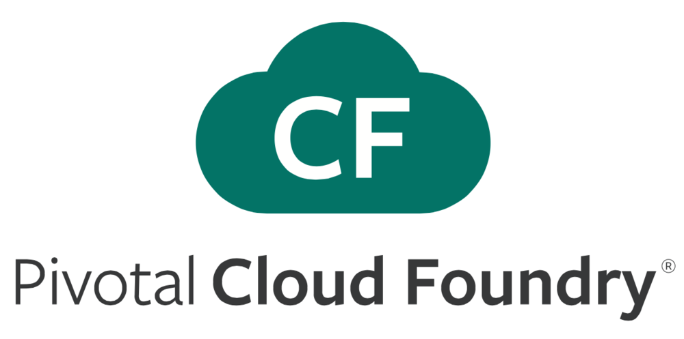


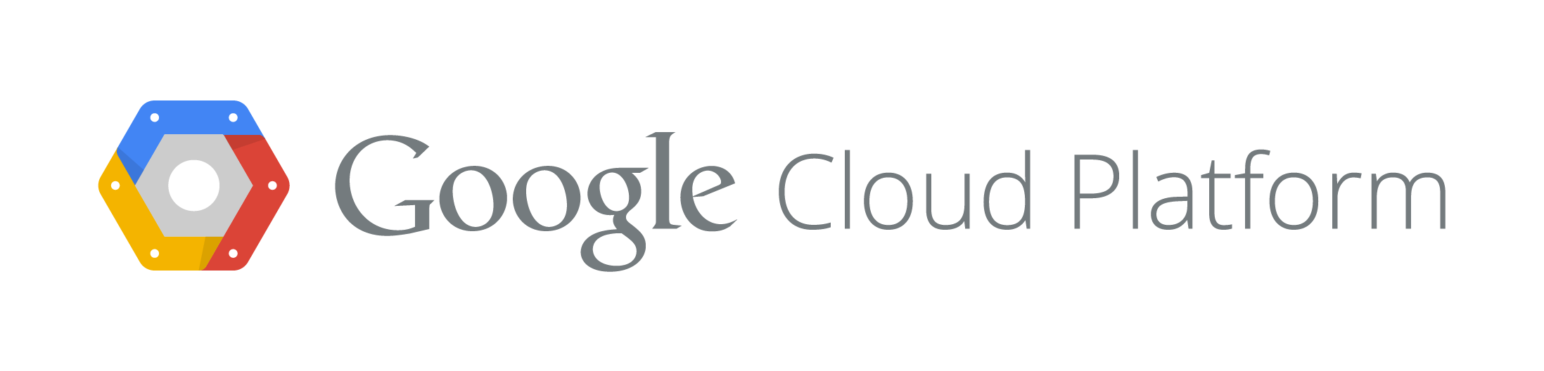
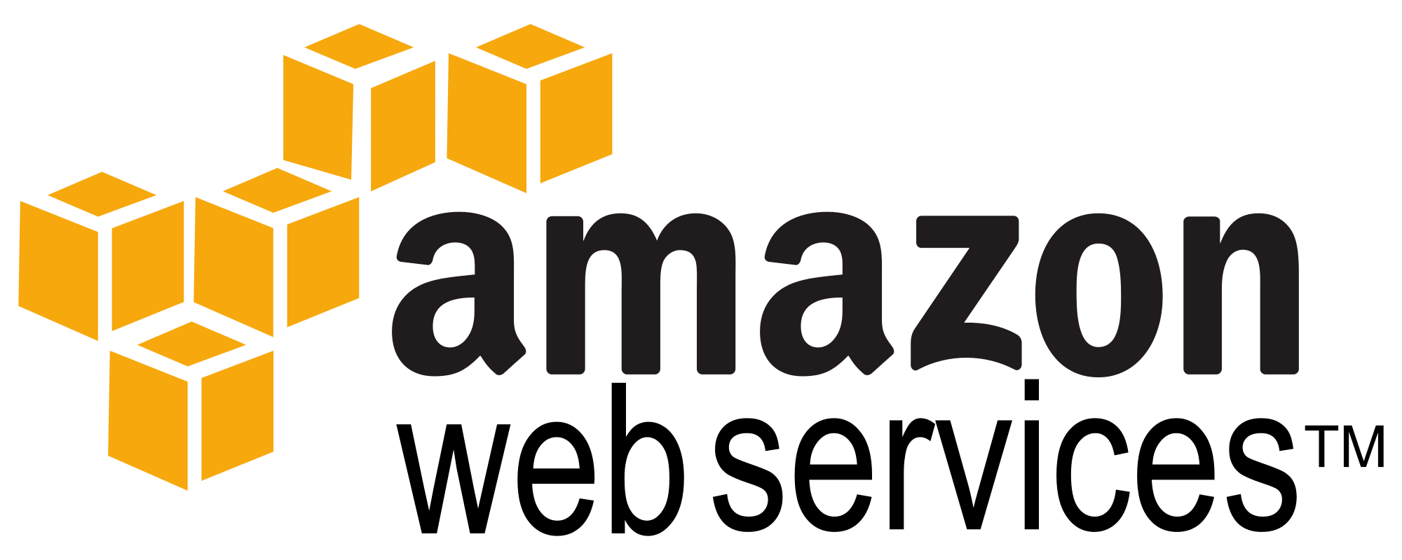

Migrating to Cloud Native Architectures
Vendors

Slide 8

Migrating to Cloud Native Architectures
HelloWorld Cloud App Push to Pivotal CF

Slide 9
Modularization
Pain Points of a Monolithic App's Class path
Are there Any Conflicts ??
Jar Hell !!!!
Is any Class Missing ??
Can I make a change with out impacting other classes ??

Slide 10
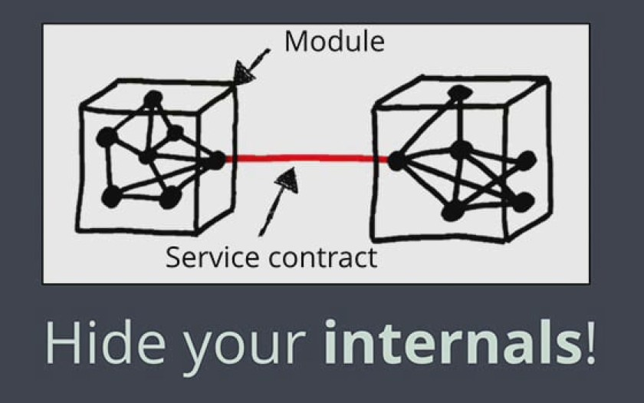
Modularization
Introduction of Modules in Java 9- Project Jigsaw
Prevent Tight Coupling
Promote Cohesion

Slide 11
Modularization
Introduction of Modules in Java 9- Project Jigsaw
com.ugcorp.modA
com.ugcorp.modA.packA
Class A_a
Class A_b
com.ugcorp.modA.packB
Class A_c
Class A_d
Module-info.java
Module com.ugcorp.modA {
requires com.ugcorp.modB
exports com.ugcorp.modA.packA
}
com.ugcorp.modB
Class B_a
Class B_b
Module-info.java
Over Come Jar Hell !!
com.ugcorp.modC
Class C_a
Class C_b
Is Anything Missing ? – NO
Are there any conflicts ? – NO
Is it easy to change ? – Yes

Slide 12
Modularization
Project Jigsaw and OSGI
Very Similar
Is Jigsaw going to replace OSGI ??
OSGI is more mature as its alliace started in 1998 . Check out OSGI.org

Slide 13
Modularization
Example OSGI Product- Websphere Liberty Profile

Slide 14

Modularization
Internet Of things ( IOT )

Slide 15

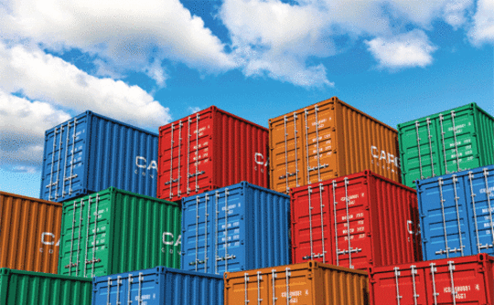
Containerization
What are Containers ??

Slide 16
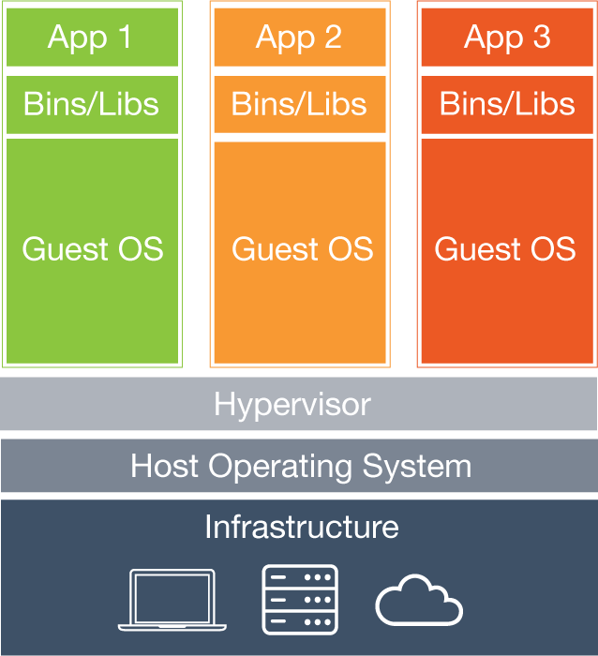
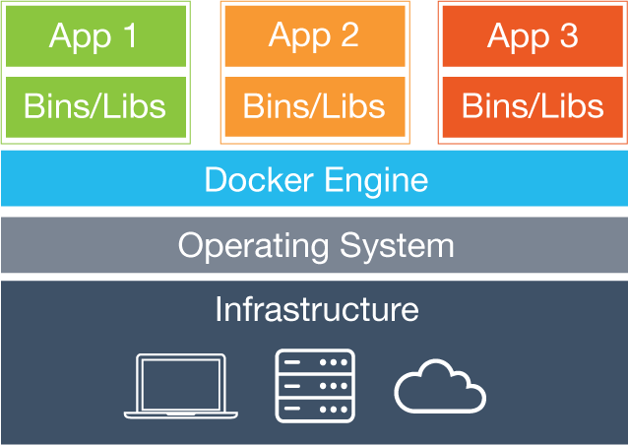
Containerization
Is it similar to VMWare ?? – NO!!
Virtual Machines
Containers

Slide 17
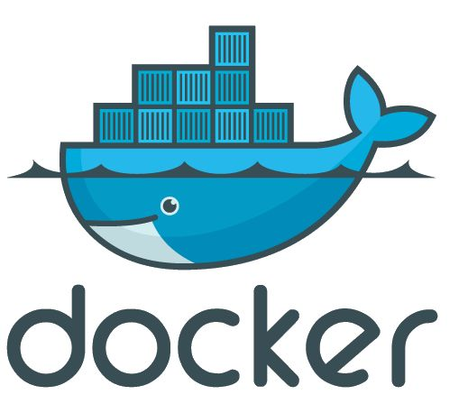
Containerization
Docker – Open Source Project for Containers
Docker allows you to package an application with all of its dependencies into a standardized unit for software development
https://www.docker.com/

Slide 18

Spring Boot for Java EE developers
– NO XML configuration
– Embedded Servlet Container
– Quick Starter with basic assumptions
Supports :
1) Serlvet Filters
2) JPA
3) JMS
4) WebSockets
5) Bean Validations
6) Caching

Slide 19
Some Pictures from java One 2015

Slide 20
Some Pictures from java One 2015

Slide 21
Some Pictures from java One 2015

Slide 22


