Slide 1
Project #2 Final Demo: [$1 Unistroke Gesture Recognizer - Protractor & GSS], [Online dataset and user collected dataset] [Group 14: Venkata Satya Sai Subhash Vadlamani & Veera Nitish Mattaparthi]
[CIS4930/CIS6930] Human-Centered Input Recognition Algorithms Instructor: Dr. Lisa Anthony, Spring 2023
18th April, 2023

Slide 2
Project #2 Overview
Algorithm: $1 Unistroke Gesture Recognizer(Protractor & GSS)
Language: Python
Existing dataset*: Online dataset that is available on the $1 website
New dataset*: Data collected by four means(trackpad, mouse, stylus, touchscreen) from six users each.
Analysis: GHoST Analysis

Slide 3
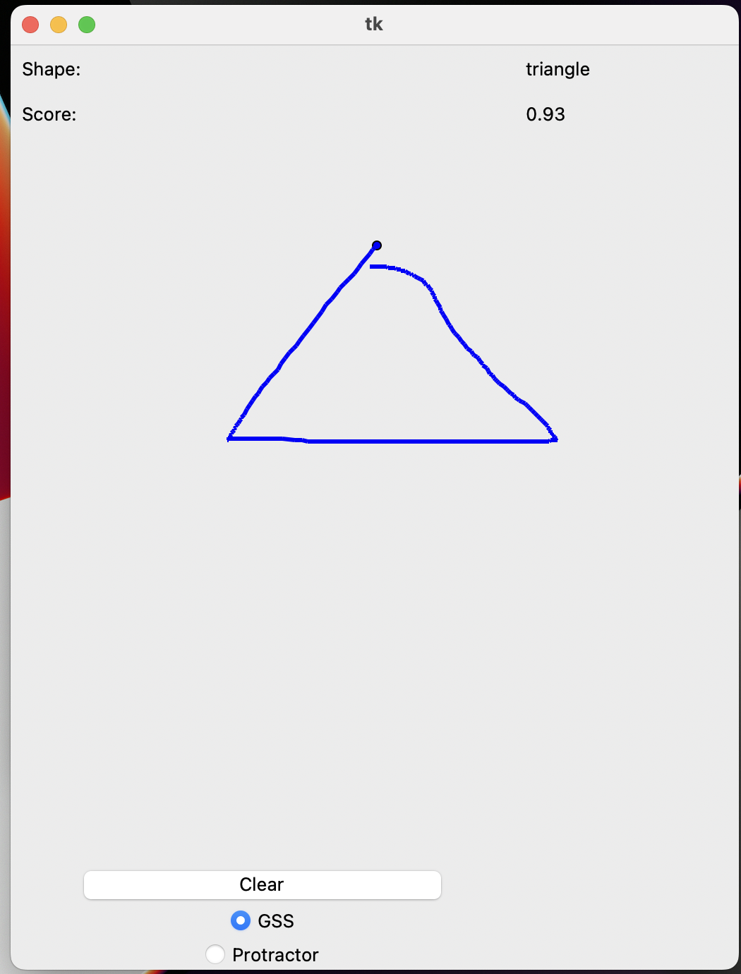
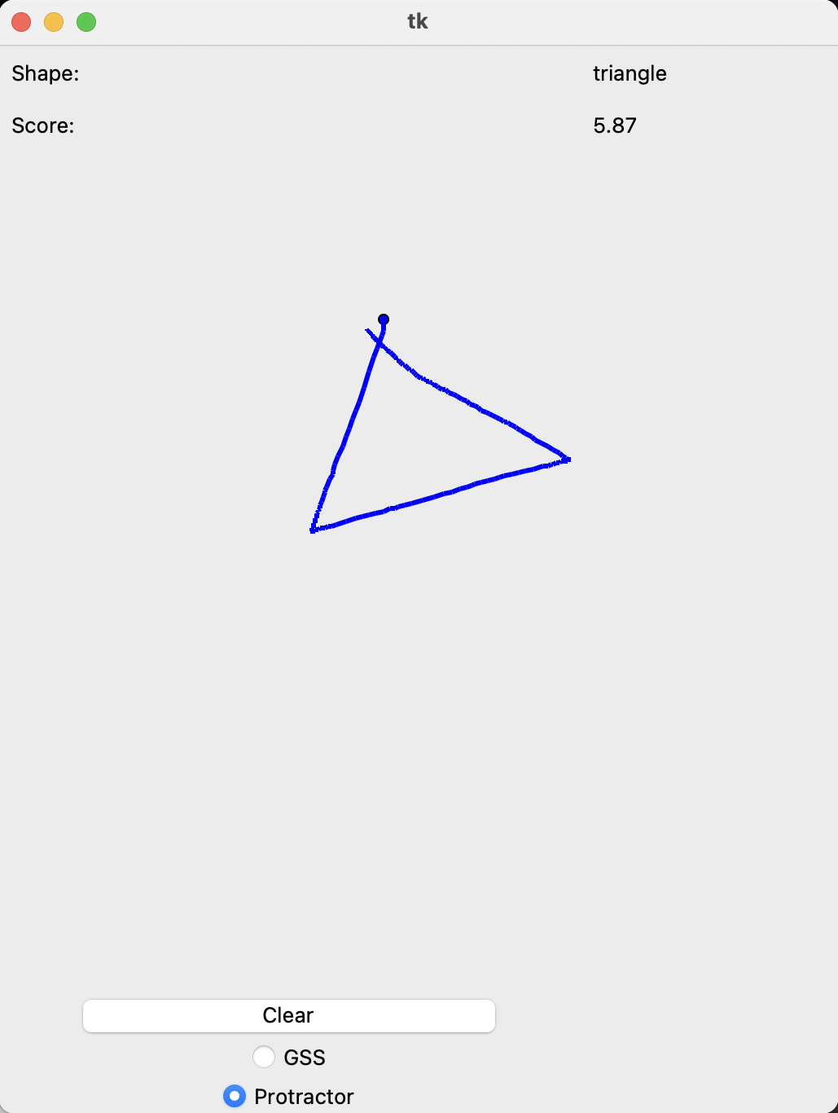
Online / Live Demo

Slide 4
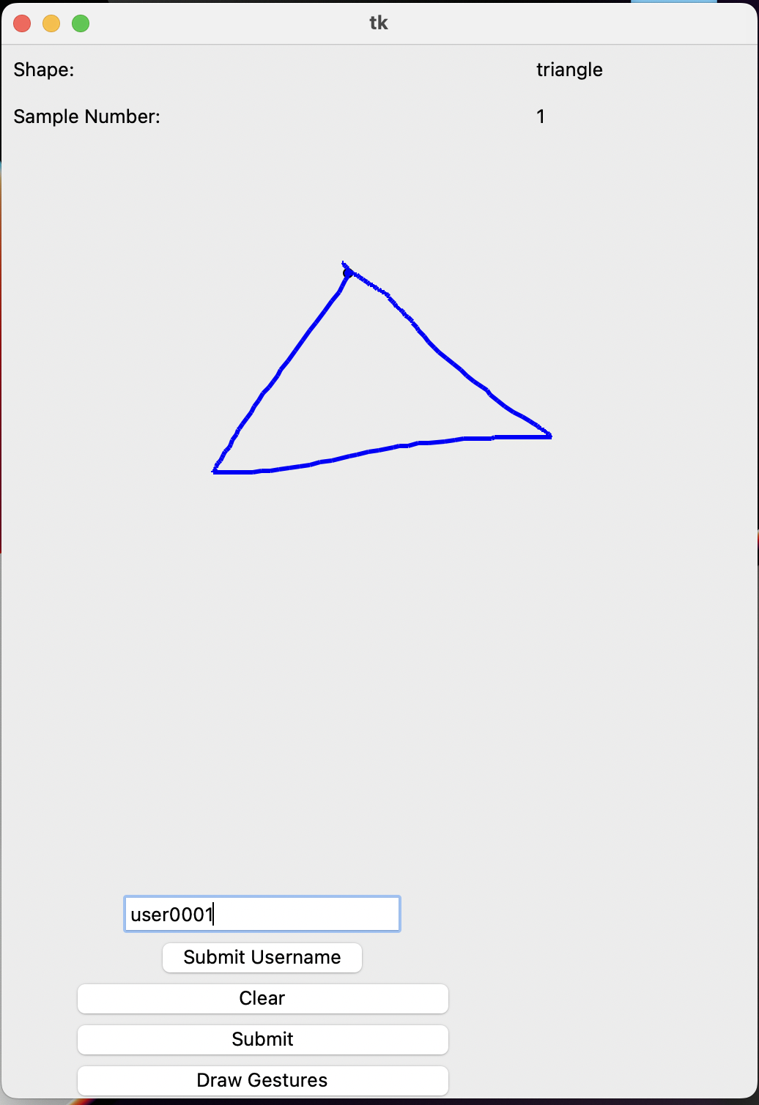
Collecting Data

Slide 5
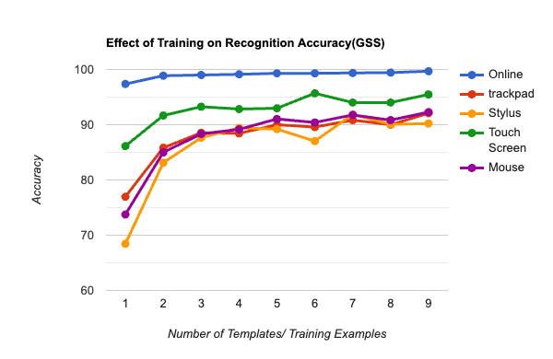
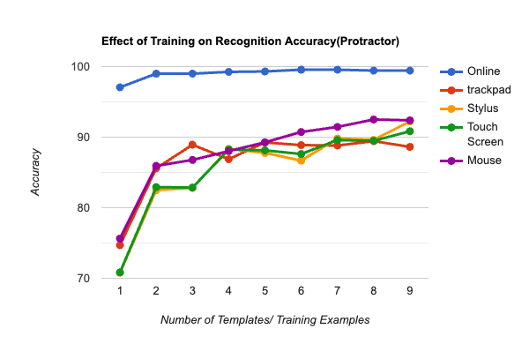
Offline Recognition Tests
Accuracy with GSS
Accuracy with Protractor

Slide 6
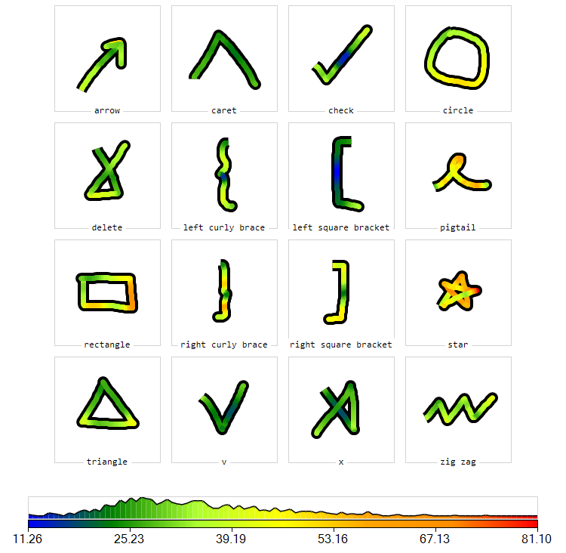
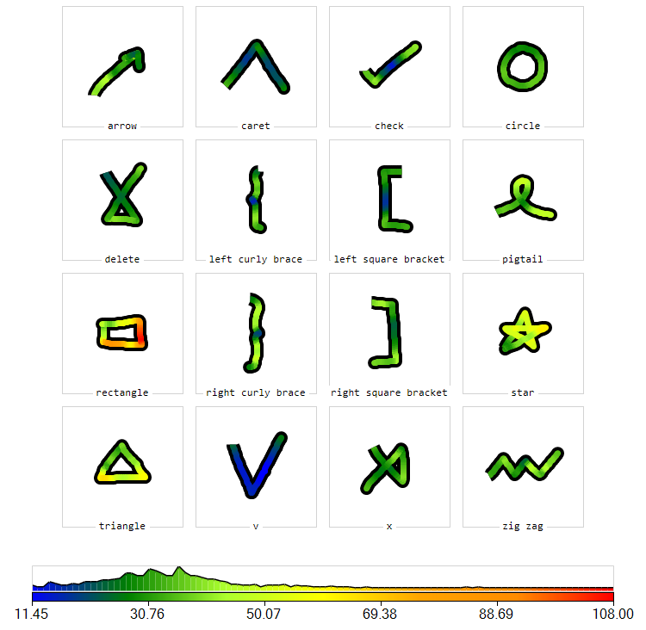
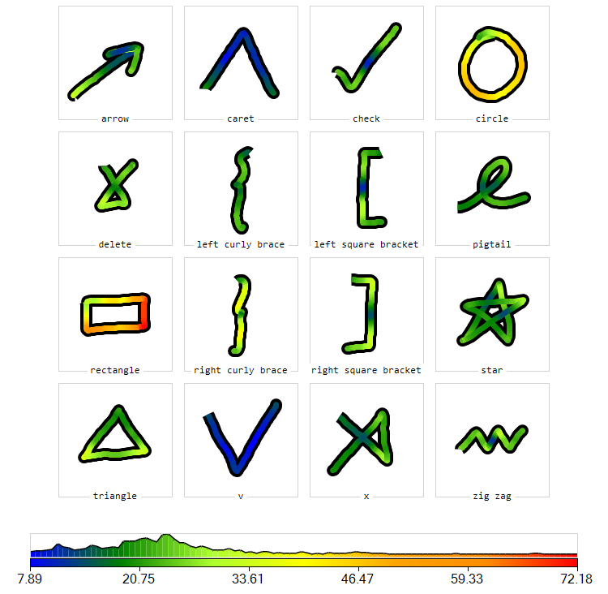
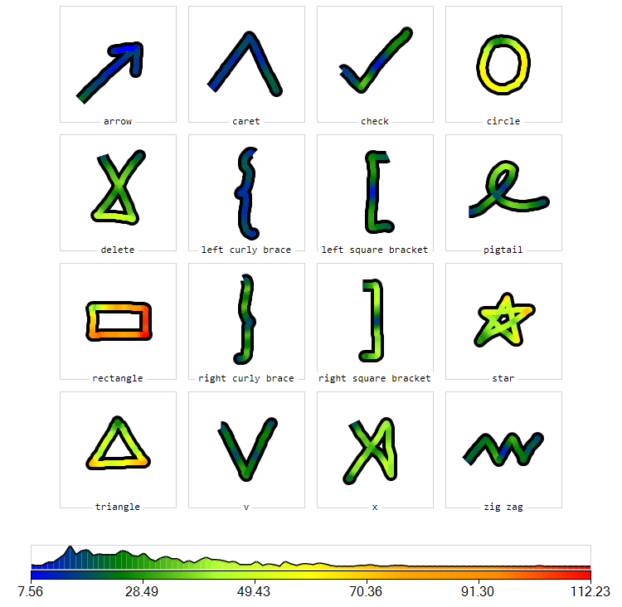
Analyses
Heat-map(Trackpad)
Heat-map(Mouse)
Heat-map(Touchscreen)
Heat-map(Stylus)

Slide 7
Implementation and Challenges
We Implemented the Protractor mechanism with the $1 algorithm. At first, it was difficult to understand how we had to store the points in the form of vector. After reading through the research paper and going through the implementation provided by the author, we understood how to create the vector.
Collecting inputs using a stylus was challenging but we figured out a way to run our python code on an iPad without writing an app for it.
We found it difficult on how to store vector templates and non-vector templates at the same time. We fixed the issue by having different template list.

Slide 8
Predicted and Actual Outcome
As expected, there was a drastic increase in the speed of offline recognition tests with the protractor algorithm. Where the GSS offline recognition took more than an hour, the protract recognition was completed within a minute.
While we got very high accuracies with both Protractor and GSS for all the 4 modes of data collection, the order of accuracy was different.
GSS : Touchscreen > Mouse > Trackpad > Stylus
Protractor : Mouse > Touchscreen > Trackpad > Stylus.
For online data, a very good accuracy is being achieved at E=3. For data that we collected by using different means however, accuracy peaks at at a much higher value of E, at around E=5.
Before the experiment, we predicted that the highest accuracy would be achieved using the Stylus but we did not observe this trend. Upon interviewing our participants, we found that many of them used the iPad stylus for the first time and they were much more comfortable using the mouse and the touchscreen. Because of this, we came to a conclusion that even though Stylus might seem very easy to use, it has a learning curve to get used to.
In fact, users were most comfortable with Touchscreen and we expect the touch screen to perform the best if some users did not make a mistake of drawing wrong gestures sometimes.
According to the users, comfort level was: Touchscreen > Mouse > Stylus > Trackpad.

Slide 9
The End!

