Slide 1

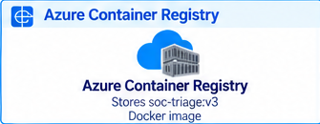


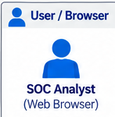
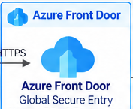








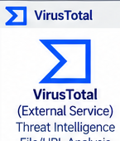






SOC-Triage — System Architecture
Secure · Scalable · AI-Powered Triage with Claude Agents
Azure Container Registry
Microsoft Entra ID
Stores soc-triage:v3
Docker image
SSO + RBAC group claims
Anthropic Claude Platform
Image pull
(on deploy)
ID token (OIDC)
via MSAL
claude-sonnet-4-6 / claude-opus-4
User / Browser
Azure Front Door
Azure Virtual Network (VNet) 10.0.0.0/16
SOC Analyst
(Web Browser)
Global Secure Entry
WAF + DDoS Protection
10.0.0.0/16
Claude Models (via API)
HTTPS
HTTPS
(443)
Subnet: App Service (10.0.1.0/24)
soc-team-lead
Azure App Service (Linux)
Orchestrator · Delegates to specialists
Runs containerized SOC-Triage application
(Port 8787)
VNet Integration
soc-siem-analyst
Docker Container (soc-triage:v3)
⇄
Frontend
FastAPI Backend
Outbound traffic routing
to external services
Exabeam UEBA · Risk scores · Event correlation
REST API
(localhost)
soc-network-analyst
Exabeam
Nginx / HTML/JS + MSAL
(Port 8787)
uvicorn :8787
Python FastAPI
API + Business Logic
(External Service)
SIEM / Security Events
OAuth2 + REST
(HTTPS)
Request / Response
Darktrace · XDR · Network breach analysis
Exabeam Poller
Claude Code Agents
API calls · HTTPS
Messages API
soc-threat-intel
Background Process
Fetch & Process Alerts
(Scheduled/Async)
6 AI Agents
Triage · Analyze · Enrich
Generate Recommendations
VirusTotal · Recorded Future · IOC enrichment
soc-mabel
VirusTotal
HTTPS
Request / Response
Persistent Storage
Institutional memory · Knowledge base · Playbooks
(External Service)
Threat Intelligence
File/URL Analysis
/home/ · Reports · Inbox · Logs
(App Service Linux — only /home is persistent)
soc-verdict
App Service (Linux) Container Runtime
Decision matrix · Classification · Severity · Action
Managed
Identity
Pulls image from ACR and runs container (soc-triage:v3)
Managed Identity
(system assigned)
secrets via
Private Endpoint
Subnet: Private Endpoints (10.0.2.0/24)
Private connection
(HTTPS)
Private Endpoint
Azure Key Vault (Private)
10.0.2.4
Stores 5 secrets
VNet: 10.0.0.0/16 Subnets: App Service (10.0.1.0/24) | Private Endpoints (10.0.2.0/24)
Key Benefits
Legend
Secure
Scalable
Integrated
AI-Powered
Persistent
Enterprise Ready
Azure service
Identity / Security
Azure Front Door +
Private Endpoints
Containerized on
Azure App Service
Exabeam, VirusTotal,
Claude via APIs
6 Specialized Agents
for SOC Triage
/home for logs, reports
and knowledge
SSO, RBAC, Monitoring
and Secure by Design
Anthropic / Claude
External service
Notes:
Recreated as editable PowerPoint objects. Individual icons are separate selectable image objects; all boxes, text, boundaries, and connectors are editable PowerPoint objects.

