Slide 1
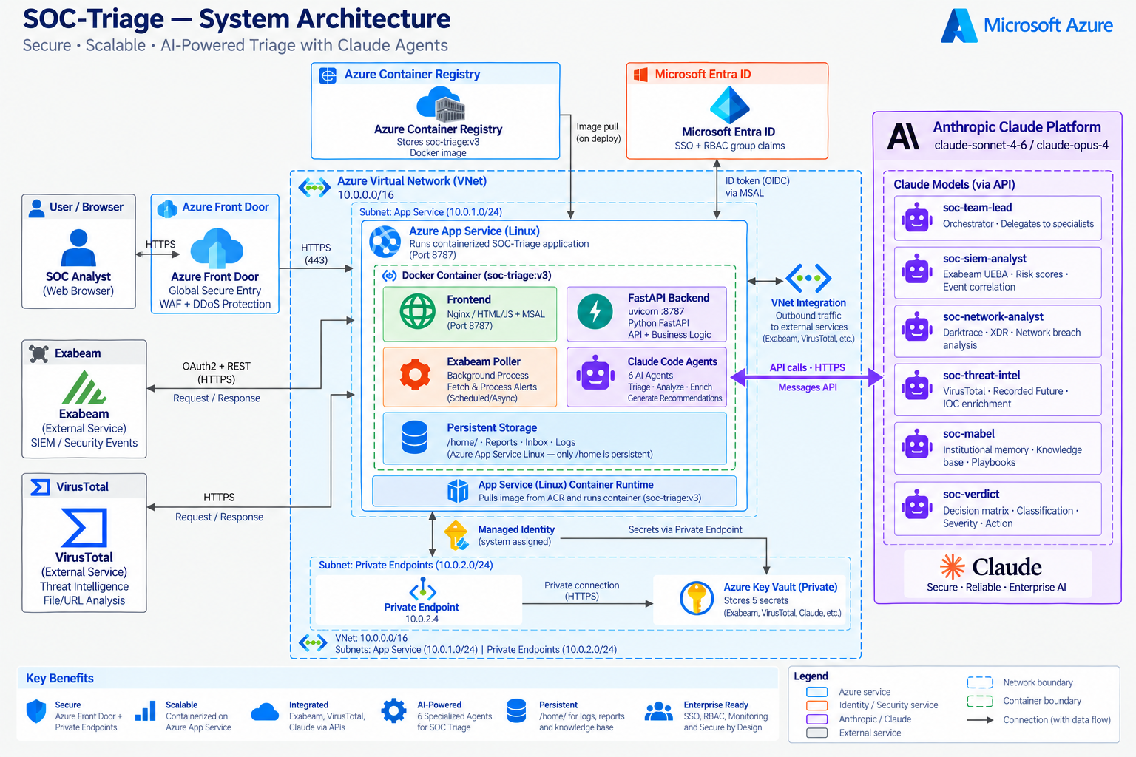

Slide 2
Pixel-perfect reference — the architecture artwork is preserved exactly from the generated diagram.

