Slide 1
OOPS
Object oriented programming

Slide 2
Object Oriented programming
Object Oriented Programming is a programming paradigm which is based upon the concept of objects.
In object oriented programming, computer programs are designed using the concept of objects that interact with real world.

Slide 3
Procedural language
Procedural Programming is a programming paradigm that uses a linear or top-down approach.
It relies on procedures or subroutines to perform computations.
In procedural programming, a program consists of data and modules/procedures that operate on the data.
During a program’s execution, any given procedure might be called at any point, including by other procedures or itself.

Slide 4
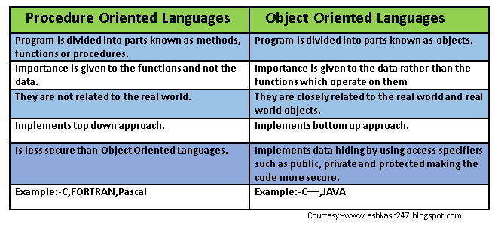
Differences between procedural and object oriented language

Slide 5
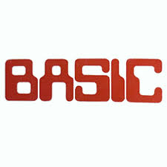
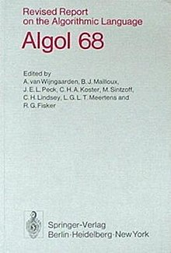

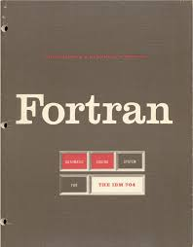
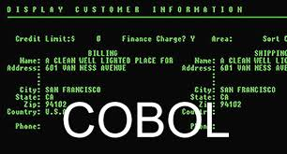

PROCEDURAL LANGUAGES

Slide 6

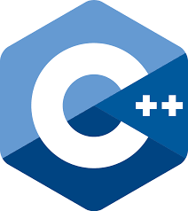




OBJECT ORIENTED LANGUAGES

Slide 7
Characteristics of oops
CLASS
OBJECT
ENCAPSULATION
ABSTRACTION
INHERITANCE
POLYMORPHISM

Slide 8
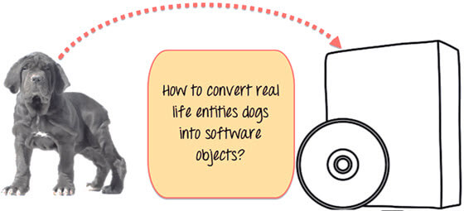

Slide 9

OOPs….

Slide 10
Objects
It is a basic unit of Object Oriented Programming and represents the real life entities. A typical Java program creates many objects, which as you know, interact by invoking methods.
An object consists of
State : It is represented by attributes of an object. It also reflects the properties of an object.
Behavior : It is represented by methods of an object. It also reflects the response of an object with other objects.
Identity : It gives a unique name to an object and enables one object to interact with other objects.

Slide 11
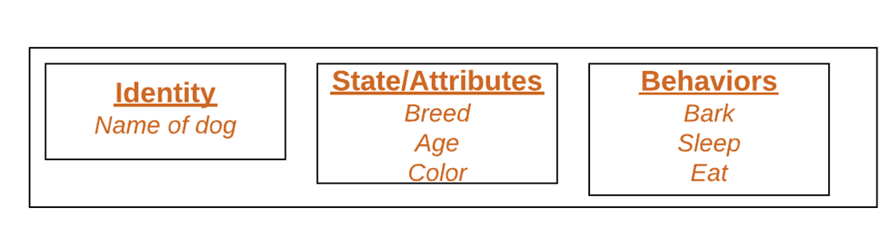

Slide 12
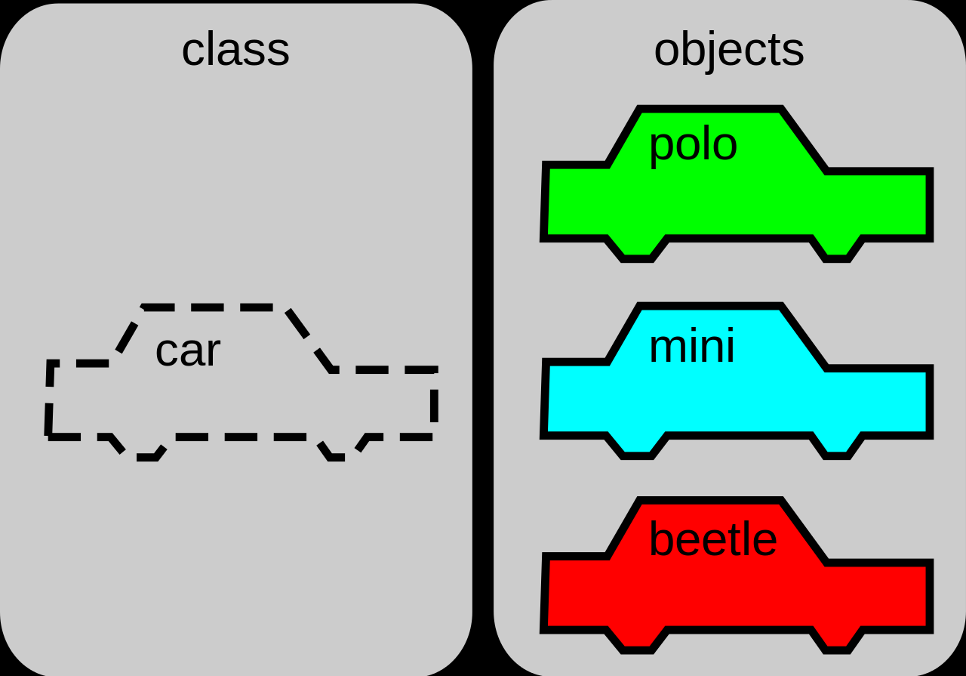
Classes

Slide 13
A class is a blueprint for creating objects , providing initial values for
state (member variables or attributes), and
implementations of behavior (member functions or methods).

