Slide 1
OOPS
Object oriented programming

Slide 2

53 years ago…
Alan Kay in 1967 coined “object oriented programming”.
Inspired from cells .
Developed Smalltalk at Xerox.
According to Alan Kay, the essential ingredients of OOP are:
Message passing
Encapsulation
Dynamic binding

Slide 3
Object Oriented programming
Object Oriented Programming is a programming paradigm which is based upon the concept of objects.
In object oriented programming, computer programs are designed using the concept of objects that interact with real world.
Another reason to use Object-oriented Programming is the ease of development and ability for other developers to understand the program after development

Slide 4
Procedural language
Procedural Programming is a programming paradigm that uses a linear or top-down approach.
It relies on procedures or subroutines to perform computations.
In procedural programming, a program consists of data and modules/procedures that operate on the data.
During a program’s execution, any given procedure might be called at any point, including by other procedures or itself.

Slide 5
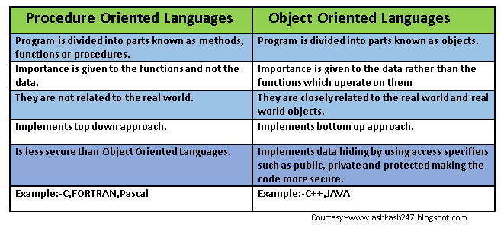
Differences between procedural and object oriented language

Slide 6
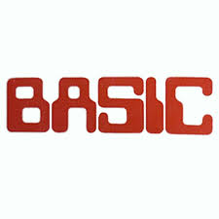



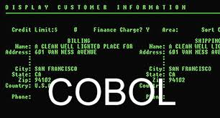

PROCEDURAL LANGUAGES

Slide 7

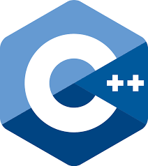




OBJECT ORIENTED LANGUAGES

Slide 8
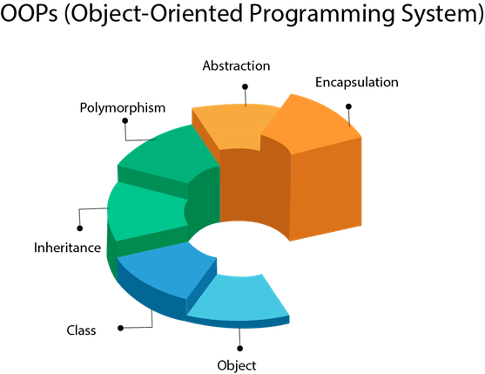
Characteristics of oops
CLASS
OBJECT
ENCAPSULATION
ABSTRACTION
INHERITANCE
POLYMORPHISM

Slide 9
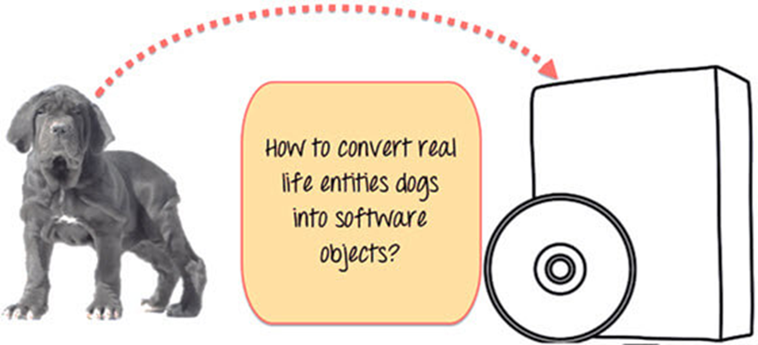
OOPs….

Slide 10
Objects
It is a basic unit of Object Oriented Programming and represents the real life entities. A typical Java program creates many objects, which as you know, interact by invoking methods.
An object consists of
State : It is represented by attributes of an object. It also reflects the properties of an object.
Behavior : It is represented by methods of an object. It also reflects the response of an object with other objects.
Identity : It gives a unique name to an object and enables one object to interact with other objects.

Slide 11
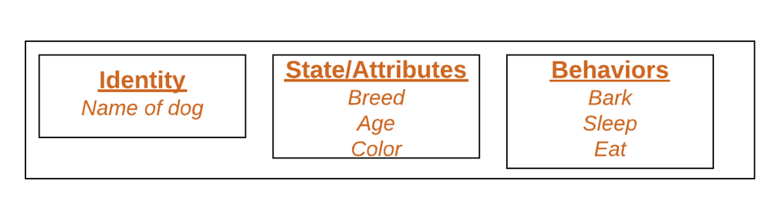

Slide 12
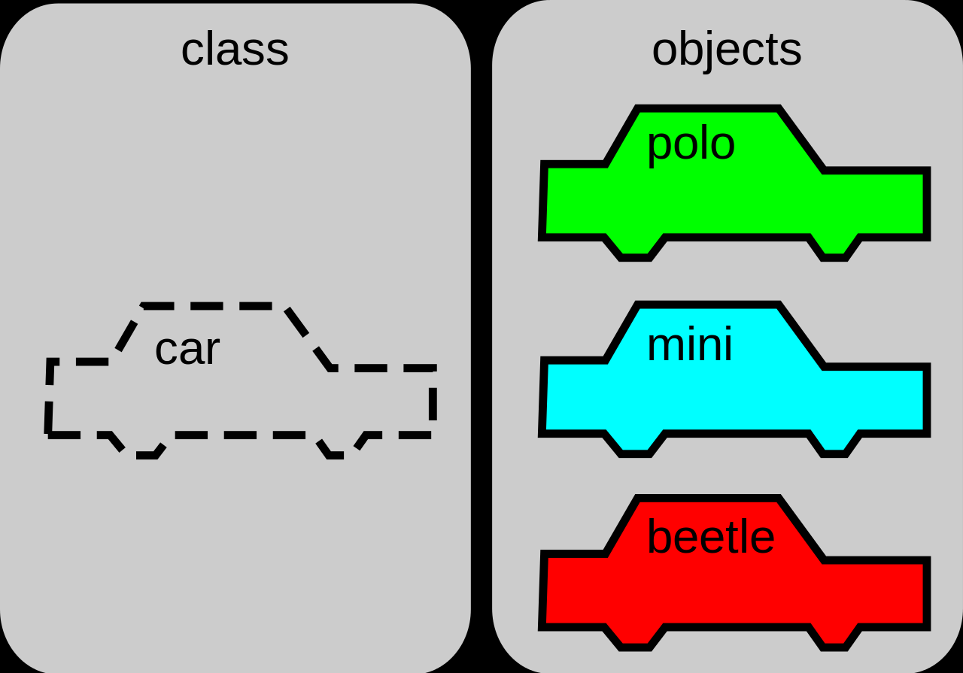
Classes

Slide 13
A class is a blueprint for creating objects , providing initial values for
state (member variables or attributes), and
implementations of behavior (member functions or methods).

Slide 14
class
Modifiers: A class can be public or has default access
Class name: The name should begin with a initial letter
Superclass(if any): The name of the class’s parent (superclass), if any, preceded by the keyword extends. A class can only extend (subclass) one parent.
Interfaces(if any): A comma-separated list of interfaces implemented by the class, if any, preceded by the keyword implements. A class can implement more than one interface.
Body: The class body surrounded by braces, { }.

