Slide 1
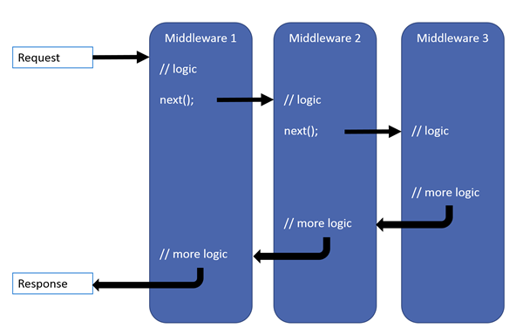
Middleware In ASP.Net Core

Slide 2
Middleware forms the request handling pipeline
Application configuration occurs inside of Program and Startup classes
We can have as many middleware components as we deem necessary
Order of the registered middleware components matters
Middleware components can short-circuit the request and generate the request immediately

Slide 3
Ways of configuring the middleware pipeline: Run – Generate a response and short-circuit the request Use – Perform logic and send request to next part Map – Conditionally send the request to other middleware MapWhen – Behaves almost the same as Map except that we can specify the detailed condition by using HttpContext object. We could check for URL, headers, query strings, cookies, etc). UseWhen – Similar to Mapwhen, but will not break the flow.

Slide 4
Static Files:
Microsoft.AspNetCore.StaticFiles
UseStaticFiles
StaticFileOptions
UseDefaultFiles
UseDefaultFilesOptions
UseFileServer

Slide 5
Exceptions:
Microsoft.AspNetCore.Diagnostics Package
UseDeveloperExceptionPage
UseExceptionHandler
UseStatusCodePages
UseWelcomePage

Slide 6
Custom Middleware:
A public constructor with a parameter of type RequestDelegate.
public static void Run(this IApplicationBuilder app, RequestDelegate handler)
A public method named Invoke or InvokeAsync.
This method must return a Task and accept the first parameter of type
HttpContext. Additional parameters for the Invoke/InvokeAsync are
populated by dependency injection.
public delegate Task RequestDelegate(HttpContext context);

Slide 7
Custom Middleware:
A public constructor with a parameter of type RequestDelegate.
public static void Run(this IApplicationBuilder app, RequestDelegate handler)
A public method named Invoke or InvokeAsync.
This method must return a Task and accept the first parameter of type
HttpContext. Additional parameters for the Invoke/InvokeAsync are
populated by dependency injection.
public delegate Task RequestDelegate(HttpContext context);

