Slide 1
Azure traffic manager by Subhash Gunda Deep Azure @McKesson

Slide 2
Problem Statement
Tech survey ecommerce site need a better solution for their application which is deployed geographically in different zones across the world for them performance and uptime are the main key points to keep their site up and running with no single point of failure.
Overview of Technology
Microsoft Azure Traffic manager is the point of discussion here. Briefly about it, Microsoft Azure Traffic Manager allows control the distribution of user traffic for service endpoints in different datacenters. Service endpoints supported by traffic manager include Azure VMs, Web Apps, and cloud services. It can also be used with external , non-Azure endpoints.
Traffic Manager uses DNS to direct client requests to most appropriate endpoint.
Endpoints based on traffic-routing method and Health of the endpoints.

Slide 3
Traffic Manager benefits
Improves the availability of critical applications
Improves the responsiveness of high-performance applications
Performs service maintenance without downtime
Combines on-premises and Cloud-based applications
Distribute traffic for large, complex deployments
Traffic Manager routing methods
Azure traffic Manager supports four traffic-routing methods to determine how to route network traffic to the various service endpoints. Traffic Manager applies the traffic-routing method to each DNS query it receives. Below are four traffic routing methods.
Priority
Weighted
Performance
Geographic

Slide 4
High Level Overview of steps
Four Azure windows based VMs each with a power shell script
Installed Java 1.8 JDK, NetBeans IDE 8.2 along with Glassfish Server 4.1 on all of them
Installed Oracle Database 11g Express Edition on one of the VM
Ran SQL queries to ingest data on the database
Deployed survey and survey admin apps on Glassfish server by changing libraries
Updated JDBC connection string to talk to the DB respectively from each GlassFish Server.
Ran PowerShell script to Create Azure Traffic Manager Profile ‘performance’ based
Create DNS for the site using DNS Zone and did a CNAME to point to Traffic Manager Profile.

Slide 5
Data Set
Survey URLs: http://gsrworld.techsurvey.com/survey/index.xhtml
Survey Admin URLs: http://gsrworld.techsurvey.com/surveyadmin/home.jsp
Traffic Manager Survey URLs:
http://gen-unique.trafficmanager.net/survey/index.xhtml
Traffic Manager Survey Admin URL:
http://gen-unique.trafficmanager.net/surveyadmin/home.jsp
Online-Survey-System-Java-Project - Size: 3..2 MB
I haven’t included other tools as they are big like netbeans, oracle db and java jdk
Power shell scripts are included

Slide 6
Hardware
Windows Server 2012 R2
Azure Traffic Manager
Software:
NetBeans IDE 8.2
GlassFish Server 4.1
Java JDK 1.8
Oracle Database 11g Express Edition
JDBC Driver - ojdbc7.jar
JSF Libraries – 1.2, 2.2
My PC with Apache 2.4
MY PC with host entry change
References:
http://www.codewithc.com/online-survey-system-project-java/

Slide 7
Lessons Learned & Pros/Cons
Need to disable Windows Firewall which was not allowing incoming traffic
NSGs can able applied at the network interface level or the subnet level for a VM.
Not able to submit the survey – may be a code but couldn’t figure out.
DNS zone Site DNS CNAME to Azure Traffic Manager Profile not working so I used my PC with apache as a portal DNS Server

Slide 8
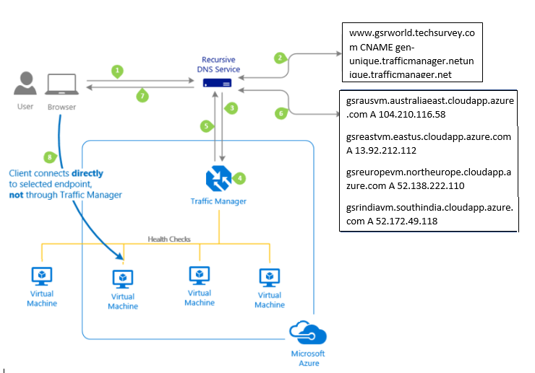
Depiction of flow of Traffic for gsrworld.techsurvey.com Site

Slide 9
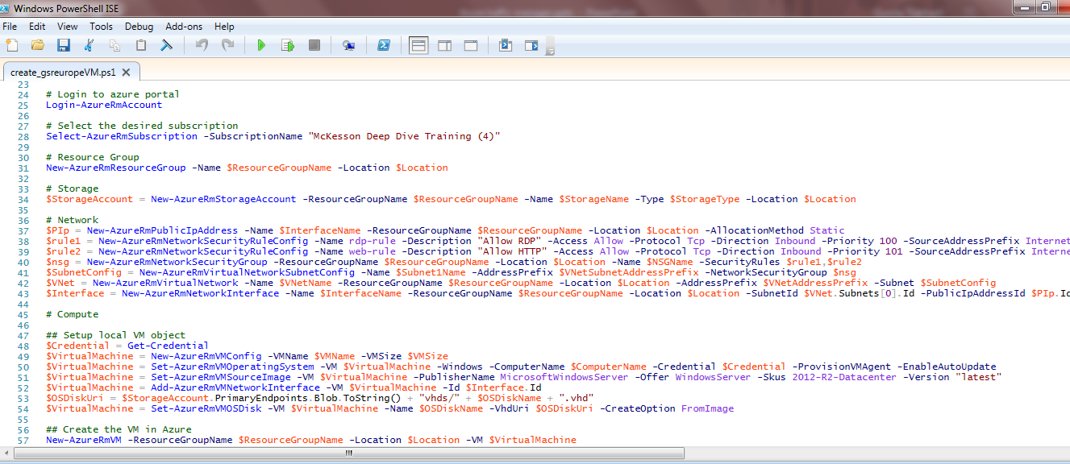
Power Shell Script for the Europe VM And its Execution

Slide 10
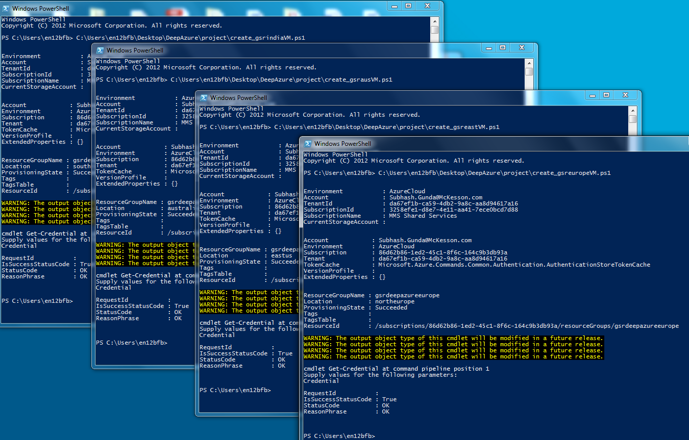

Slide 11
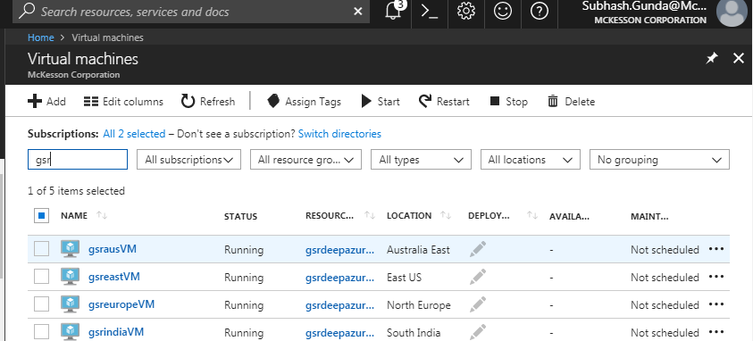
List of all the VMs on Azure portal after Execution

Slide 12
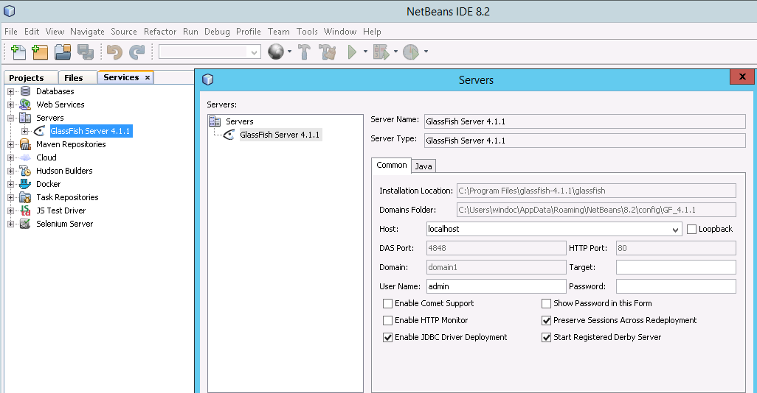
Software Installation
RDP to the VMS
Install Java 1.8 JDK
Install NetBeans 8.2 along with GlassFish Server
Update port for GlassFish Server to be 80

Slide 13
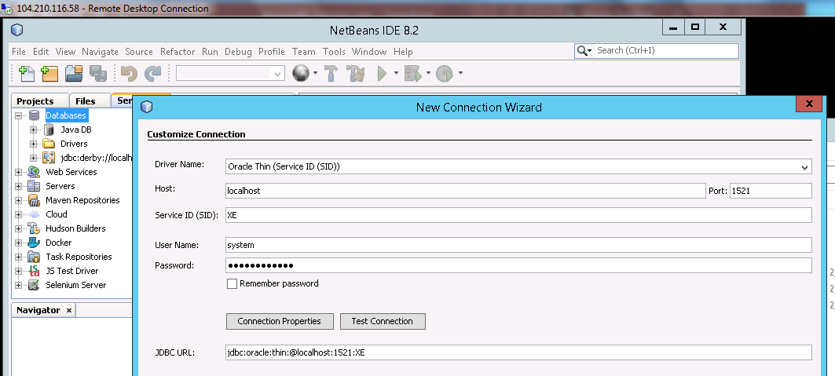
Oracle Database 11g Express Edition Steps
Install Oracle Database 11g Express Edition on one of the VM in this case Australia VM
Connect to the DB with IDS and ingest data from web app folder

Slide 14
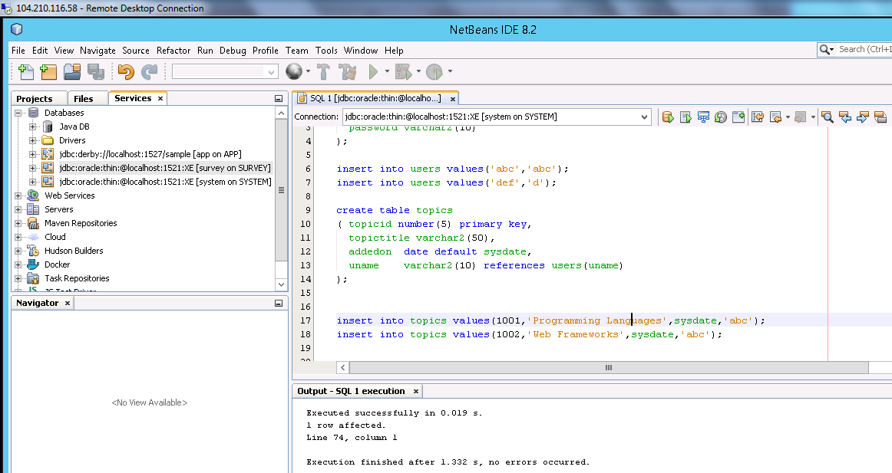
Ingesting Data in to the Oracle DataBase

Slide 15
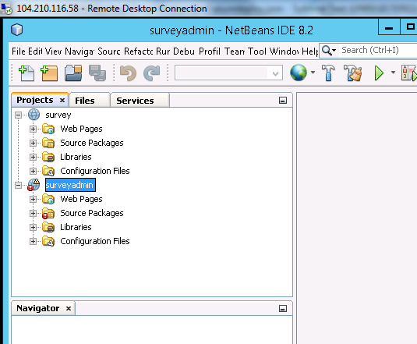
Import two Java Projects into IDE

Slide 16
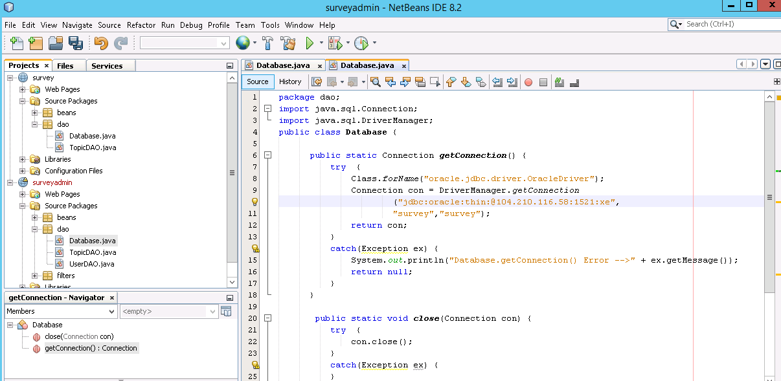
Java Program Changes
Import survery and surveyadmin projects in to the IDE
Make changes to Database.java file on eastus, india, Europe VMs to point to the public IP of Australia VM database instance

Slide 17
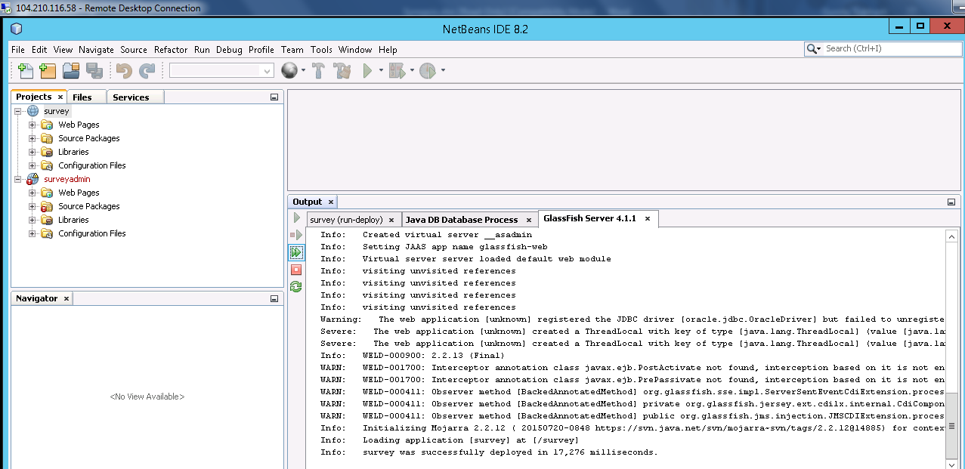
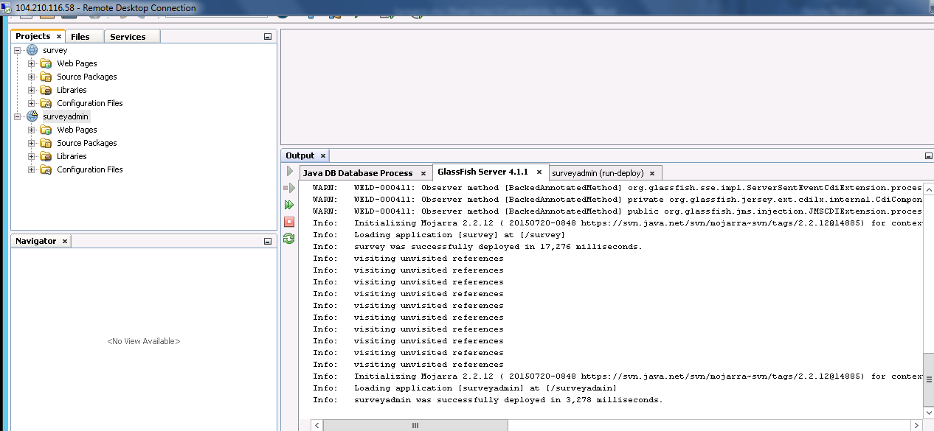
Deploy the Final Changes to Glassfish Server

Slide 18
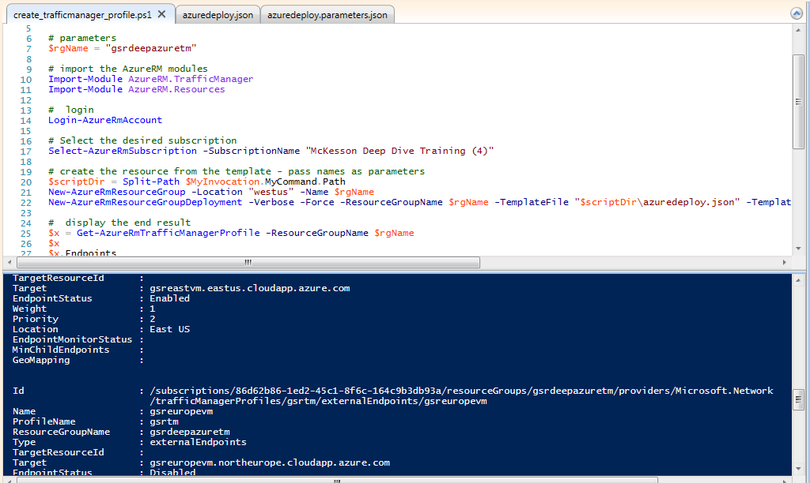
Create Azure Traffic Manager Profile
File updated to include the end points
Run the power shell Script
create_trafficmanager_profile.ps1
Azuredeploy
azuredeploy.parameters

Slide 19
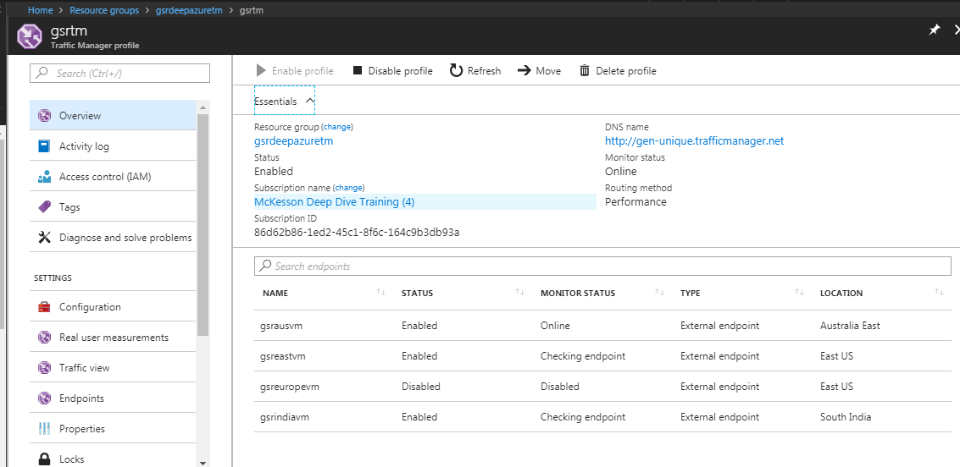
Configuration of Traffic Manager Profile

Slide 20
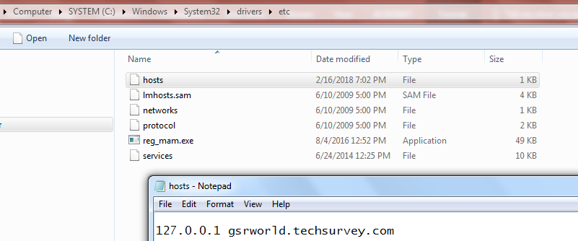
Hosts Entry Change on a workstation
As really don’t have a DNS to play with I am using my pc with hosts entry change to mimic the demo.

Slide 21
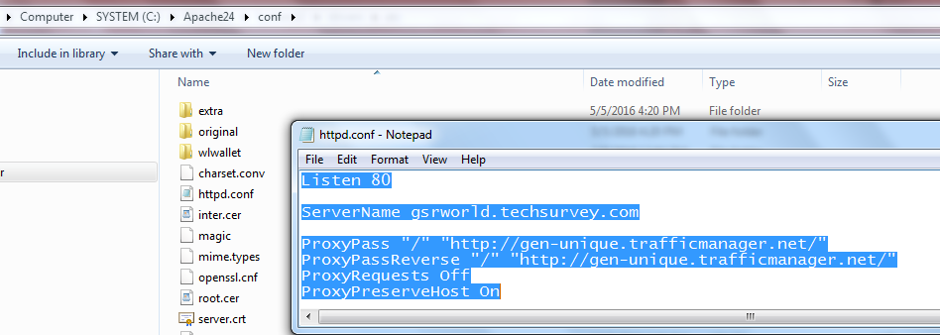
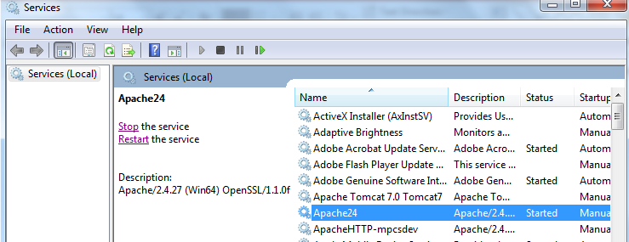
Install Apache and Configure on Workstation
Install Apache 2.4
Configure to include the server name
Use reverse proxy to route traffic to Traffic Manager
Start Apache 2.4 service

Slide 22
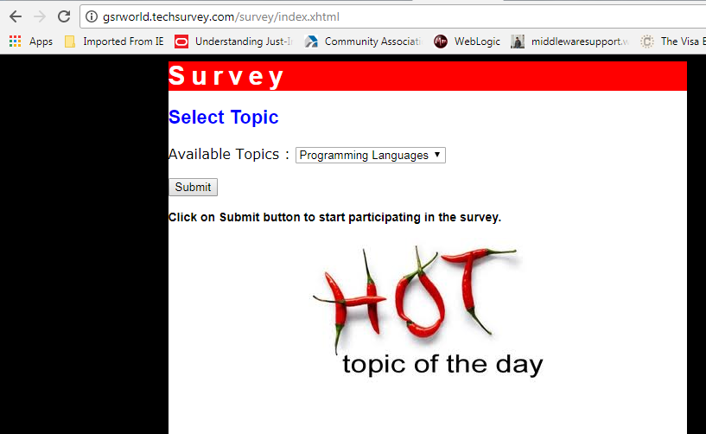
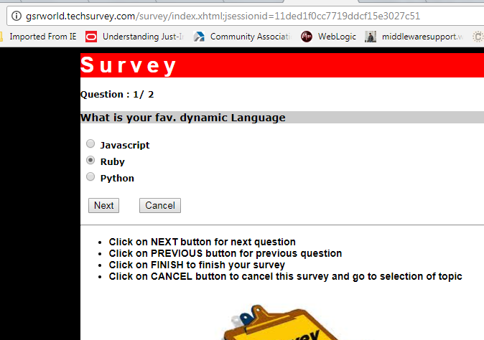
Access Site to Submit Survey
Open URL on the workstation http://gsrworld.techsurvey.com/survey/index.xhtml
To submit the survey proceed further

Slide 23
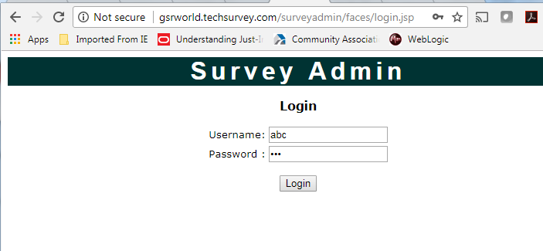
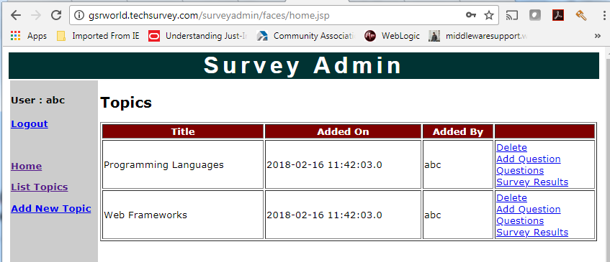
Access Survey Admin Site to View the entries
Access surveyadmin site here to view the survey content.
New topic can be added for the survey

Slide 24
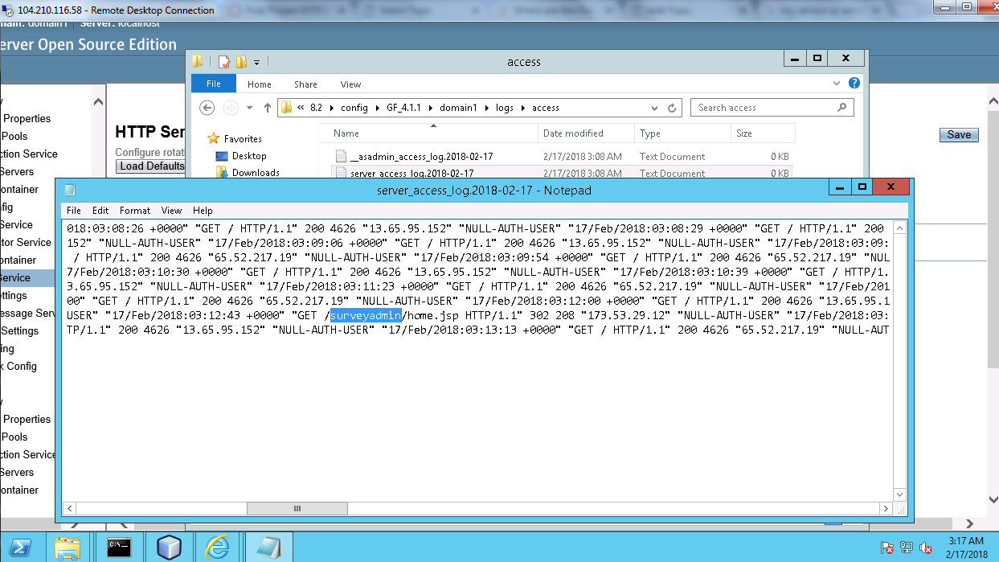
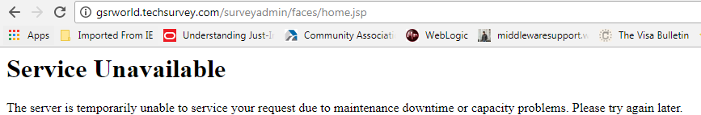
Testing Site with Traffic Manager
While I accessing the above pages I found from the server logs where session landed.
I disabled that endpoint from TM profile but the client still go to the same error even when that end point is removed TM routed my traffic to a second node.
So finally I stopped the service and I get the service unavailable error as shown below

Slide 25
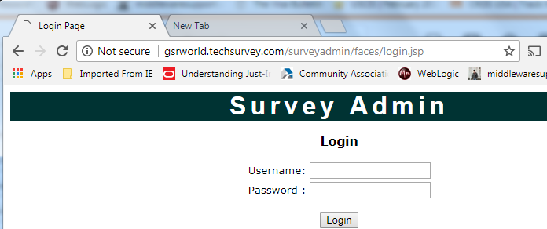
Service restored after a while

Slide 26
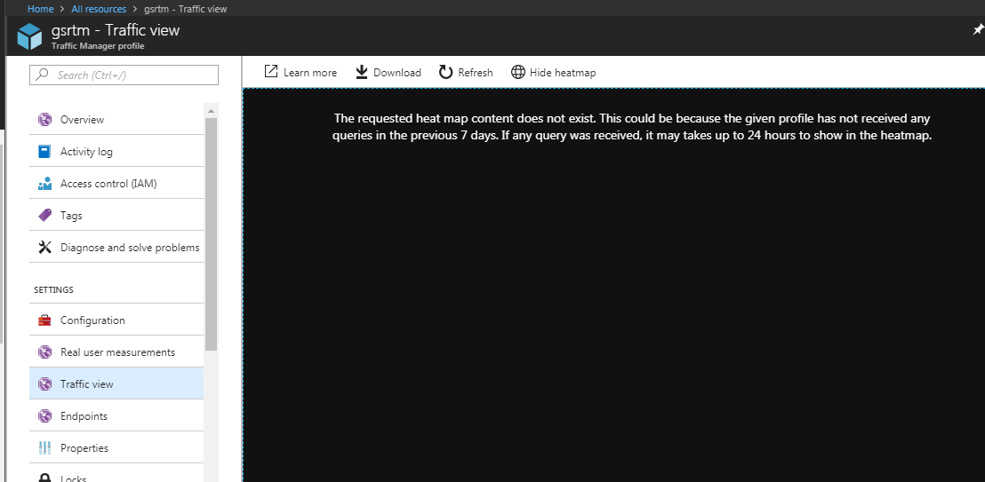
Traffic View and Real user measurments
For some reason I couldn’t see the traffic view

Slide 27
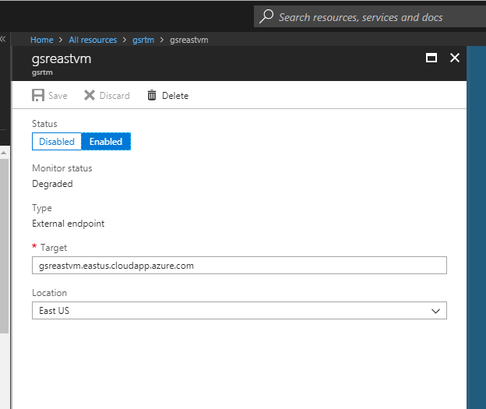
Enable/Disable/Remove endpoint on Traffic Manager for maintenance
We can enable or disable the nodes according for maintenance
Remove endpoint by clicking the delete option

Slide 28
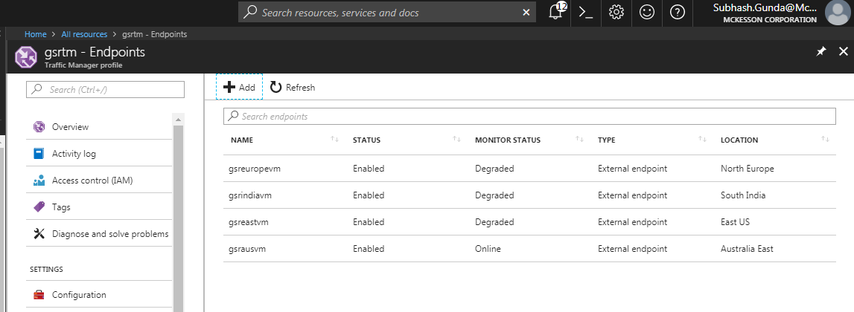
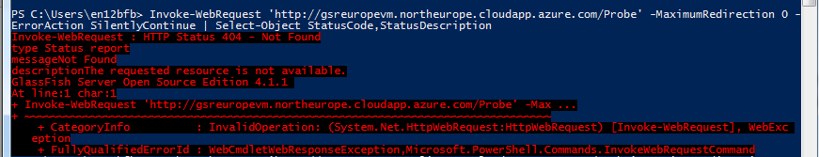
Suggestion For Later
Below the end points are showing degraded we need to include a proper probe with the path or have the glassfish server have a home page to serve.

Slide 29
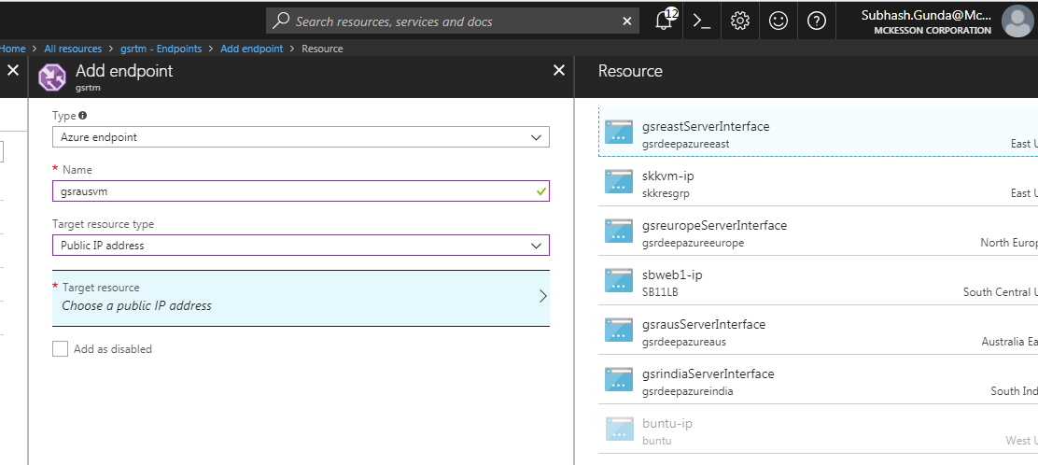
We can also change end points to be of type ‘Azure endpoint’ by selecting the respective public IP address.

