Slide 1


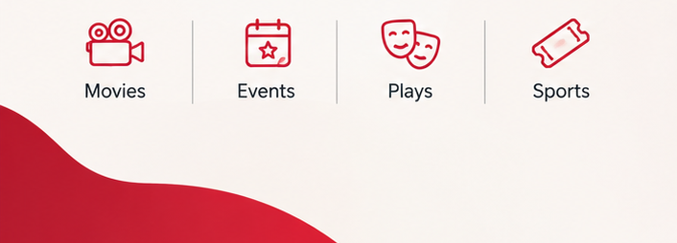
Movie Ticket Booking & Revenue Analysis
Finding Booking Trends and Revenue Patterns in Movie

Slide 2
OUR BIG IDEA
Understanding the Movie Booking Industry
Challenge:
Without proper data analysis, it is difficult to identify booking trends, popular movies and revenue patterns.
Our Approach:
Using SQL, we analyse booking data to discover meaningful insights and understand business performance.
Online movie ticket booking platforms like BookMyShow handle large amounts of booking data every day.
This data includes:
Customer booking details.
Movie and genre preferences.
Ticket purchase information.
Theatre and payment details.

Slide 3
PROJECT OBJECTIVE
Analyse Booking Data | Identify Booking Trends | Evaluate Revenue | Apply SQL Techniques
Understand customer, movie, show and ticket booking information. | Discover popular movies, genres and customer booking patterns | Analyse revenue generated across different movies and theatres. | Use filtering, aggregation, grouping and joins to extract meaningful insights.
KEY QUESTION
How can SQL help identify booking trends and revenue patterns in movie ticket data?

Slide 4
Dataset Overview
04 Ratings
Ratings: 35,861 rows
05 Venues
Venues: 54 rows
Customer ratings • Reviews • Venue details
01 Customers
1,500 rows
Customer ID • Name • Age • Gender • City • Membership Tier
02 Events
Events: 57 rows
03 Shows
shows: 3210 rows
Event details• Show details • Dates • Timings
Note: These datasets are used for SQL-based analysis of movie booking trends and customer preferences.

Slide 5
KEY
How the
Tables Connect GOAL
01 Customers | PK: customer_id FK: None
02 Events | PK:event_id FK: None
03 Shows | PK: show_id FK: venue_id → venues(venue_id)
04 Ratings | PK: rating_id FK: event_id → events(event_id)
05 Venues | PK: venue_id FK: None

Slide 6
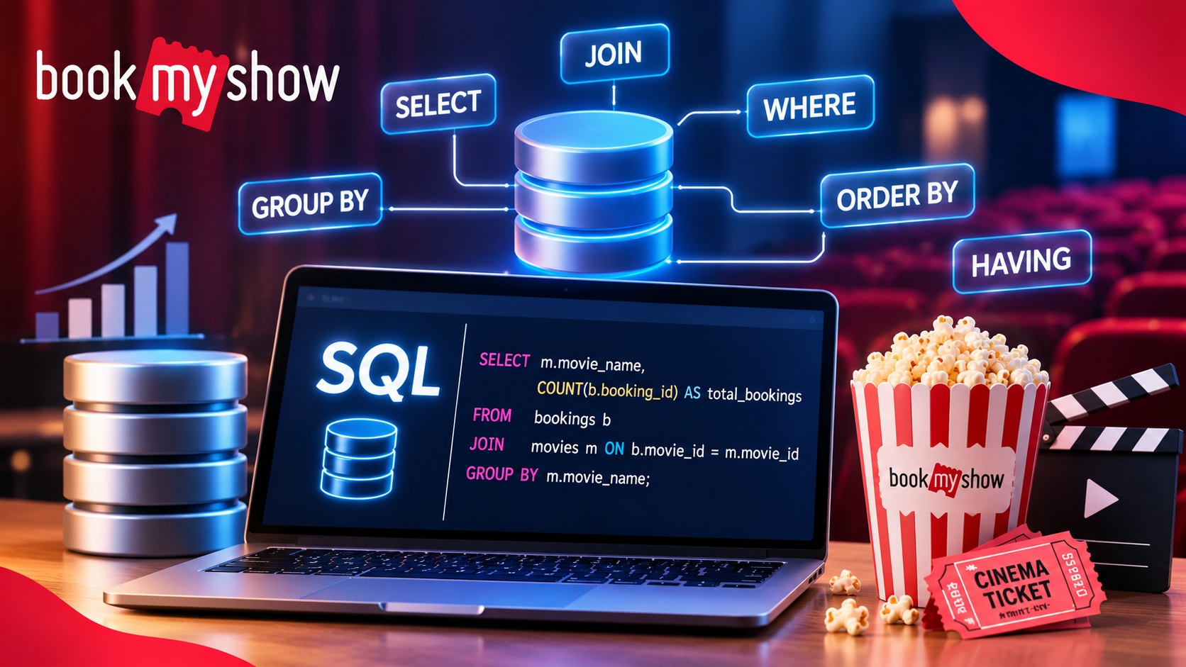
SQL Concepts & Techniques Applied
SELECT-: Retrieve customer, event and show records.
WHERE-: Filter records based on specific conditions.
DISTINCT-: Identify unique cities and categories.
ORDER BY-: Sort events based on ratings.
5. LIMIT-: Display the top 5 events.
6. Aggregate Functions-: Calculate COUNT, AVG, MIN and MAX.
7. GROUP BY-: Analyse data category-wise and city-wise.
8. HAVING-: Filter grouped analysis results.
9. JOINS-: Combine data from multiple tables.
10. Subqueries-: Perform advanced data comparisons.

Slide 7

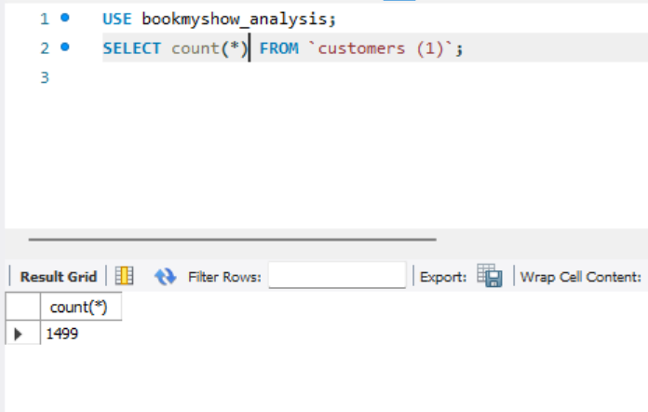
How many customers are available in the database?
Concepts: COUNT()
Insight: Identifies the total number of customers available in the dataset.

Slide 8
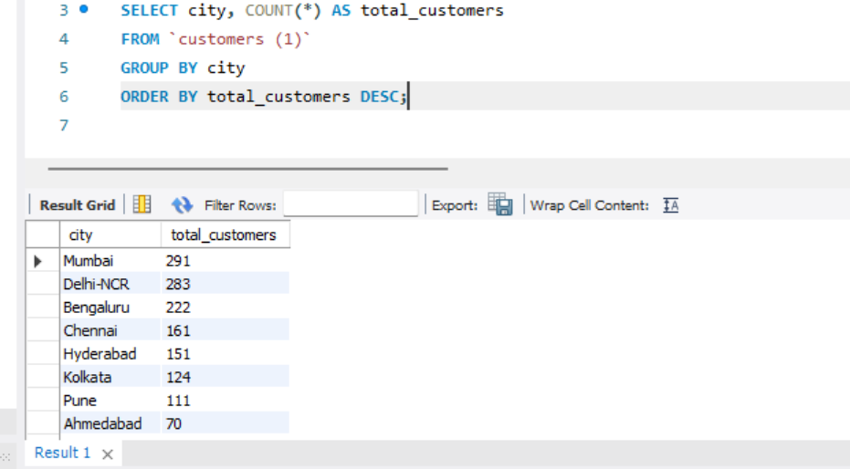
How many customers belong to each city?
Concept:- Count(), Group by,order by.
Insights:- Identifies the city with the highest number of customers

Slide 9
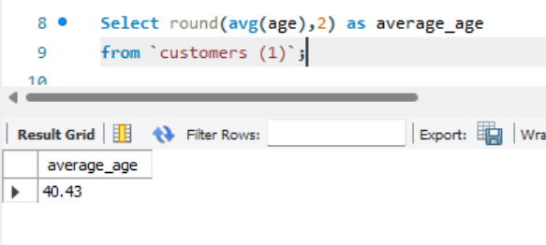
What is the average age of customers?
Concept:- Round(avg(),2)
Insights:- Identifies the average age of customers using the platform.

Slide 10
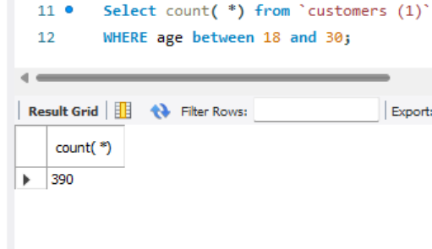
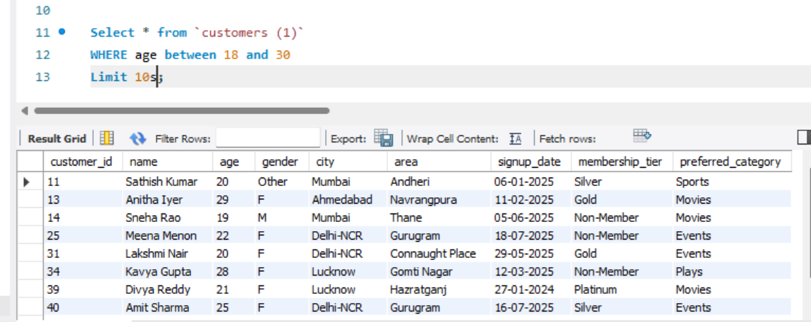
Which customers are between 18 and 30 years old?
Cocncept:- Between
Insights:- Identifies customers who fall within the age range of 18 to 30 years.
Total:-

Slide 11
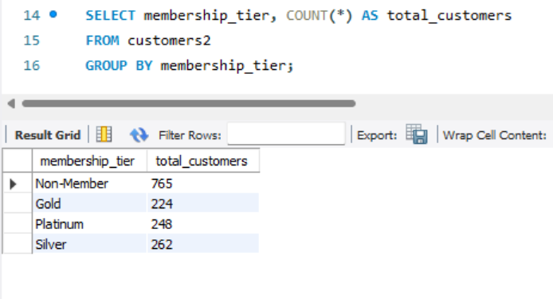
How many customers belong to each membership tier?
Concepts:- Group by
Insights:- Shows the distribution of customers across different membership tiers.

Slide 12
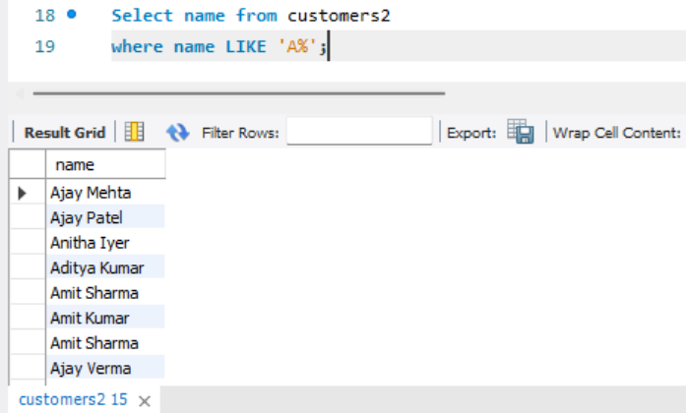
Which customers have names starting with the letter 'A'?
Concepts:- Where,Like
Insights:- Identifies customers whose names begin with the letter 'A’.

Slide 13
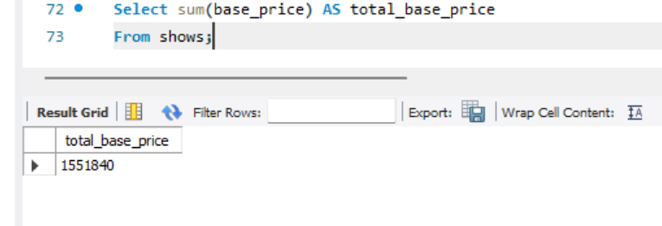
What is the total base price of all available shows?
Concept: SUM()
Insight: Calculates the combined base price of all shows available in the database.

Slide 14
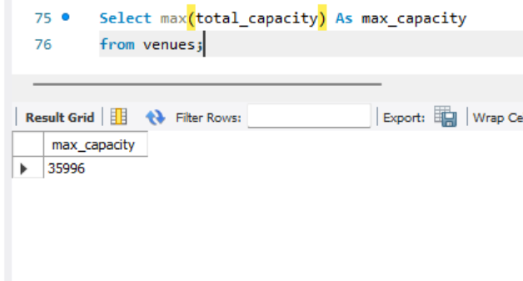
What is the maximum seating capacity available among all venues?
Concept: MAX()
Insight: Identifies the highest seating capacity available among all venues.

Slide 15
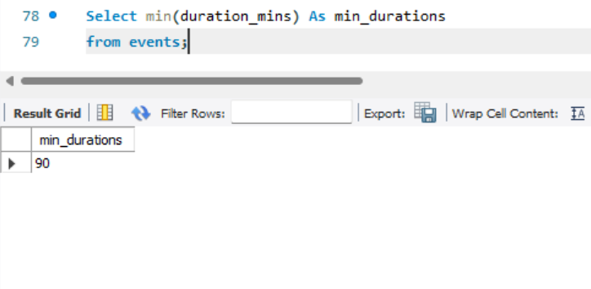
What is the minimum duration of an event?
Concept: MIN()
Insight: Identifies the shortest event duration available in the database.

Slide 16
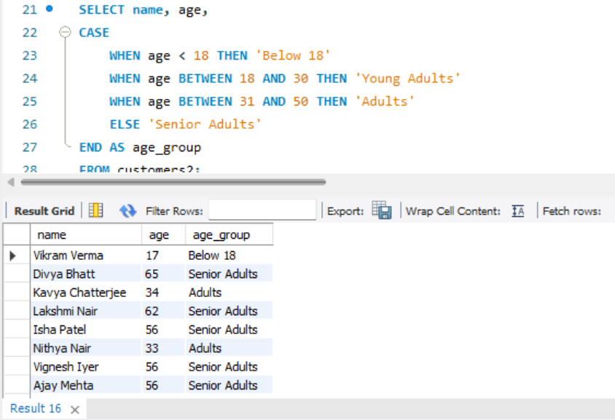
How can customers be classified into different age groups?
Concepts:- Case Conditions
Insights:-Categorizes customers into different age groups for better customer analysis.

Slide 17
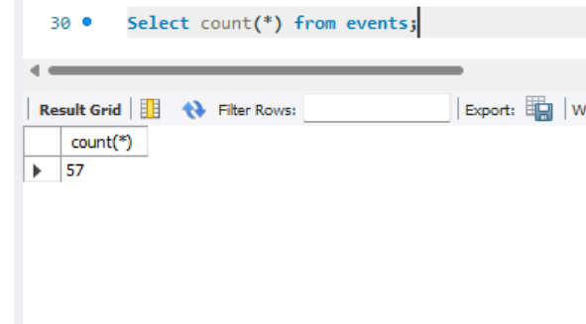
How many events are available in the database?
Concepts:- Count()
Insight: Identifies the total number of events available in the database.

Slide 18
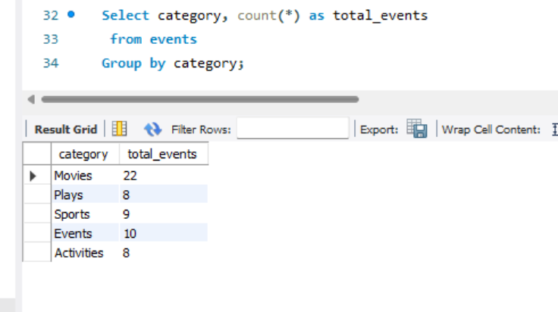
How many events belong to each category?
Concepts:- Count, group by
Insight: Shows the distribution of events across different categories.

Slide 19
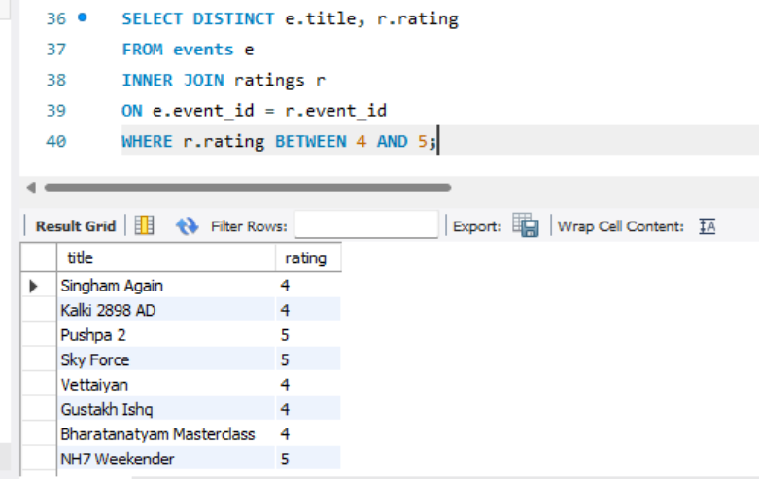
Which events have ratings between 4 and 5?
Concepts:- distinct , inner join , where , between
Insight: Identifies events that have received ratings between 4 and 5.

Slide 20
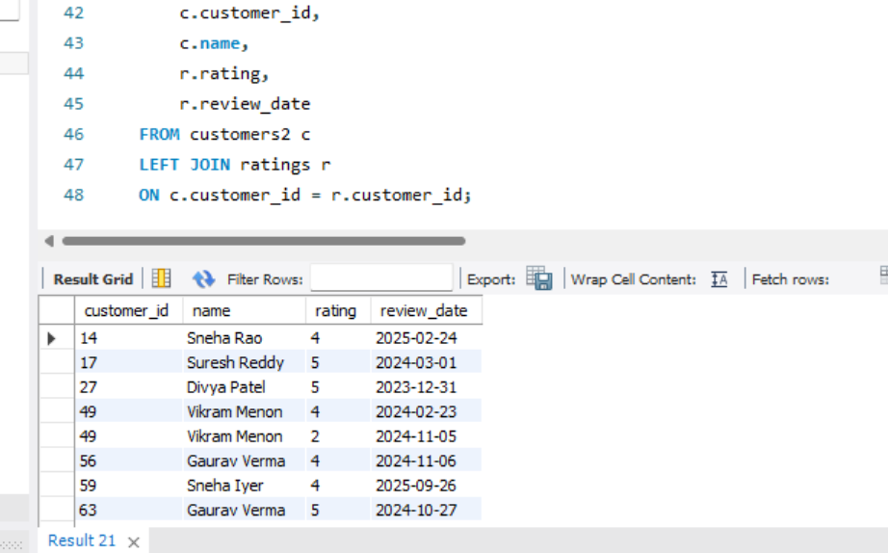
Display all customers along with their ratings, including customers who have not submitted any ratings.
Concept: LEFT JOIN
Insight: Displays all customers and their rating details, including customers who have not submitted any ratings.

Slide 21
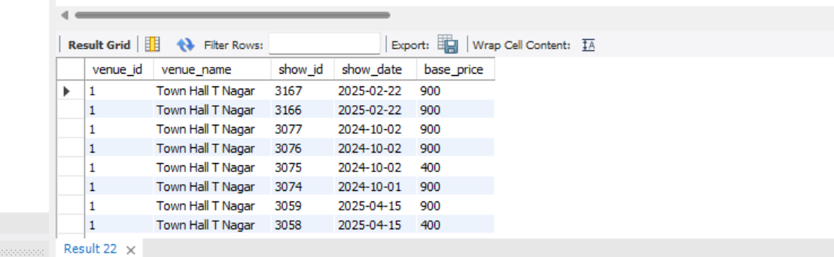
Display all venues and shows, including unmatched records from both tables.
Concept: FULL OUTER JOIN (using LEFT JOIN + RIGHT JOIN + UNION)
Insight: Displays all venues and shows, including venues without shows and any shows without matching venues.

Slide 22

THANK YOU!
Subhashini devendra

