Slide 1
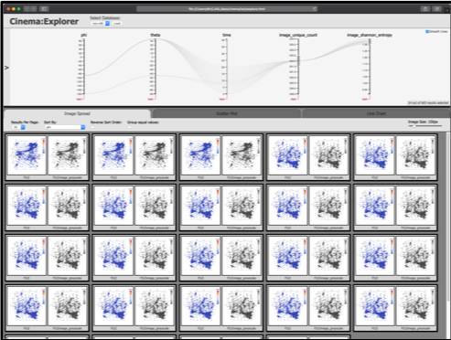
Coupled code/in-situ infrastructure
Nyx
Simulation code
ASCENT
Visualization
Algorithm
CINEMA DB on disk
CINEMA
Analysis
algorithm
Installed
Cinema viewer

