Slide 1
HELP DOCUMENT FOR EGFRisopred Application

Slide 2
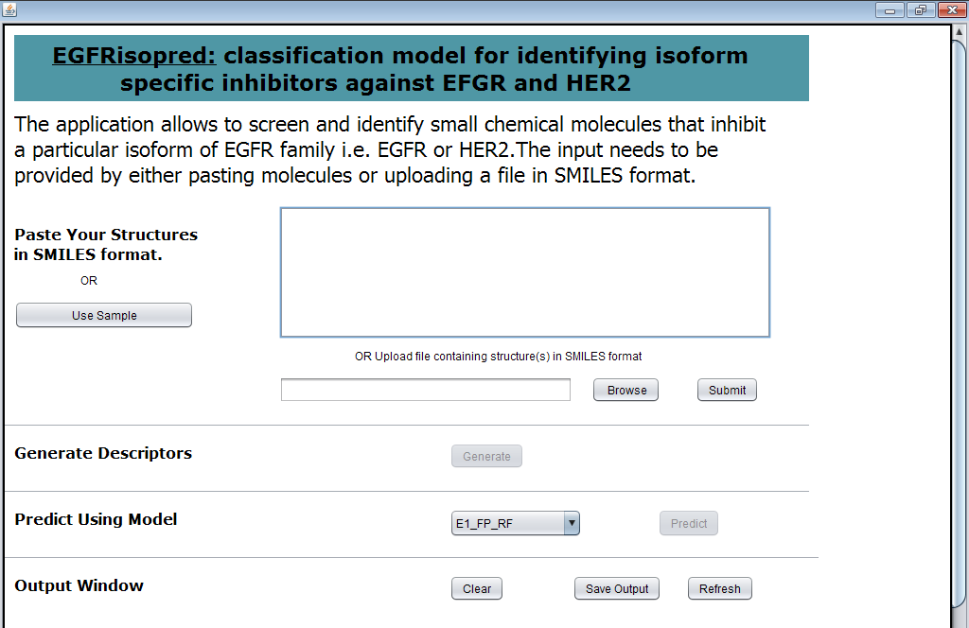
The FIRST SCREEN

Slide 3
The user can either provide the list of molecules in smiles format or upload a file in smiles format
Paste molecules
in smiles format or browse the file (as in the given example)
1
2
Press submit button

Slide 4
After a while, when processing is completed, the Generate button will become active. Press “Generate” button now.
Paste molecules
in smiles format or browse the file (as in the given example)
1
2
Press submit button
3
Press Generate button

Slide 5
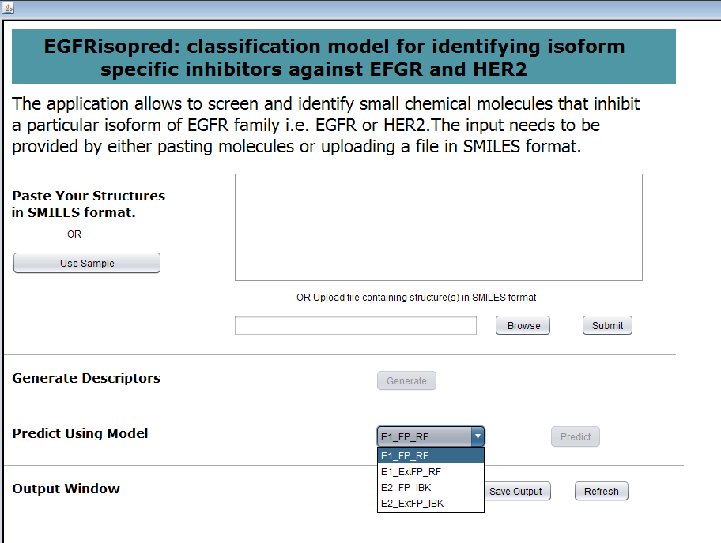
Again after processing is completed, the Predict button will become active. Select any one of the three models and Press “Predict” button
Paste molecules
in smiles format or browse the file (as in the given example)
1
2
Press submit button
3
Press Generate button
Select one model i.e. E1_FP_RF or E1_ExtFP_RF or E2_FP_IBK or
E2_ExtFP_IBK
5
4
Click Predict

Slide 6
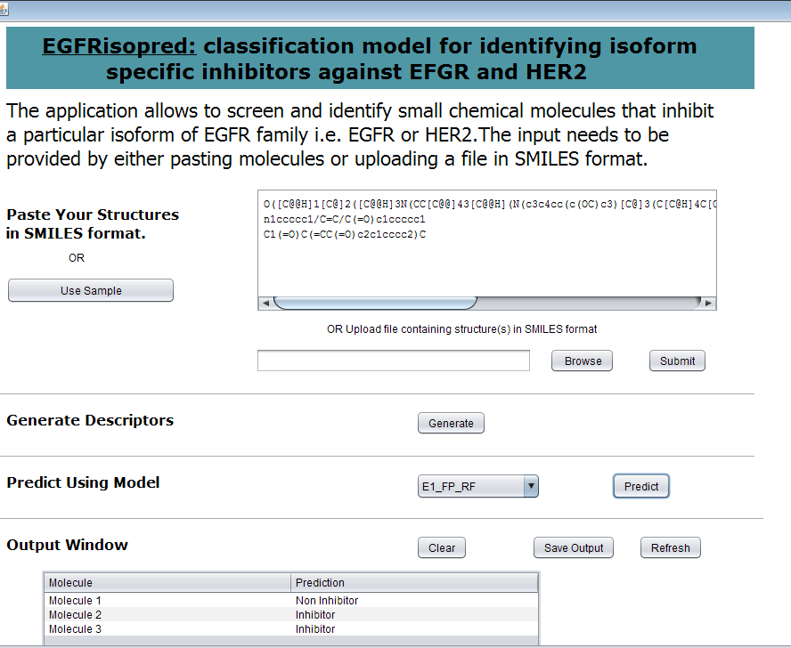
Finally, the Prediction for the molecules in is displayed in the Output window, which can also be saved using “Save Output” button.
Press Refresh button if you wish to run predictions for new set of molecules
7
6
Prediction is displayed

