Slide 1
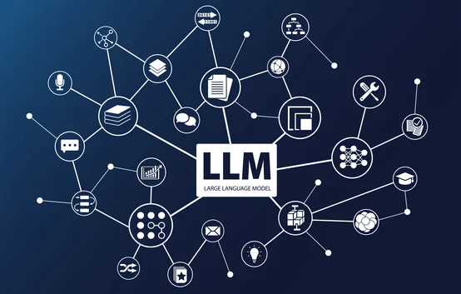
When Large Language Models Meet Vector Databases: A Survey
Unlocking the future of AI with efficient knowledge retrieval and generation.

Slide 2
Introduction: What’s the Big Idea?
Large Language Models (LLMs) like GPT-4 are changing the game in AI.
They understand language, create content, and answer complex questions.
Challenges remain: cost, hallucinations, memory issues, and outdated knowledge.
Vector Databases (VecDBs) offer solutions by efficiently managing data.
Together, they redefine how we interact with AI.

Slide 3
Why Do LLMs Need Help?
LLMs face significant challenges:
Hallucinations: Generate incorrect but plausible responses.
Outdated Knowledge: Static training data limits updates.
High Costs: API usage and retraining are expensive.
Memory Problems: Forgetting previous inputs, leading to disjointed interactions.
Real-world example: Customer chatbots often repeat themselves or provide incorrect answers.

Slide 4
What Are Vector Databases?
VecDBs store, search, and manage vectorized representations of data.
Use cases include text, images, audio, and more.
Examples: Pinecone, Milvus, ChromeaDB.
Designed to handle high-dimensional data efficiently.

Slide 5
The Magic of VecDBs
Key Benefits:
High-speed, scalable retrieval.
Support for multi-modal data (text, image, and audio).
Cost-efficient storage and processing compared to retraining models.
Example: VecDBs power image search engines by finding visually similar items.

Slide 6
The Synergy: LLMs + VecDBs
By combining LLMs and VecDBs:
LLMs get real-time external knowledge from VecDBs.
VecDBs store and retrieve context for LLMs to improve responses.
Significantly reduces API calls and costs.
Example: A chatbot for a legal firm retrieves case laws stored in VecDBs to answer client questions.

Slide 7
Retrieval-Augmented Generation (RAG)
Steps:
Pre-process and store data as vector embeddings in VecDBs.
Search VecDBs to retrieve relevant data.
Use LLMs to generate context-rich responses.
Why RAG?
Reduces hallucinations.
Provides dynamic, domain-specific answers.
Example: Customer support AI answering complex product queries accurately.

Slide 8
Real-World Applications: Smarter Chatbots
Chatbots with VecDBs:
Store and recall customer interaction history.
Provide accurate, domain-specific responses.
Example: Healthcare chatbot retrieves and explains medical procedures.
Benefits:
Reduced response times.
Enhanced user experience.

Slide 9
Semantic Search in E-Commerce
VecDBs improve search by understanding user intent:
Example Query: “Lightweight jackets under $50.”
VecDBs fetch results that match intent, even without exact keyword matches.
Impact: Better product discovery, increased customer satisfaction.

Slide 10
Personalized Recommendations
VecDBs analyze user data to provide tailored suggestions.
Example: A streaming platform recommending shows based on themes you enjoy.
Advantages:
Engages users more effectively.
Increases platform usage and loyalty.

Slide 11
Tackling Hallucinations
Hallucinations in LLMs are reduced by relying on accurate, pre-vetted data in VecDBs.
Example: Financial chatbots use VecDBs to pull updated market data for investment advice.
Benefits: Builds trust in AI-generated responses.

Slide 12
Cost Savings with Semantic Caching
VecDBs save commonly queried data to avoid repetitive API calls.
Example: A call center using GPT-Cache reduces API usage by 30%.
Benefits:
Lower operational costs.
Faster response times.

Slide 13
VecDB as LLM Memory
Overcoming memory limitations:
VecDBs store conversation history for continuous interactions.
Real-world Example: A personal assistant chatbot remembers user preferences and past tasks.
Benefits: Consistent, user-friendly experiences.

Slide 14
Architecture: RAG Workflow
Core components:
Input embedding.
Vector search in VecDB.
Context-driven response generation by LLM.
Real-world Example: A travel chatbot generating detailed trip itineraries.

Slide 15
Key Metrics for Integration
Performance Metrics:
Retrieval accuracy: Correctness of VecDB results.
Latency: Speed of retrieval and response.
Cost efficiency: Reduced API usage.
Memory retention: Ability to maintain context.
Example: Healthcare AI achieving 90% retrieval accuracy using VecDBs.

Slide 16
Multimodal Capabilities
VecDBs handle multiple data formats like text, images, and audio.
Example: A VecDB-backed search engine lets users find items by uploading photos.
Potential: Revolutionizing cross-modal AI applications.

Slide 17
Challenges
Key Challenges:
Hybrid search: Combining structured and unstructured data.
Real-time updates: Keeping VecDBs up-to-date.
Multi-modal fusion: Integrating data types seamlessly.
Example: E-commerce platforms balancing structured (price) and unstructured (reviews) data.

Slide 18
Future Directions
What’s Next?
Build hybrid systems combining vector and relational searches.
Enable real-time updates and scalability.
Enhance multimodal VecDB support for rich user interactions.
Example: AI assistants using speech, image, and text data simultaneously.

Slide 19
Conclusion
Content:
LLMs + VecDBs = Smarter, faster, and more cost-effective AI.
Together, they address LLM limitations and create new possibilities.
Call to action: Explore this technology to shape the future of AI.

Slide 20
Call to Action
Let’s shape the future of AI together. Explore the GitHub repository the synergy of LLMs and VecDBs isn’t just about AI—it’s about transforming how we interact with the world.
Github Repo: https://github.com/subhashpolisetti/RAG-LLM-VecDB-Survey

