Slide 1
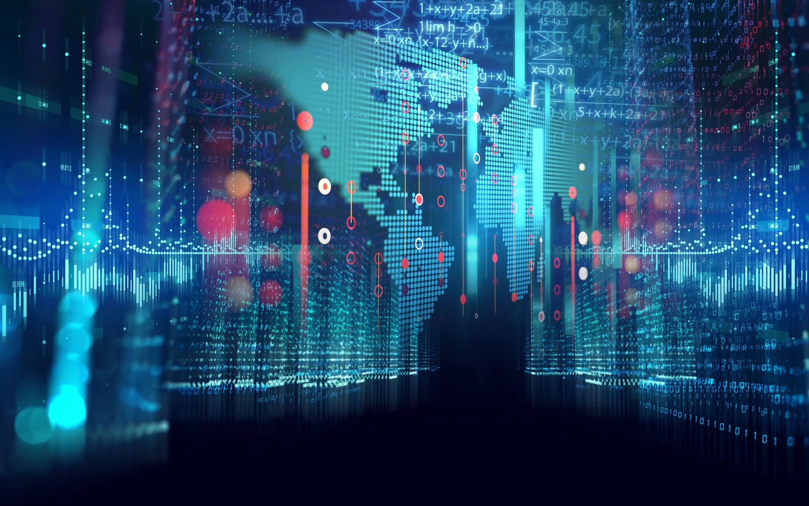
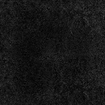
Machine Learning Handwriting Analysis
Team 2
Edyson Katuuo, Subhashree Mallick,
Alekyia Gadiraju, Shawntell Manning

Slide 2

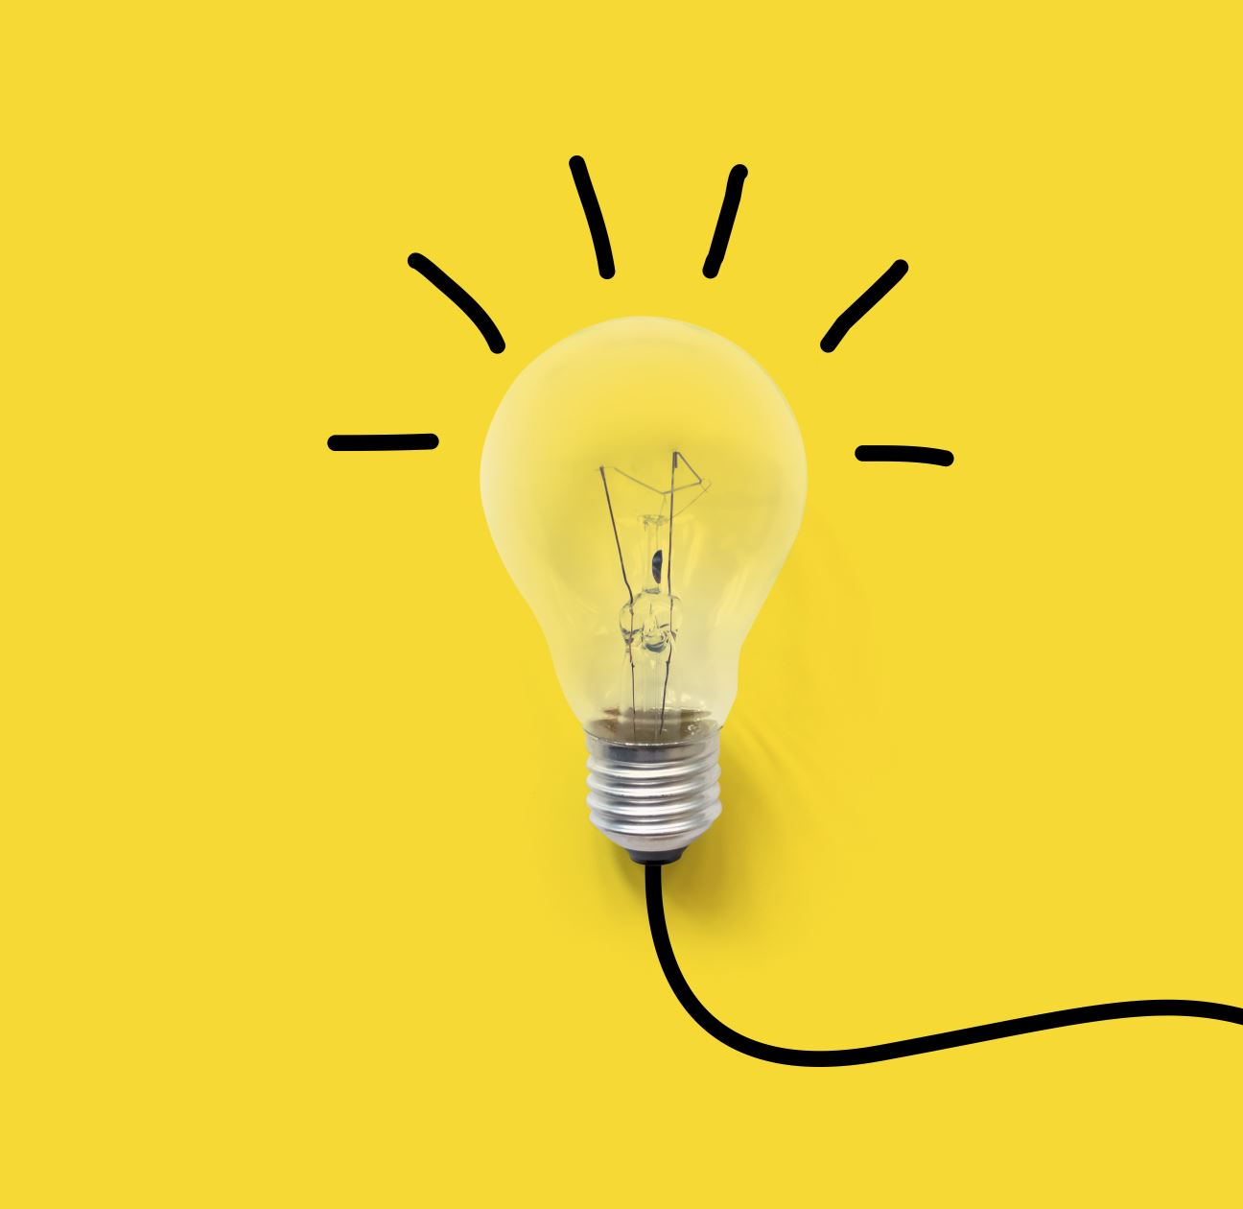
Project Objective
In this project, we used a convolutional neural network to create a deep learning algorithm to apply to a model for interpreting an input image of handwritten characters for differentiation and prediction.

Slide 3
Data Source
One csv file with A-Z Handwritten Data for analysis
370K+ English Alphabet Characters
785 columns
666.53 MB
Kaggle.com: https://www.kaggle.com/sachinpatel21/az-handwritten-alphabets-in-csv-format

Slide 4
Process
Train the Model
Create Web App Using Flask
Commit the Code in GitHub
Create an Account in Heroku
Link GitHub to Heroku
Deploy the Model
Web App for Demo

Slide 5
Train the Model
Used python and Jupyter Notebook to create, test, train and save the model.
Dependencies: Matplotlib Pyplot, cv2, numpy, keras, tensorflow, pandas, sklearn

Slide 6
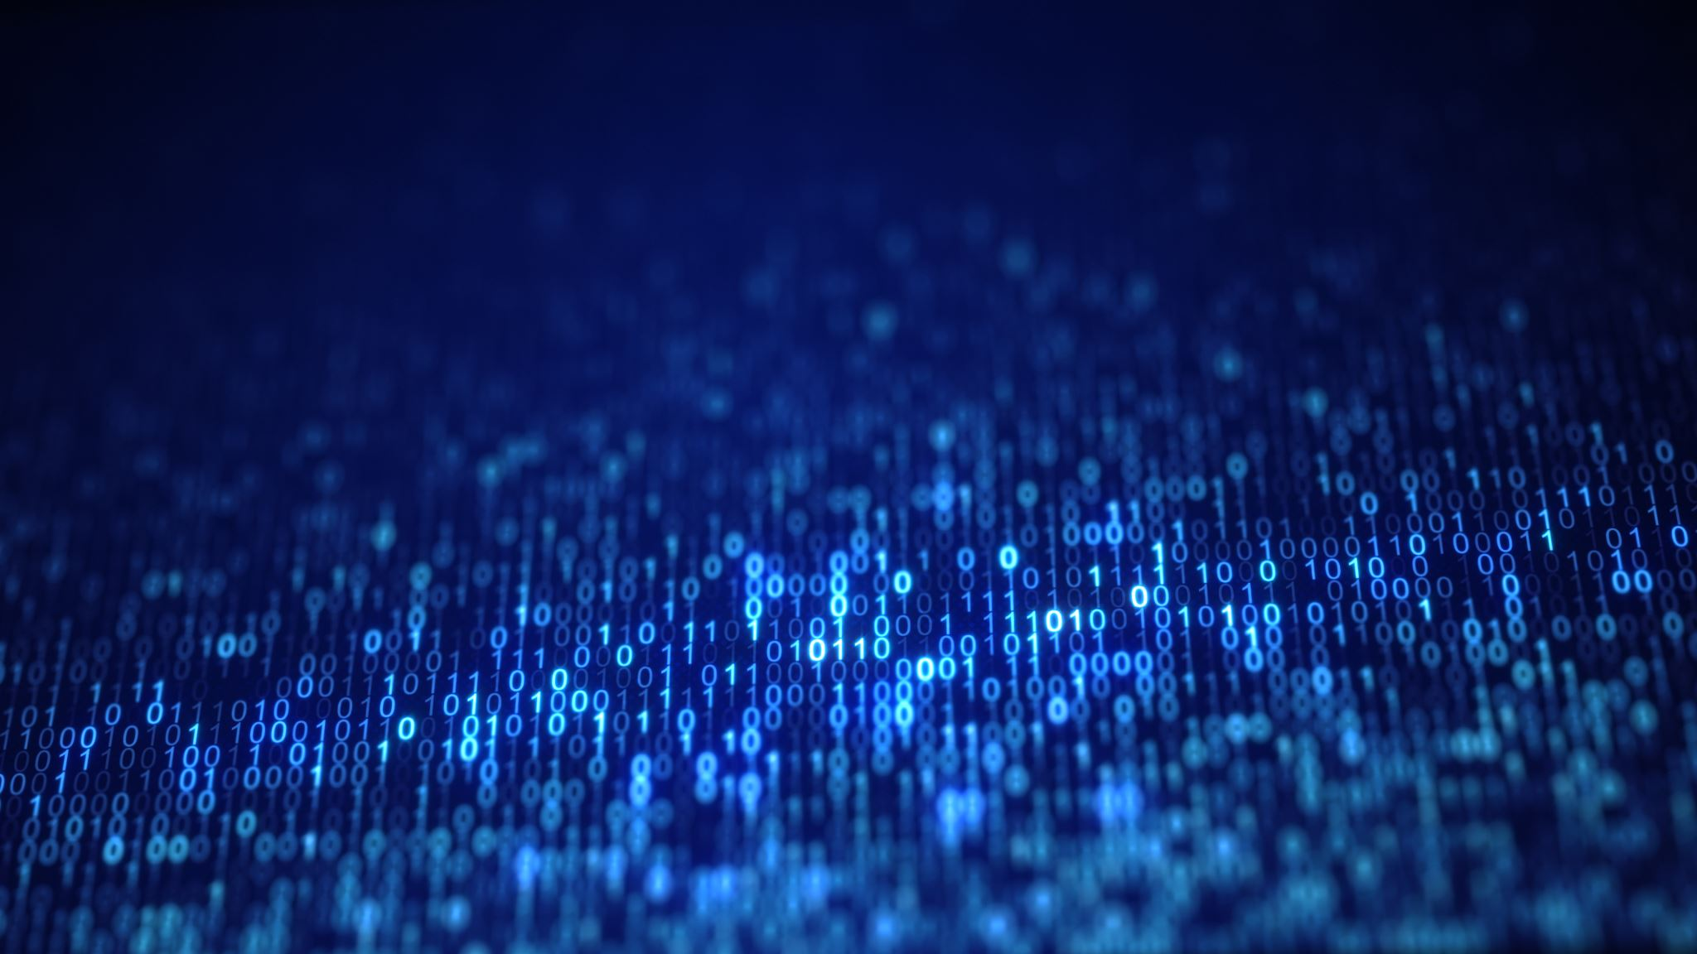
Train the Model
Review Code

Slide 7
Flask App
Created a web application using a Flask framework (app.py)
Dependencies: flask, werkzeug.utils, tensorflow, keras, cv2, numpy
Takes a character image to upload and uses our model to make a prediction on that character.

Slide 8

Flask App – Code Review
Review Code

Slide 9
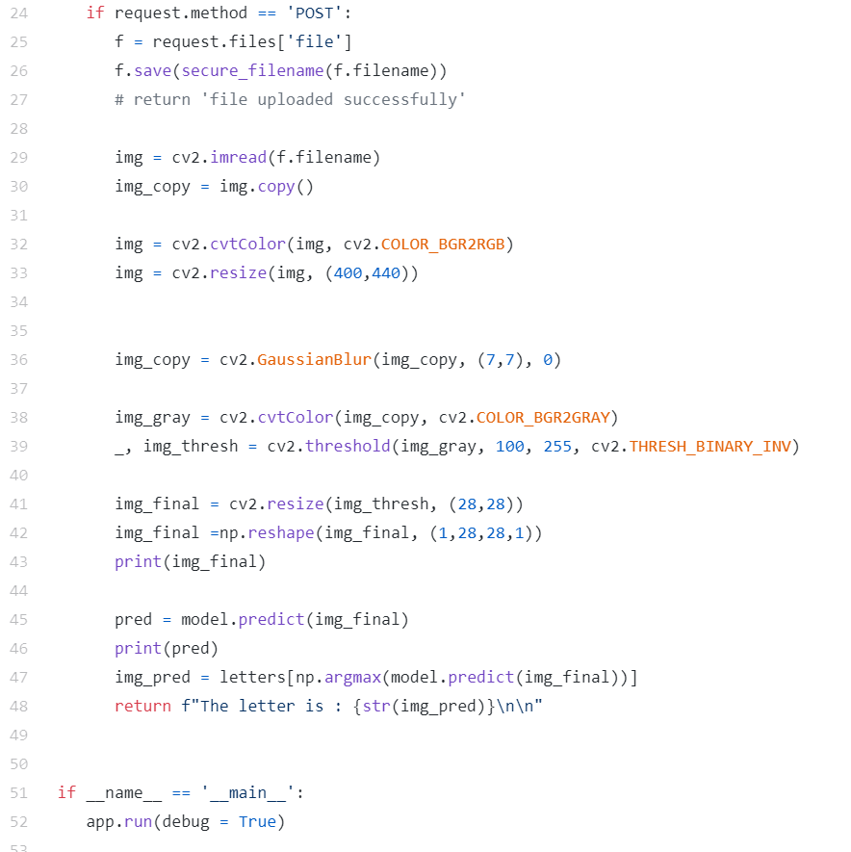
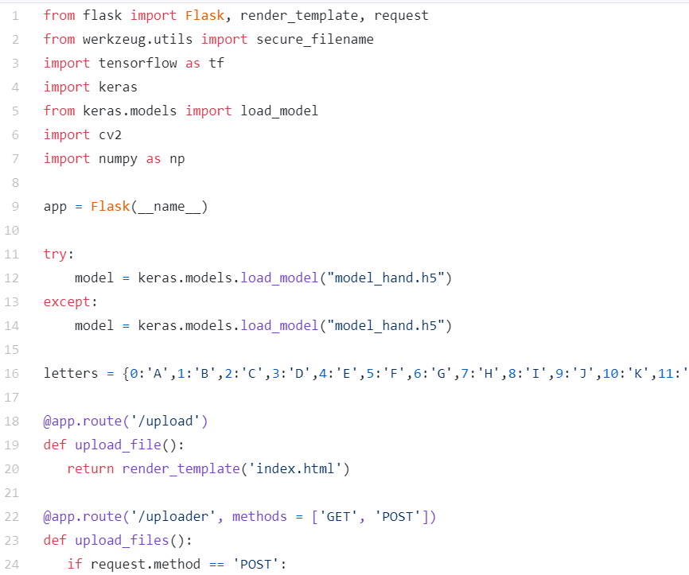

Slide 10
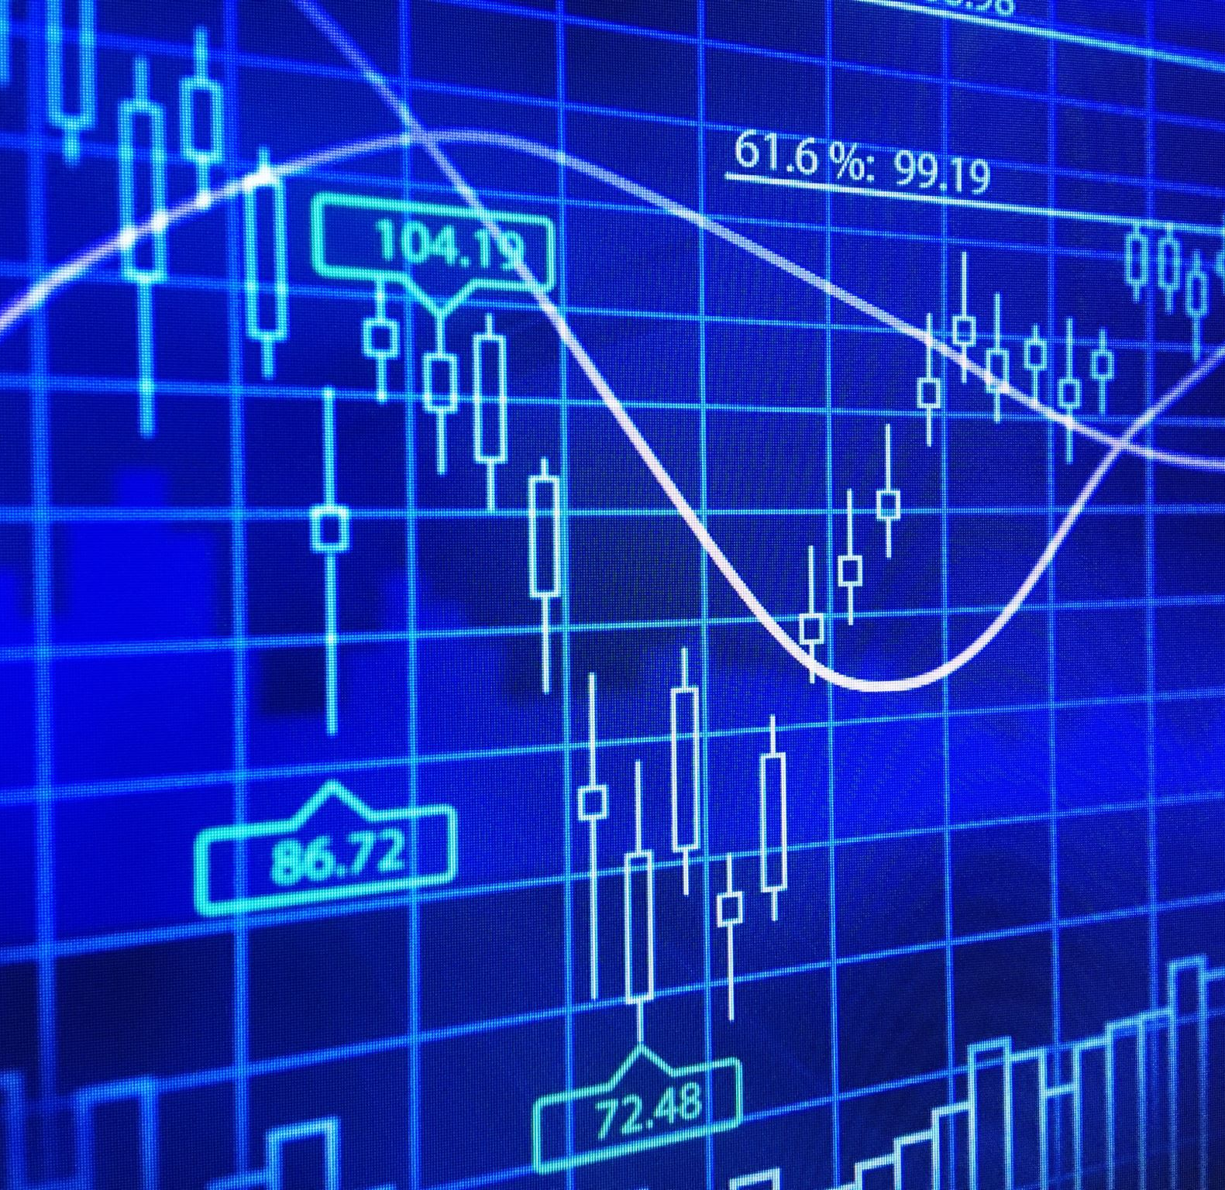
Prediction Analysis
Demo

