Slide 1



Garbha Analytics:
Data-Driven IVF Outcome Monitoring

Slide 2

Contents
Business Objective
Business Constraints
Project Architecture - Data Flow Diagram
Data Collection
Exploratory Data Analysis
Data Visualization
Notes:
Change

Slide 3


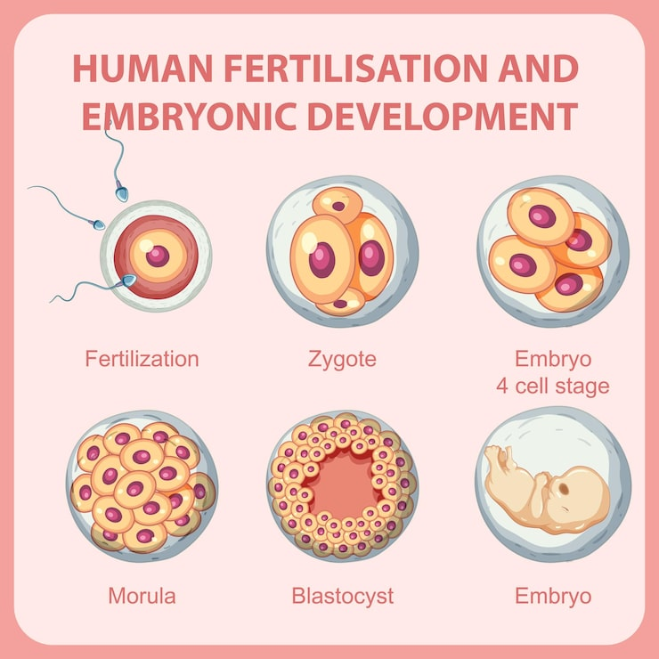
Business Problem
Inconsistent embryo grading and delayed outcome insights IVF success rates while increasing treatment costs and decision delays
📉Low Success Rates:
Low 30-35% success rates with 25-40% variability in embryo grading causing 15-20 % loss in potential outcomes.
🔄High Variability:
High inter-observer variability (25–40%) in embryo grading leads to inconsistent outcomes across labs.
💰 10-15% Increase in operational Cost:
Inefficiencies in current processes contribute to higher costs per cycle, affecting clinic profitability.

Slide 4

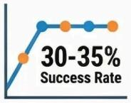
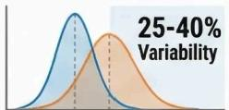


Business Problems
Executive Pain Points:
Success rates remain stagnant at 30-35%:
IVF success rates remain low (30–35%) despite increasing patient demand.
25-40%inter-observer variability in embryo grading:
High inter-observer variability (25–40%) in embryo grading leads to inconsistent outcomes across labs.
3-4 month wait for definitive outcome clarity:
Delayed feedback creates uncertainty for patients and clinicians, hindering timely decision-making
10-15%increase in operational costs:
Inefficiencies in current processes contribute to higher costs per cycle , affecting clinic profitability.

Slide 5


Business Objective
Clinician & Embryologist Challenges:
25-40% inconsistency in embryo grading among embryologists leads to 15-20%
loss in implantation potential.
Limited ability to compare historical embryo outcomes with current cases.
No consolidated view of key success indicators (embryo grade, day of
transfer, implantation outcome).
Difficulty identifying which embryo characteristics truly influence
implantation success.
Delayed feedback loop prevents learning from past cycles and improving
clinical protocols.
Manual analysis increases cognitive load and time spent on
decision-making.

Slide 6
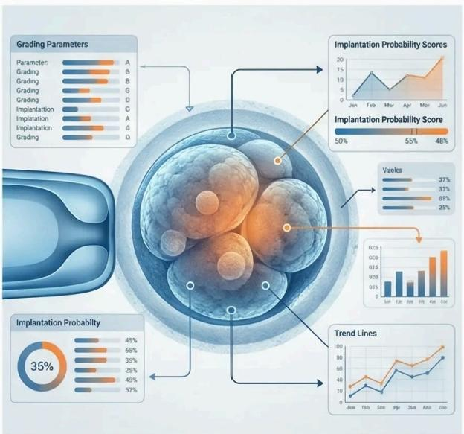
Business Problem:
Gynecologist & Patient Impact:
Limited ability to predict and explain IVF success probabilities to patients
early in the treatment.
Delayed outcome clarity makes patient counseling challenging and
increases anxiety.
Difficulty in setting realistic expectations around embryo quality and
implantation chances.
Lack of data-backed insights to support treatment personalization.
Reduced patient trust and satisfaction due to uncertain timelines
and outcomes.

Slide 7


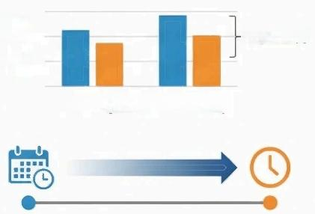


Project Overview and Scope
Reduce Inter-Observer Variability: Implementing Al-powered standardization to address the 25-40%variability in
embryo grading processes
Improve Implantation Success Rate: Targeting 15-20%improvement in implantation potential
through data-driven embryo selection.
Identification of key success indicators: Analysis of embryo quality , day of transfer, AMH, FSH level, Endometrial Thickness, Blastocyst Stage.
Enhance Cost Efficiency: Reducing the 10-15%operational cost inflation through automation and standardized procedures
Develop Predictive Framework: Creating an evidence-based model using historical data analysis and advanced Al algorithms.

Slide 8



Data Dictionary
Patient Demographics Drive IVF Outcomes:
The dataset enables analysis of age-related success rate trends, supporting personalized treatment counseling.
Helps clinicians identify high-risk age groups early in the IVF journey
Embryo & Cycle-Level Data Selection:
Data dictionary includes embryo-level indicators (grading, development stages).
Allows correlation analysis between: Embryo quality, Day of transfer, Implantation and live birth success.
Predictive & Comparative Analysis:
Use of binary and numeric variables makes the dataset suitable for: Trend analysis, Succes probability estimation, Risk stratification.
Enables comparison of outcomes across: Different clinicians, different protocols, different patient profiles

Slide 9
Exploratory Data Analysis [EDA]
Statistical Insights
Business Insights
🎯 High IVF Potential Patient Base
→ Majority patients are in early 30s
⚠️ Early Ovarian Reserve Screening is Critical
→ Skewed AMH & FSH distributions
💊 Medication & Cost Optimization Opportunity
→ Hormonal variability impacts dosing
🔍 Early Identification of Poor & High Responders
→ Reduces cycle cancellations
🧠 Better Patient Counseling & Expectation Setting
→ Data-backed success probability discussion
📊 Foundation for Clinical Decision Dashboards
→ Supports doctors, embryologists, and management
📊 Average Female Age (~32 years)
→ Indicates majority patients are in optimal reproductive age group
👨‍⚕️ Male Age Shows Higher Variability
→ Wider spread compared to female age
🧬 AMH is Positively Skewed (1.26)
→ Majority patients have low ovarian reserve
⚗️ FSH Shows Positive Skewness (1.05)
→ Many patients fall in borderline/high FSH range
📉 Low Variance but High Kurtosis in AMH
→ Clustered values with few extreme responders
📐 Female Age Distribution is Stable
→ Near-zero skewness suggests reliable age data
🚨 High AMH Kurtosis (3.81)
→ Presence of extreme low & high responders
Notes:
EDA is used for seeing what the data can tell us before the modeling task.
Change

Slide 10
Data Preprocessing
🧹 Data Cleaning:
Removed duplicates and handled missing clinical and lab values.
Handled missing values in AMH, FSH, AFC, Oocytes Retrieved.
Corrected inconsistent categorical entries (Yes/No, Y/N)
🔢 Standardization:
Unified data types, formats, and categorical values.
Converted hormonal parameters (AMH, FSH) to numeric format
Standardized age fields as whole numbers
Ensured date fields followed consistent format.
📉 Outlier Management:
Identified extreme hormonal and response values while retaining clinically valid cases.
Feature Engineering:
Created Age Groups (≤30, 31–35, 36–40, >40)
Categorized AMH levels (Low / Normal / High)
🔍 Data Validation:
Cross-checked lab values with clinical ranges.
Ensured logical relationships (e.g., AMH vs Oocytes)
Verified no negative or impossible values
Notes:
Keep observations

Slide 11
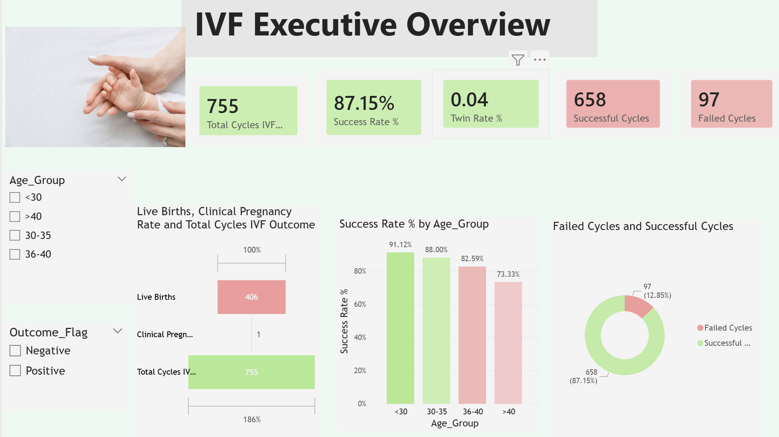
Data Visualization
Executive Overview:
🧠 High overall success rate enhances clinic credibility and patient trust.
⚠️ Older age groups represent a key focus area for protocol optimization and counseling
📉 Failed cycles analysis can help reduce costs and improve efficiency.
🎯 Dashboard enables real-time monitoring of IVF performance KPIs for leadership.
🟢 Patients under 30 years show the highest success rate (91.12%).
🟢 Age group 30–35 maintains a strong success rate of 88%, while, 36–40 age group (82.59%), indicating age-related fertility impact.
🔴 Patients above 40 show the lowest success rate (73.33%), requiring personalized treatment strategies.
✅ Overall success rate is 87.15%, indicating high clinical effectiveness.
📉 Failed cycles account for 12.85%, highlighting a smaller but important improvement opportunity.
Notes:
Add graphical

Slide 12
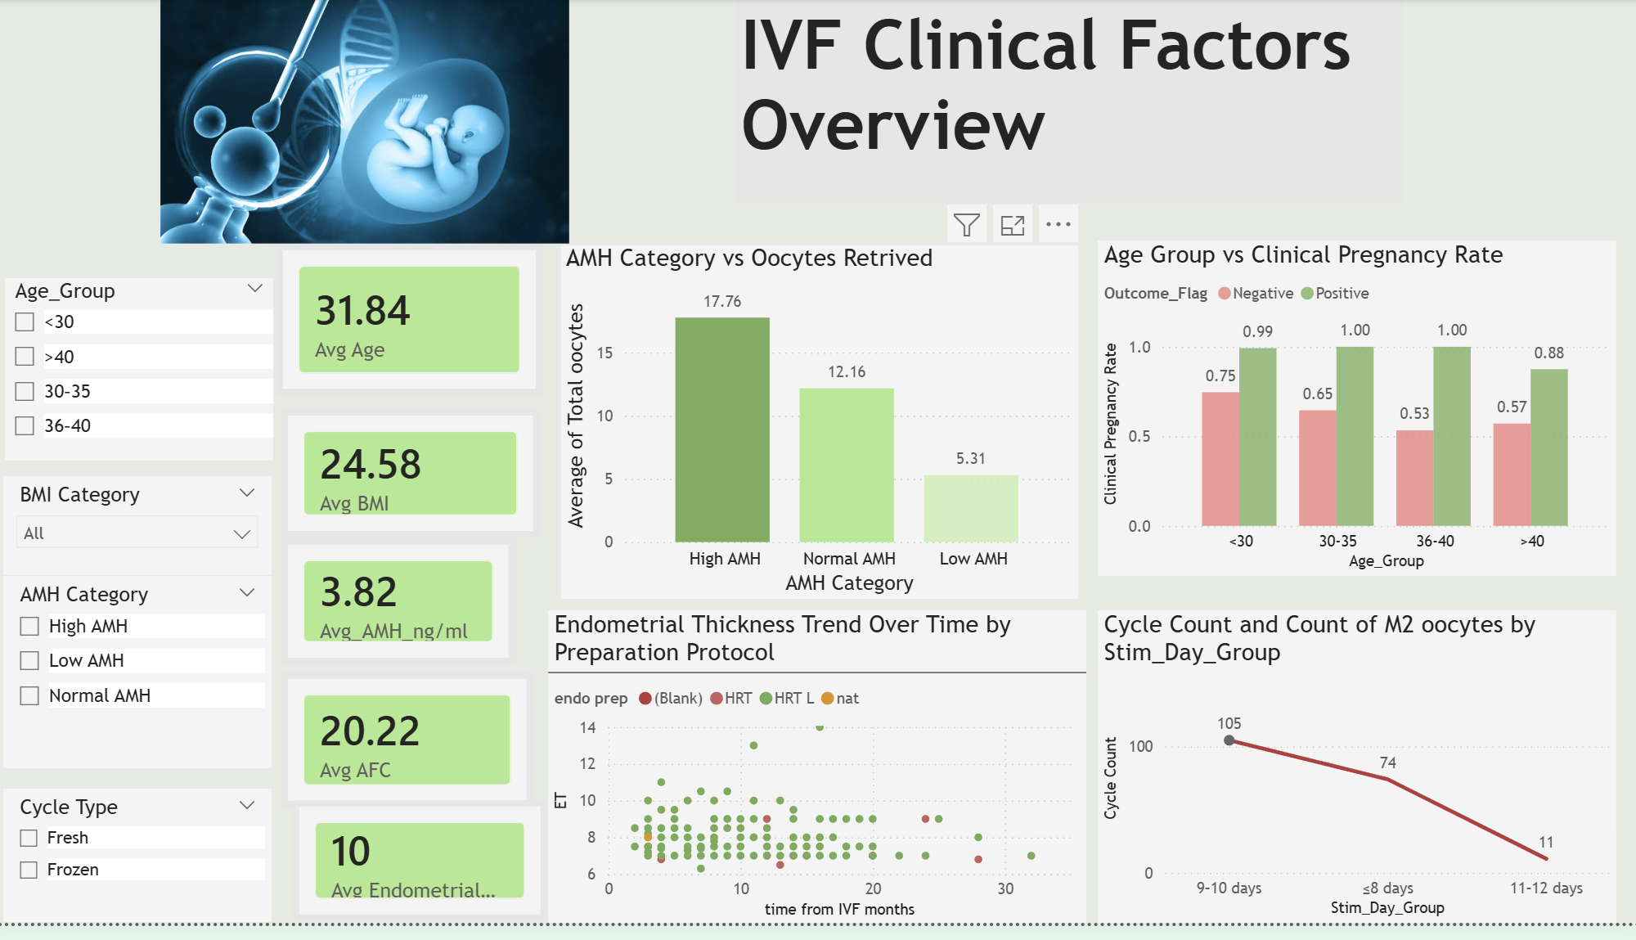
Data Visualization
Doctors Overview:
👩‍⚕️ Patient Profile Summary:
📊 Average female age is 31.84 years, indicating a predominantly optimal reproductive age group.
🧬 Average AMH is 3.82 ng/ml, suggesting overall good ovarian reserve.
🔬 Average AFC is 20.22, supporting strong follicular potential.
🩺 Average endometrial thickness is ~10 mm, within optimal implantation range.
🧬 Ovarian Reserve & Oocyte Yield:
🟢 High AMH patients retrieve the highest number of oocytes (≈17.76).
🟡 Normal AMH patients show moderate oocyte yield (≈12.16).
🔴 Low AMH patients retrieve significantly fewer oocytes (≈5.31).
🧫 Endometrial Thickness & Protocol Trends:
📊 Endometrial thickness remains largely stable over time across preparation protocols.
🟢 HRT and Natural cycles show consistent endometrial development.
💉 Stimulation Duration & Lab Yield:
📈 9–10 stimulation days show the highest cycle count and M2 oocytes (105).
🎯 Optimal stimulation window appears to be 9–10 days.
🤝 Enhances patient counseling with data-backed expectations

Slide 13
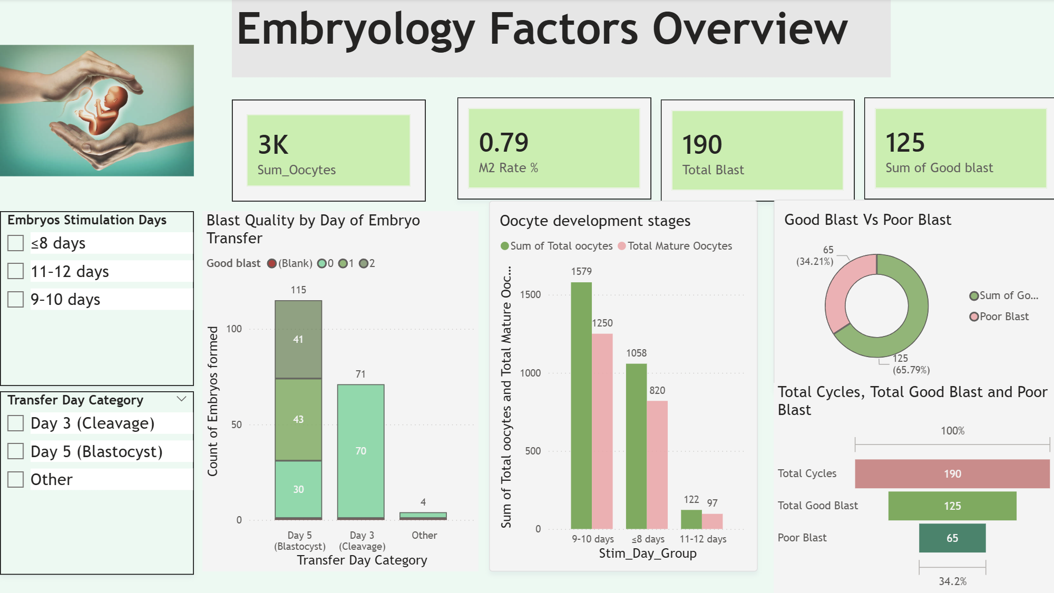
Data Visualization
🧫 Embryology Factors:
🧠 Embryology KPIs enable lab quality monitoring and benchmarking.
🎯 Supports decision-making on optimal stimulation duration and transfer day.
💊 Helps reduce resource waste by identifying inefficient stimulation
protocols.
🤝 Improves clinician–embryologist collaboration through shared metrics
📅Blast Quality Distribution:
🟢 Good-quality blastocysts account for 65.79% .
🔴 Poor-quality blastocysts account for 34.21% .
🟢 Day-5 (Blastocyst) transfers show the highest number of good-quality embryos.
🟡 Day-3 (Cleavage) transfers produce fewer good-quality embryos compared to Day-5.
🎯 Data supports Day-5 transfer as the preferred clinical strategy.
🔬 Overall Lab Performance:
⚖️ Average BMI is 24.58, which falls within the normal–borderline range
🧬 ~3,000 total oocytes processed across all IVF cycles.
⚗️ M2 (mature oocyte) rate is 0.79, indicating strong lab maturity outcomes.
🎯Optimal stimulation duration and Day-5 transfer significantly improve blastocyst quality and lab efficiency.

Slide 14


