Slide 1
TellCo: user analytics and acquisition view
Overview, engagement, experience and satisfaction from one month of xDR data
Nexthikes IT Solutions | Project 5
By: Subhashree Mohanty

Slide 2
Bottom line: promising, but not yet a buy on this data alone
106,856
26%
16%
users, 150,000 sessions
of the 73.8 TB comes from the top 10% of users
of traffic from 12% of users on router/hotspot devices
Positive on the network evidence: usage is concentrated in a heavy-user and router segment, and most phone users show low throughput, so quality and plan upgrades have room to lift usage.
The data cannot show whether TellCo is undervalued: it has no revenue, churn or growth figures.
Recommendation: continue due diligence and buy only if the financials and the data checks on the last slides support the price.

Slide 3
Data, variables and method
Group | Variables | Type
Identifiers | Bearer Id, MSISDN, IMSI, IMEI | ID (integer)
Time | Start, End, Dur. (ms) | Date / numeric
Handset | Manufacturer, Type | Category
Network | RTT, throughput, TCP retransmission (DL/UL) | Numeric
Application | Social, Google, Email, YouTube, Netflix, Gaming, Other (DL/UL bytes) | Numeric
Totals | Total DL, Total UL (bytes) | Numeric
150,000 sessions, 106,856 users (MSISDN); totals row and duplicate duration column removed.
Missing values and 1.5xIQR outliers replaced by the mean of normal values, as specified.
K-means on min-max scaled metrics; PCA on standardised application volumes.
Satisfaction = mean of engagement and experience scores (distances to cluster centres).

Slide 4
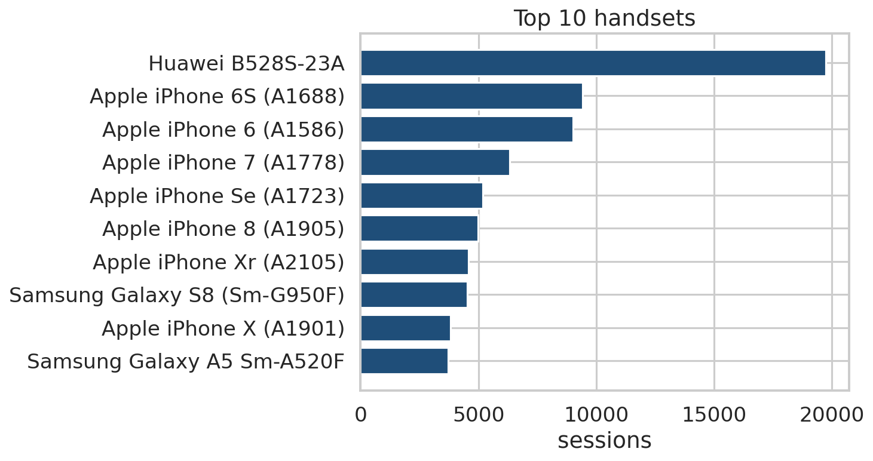
Handsets: Apple leads, but the top device is a router
Top handset: Huawei B528S-23A (13% of sessions), a home router.
Manufacturers by sessions: Apple (40%), Samsung (27%), Huawei (23%).
6.4% of sessions have no handset recorded and are excluded.
Marketing: bundle plans with the popular routers; target iPhone and Samsung owners with data offers.

Slide 5
Top 5 handsets for each top-3 manufacturer
Manufacturer | Handset | Sessions
Apple | Apple iPhone 6S (A1688) | 9,419
Apple | Apple iPhone 6 (A1586) | 9,023
Apple | Apple iPhone 7 (A1778) | 6,326
Apple | Apple iPhone Se (A1723) | 5,187
Apple | Apple iPhone 8 (A1905) | 4,993
Samsung | Samsung Galaxy S8 (Sm-G950F) | 4,520
Samsung | Samsung Galaxy A5 Sm-A520F | 3,724
Samsung | Samsung Galaxy J5 (Sm-J530) | 3,696
Samsung | Samsung Galaxy J3 (Sm-J330) | 3,484
Samsung | Samsung Galaxy S7 (Sm-G930X) | 3,199
Huawei | Huawei B528S-23A | 19,752
Huawei | Huawei E5180 | 2,079
Huawei | Huawei P20 Lite Huawei Nova 3E | 2,021
Huawei | Huawei P20 | 1,480
Huawei | Huawei Y6 2018 | 997

Slide 6
Basic metrics and dispersion of per-user data
Variable | Mean | Median | Std dev | IQR | Skew
Sessions per user | 1.39 | 1.00 | 0.81 | 1.00 | 3.35
Duration (s) | 128.91 | 97.15 | 102.10 | 98.32 | 2.70
Total data (GB) | 0.69 | 0.62 | 0.49 | 0.50 | 2.27
Mean is above median for every variable and skew is above 2: most users are light, a few are very heavy.
A typical user has one session of about 1.5 minutes and 0.6 GB; averages overstate the typical user.
This is why users are segmented (deciles, clusters) instead of judged on averages.

Slide 7
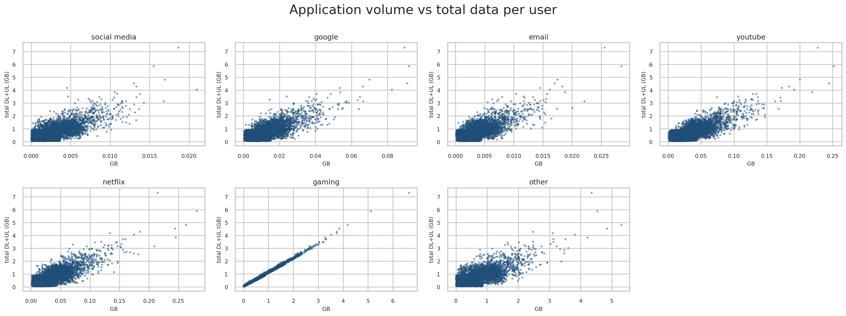
Graphical univariate and bivariate analysis
Histograms and boxplots of every per-user variable show long right tails (charts in the appendix folder).
Each application rises with total data. Gaming is almost perfectly linear (r = 0.997).
Caution: application volumes exceed the session total (median 1.9x), so gaming mirrors the total instead of showing app mix.

Slide 8
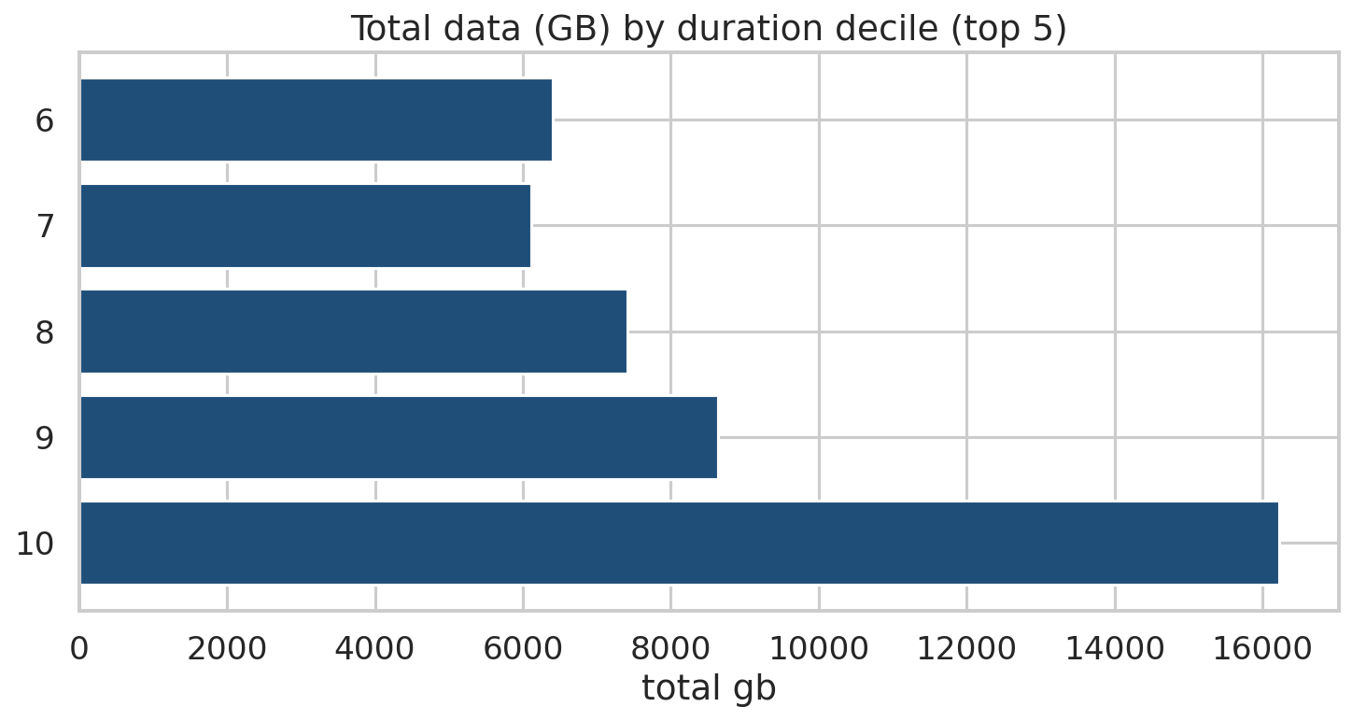
Duration deciles: the longest-duration users carry the traffic
Users split into 10 duration deciles; the top five (6-10) are shown.
These five deciles hold about 61% of all traffic.
The top decile alone carries 16.2 TB, about 22% of the total.
Target premium and unlimited plans at the top deciles.

Slide 9
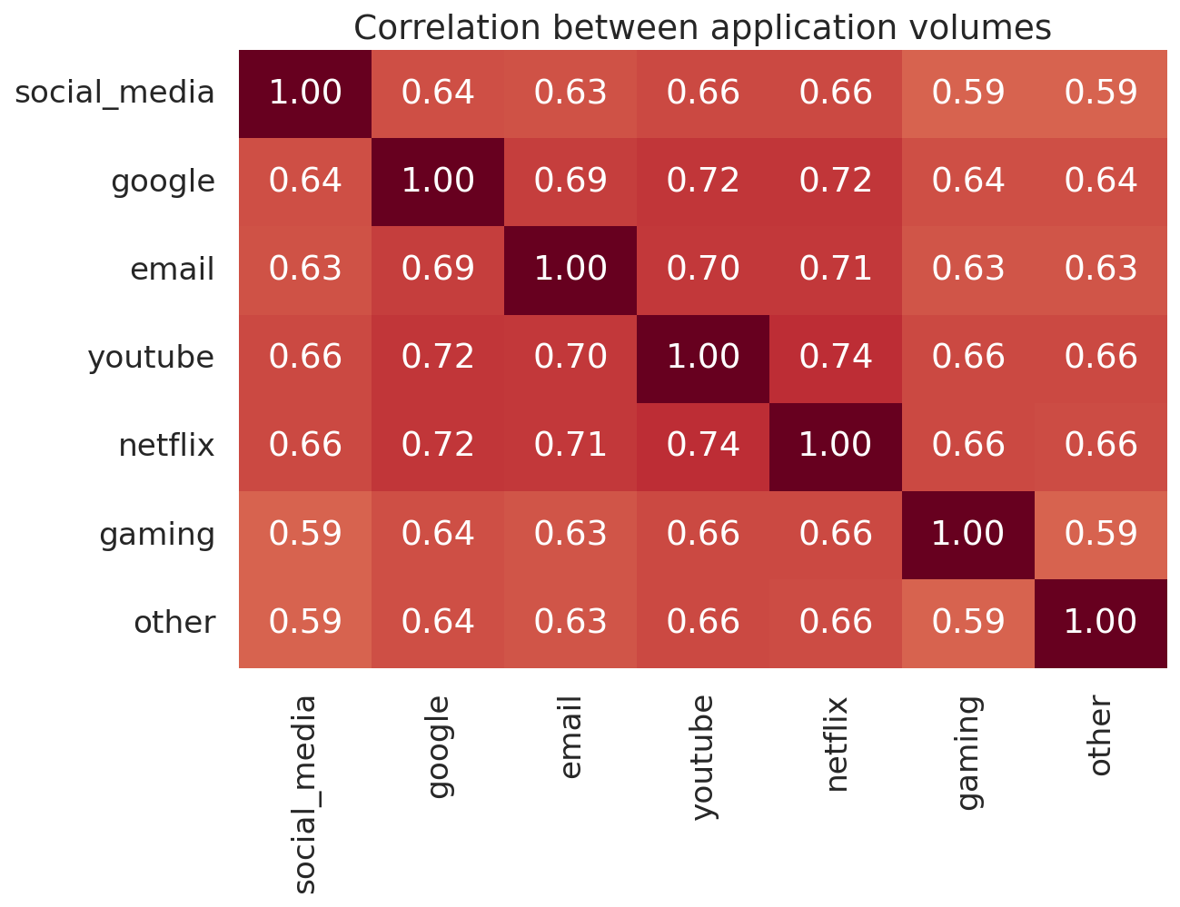
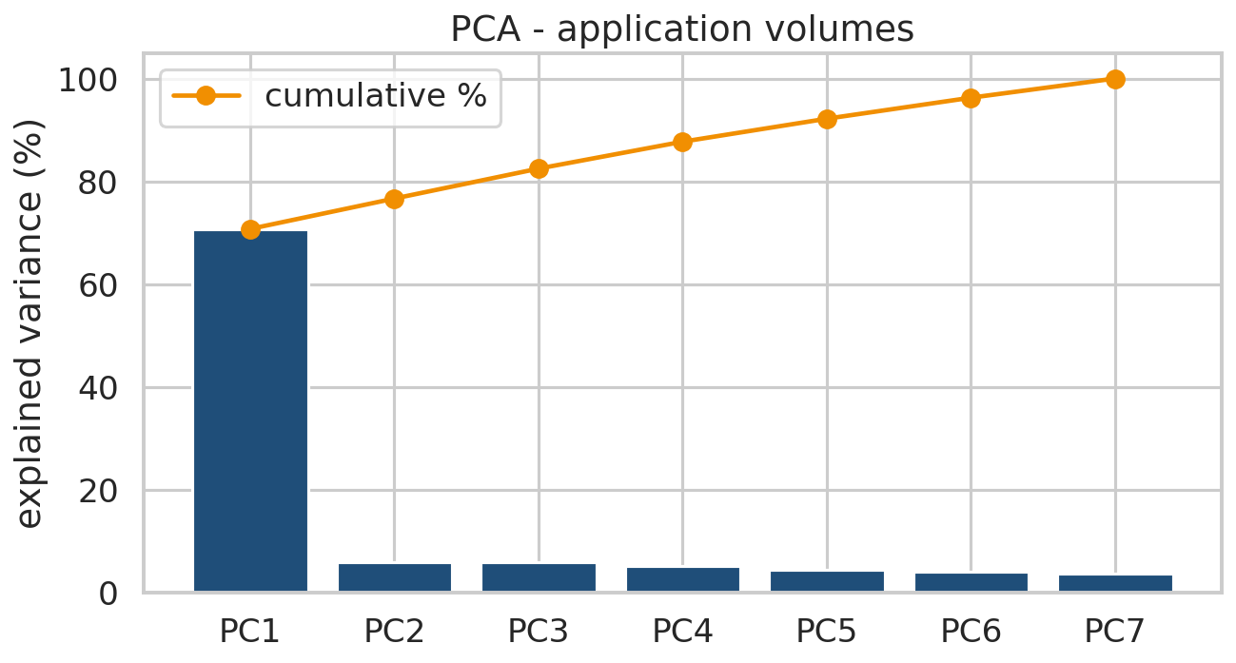
Correlation and dimensionality reduction
All application correlations are positive (0.59 to 0.74); YouTube and Netflix are strongest.
PCA: PC1 explains 71% of variance (77% with two components) and is overall volume. Users differ in how much they use, not in which apps.

Slide 10
Engagement: top 10 customers per metric
By sessions
By duration (s)
By traffic (gb)
MSISDN | Sessions
33626320676 | 18
33614892860 | 17
33625779332 | 17
33659725664 | 16
33675877202 | 15
33760536639 | 15
33667163239 | 13
33603127838 | 12
33604515716 | 12
33627080969 | 12
MSISDN | Duration (s)
33659725664 | 1,964
33626320676 | 1,867
33675877202 | 1,804
33659359429 | 1,771
33614892860 | 1,760
33760536639 | 1,716
33625779332 | 1,693
33664712899 | 1,534
33786323068 | 1,475
33606582008 | 1,322
MSISDN | Traffic (GB)
33614892860 | 8.85
33760536639 | 8.51
33625779332 | 8.50
33626320676 | 7.97
33675877202 | 7.89
33659725664 | 7.71
33666464084 | 7.31
33760413819 | 7.13
33664712899 | 6.90
33698792269 | 6.54

Slide 11
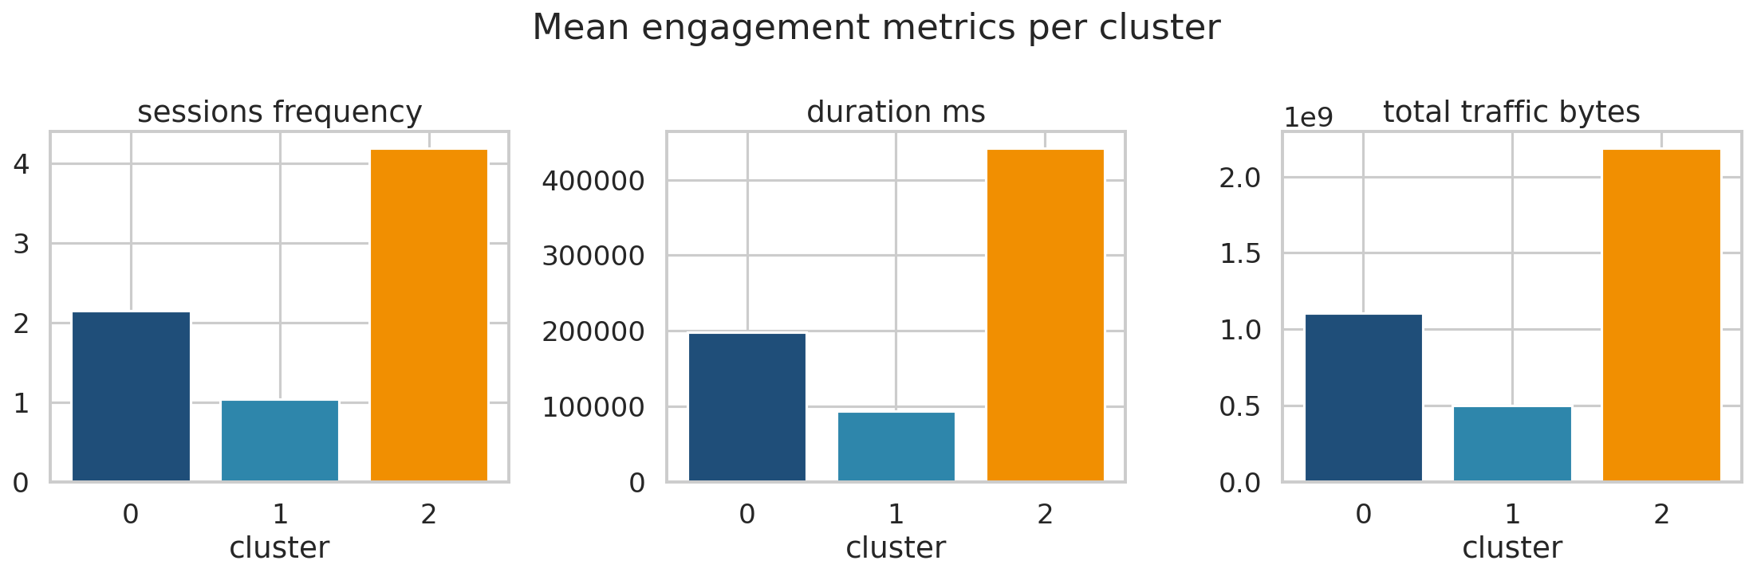
Engagement clusters (k=3)
Cluster | Users | Avg sessions | Avg duration (s) | Avg traffic (GB) | Total traffic (TB)
Least engaged | 80,760 | 1.04 | 94 | 0.50 | 40.3
Medium | 21,753 | 2.15 | 198 | 1.11 | 24.1
Most engaged | 4,343 | 4.19 | 441 | 2.18 | 9.5
The least engaged cluster is 76% of users and 55% of traffic; the most engaged is 4% of users and 13% of traffic.

Slide 12
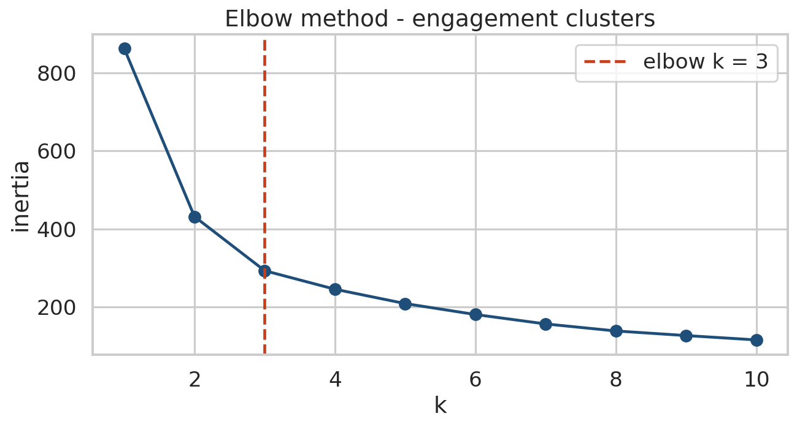
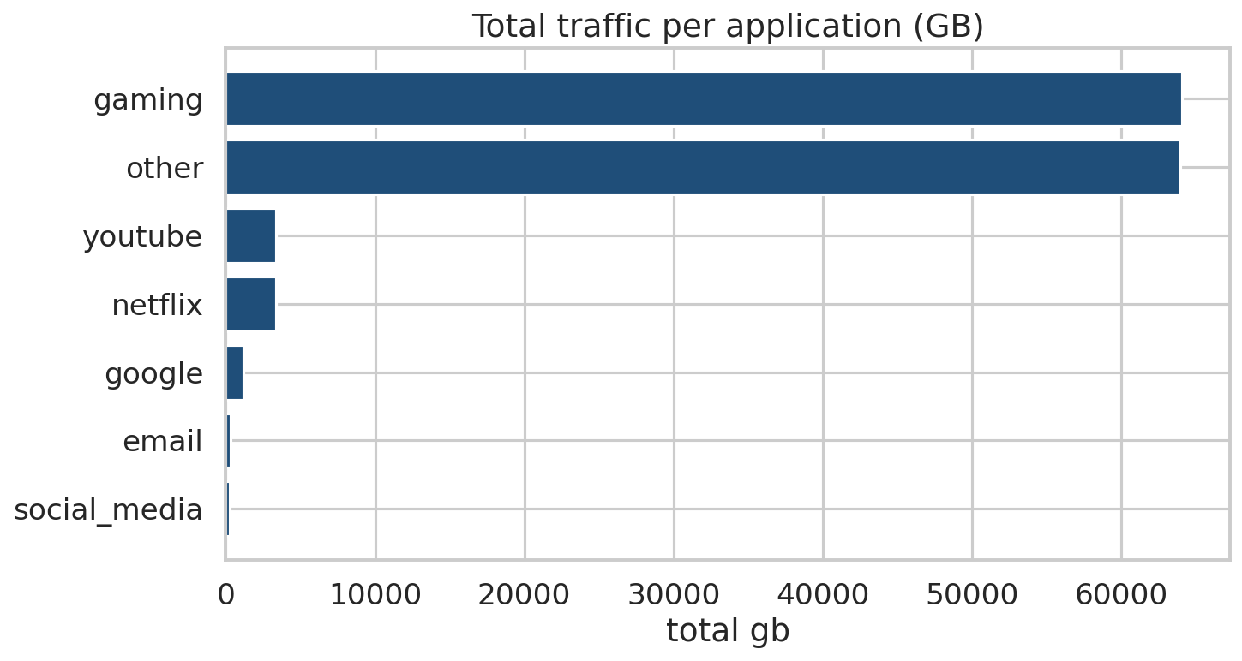
Optimal k and most used applications
Elbow method gives k=3; silhouette peaks at k=2, so three groups are a practical simplification. Top applications by volume: gaming, other, youtube; treat the app mix with caution (volumes exceed session totals).

Slide 13
Experience: top, bottom and most frequent values
Metric (per session) | Top 5 | Bottom 5 | Most frequent 3
TCP retransmission (bytes) | 4,344,115,651, 4,301,477,439, 4,294,431,965, 4,291,464,950, 4,288,120,860 | 2, 2, 3, 3, 3 | 1,294, 1,330, 2,660
RTT (ms) | 96,924, 64,641, 55,812, 54,848, 27,278 | 0, 0, 0, 0, 0 | 29, 39, 38
Throughput (kbps) | 382,262, 313,244, 304,299, 300,546, 283,931 | 0, 0, 0, 0, 0 | 63, 15, 97
These use the original values, not the mean-filled ones. TCP is missing in 57% of sessions and RTT in 19%, so conclusions on them are tentative.

Slide 14
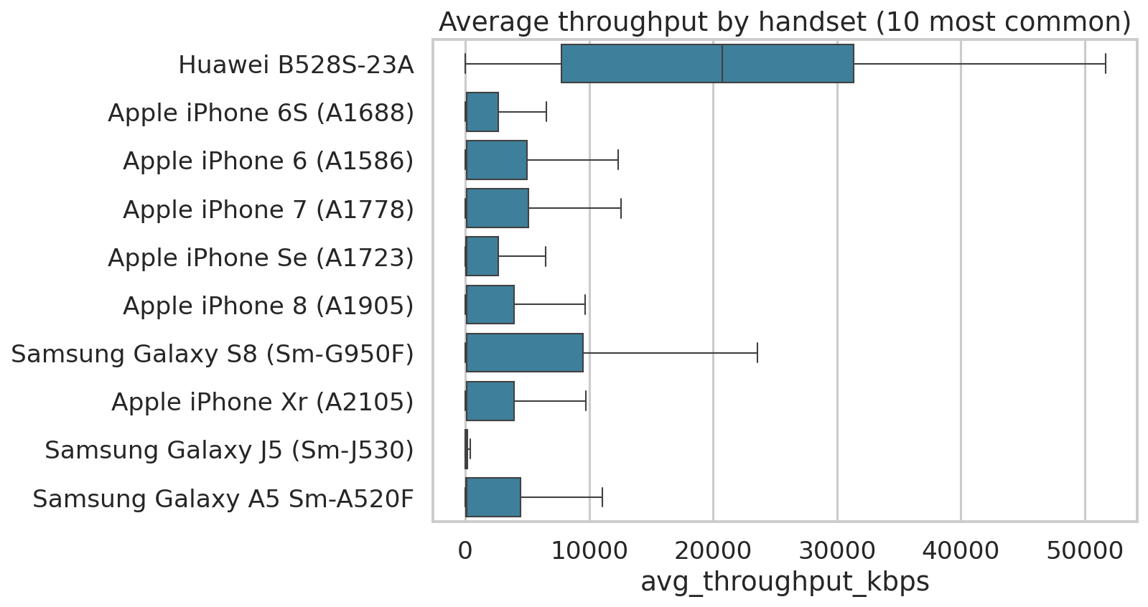
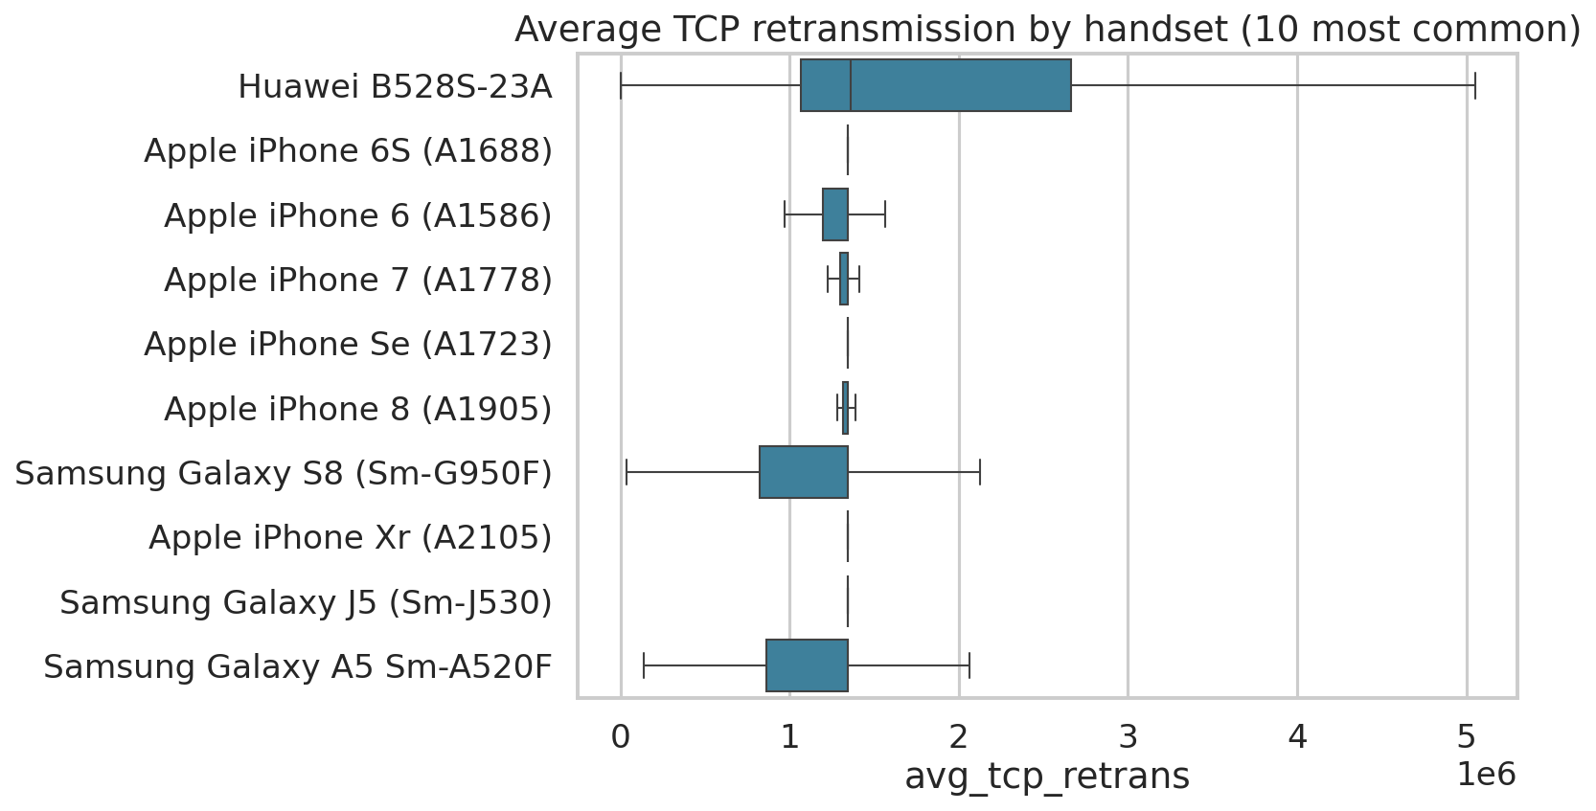
Experience by handset: throughput and TCP retransmission
Router and hotspot devices average 21 Mbps versus 5 Mbps for others and show the highest retransmission, because retransmitted bytes grow with data sent. Phone medians are near 0.1 Mbps while means are several Mbps.

Slide 15
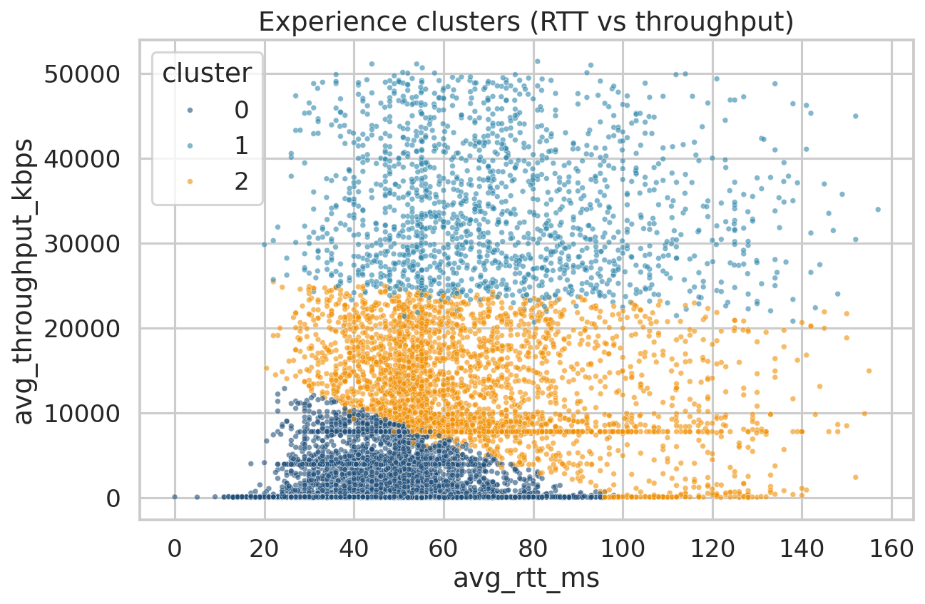
Experience clusters (k=3)
Cluster | Users | Throughput (Mbps) | RTT (ms) | TCP retrans. (MB)
Low throughput | 74,127 (69%) | 1.0 | 47 | 1.21
Middle | 21,509 (20%) | 13.2 | 68 | 1.43
High throughput | 11,220 (11%) | 34.3 | 73 | 1.79
The low-throughput cluster (69% of users, about 1.0 Mbps) has the lowest RTT and retransmission, so it may mean light use rather than a poor network; this data cannot tell. The high-throughput cluster is mostly heavy router users.

Slide 16
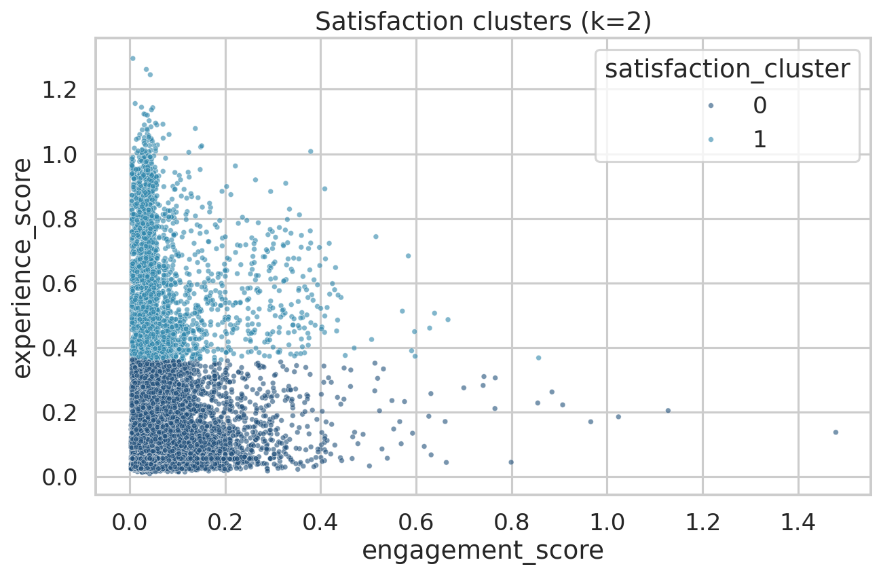
Satisfaction: scores, clusters and model
Top 10 satisfied customers
MSISDN | Engagement | Experience | Satisfaction
33675877202 | 1.46 | 0.30 | 0.88
33614892860 | 1.58 | 0.18 | 0.88
33659725664 | 1.54 | 0.18 | 0.86
33626320676 | 1.59 | 0.12 | 0.86
33625779332 | 1.54 | 0.15 | 0.85
33664712899 | 1.19 | 0.43 | 0.81
33760536639 | 1.48 | 0.14 | 0.81
33659359429 | 1.14 | 0.44 | 0.79
33760413819 | 1.17 | 0.37 | 0.77
33604515716 | 1.04 | 0.43 | 0.74
k=2 clusters: 86,797 users (satisfaction 0.09) and 20,059 users (0.34); they split on experience score.
Gradient boosting reaches R2 0.997 (linear 0.92), but the target is built from the same inputs, so this checks the formula only. Runs are tracked in MLflow.

Slide 17
Recommendation and growth opportunities
Growth potential: positive on network evidence. Most phone users sit at very low throughput and usage is concentrated, so network quality and plan upgrades can lift usage and loyalty.
Router and hotspot customers use more data and get the fastest service: grow them with fixed-wireless bundles.
Handset-led marketing: Apple and Samsung promotions; upgrade offers for owners of older devices.
Buy decision: do not buy on this analysis alone. Continue due diligence and buy only if revenue, churn and network investment figures support the price.

Slide 18
Limitations
One month of data and mostly single-session users: no trends, seasonality or churn.
No revenue, ARPU, cost or subscriber-growth data, so valuation and profitability are not assessed.
Application volumes exceed totals in every session; TCP missing in 57% and RTT in 19% of sessions; 15,291 rows share a Bearer Id.
Mean replacement of missing values and outliers reduces variance.
The satisfaction regression is circular, and satisfaction is dominated by the experience score.

Slide 19
References
TellCo xDR extract and field descriptions supplied for the project.
Code, tests, dashboard and MLflow runs: project repository (add your GitHub link here).
Methods: scikit-learn (KMeans, PCA, gradient boosting), MLflow, Streamlit, MySQL.

