Slide 1



Employee Attrition Data Analysis
Subhasish Ghosh

Slide 2
CONTENTS
INTRODUCTION
OVERVIEW
QUESTIONS
DASHBOARD
REASONS FOR ATTRITION
INSIGHTS
RECOMMENDATIONS FOR REDUCING EMPLOYEE ATTRITION
CONCLUTION

Slide 3
INTRODUCTION
The purpose of this analysis is to understand the underlying reasons why employees leave company and to identify patterns in turnover. By examining data sourced from internal HR records and exit surveys, My aim to uncover the root causes of attrition. My primary objectives are to provide actionable recommendations to reduce employee turnover, enhance retention strategies, and ultimately create a more stable and engaged workforce. Through this analysis, I seek to gain insights that will help me improve employee satisfaction and organizational effectiveness.

Slide 4
OVERVIEW
EmployeeID: A unique identifier assigned to each employee.
Age: The age of the employee.
Attrition: Indicates whether the employee has left the company (Yes or No).
BusinessTravel: Frequency of business travel (e.g., Rarely, Frequently).
Department: The department in which the employee works (e.g., Sales, Research & Development, Human Resources).
DistanceFromHome: The distance (in kilometers or miles) between the employee's home and workplace.
Education: The highest level of education achieved by the employee (numeric scale).
Education Field: The field of study for the highest level of education (e.g., Life Sciences, Medical, Marketing).
Gender: The gender of the employee (e.g., Male, Female).
Job Level: The level of the employee's job position within the company.
Job Role: The specific role or title of the employee (e.g., Sales Executive, Research Scientist).
Marital Status: The marital status of the employee (e.g., Single, Married, Divorced).
Monthly Income: The monthly income of the employee.
NumCompaniesWorked: The number of companies the employee has worked for prior to the current organization.
ETC.

Slide 5
QUESTIONS
Total no of Employees.
Attrition Rate.
Total no of Department.
Total no of job role.
Total no of Education Department.
Count of Department by Attrition.
Count of Employees by Gender.
Sum of Monthly Income by Gender.
Count of Attrition by Training-Times Last Year.
Average of Custom by Distance From Home.
Sum of Employees by Performance-Rating.

Slide 6
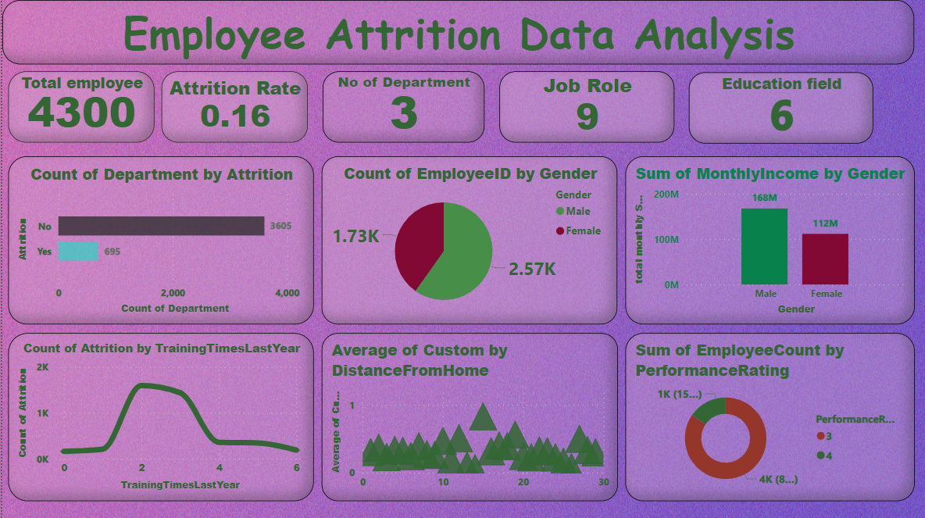
DASHBOARD

Slide 7
REASONS FOR ATTRITION
Common Reasons:
Lack of Growth Opportunities
Limited career advancement prospects.
Poor Work-Life Balance
Inflexible work hours or excessive workload.
Compensation and Benefits
Below-market salaries or inadequate benefits.
Company Culture
Negative workplace culture or lack of inclusivity.
Job Satisfaction
Dissatisfaction with job role or responsibilities.
Management Issues
Poor leadership or lack of managerial support.
Workplace Stress
High-pressure work environment or burnout.
External Factors:
Market Trends
Industry shifts or economic conditions.
Geographical Relocation
Moving to another location for personal reasons.
Family Obligations
Family-related issues or caregiving responsibilities.
Health Concerns
Personal health issues affecting work.

Slide 8
INSIGHTS
Count of Department by Attrition
Count of Employees by Gender
Attrition | Count of Department
No | 3605
Yes | 695
Gender | Count of EmployeeID
Male | 2571
Female | 1729
Sum of Monthly Income by Gender
Sum of Employees by Performance-Rating
Gender | Sum of Monthly Income
Male | 167878310
Female | 111879020
Performance Rating | Sum of Employees
3 | 3638
4 | 662

Slide 9
RECOMMENDATIONS FOR REDUCING EMPLOYEE ATTRITION
Retention Strategies :
Competitive Compensation: Align salaries and benefits with industry standards.
Career Development: Offer training programs and clear promotion paths.
Work-Life Balance: Introduce flexible hours and remote work options.
Policy Changes :
Exit Interviews: Standardize exit interviews to understand attrition reasons.
Performance Reviews: Focus on constructive and development-oriented reviews.
Onboarding Programs: Enhance onboarding to support new hires.
Employee Engagement Initiatives :
Feedback Systems: Implement regular employee surveys to gauge satisfaction.
Recognition Programs: Establish programs to celebrate achievements.
Team Building: Organize regular team-building activities.

Slide 10
CONCLUTION
My analysis of employee attrition data has provided valuable insights into the factors influencing turnover rates within my organization. By identifying common reasons for attrition, such as limited growth opportunities, poor work-life balance, and compensation issues, I am better equipped to implement targeted retention strategies and policy changes. Additionally, understanding external factors contributing to attrition, such as market trends and personal obligations, allows us to adapt my approach to employee engagement and support. Moving forward, it is imperative that i prioritize initiatives aimed at improving workplace culture, enhancing career development opportunities, and fostering a supportive environment for employees. By implementing these recommendations, I can mitigate attrition rates, enhance employee satisfaction, and ultimately contribute to the long-term success of my organization.

Slide 11


