Slide 1
INVESTMENT ASSIGNMENT SUBMISSION
Subhasis Jethy

Slide 2
Identifying Investment Opportunities for Spark Funds
Spark Funds, an asset management company wants to make investments in a few companies. The CEO of Spark Funds wants to understand the global trends in investments so that she can take the investment decisions effectively.
Spark Funds has two minor constraints for investments:
It wants to invest between 5 to 15 million USD per round of investment
It wants to invest only in English-speaking countries because of the ease of communication with the companies it would invest in
Spark Funds wants to invest where most other investors are investing. This pattern is often observed among early stage startup investors.
The data has been taken from crunchbase.com.

Slide 3
Problem solving methodology
Data Collection / Cleaning
Collect & Load all data (Company, Funding Round details, Sector Classification)
Basic data cleaning
Explore and understand all the data available
Funding Type Analysis
Identify representative value of Funding Types
Identify the best funding type within 5 to 15 Million USD’s
Country Analysis
Collate different datasets into one Master Frame
Sector Wise Investment Analysis
Identify Top nine countries according to funding
Identify the Top 3 English speaking countries suitable for investment
Sector Analysis 1
Extract Primary Sector
For each of the Top 3 countries identify the top invested Main Sectors.
Identify the top invested sectors along with the top companies for each of the Top 3 Countries.

Slide 4
Data Cleaning
Assumptions:
An outer join was performed for creating the master frame, as rounds has more companies than the companies dataset and we want to keep all the companies. The permalink and company_permanlink columns were converted to lower case for standardizing the text.
The raised amount column has 19,995 ‘NaN’ values .As it was said earlier Missing values should not be replaced without understanding why they exist. At times, it is better to do the analysis by ignoring the missing values, instead of replacing the missing values by other values. So we removed the rows where raised amount is ‘NaN’.
For creating the sector information, a left join was performed with Master Frame and Mapping dataset, in order to retain the companies from master frame which did not have a matching primary sector. The column with NaN was filled with a text ‘Missing_Value’ and the columns were lower cased before joining. Also the same was done for the master_frame where 634 values in category_list were missing.

Slide 5
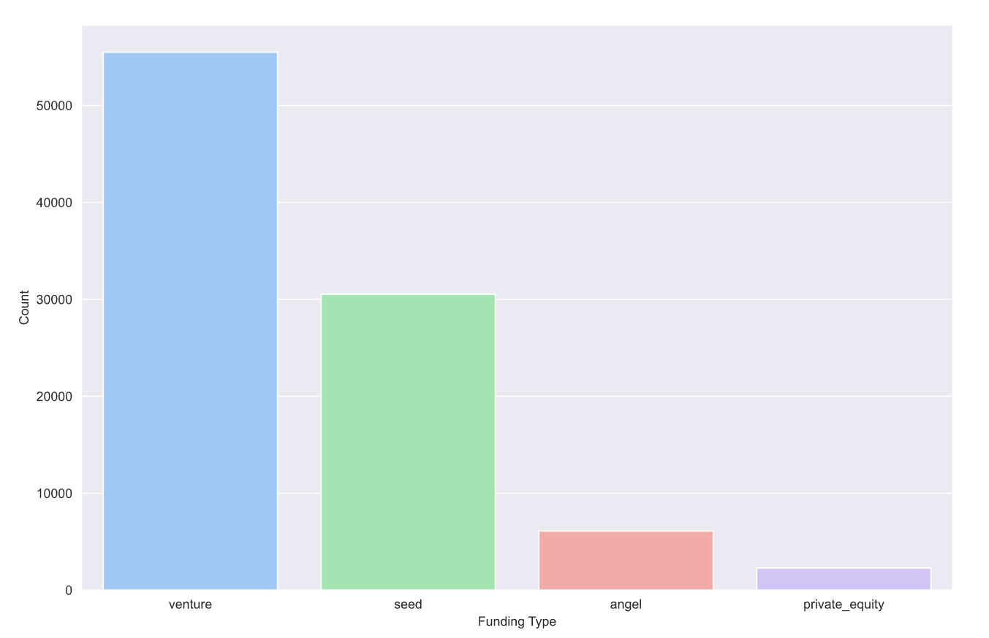
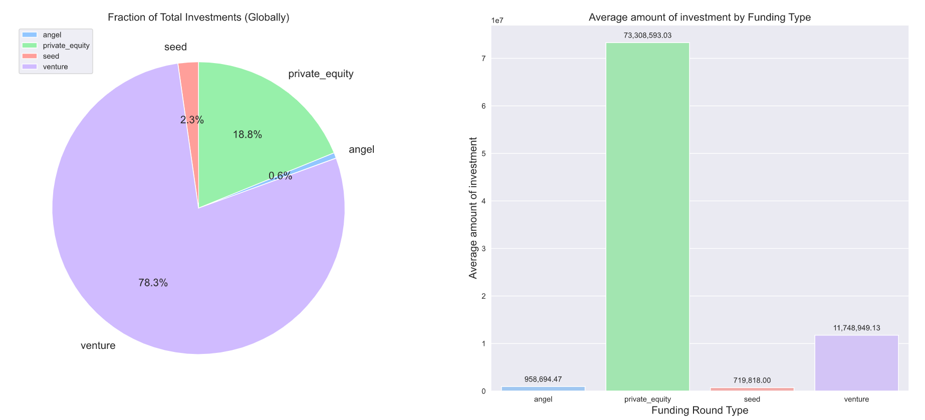
Funding Type Analysis
After some basic cleaning tasks we found 66,370 unique companies in the funding rounds dataset and 66,368 unique companies in the Companies Dataset. We also identified Venture type investment is the most suitable investment type for Spark Funds according to the provided constraints of 5 – 15 Million USD’s.
Funding Round Type | Raised Amount in USD
angel | 958,694.47
private_equity | 73,308,593.03
seed | 719,818.00
venture | 11,748,949.13

Slide 6
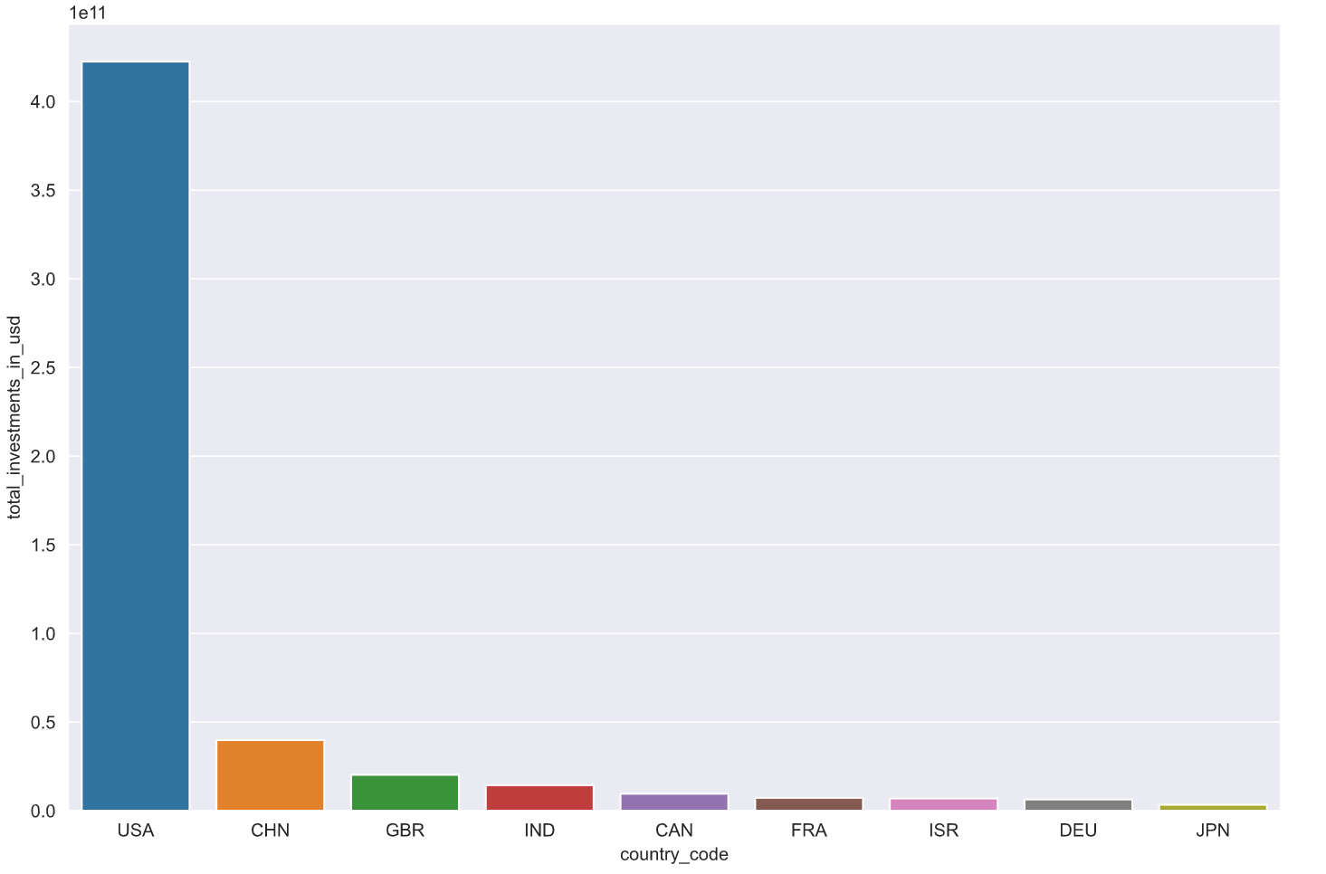
Country Analysis
Top nine countries which have received the highest total funding (across ALL sectors for the Venture investment type)
The Top 3 English speaking countries according to https://en.wikipedia.org/wiki/List_of_territorial_entities_where_English_is_an_official_language are USA, Great Britain (UK) and India.
Country Code | Total Investments in USD
USA | 422,510,842,796.00
CHN | 39,835,418,773.00
GBR | 20,245,627,416.00
IND | 14,391,858,718.00
CAN | 9,583,332,317.00
FRA | 7,259,536,732.00
ISR | 6,907,514,579.00
DEU | 6,346,959,822.00
JPN | 3,363,676,611.00
USA is the most preferred country for investments, followed by China, U.K. and India.

Slide 7
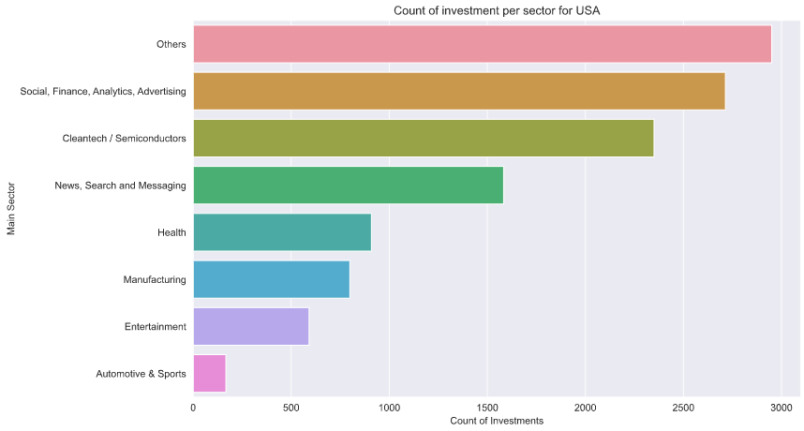
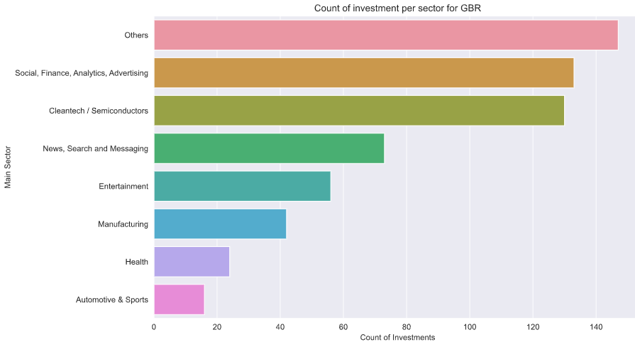
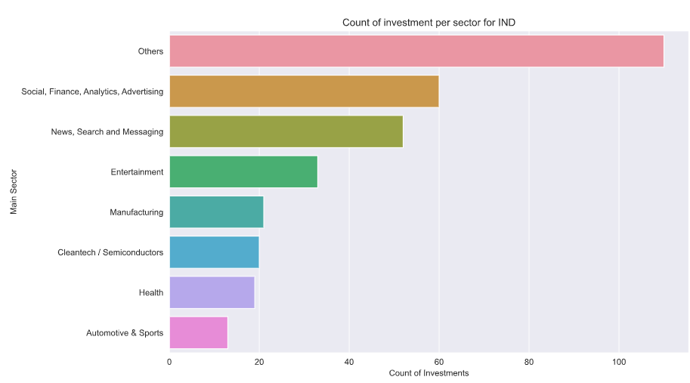
Sector Analysis
Top Sectors for the Top 3 English Speaking Countries
The Top sector for investment for USA is "Others“.
The Top sector for investment for GBR is “Others“.
The Top sector for investment for IND is "Others"

Slide 8
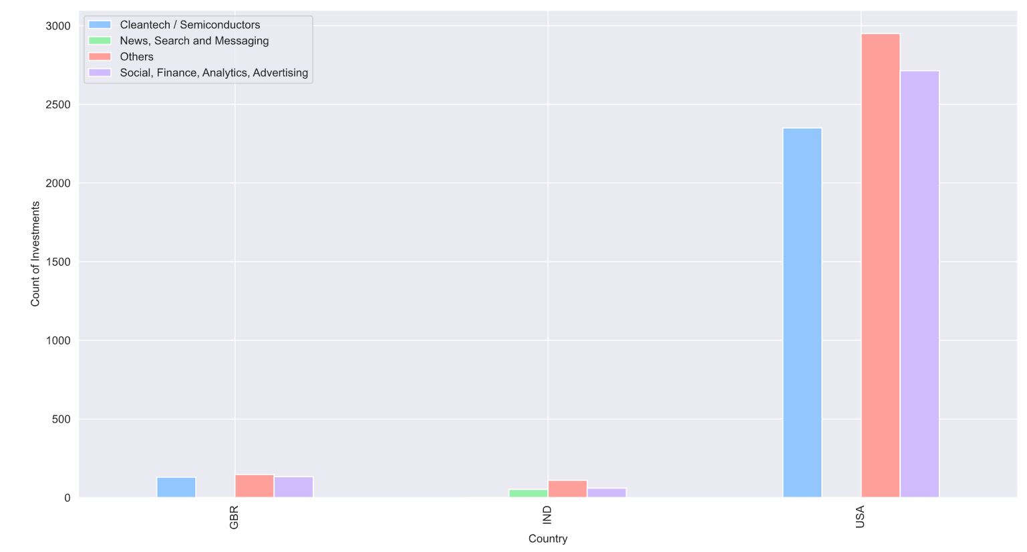
Sector Analysis for Top 3 Countries
The top 3 sectors compared for each of top 3 countries suitable for investment.
Top 3 Sectors for USA
Top 3 Sectors for India
Others
Social, Finance, Analytics, Advertising
Others
Social, Finance, Analytics, Advertising
Top 3 Sectors for GBR
Others
Social, Finance, Analytics, Advertising
Cleantech / Semiconductors
Cleantech / Semiconductors
News, Search and Messaging

Slide 9
Conclusions
Venture type funding is the most suitable Funding type for the company.
The Top 3 English Speaking Countries recommended for Investment along with their Top Sectors and Companies are:
1. USA
2. GBR (United Kingdom)
3. India
1. Others
2. Social, Finance, Analytics, Advertising
3. Cleantech / Semiconductors
1. Others
2. Social, Finance, Analytics, Advertising
3. Cleantech / Semiconductors
1. Others
2. Social, Finance, Analytics, Advertising
3. News, Search and Messaging
virtustream
sst inc. (formerly shotspotter)
airspan networks
electric cloud
celltick technologies
eusa pharma
firstcry.com
manthan systems
gupshup
Countries
Sectors
Companies

