Slide 1
Machine Learning Methods for Hate Speech Recognition in Twitter Text Data
Presented By :-
Subhasis Sahoo(21BCSL07)
Bishal Mohanty(20BCSB98)
Guided By:- DR Satyananda Champati Rai

Slide 2
-: Introduction :-
What is machine Learning ?
Machine learning is programming computers to optimize a performance criterion using example data or past experience.
Types of Machine learning.
Supervised Learning
Unsupervised Learning
Reinforcement Learning

Slide 3
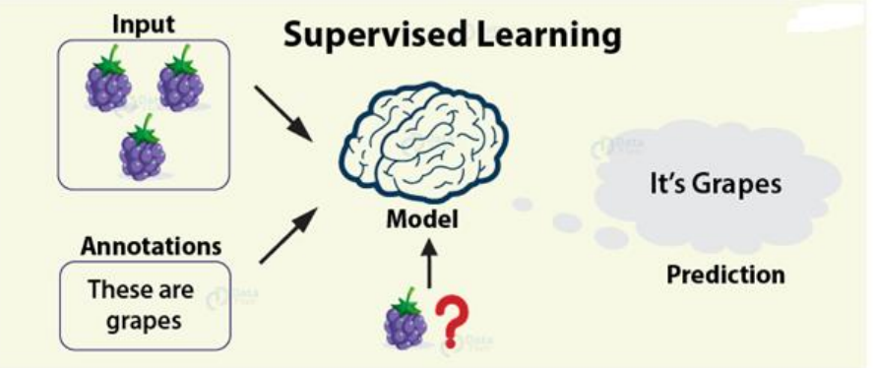
Supervised Learning
Supervised learning, also known as supervised machine learning, is a subcategory of machine learning and artificial intelligence.
In supervised learning, the training data provided to the machines work as the supervisor that teaches the machines to predict the output correctly. It applies the same concept as a student learns in the supervision of the teacher.

Slide 4
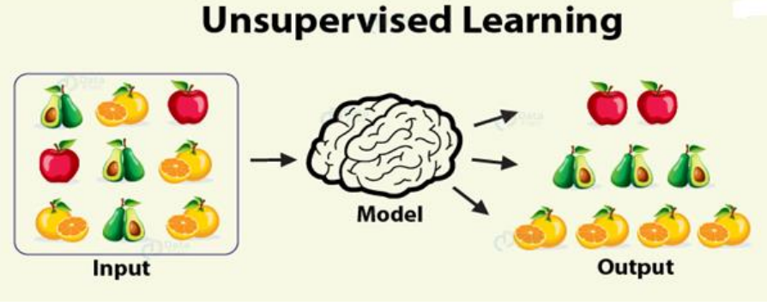
Unsupervised Learning
Unsupervised learning, uses machine learning algorithms to analyze and cluster unlabeled data sets
These algorithms discover hidden patterns or data groupings without the need for human intervention

Slide 5
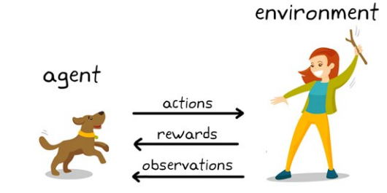
Reinforcement Learning
Reinforcement learning is a machine learning training method based on rewarding desired behaviors and/or punishing undesired ones.
Reinforcement learning uses algorithms that learn from outcomes and decide which action to take next. After each action, the algorithm receives feedback that helps it determine whether the choice it made was correct, neutral or incorrect. It is a good technique to use for automated systems that have to make a lot of small decisions without human guidance.

Slide 6
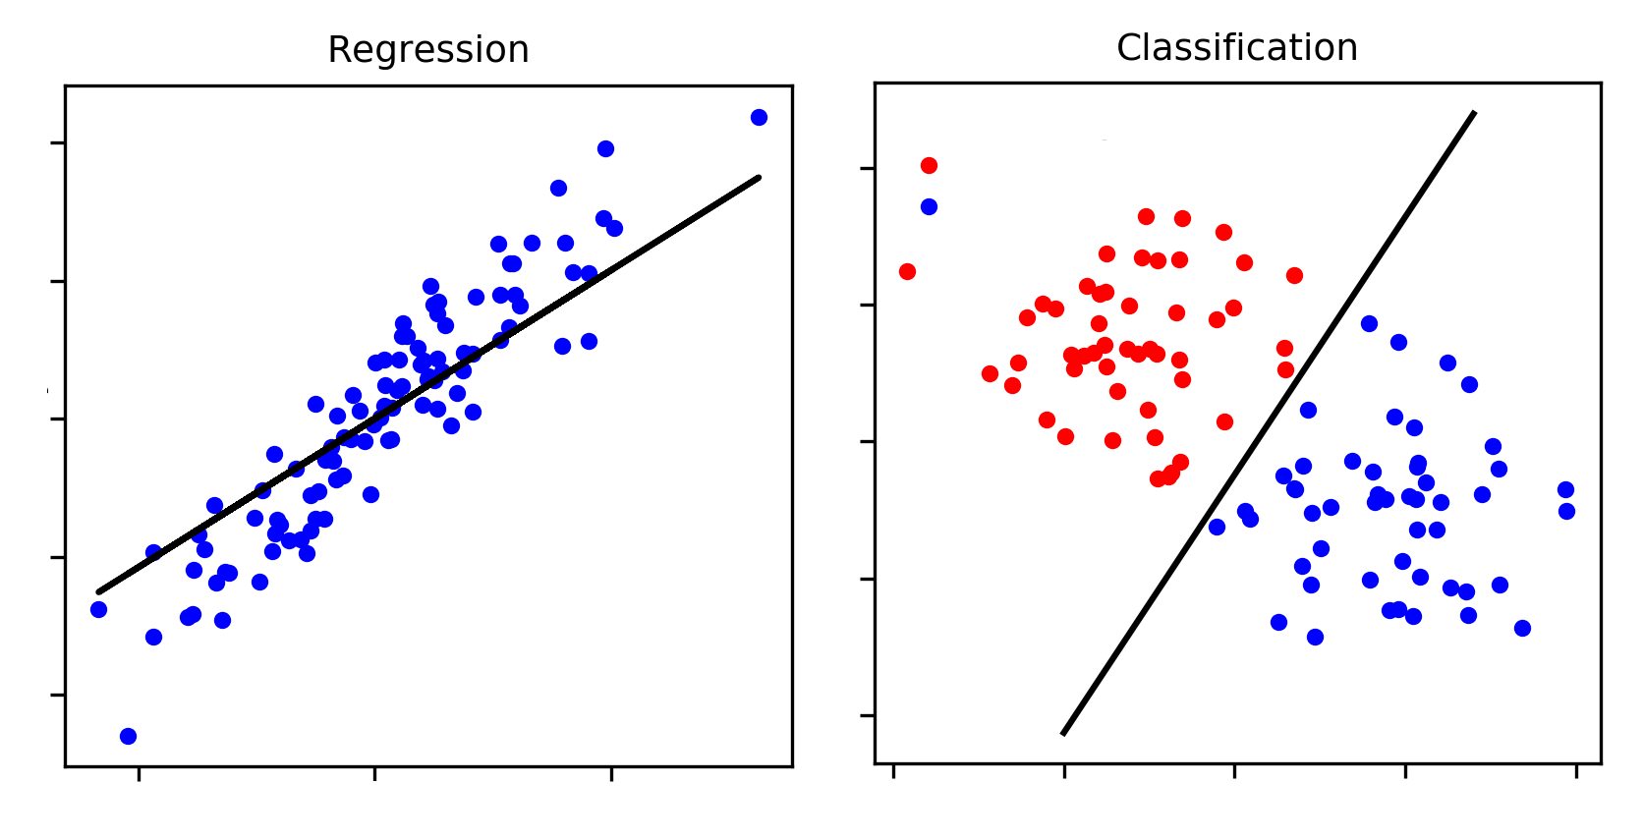
Classification
Classification is a supervised machine learning method where the model tries to predict the correct label of a given input data.
In classification, the model is fully trained using the training data, and then it is evaluated on test data before being used to perform prediction on new unseen data.
regression
Regression in machine learning consists of mathematical methods that allow data scientists to predict a continuous outcome (y) based on the value of one or more predictor variables (x).

Slide 7

Naive Bayes Classifier
Naive Bayes algorithm is a supervised learning algorithm, which is based on Bayes theorem and used for solving classification problems.
it is mainly used in text classification that includes a high-dimensional training dataset.
It is a probabilistic classifier, which means it predicts on the basis of the probability of an object.
examples of Naive Bayes Algorithm are spam filtration, Sentimental analysis, and classifying articles.
P(A|B) is Posterior probability: Probability of hypothesis A on the observed event B.
P(B|A) is Likelihood probability: Probability of the evidence given that the probability of a hypothesis is true.
P(A) is Prior Probability: Probability of hypothesis before observing the evidence.
P(B) is Marginal Probability: Probability of Evidence.

Slide 8
Steps to implement:
Data Pre-processing step
Importing Dataset
Arrange Data into features and target
Create a feature bar plot to show the feature
Split data into training and testing
Create a pie chart to show data
Implementation of algorithms
import necessary functions and libraries
Download the dataset and the stop words from nltk
load the text fields of the positive and negative tweets
remove the special character & number
Tokenize the tweet
removing stopwords and punctuation
process_tweet on a random tweet from the dataset
Build a frequency dictionary

Slide 9
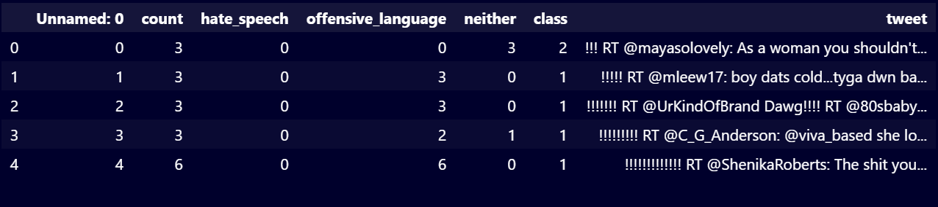
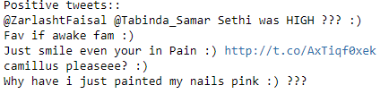
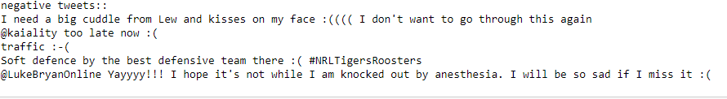
Predicting the test result
Naive Bayes accuracy
Test accuracy of the result(Creation of Confusion matrix)
Test Naive Bayes accuracy
make predictions on our own tweets
Calculate precision, recall,f1-score & support
Construct confusion matrix
Visualizing the test set result.

Slide 10
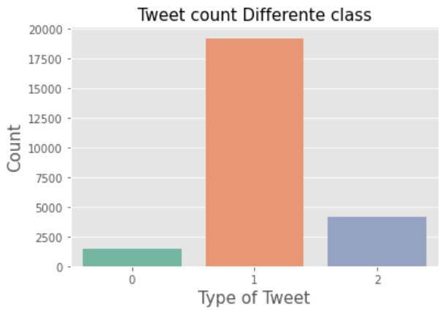
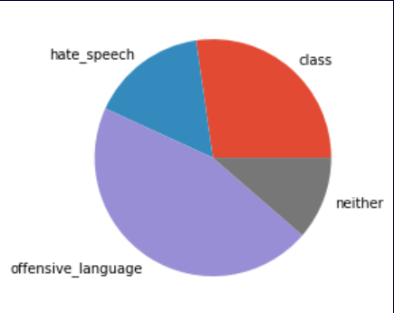
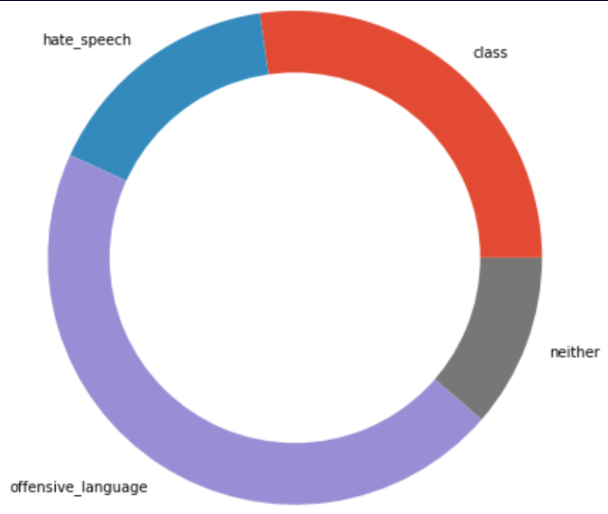

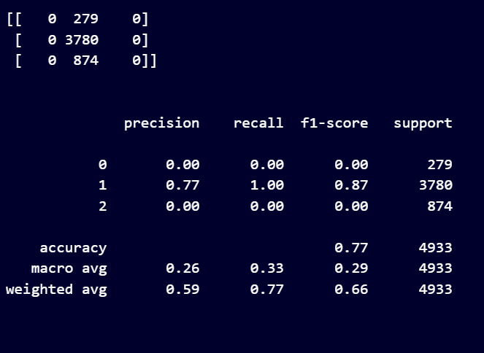
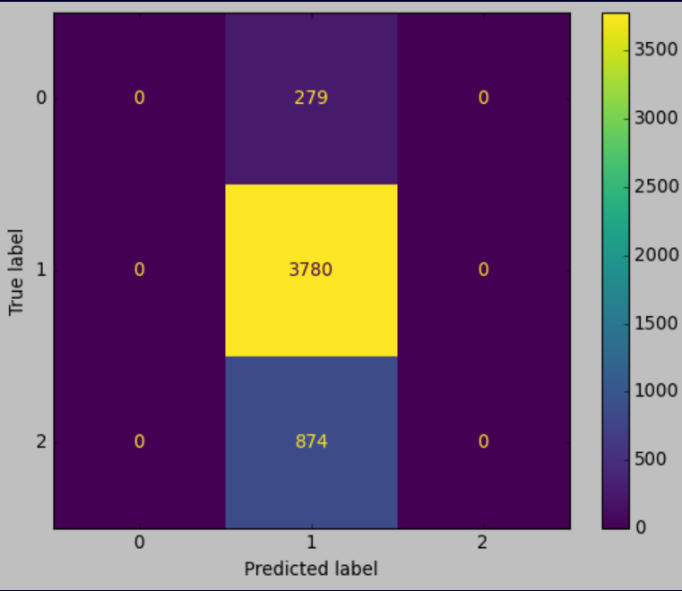
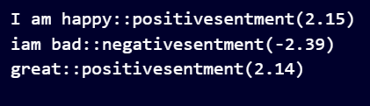

Slide 11
Conclusion
In our work using the benchmark dataset, Naive Bayes appeared to be key player when it comes to precision score, recall value, F1 score and accuracy, when used with TF-IDF transformer embedding.
Although we tried hard and gave even more time and effort to all the systems and methods mentioned in the methodology section to increase the performance, the results shown by Naïve Bays outperformed logistic regression and overall analysis suggests that Naive Byes is the best method among these.

Slide 12
refference
T. Davidson, D. Warmsley, M. Macy, and I. Weber, “Automated hate speech detection and the problem of offensive language,” in Proceedings of the 11th International AAAI Conference on Weblogs and Social Media, ser. ICWSM ’17, 2017.

Slide 13
Thank you ☺

