Slide 1
Prepared for: Made In China
Prepared By: Subhasis Sahoo(10820896)
November 26, 2024

Slide 2
Made In China Overview
Made in China is an online platform tailored for both B2B (business-to-business) sales, offering a vast array of products across categories like electronics, clothing, and home goods. It connects buyers with verified suppliers from over 220 countries, ensuring a diverse and extensive selection. The platform emphasizes competitive pricing, secure transactions, and quality assurance, making it a reliable choice for businesses and consumers looking to source products efficiently. With customizable options and a user-friendly interface, Made in China simplifies global trade, helping businesses and consumers find the right products to meet their needs.

Slide 3
Modules
Connecting over Social Media
Downloading App
Privacy Policy
Wholesale Product
User Agreement
Help Function
About Us
Computers Products
Smart Expo
Start Suppliers
Lights and Light and Lightings
Trade Show
Toys
Customize Your Products
User Login
Searching
Secured Trading Service
Top Ranking Products
Different Categories
User Manual
Sub Header
Sporting Goods & Recreation
Manufacturing & Processing Machinery
Language options
Product Alert

Slide 4
Software Requirements
Operating Systems: Windows 10/11.
Browsers: Latest versions of Chrome
Development Tools: Selenium, TestNG, Cucumber.
Work-Space: Eclipse, Visual Studio Code

Slide 5
Hardware Requirements
Processor: High-performance multi-core processor 11th Gen Intel® Core™ i5-1145G7 @ 2.60GHz.
RAM: At least 16 GB of RAM to ensure smooth execution of multiple test cases simultaneously.
Storage: SSD with at least 512 GB of storage for fast read/write operations and to store test data.
Monitor: High-resolution monitor (at least 1080p) for clear visibility and detailed inspection of the user interface.
Network: Stable and high-speed internet connection for accessing online testing tools and remote repositories.
Processor: High-performance multi-core processor 11th Gen Intel® Core™ i5-1145G7 @ 2.60GHz.

Slide 6
Automation Feature
In the "Made In China" website automation project, I have implemented several categories to enhance the automation process:
Browser Management:
Efficient setup and teardown of browser instances.
Cross-browser compatibility testing.
Element Interaction:
Methods for clicking, scrolling, and sending keys to elements.
Structured classes for UI elements and locators to promote code reusability and maintainability.
Screenshot Capture:
Automated screenshots with timestamps for better debugging and reporting.
Logging:
Detailed log generation for each step to track the execution flow and identify issues.

Slide 7
Automation Feature
5. Reporting:
Comprehensive Extent Reports to visualize test results, including pass, fail, and error statuses.
6. Test Data Management:
Organized storage of test data files and Excel sheets for data-driven testing.
7. Page Object Model (POM):
Contains all dependencies and plugin.
8. Step Definitions:
Abstract methods implemented to map Gherkin steps to Java code, ensuring clear and readable test scripts.

Slide 8
Utilities
The utilities package simplifies automation by providing essential tools for browser management, screenshot capture, element interaction, logging, and reporting.
Base.java: Manages the browser.
CaptureScreenshot.java: Captures screenshots with current date and time.
DriverHelper.java: Contains methods like:
Click Element
Scroll Element
Send Keys
Soft Asserting These methods simplify our work by allowing direct calls in the page.
4.Event Handler: Used to run backend test cases in the workspace.
5.Logger Generator: Generates log messages for each step, indicating if the functionality is working properly.
6.ReporterMaker: Generates an Extent Report showing the test status (pass, fail, or error).

Slide 9
Utils Package
Architecture of Hybrid Framework
Pages Package
Base
Open Browser
WebdriverHelper
Test Runner
Apparel Details
ReportMaker
Config
Have not Found
Screenshot
More Categories
ExcelReader
Secure Trading
Log4j
Logger Handler
Supplier
UIStore

Slide 10
Utils Package
Architecture of BDD Framework
Open Browser
Pages Package
Base
Test Runner
WebdriverHelper
Apparel Details
ReportMaker
Config
Have not Found
Screenshot
Features
More Categories
ExcelReader
Step Definitions
Secure Trading
Log4j
Logger Handler
Supplier
Hooks
UIStore

Slide 11
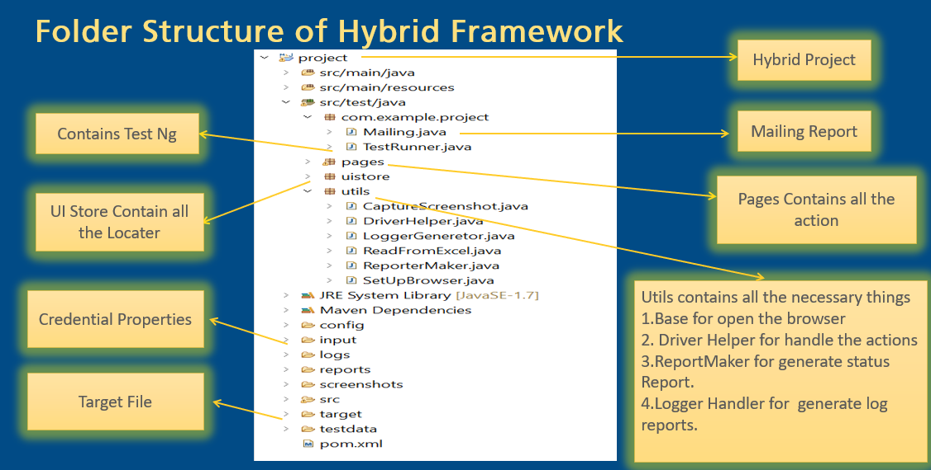

Slide 12
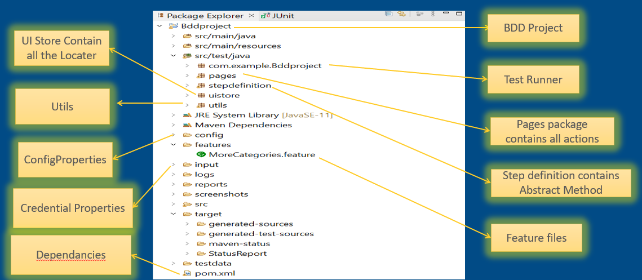
Folder Structure of BDD Framework

Slide 13
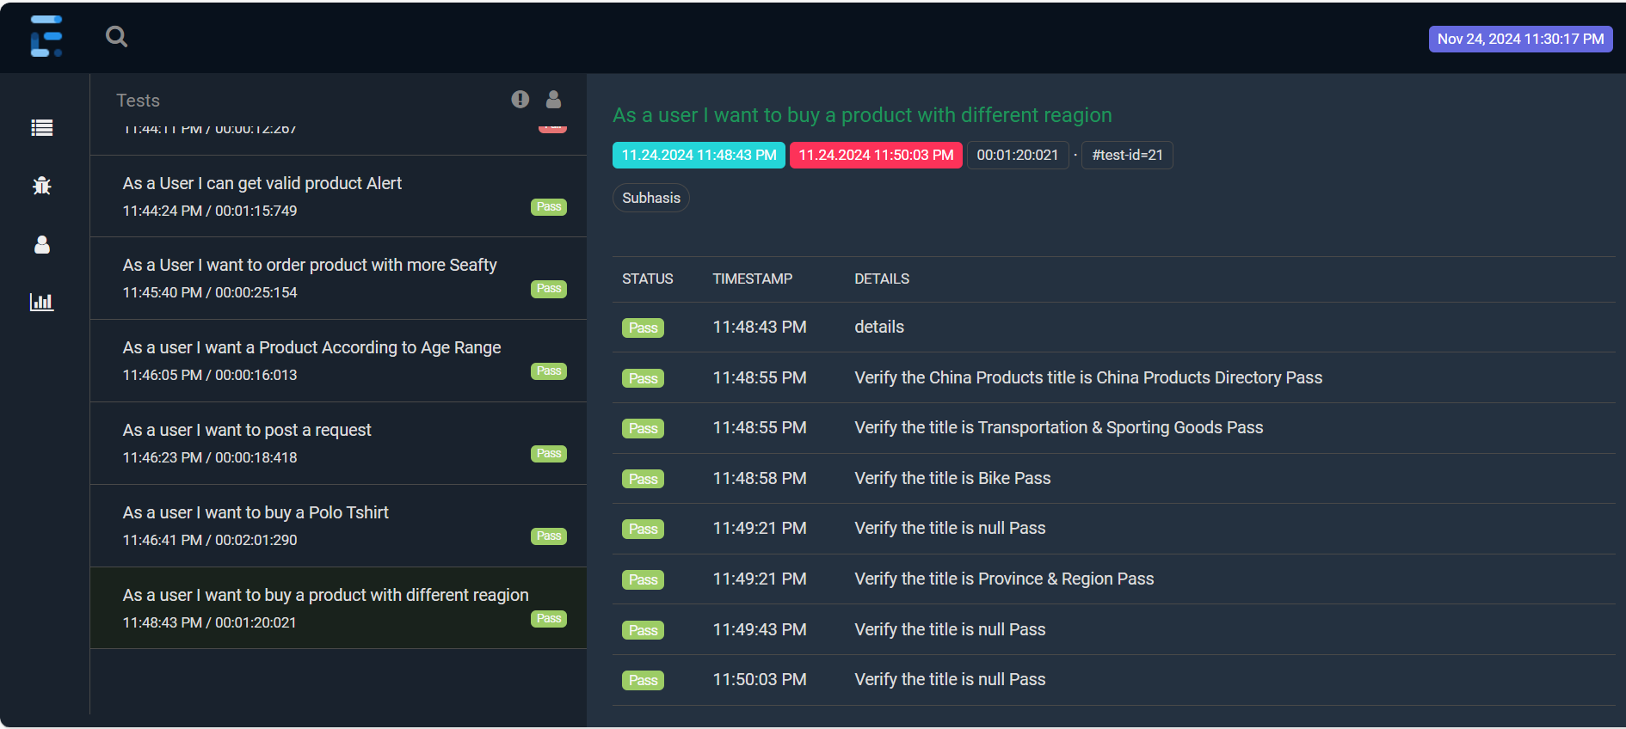
Extent Report Screenshot for all test case Passed

Slide 14
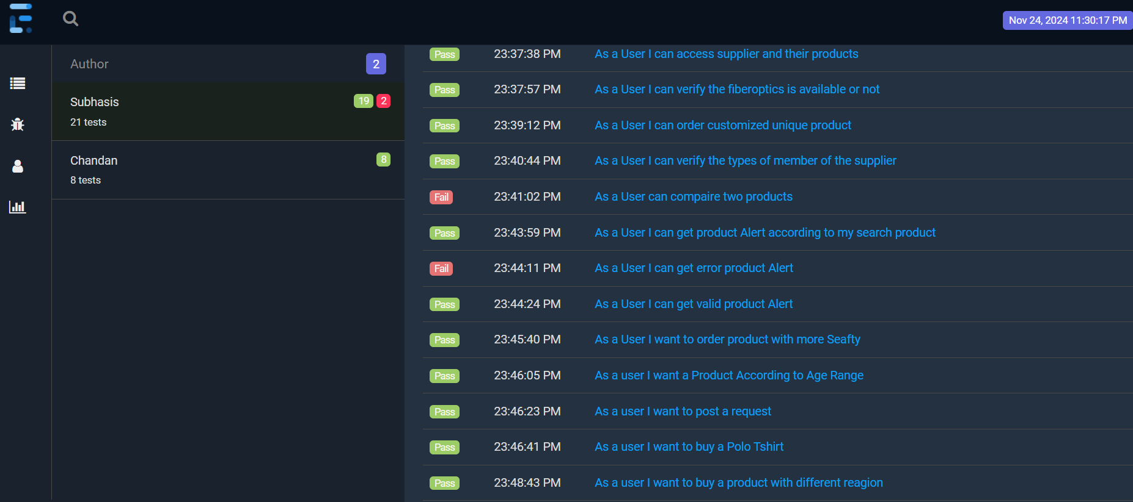
Extent Report Screenshot according to Author
Author

Slide 15
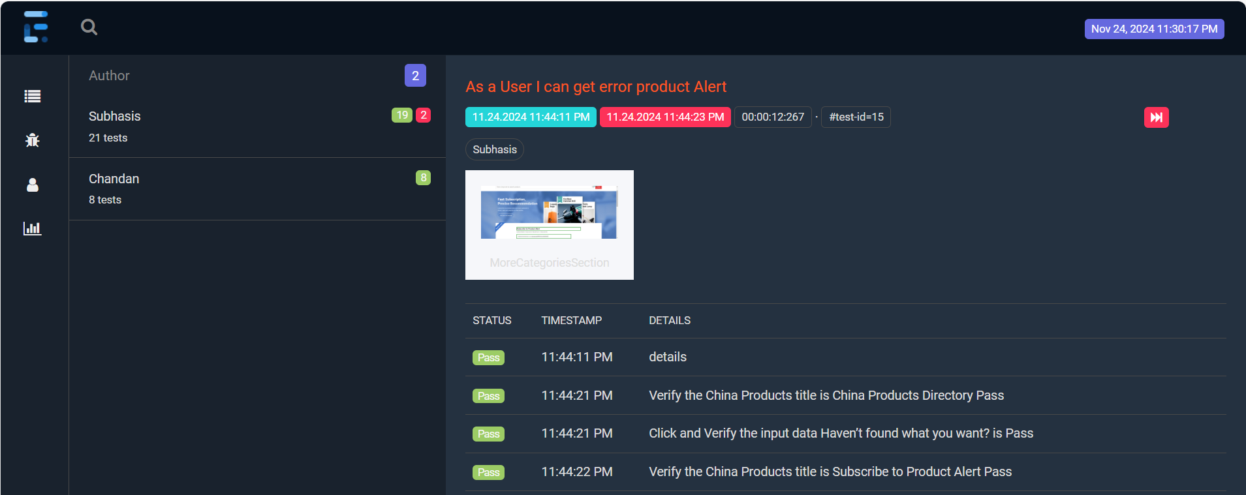
Extent Report Screenshot

Slide 16
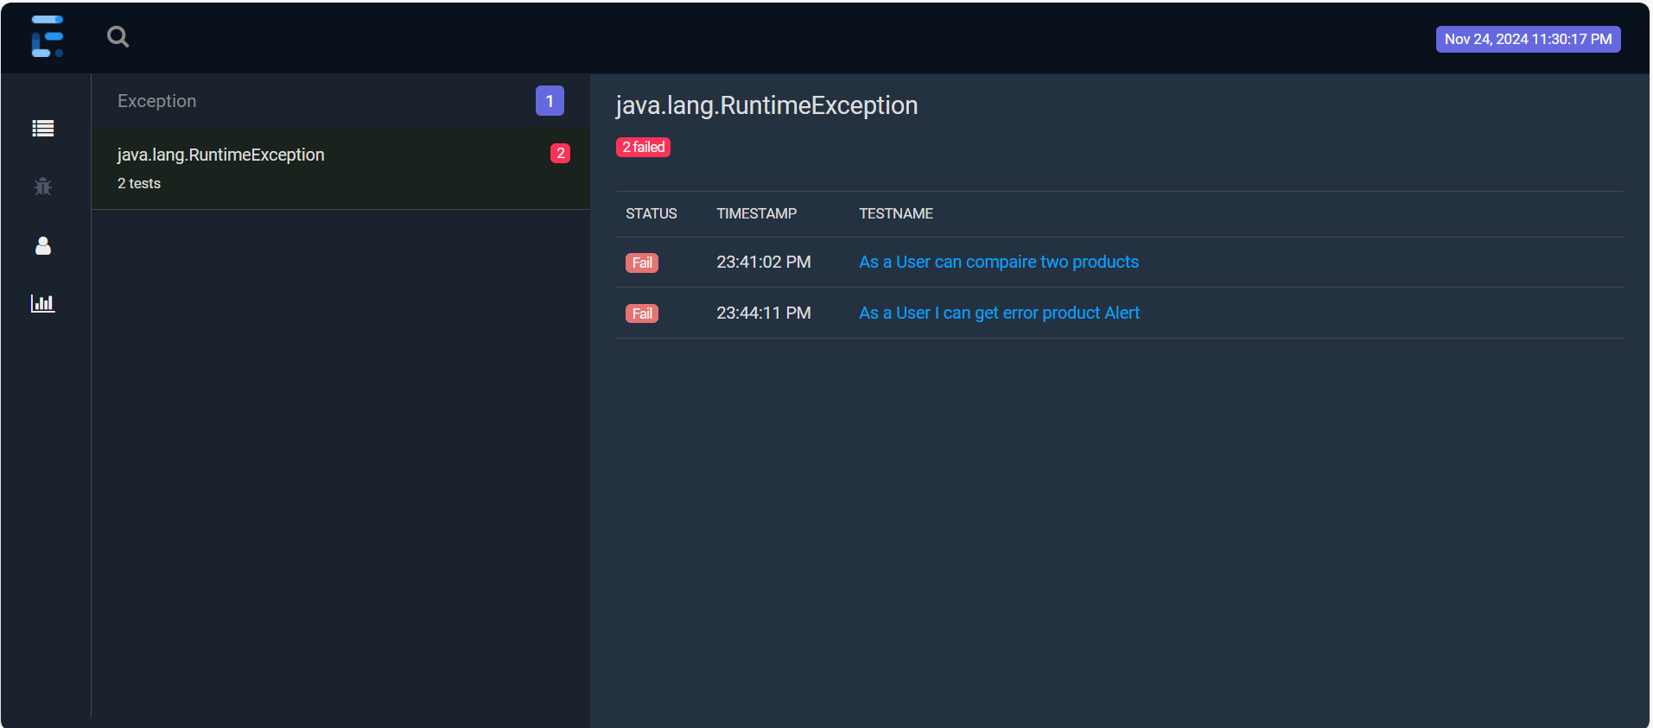
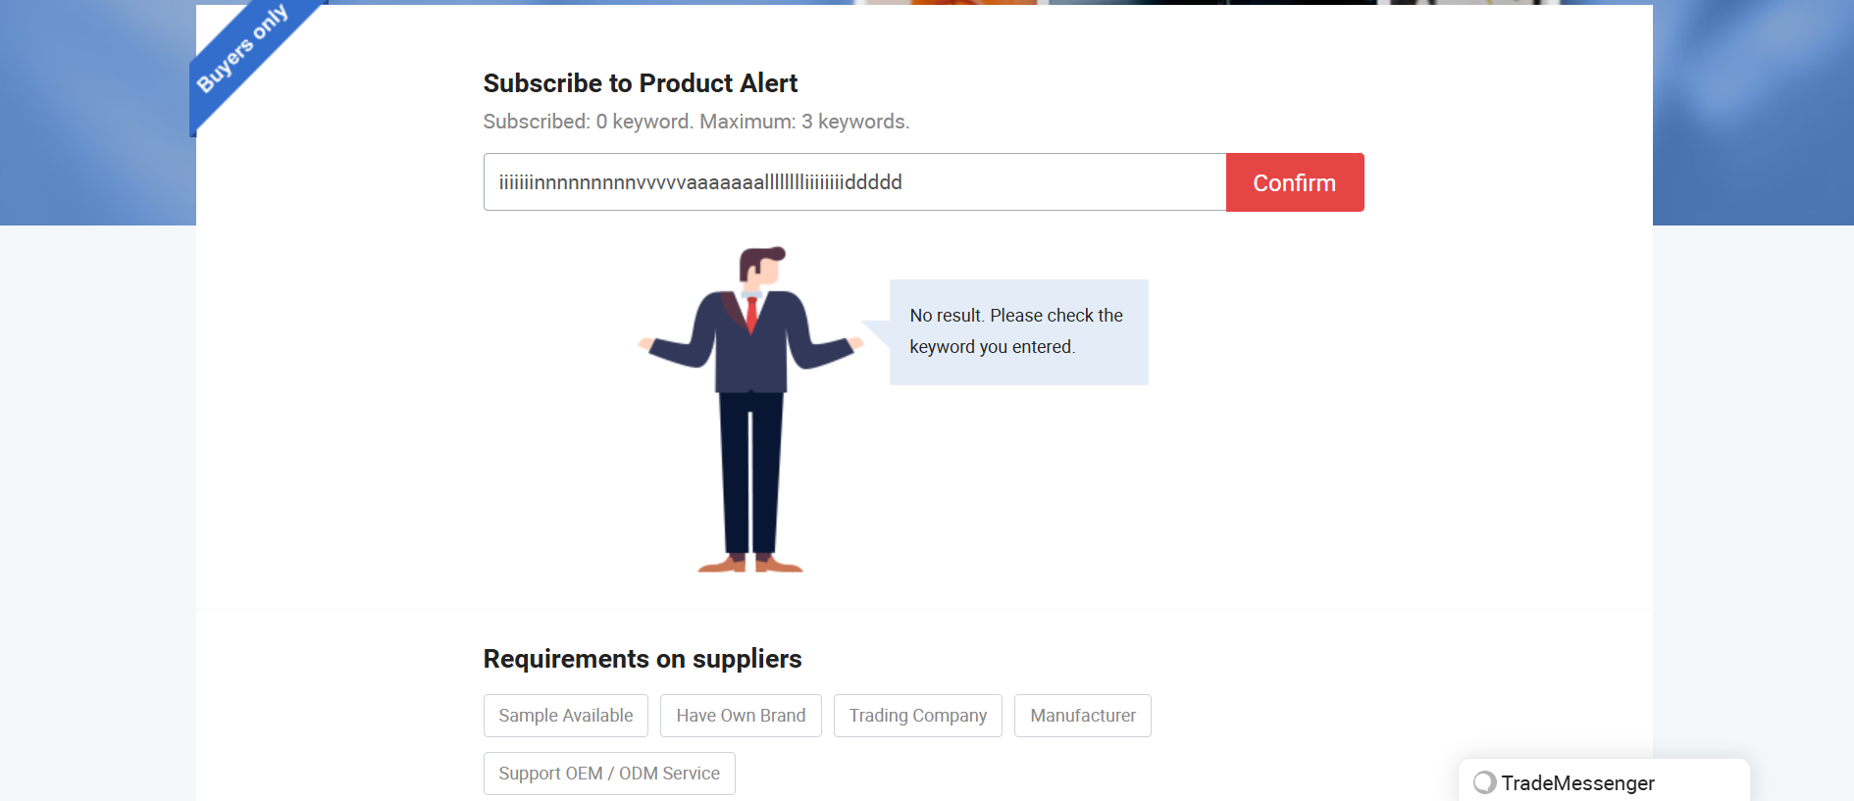
Extent Report Screenshot for testcase Fail with exception
Exception occurred

Slide 17
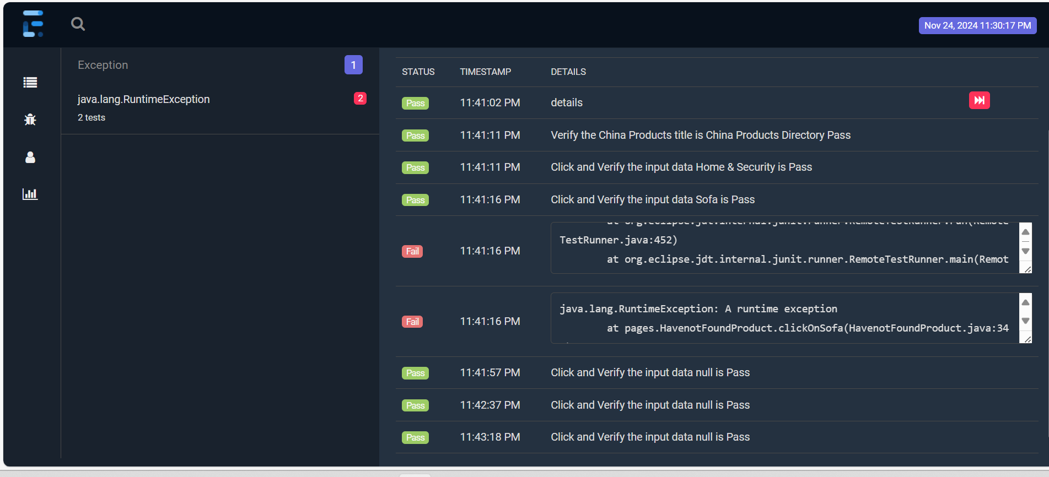
Extent Report Screenshot for Exception occured
Exception occurred

Slide 18
THANK YOU

