Slide 1

MBA652A PROJECT 1
Ordinary Least Squares (OLS) Regression
Analysis of Air Quality Index (AQI)
Group No.11
GROUP MEMBERS
Subhasmita Mallick
251250051
Vikram Anand
251140027
Rajdatta Kohale
251140018
Rohit Kumar Singh
251140020
MBA652A · OLS Regression Analysis of AQI

Slide 2
INTRODUCTION
Introduction to the Problem and Objective
The primary objective involves modeling and predicting the overall Air Quality Index (AQI) based on localized environmental factors and chemical sensor responses.
Translating raw, noisy chemical concentrations into a unified public health metric provides actionable insights for urban policy planning and pollution control.
Predicting AQI dynamically allows municipal authorities to issue timely health advisories during periods of severe atmospheric degradation, ultimately protecting vulnerable populations.
MBA652A · OLS Regression Analysis of AQI
2

Slide 3
MOTIVATION & METHOD
Motivation & Method
ECONOMIC IMPACT
METHODOLOGY
Ordinary Least Squares (OLS) Multiple Linear Regression was employed as the primary analytical framework for this study.
This approach evaluates multiple continuous independent variables while rigorously diagnosing and correcting for structural model violations, specifically multicollinearity and heteroskedasticity.
Prolonged exposure to poor air quality directly increases public healthcare costs, reduces overall workforce productivity, and negatively impacts local real estate valuations over time.
MBA652A · OLS Regression Analysis of AQI
3

Slide 4
DATA & PREPROCESSING
Data Source & Cleaning Processing
Data originates directly from the UCI Machine Learning Repository, specifically the “Air Quality” dataset, comprising hourly averaged responses from an array of multi-sensor devices deployed across an Italian city.
During the cleaning phase, the dataset's default missing value placeholders were replaced with standard NaNs, empty trailing rows were removed, and instances of missing target data were dropped.
Following this rigorous preprocessing, the final dataset yielded 827 hourly observations for continuous OLS estimation.
FINAL SAMPLE SIZE
827
hourly observations, for continuous OLS estimation
MBA652A · OLS Regression Analysis of AQI
4

Slide 5
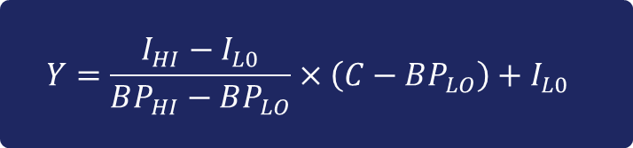
FEATURE ENGINEERING
Engineering the Dependent Variable (Y)
Rather than predicting a single raw chemical output, a continuous AQI score was engineered based on the standard EPA piecewise formula.
$$Y=\frac{I_{HI}−I_{L0}}{BP_{HI}−BP_{LO}}×\left(C−BP_{LO}\right)+I_{L0}$$
𝐶 (Concentration) Represents the actual hourly concentration of the pollutant extracted directly from the dataset.
${BP}_{HI}$ & ${BP}_{LO}$ Define the upper and lower concentration breakpoints for a specific AQI category.
$I_{HI}$ & $I_{LO}$ Represent the AQI score boundaries that perfectly correspond to those exact concentration breakpoints.
MBA652A · OLS Regression Analysis of AQI
5

Slide 6
FEATURE ENGINEERING
Feature Engineering: AQI Breakpoint Mapping
Since the final index thresholds are not native to the dataset, a function dynamically maps the raw pollutant concentration to its corresponding EPA sub-index.
Calculation Example: an hourly CO concentration reading of 6.5 mg/m³ falls into the “Moderate” category breakpoints, and applying the formula yields a specific sub-index. This process is repeated for NO2, and the final AQI target variable is determined by extracting the maximum of the computed sub-indices.
AQI Level | AQI Range
Good | 0 – 50
Moderate | 51 – 100
Unhealthy | 101 – 150
Unhealthy for Strong People | 151 – 200
Hazardous | 201+
MBA652A · OLS Regression Analysis of AQI
6

Slide 7
FEATURE ENGINEERING
Description of Independent Variables (X)
The independent variables driving the model consist of continuous hourly readings from five distinct metal oxide chemical sensors and two standard atmospheric conditions.
Standardization Note: Prior to modelling, all independent variables and the target variable were standardized (Z-score normalized) to ensure their final coefficients act as Beta weights, allowing for direct, scale-independent comparison of their impacts.
PT08.S1 (CO) & PT08.S2 (NMHC) — Tin oxide and Titania sensors specifically targeting Carbon Monoxide and Non-Methane Hydrocarbons.
PT08.S3 (NOx) & PT08.S4 (NO2) — Tungsten oxide sensors highly sensitive to Nitrogen Oxides and Nitrogen Dioxide.
PT08.S5 (O3) — An Indium oxide sensor measuring atmospheric Ozone.
T & AH — Ambient Temperature measured in Celsius and Absolute Humidity.
MBA652A · OLS Regression Analysis of AQI
7

Slide 8
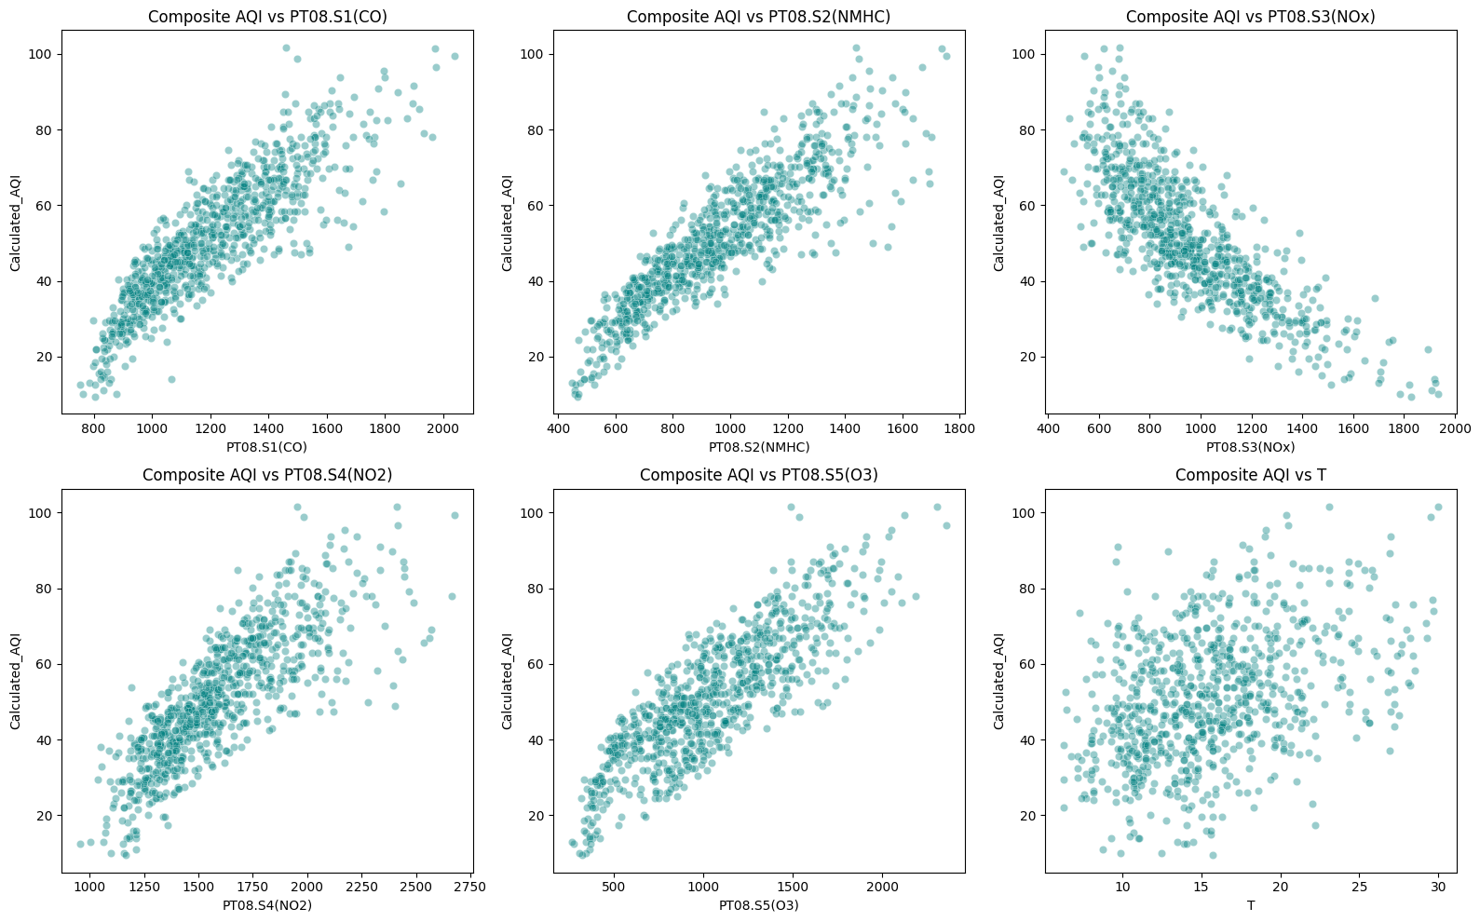
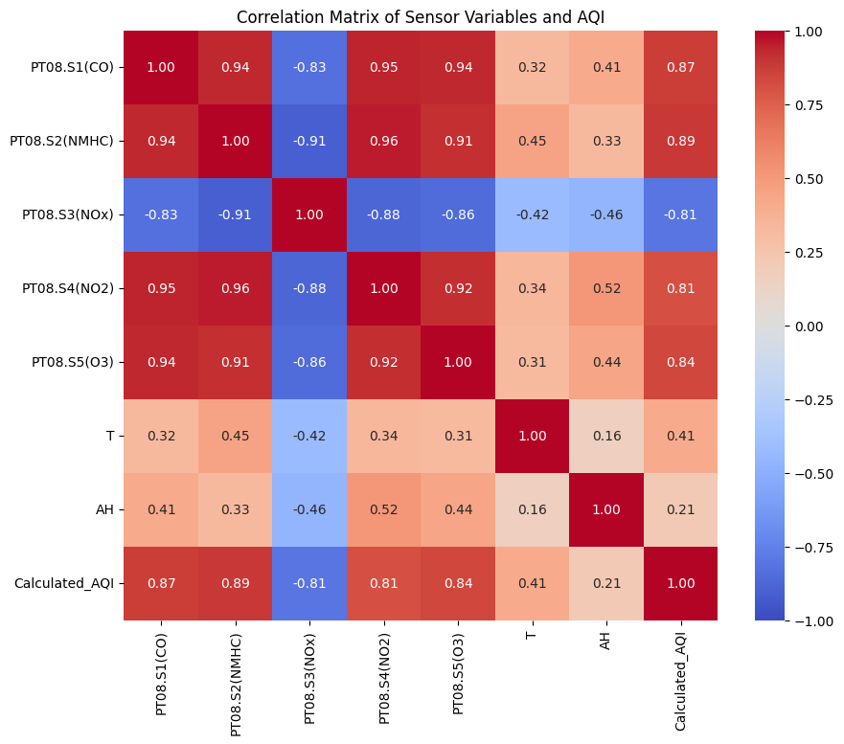
DESCRIPTIVE ANALYTICS
Descriptive Analytics: Linearity & Collinearity
Initial scatter plots verify clear linear relationships between the individual sensors and the calculated AQI, satisfying the foundational assumption of the OLS approach.
The correlation matrix highlights relationships exceeding 0.85 among several metal oxide sensors, signaling an immediate and severe risk of multicollinearity requiring correction.
Scatter Plots: AQI vs. Each Sensor / Covariate
Correlation Matrix: Sensor Variables & AQI
MBA652A · OLS Regression Analysis of AQI
8

Slide 9
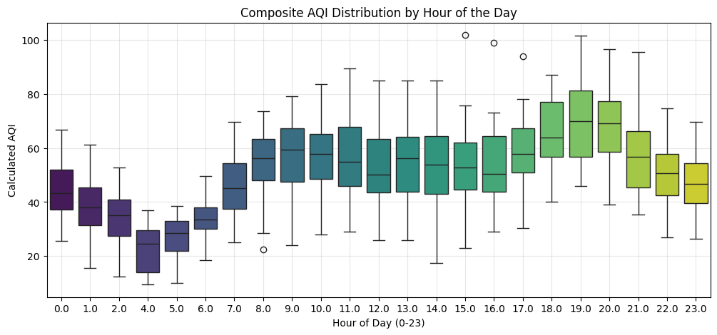
DESCRIPTIVE ANALYTICS
Descriptive Analytics: Temporal Commute Peaks
Visualizing this through boxplots and a smoothed curve demonstrates clear, recurring pollution spikes occurring sharply at 08:00 and between 18:00 and 19:00.
These spikes align perfectly with heavy automotive traffic during standard office commute hours, providing a strong behavioral explanation for the variance.
AQI Distribution by Hour of Day
MBA652A · OLS Regression Analysis of AQI
9

Slide 10
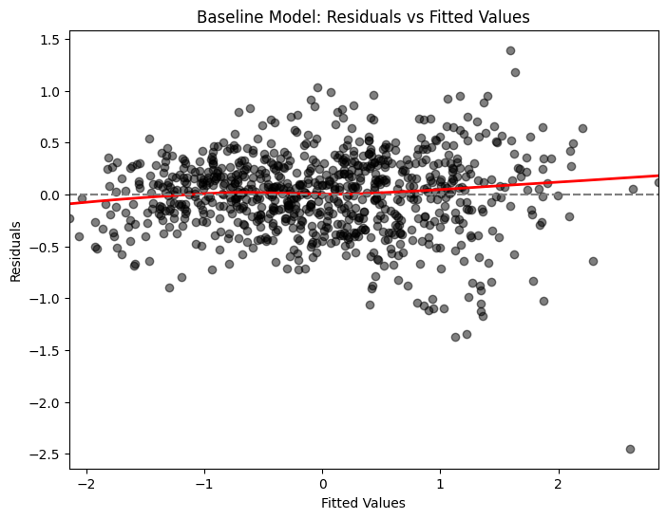


BASELINE MODEL
Baseline OLS Model & Diagnostics
R² = 0.849 / Adj. 0.847
The baseline model achieved an R-squared of 0.849 and Adjusted R-squared of 0.847.
Scatter plots of the independent variables against the Calculated AQI shows that the variance of the errors changes significantly across observations (heteroskedasticity).
$$H_{o_{ⅈ}}:β_{i}=0$$
(The independent variable i has no significant effect on AQI)
$$H_{o_{ⅈ}}:β_{i}≠0$$
(The independent variable i has a significant effect on AQI)
Variable | Coefficient
PT08.S1 (CO) | 0.5759 (p = 0.000)
PT08.S2 (NMHC) | 1.0989 (p = 0.000)
PT08.S3 (NOx) | −0.0577 (p = 0.187)
PT08.S4 (NO2) | −1.0075 (p = 0.000)
PT08.S5 (O3) | 0.1636 (p = 0.000)
T | −0.0065 (p = 0.727)
AH | 0.0447 (p = 0.138)
Baseline Model: Residuals vs. Fitted Values
MBA652A · OLS Regression Analysis of AQI
10

Slide 11
DIAGNOSTICS
Multicollinearity & Variance Inflation Factors (VIF)
Variance Inflation Factor (VIF) scores confirmed extreme structural collinearity across the feature set.
The NMHC sensor reached a highly unstable VIF of 73.49, indicating that its information is almost entirely redundant and inflated by other predictors.
To mathematically resolve this, backward elimination iteratively dropped any variable with a VIF exceeding the strict 5.0 threshold, successfully removing NMHC, NO2, and O3.
Variable | VIF
 | Iter 1 | Iter 2 | Iter 3 | Iter 4
PT08.S1 (CO) | 15.56 | 14.25 | 8.17 | 3.22
PT08.S2 (NMHC) | 73.49 | - | - | -
PT08.S3 (NOx) | 10.34 | 5.37 | 4.44 | 3.74
PT08.S4 (NO2) | 49.26 | 15.18 | - | -
PT08.S5 (O3) | 9.84 | 9.84 | 9.78 | -
T | 1.86 | 1.24 | 1.24 | 1.22
AH | 4.92 | 1.49 | 1.29 | 1.28
MBA652A · OLS Regression Analysis of AQI
11

Slide 12
MODEL REFINEMENT
Sophistication of Models: Correction & Refinement
1
Robust Standard Errors
2
Feature Retention
After resolving multicollinearity, the model was re-fit utilizing Heteroskedasticity-Consistent robust standard errors to mathematically correct the biased p-values flagged during the visual scatter plot analysis
Backward elimination based on the new robust p-values was applied. All remaining predictors—CO, NOx, Temperature, and Absolute Humidity—maintained strict statistical significance (p < 0.05), indicating a structurally sound feature set. No further variables were dropped.
MBA652A · OLS Regression Analysis of AQI
12

Slide 13
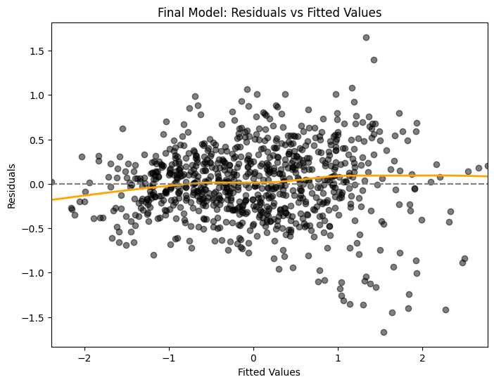
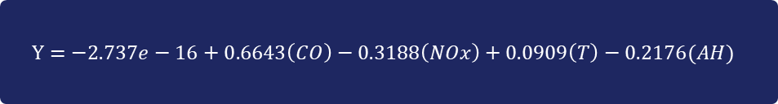
FINAL MODEL
Final Refined OLS Model Results
Adj. R² = 0.825
This represents a statistically valid equation, having intentionally traded artificial R-squared inflation for structural integrity. Every remaining variable is strictly significant, with robust p-values hitting 0.000 across the board.
$$Y=−2.737e−16+0.6643\left(CO\right)−0.3188\left(NOx\right)+0.0909\left(T\right)−0.2176(AH)$$
Variable | Coefficient
PT08.S1 (CO) | 0.6643 (p = 0.000)
PT08.S3 (NOx) | −0.3188 (p = 0.000)
T | 0.0909 (p = 0.000)
AH | −0.2176 (p = 0.000)
Final Model: Residuals vs. Fitted Values
MBA652A · OLS Regression Analysis of AQI
13

Slide 14
DISCUSSION
Discussion of Insights
1
2
3
The Carbon Monoxide Signal
Commute-Time Interventions
The Humidity Effect
By evaluating the standardized Beta weights, the Carbon Monoxide (CO) sensor reading emerges as the absolute strongest positive predictor (0.66), having over seven times the proportional impact of Temperature (0.09) on the overall AQI score.
The dramatic commute-time emission spikes justify immediate policy interventions, such as targeted congestion pricing or staggered office hours, to effectively flatten the urban pollution curve.
Absolute Humidity (AH) serves as a strong negative driver (standardized coefficient of -0.22), meaning higher atmospheric moisture significantly reduces AQI. This signals that dry, high-traffic days warrant the most severe public health warnings.
MBA652A · OLS Regression Analysis of AQI
14

Slide 15
REFERENCES
References & Code Appendix
DATASET
UCI Machine Learning Repository — Air Quality Dataset
METHODOLOGY
GeeksforGeeks — Predicting Air Quality Index Using Python
AQI BREAKPOINTS
Official US Environmental Protection Agency (EPA) AQI Technical Assistance Document
MBA652A · OLS Regression Analysis of AQI
15

Slide 16
THANK YOU
MBA652A · OLS Regression Analysis of AQI

