Slide 1
Pointers
Pass by value/reference
Normally when passing a variable to a function, the compiler makes a COPY of the variable in the function.
Hence changing the value of the argument in the function does not change the original value.
This is called pass by value.
Sometimes, like in scanf(), we want to change the variable
inside the function.
To do this, we pass a pointer as input argument to the function
This is called pass by reference.

Slide 2
Pointers
Function argument passing by reference
If we pass a pointer to a variable into a function we can change the value of the variable within the function.
This is what is going on when we use & in scanf.

Slide 3
Pointers
What are pointers?
Pointers "point at" areas in your computer's memory.
int *p; /* p is a pointer to an int */
p
56701013
Addresses
56701013
int = 32bits = 4 bytes
56701014
What is ++p?
56701014 or 56701017
56701015
56701016

Slide 4
Pointers
What are pointers?
Pointers "point at" areas in your computer's memory.
int *p; /* p is a pointer to an int */
p
56701013
Addresses 56701013
56701014
int = 32bits = 4 bytes
What is ++p? 56701014 or 56701017
56701015
56701016

Slide 5
Pointers
Pointer Access
* on a pointer means “value of”
& on any variable means “address of”
int *p; int q = 5; p = &q;
p is a pointer to an int
q has an int value of “5”
p is assigned the address of q
Therefore *p has the value of “10” q now has the value of “10“
*p = 10;

Slide 6
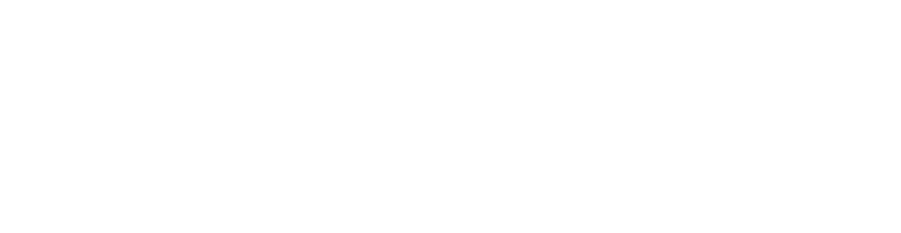
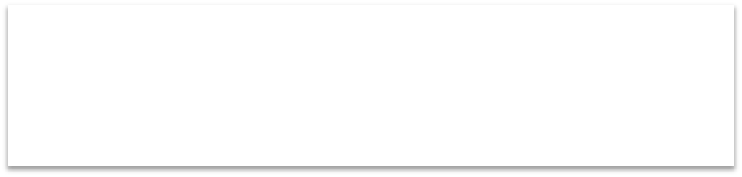


Pointers
Common C mistakes
Remember to assign a valid memory space to the pointer before using it.
int *p;
*p = 5;
This will cause problems, we
are potentially writing to some invalid Address in memory.

Slide 7


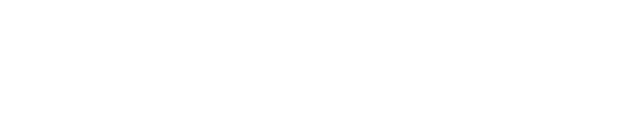
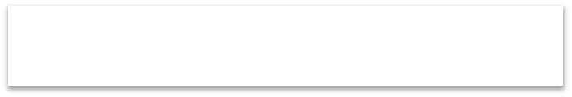


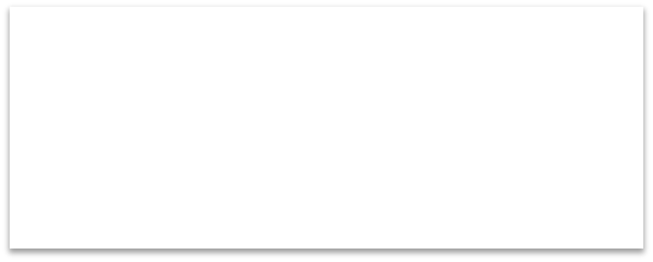

Pointers
Allocating memory
We can allocate memory with the malloc
function:
p = (int *)malloc(sizeof(int));
Cast to appropriate type
sizeof(int) returns how Many bytes an int type requires
*p = 5;

Slide 8
Pointers and NULL
NULL pointer is a reserved value representing no object.
In many implementations it is the value “0”, but it is not necessary to be so.
Good practice to initialize pointers to NULL.
int *p = NULL;
if (p == NULL) {
fprintf(stderr, “p points to no object\n”);
}

Slide 9
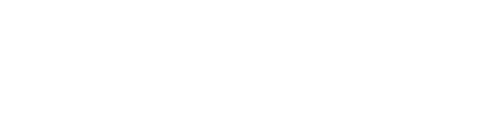
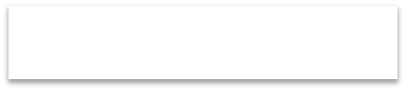


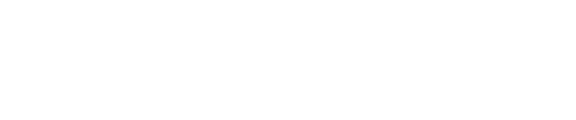
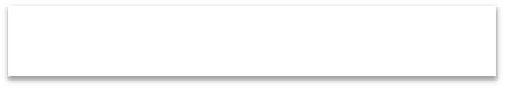


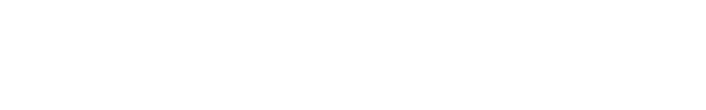
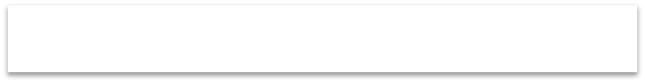


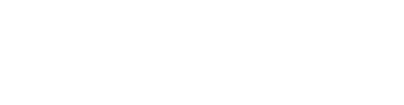
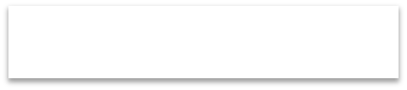

Pointers and Memory
Declare a pointer with an *
Use an & to get the "address of" (and convert a variable to a pointer)
Use an * to get the value "pointed at"
int *p; int q = 5;
Pointer to integer
q assigned with value 5
p = &q;
*p = 6;
Variable p points to q’s memory
q now has value 6

Slide 10
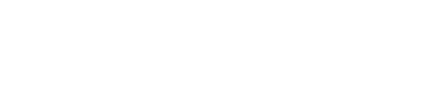
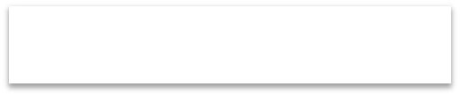


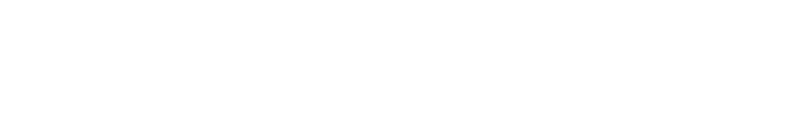
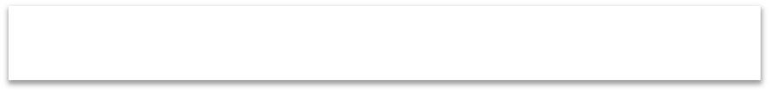



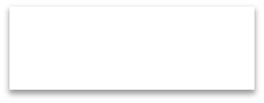

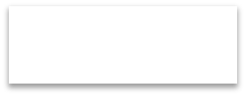


Pointer and Arrays
In C, pointers are often used to manipulate arrays
//p2_arrays.c int *p;
int q[7];
Array of 7 integers
p = &q[0];
*p = 3;
p points to memory location of q[0]
q[0] == 3
p++;
*p++ = 4;
*p++ = 5;
q[1] == 4
printf(“q[0] %d, q[1] %d, q[2] %d\n”,q[0],q[1],q[2]);

Slide 11

Pointers and char arrays
A pointer to a char array is common way to refer to a string:
char *string = | NULL;
string = (char strcpy(string, | *)malloc((strlen(“Hello)+1) “Hello”); | * sizeof(char));
H | e | l | l | o | \0

Slide 12
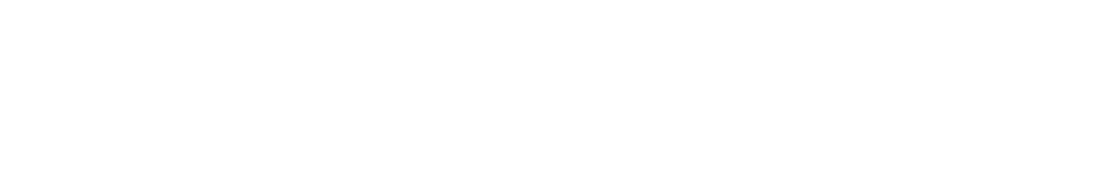
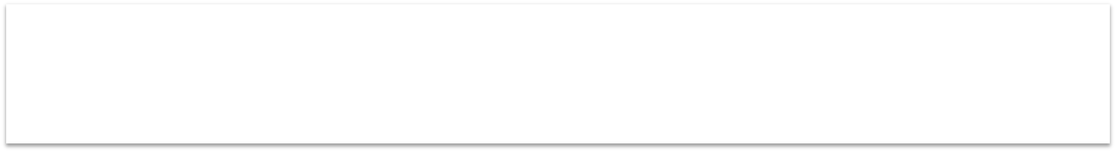

Arrays of pointers
We can declare an array of pointers like so:
char *name[]= {“John", “Jay", “Joe"};
/* Creates and initialises 3 names */
We can now use the array elements anywhere we could use a string.

Slide 13

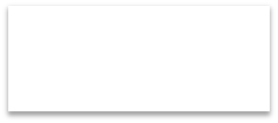


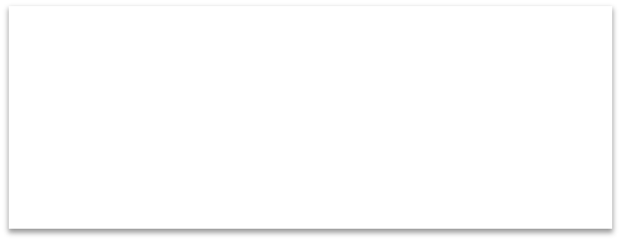

Example
int i; char *people[]= {“John", “Jay", “Joe"}; for (i= 0; i < 3; i++} { printf ("String %d is %s\n",i,people[i]);
}
Output:
String | 0 | is | John
String | 1 | is | Jay
String | 2 | is | Joe

Slide 14
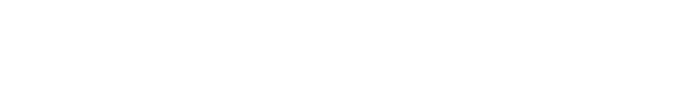
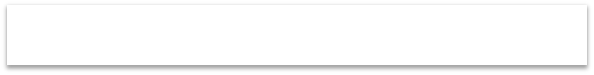


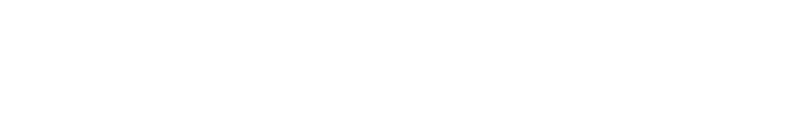
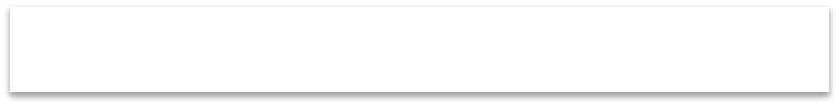


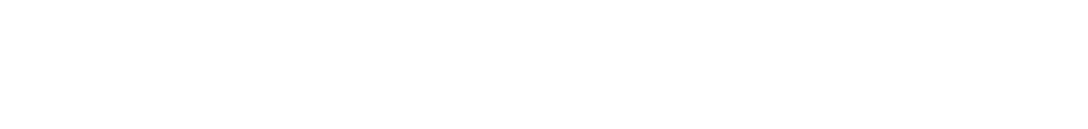

Structures
Structures are a way of constructing higher-level types. E.g.
struct coordinate { int x;
int y;
Struct coordinate has 2 members
} var;
var is of type “struct coordinate”
var.x | = | 1;
var.y | = | 2;
Dot notation “.” accesses members in struct
printf(“structure size = %d\n”, sizeof(struct coordinate));

Slide 15
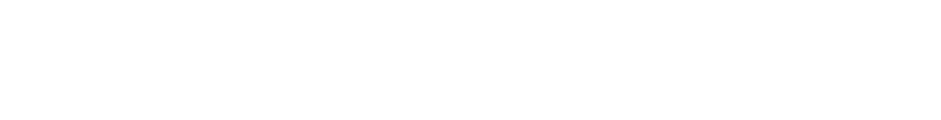
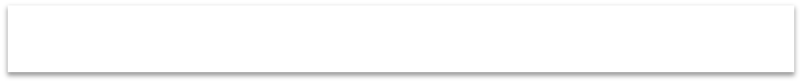
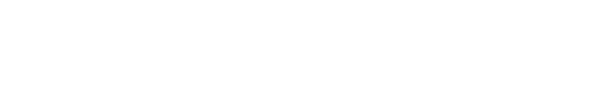
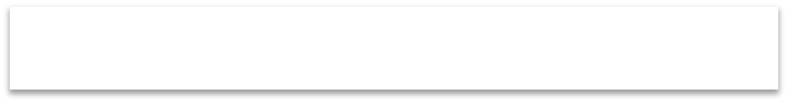


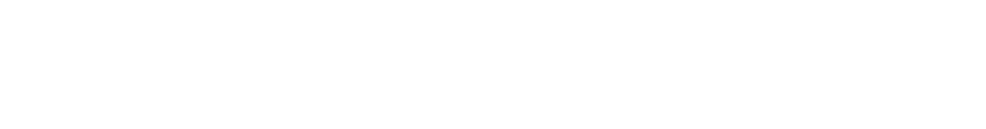
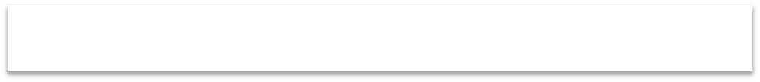
Pointers and structures
struct coordinate { int x;
int y;
} *var;
Variable is a pointer to struct coordinate
var = (struct coordinate *)malloc(sizeof(struct coordinate)); var->x = 1;
var->y = 2;
Allocate memory of correct size
Arrow notation “->” accesses members

Slide 16
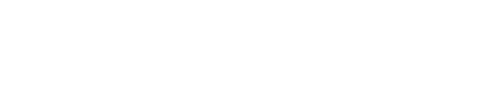
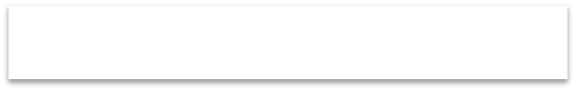


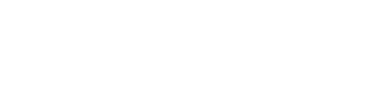
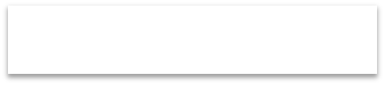

Pointers and functions
Functions can return arrays as pointers:
int *foo(void)
{
static int array[100];
…
return array;
Returns array to invoker
}
Why is this okay?

Slide 17
Pointers and functions
C passes by value, so there is no direct way for the called function to alter a variable in the calling function
swap(a,b);
.
.
.
void swap(int x, int y) /* WRONG */
{
int temp; temp = x; x = y;
y = temp;
}

Slide 18
Pointers and functions
Because of call by value, swap cannot affect the arguments a and b.
We must use pointers!
swap(&a,&b);
.
.
.
void swap(int *px, int *py) /* interchange *px and *py */
{
int temp;
temp = *px;
*px = *py;
*py = temp;
}

Slide 19

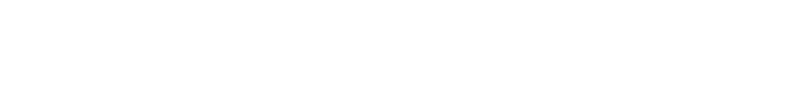
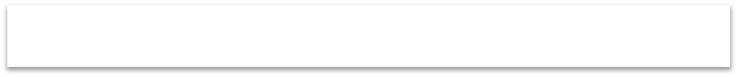
Pointers and functions
Functions can also return structs as a pointer:
struct coordinate *foo(void)
{
struct coordinate *tmp;
tmp = (struct coordinate *)malloc(sizeof(struct coordinate));
return tmp;
}
Returns heap allocated struct to invoker

Slide 20
Memory model
Properties of variable determined by type, scope and life-time
Life-time of a variable:
Static: starts and ends with program
Global and static variables
Automatic: starts and ends in block
Local and stack allocated variables
Heap: starts when allocated, ends with freed
Dynamically allocated variables

Slide 21
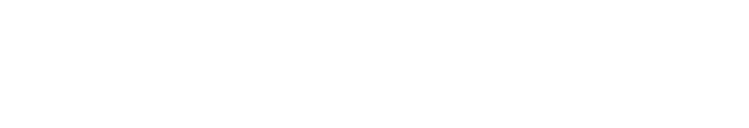
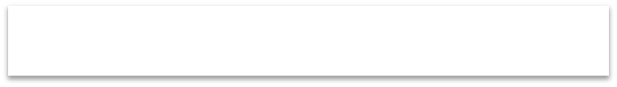


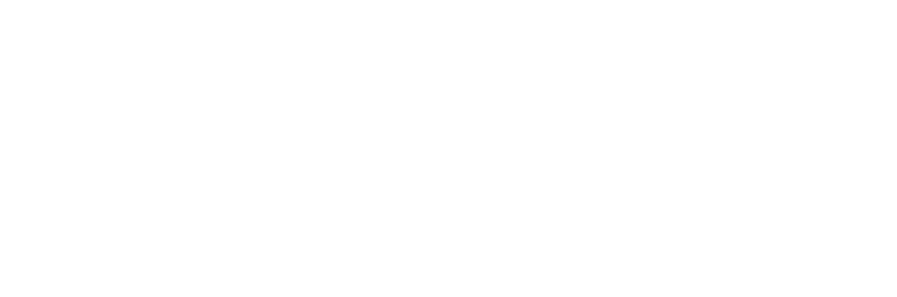
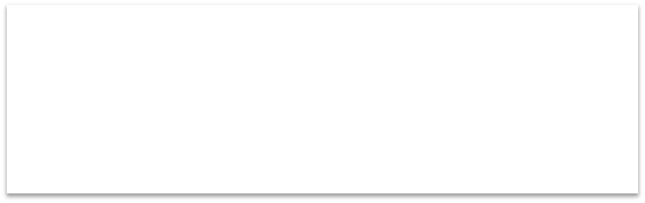




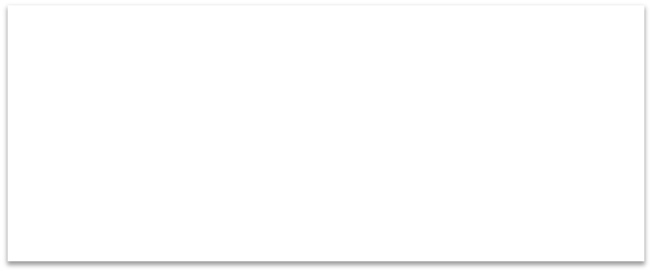


Memory model
static data
automatic data
heap data
Pre-allocated at compile time
Variables are allocated on stack
as blocks are entered and
de-allocated as blocks leave. Usually grows downwards (address-wise).
Variables are allocated in area at the bottom of the address space.
May be organized specifically to optimize re-use as life-time of variables can be arbitrary.

Slide 22







Automatic memory allocation
void foo(void)
{
int local_var = 1; printf(“Local=%d\n”, local_var++);
}
foo();
foo();
Allocated at function startup and visible only in block
Output: Local=1 Local=1

Slide 23













Static memory allocation
Allocated at program startup and visible everywhere
int g_var1 = 1;
static int g_var2 = 1; void foo(void)
{
Allocated at program startup and only visible within file
Allocated at program startup but only visible in block
static int s_var = 1;
printf(“Local=%d, Global=%d\n”, s_var++, g_var2++);
}
Output:
Local=1, Global=1
Local=2, Global=2
foo();
foo();
en.wikipedia.org/wiki/Static_variable

Slide 24







Allocating memory on heap
We can allocate memory on the heap with the malloc() function:
p = (int *)malloc(sizeof(int));
Cast to appropriate type
sizeof(int) returns how many bytes an int type requires

Slide 25








Resizing memory on heap
We can resize memory on the heap with
the realloc()
int *p; double *q;
function:
p = (int *)malloc(sizeof(int));
New size
q = (double *)realloc(p, sizeof(double));
Previously allocated heap storage

Slide 26












Freeing memory on heap
You can free memory on the heap with the
free() function:
void free(void *ptr);
Function prototype in stdlib.h
int *p = (int *)malloc(sizeof(int));
Allocate memory of size
of integer
/* use pointer p */
free(p);
After use … free it

Slide 27













Dynamic automatic memory allocation
void foo(void)
{
int *local_var = (int *)alloca(sizeof(int));
cast
Size of space requested
}
Memory space automatically de-allocated when
execution leaves block (free is not necessary)

Slide 28







Common mistake (1)
char *foo(void)
{
char *string = “hello world”; return string;
}
Returns memory to automatic variable
char *mystring; mystring = foo();
…
Could crash because foo() returns string in automatic storage area
printf(“mystring = %s\n”, mystring);

Slide 29




Common mistake (2)
void foo(int *data)
{
…
free(data);
}
int *mydata = (int *)malloc(sizeof(int));
foo(mydata);
free(mydata);
Heap storage free’d twice!

Slide 30



Common mistake (3)
void foo(void)
{
int *pt = (int *)malloc(sizeof(int));
…
return;
}
foo();
foo();
foo();
Memory Leak! May eventually crash.

Slide 31








Allocate a 2-D array
int **A;
int A_rows = 3; int A_cols = 2;
Allocate memory for all rows
A = malloc(A_rows * sizeof(int *)); If(A == NULL){
printf(“cannot allocate memory!\n”);
exit(-1);
}
for(i=0; i< A_rows; i++){
A[i] = malloc(A_cols * sizeof(int));
}
For each row allocate The entire column

Slide 32
A function using a 2-D array argument
//prototype
void 2d_func(int **A);
//function define: void 2d_func(int **A){
printf(“the value at 0,0 is:
}
%d\n”, A[0][0]);

Slide 33
De-allocate a 2-D array
//free allocated memory when finished
for(i=0; i<A_rows; i++){
free(A[i]);
}
free(A);

Slide 34
Using Dynamic Memory allocation & Functions
Write a program that performs a matrix multiply inside of a function.
You will have four functions in this program, main(), check(), matmul(), and printResult().
In the main function you can initialize the matrix by reading values from the keyboard or you can hard-code the values.
Use the check() function to determine if the two matrices can be multiplied, exit the program if they cannot.
Pass your matrixA and matrixB to the function matmul(), which will perform the matrix multiply then print the result using the printResult() function.

