Slide 1
Logistic Regression With Gradient Descent
Subhay Manandhar

Slide 2
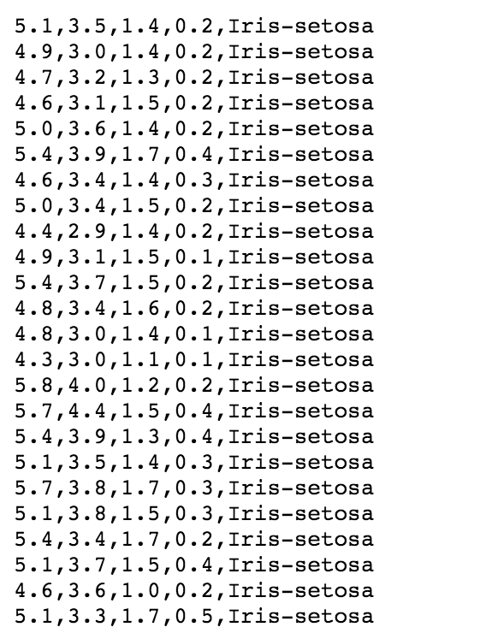
Data Set Source
Data collected from UCI machine learning repository
Link to dataset:
https://archive.ics.uci.edu/ml/datasets/Iris

Slide 3
Data Set Description
Data Set characteristics: Multivariate
Associated Tasks: Classification
Number of Instances: 150
Number of Attributes: 4 (Sepal length, Sepal Width, Petal Length, and Petal Width)
Missing Values: None
Data from 1988-07-01

Slide 4
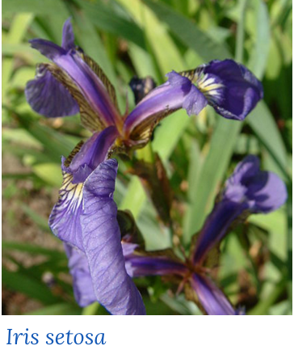
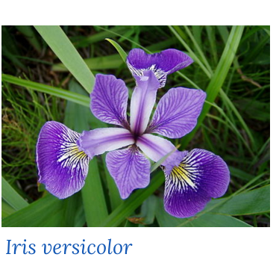

Project
Used Logistic Regression to determine weather the random plant is either Iris Setosa, Iris Versicolour or Iris Virginica

Slide 5
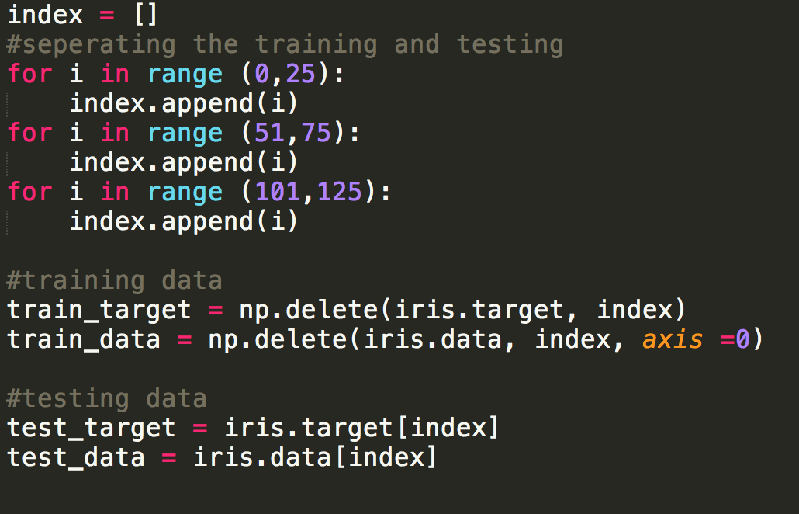
Project
150 Available data set
Divided into half for training and half for testing

Slide 6
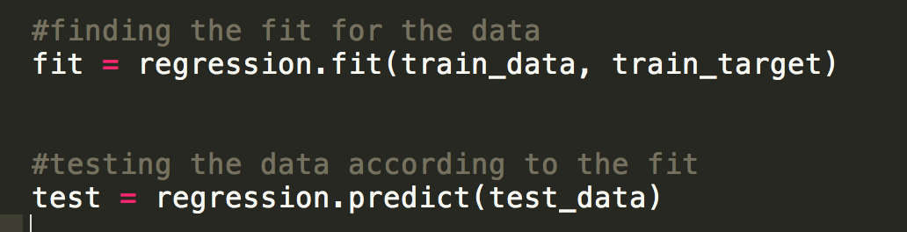
Project
Used the sklearn library to find the regression fit line and predict

Slide 7
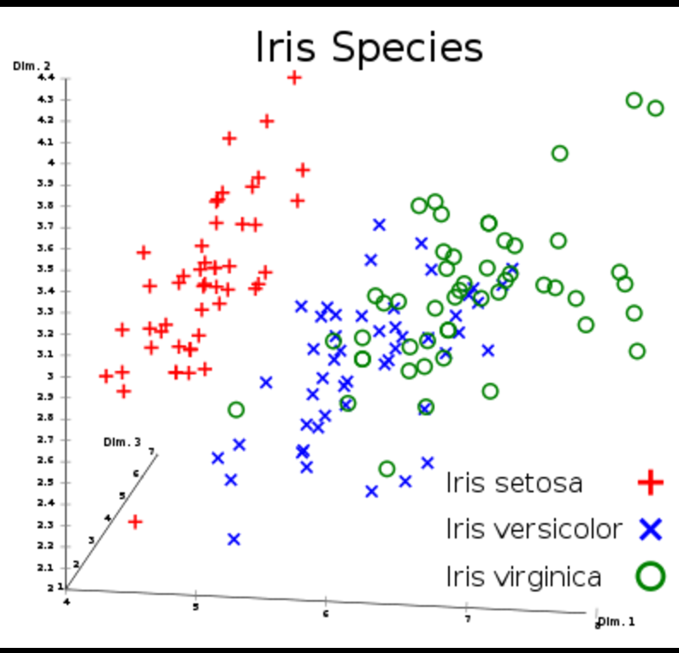
Plotting the data

Slide 8
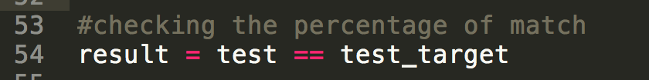
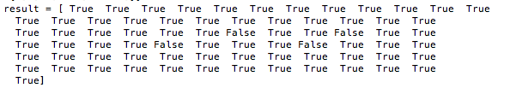
Result
I compared the test result from the regression predict function to the actual test target values. Then I put them in an array. True states the actual result and the predicted result match. False indicates otherwise.

Slide 9

Conclusion
There were a total 73 instance of data for testing the fit . It turned out that though the inbuilt fitting algorithm, there was a high match. I got 69 correct prediction while getting only 4 wrong. This turned out to be 94 % correct prediction.

