Slide 1
Lecture 02: The Waterfall Model
CSC210A Software Development Fundamentals
B. Tech. 2017
Course Leader(s):
Ms.Sahana.P.Shankar
sahana.cs.et@msruas.ac.in
Ms. Supriya, M. S.
supriya.cs.et@msruas.ac.in

Slide 2
Lecture Objectives
At the end of this lecture, student will be able to
Explain the roles of different participants in a software engineering process
Describe the software engineering process and its activities
Identify various phases in a software engineering process
Identify different participants in a software engineering process
Justify the use of various phases and roles in a software engineering process

Slide 3
Lecture Contents
Software engineering
Software development process
The waterfall model
Stake holders
Roles of engineering in a software development process

Slide 4
Software Engineering
Software Programming
Creating a set of steps that a computer can execute to solve a particular problem
Algorithm and program creation
Software Development
Refining a given problem in to simpler sub problems and then programming
Functional/Object decomposition, Algorithm and program creation
Software Engineering
Ensuring that the software meets the specified requirements with an emphasis on quality of software
Requirements analysis, development, programming and testing

Slide 5
The Meaning of Process
A process is series of steps involving activities, constrains, and resources that produce an intended output of some kind
A process involves a set of tools and techniques

Slide 6
The Meaning and Use of a Process
A process is series of steps involving activities, constrains, and resources that produce an intended output of some kind
A process involves a set of tools and techniques
Advantages
Imposes consistency and structure on a set of activities
Guide us to understand, control, examine and improve the activities
Enable us to capture our experiences and pass them along

Slide 7
Process Characteristics
Prescribes all major process activities
Uses resources, subject to set of constraints
Such as schedule
Produces intermediate and final products
Maybe composed of sub processes with hierarchy or links
Each process activity has entry and exit criteria
Activities are organized in sequence, so timing is clear
Each process has guiding principles, including goals of each activity
Constraints may apply to an activity, resource or product

Slide 8
The Waterfall Model
One of the first process development models proposed
Works for well understood problems with minimal or no changes in the requirements
Simple and easy to explain to customers
It presents
A very high-level view of the development process
Sequence of process activities
Each major phase is marked by milestones and deliverables (artifacts)

Slide 9
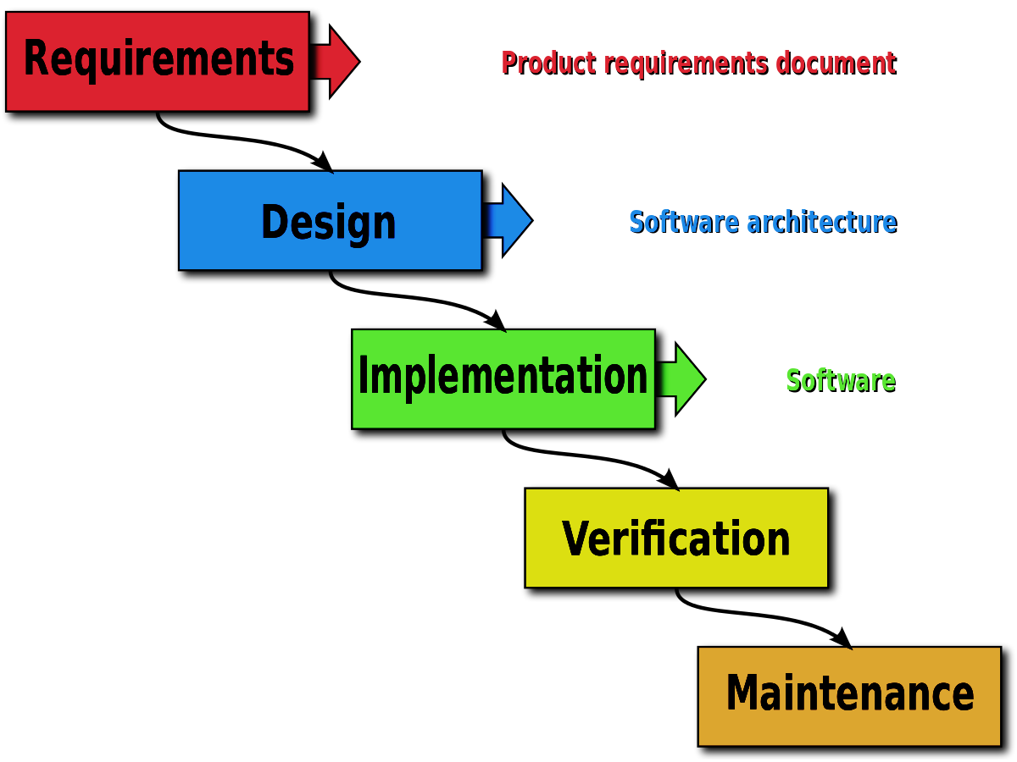
The Waterfall Model

Slide 10
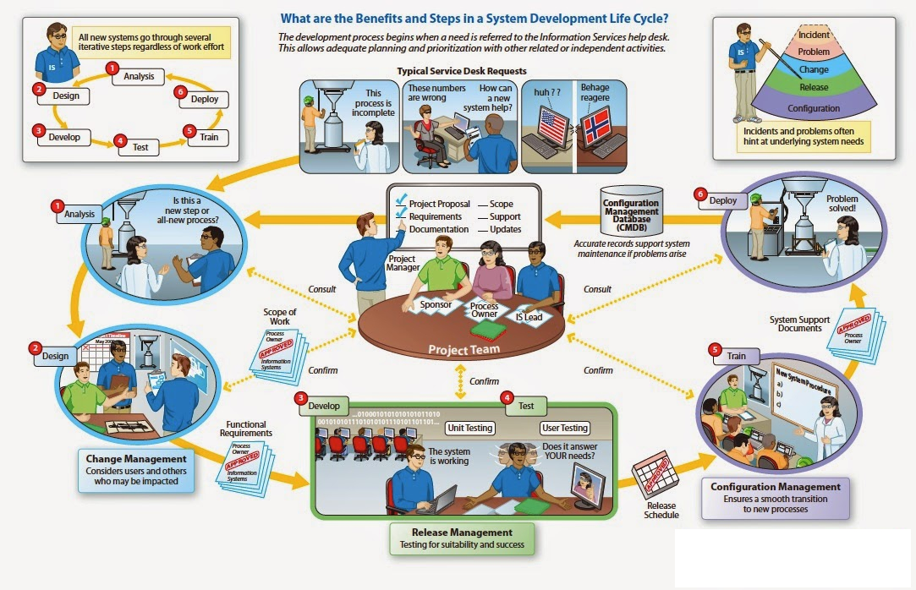
The Stake-holders and Roles

Slide 11
Summary
Process development involves activities, resources, and product
Process model includes organizational, functional, behavioral, and other perspectives
A process model is useful for guiding team behavior, coordination and collaboration
Process model should not only describe series of tasks, but also should detail factors that contribute to a project’s inherent uncertainty and risk
Waterfall model is the oldest software development process model
Various stake holders and engineering roles exist in implementing the waterfall model

