Slide 1
Lecture 03 : Requirements Engineering –I CSC210A Software Development Fundamentals
B. Tech. 2017
Course Leader(s):
Ms.Sahana.P.Shankar
sahana.cs.et@msruas.ac.in
Ms. Supriya, M. S.
supriya.cs.et@msruas.ac.in

Slide 2
Lecture Objectives
At the end of this lecture, student will be able to
Indicate the nature of requirements in software engineering
Describe the requirement engineering process
Discuss the activities and tasks of requirements engineering
Identify the functional and non-functional requirements

Slide 3
Lecture Contents
Requirements
Requirements engineering
Analysis models
Stages in requirements engineering

Slide 4
Requirement
Requirement is an expression of desired behavior
A requirement deals with
Objects or entities
The state they can be in
Functions that are performed to change states or object characteristics
Requirements focus on the customer’s needs, not on the solution or implementation
Designate what behaviour, without saying how that behaviour will be realised

Slide 5
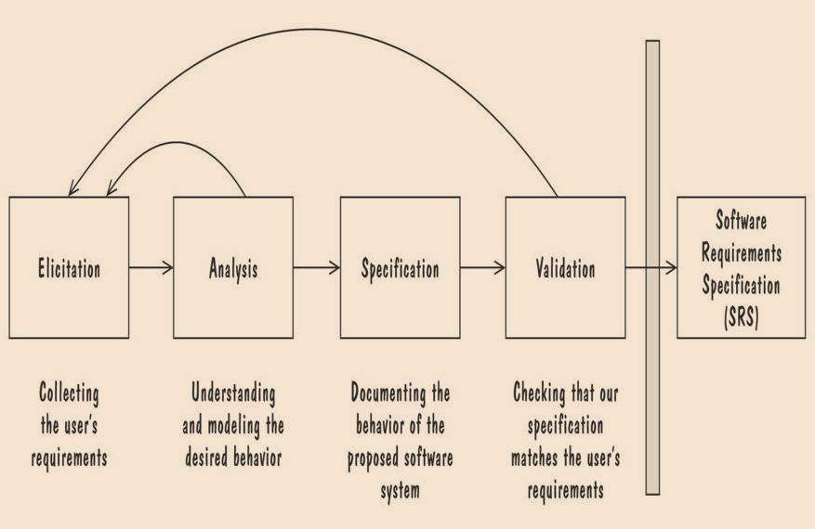
Requirement Process
Figure shows the process of determining the requirements for a proposed software system

Slide 6
Requirement Process contd.
Performed by
The requirement analyst or system analyst
The final outcome is
A Software Requirements Specification (SRS) document
SRS is used to communicate to other software developers (designer, testers, maintainers)

Slide 7
Requirements Engineering
Requirements Engineering (RE)
The broad spectrum of tasks and techniques that lead to an understanding of requirements
RE lead to an understanding of
What the business impact of the software will be
What the customer wants
How end users will interact with the software

Slide 8
Requirements Engineering Tasks
Inception - Establish a basic understanding of the problem and the nature of the solution
Elicitation - Draw out the requirements from stakeholders
Elaboration (Highly structured) - Create an analysis model that represents information, functional, and behavioral aspects of the requirements
Negotiation - Agree on a deliverable system that is realistic for developers and customers

Slide 9
Requirements Engineering Tasks
Specification - Describe the requirements formally or informally
Validation - Review the requirement specification for errors, ambiguities, omissions, and conflicts
Requirements management - Manage changing requirements

Slide 10
Inception
At project’s inception software engineers ask a set of questions that establish
Basic understanding of the problem
The people who want a solution
The nature of the solution that is desired
The effectiveness of preliminary communication and collaboration between the customer and the developer

Slide 11
Elicitation
Elicit requirements from customers, users and others
Find out from customers, users and others what the product objectives are
What is to be done
How the system or product fits into business needs
How the system or product is used on a day to day basis

Slide 12
Requirement Elicitation - Stakeholders
Clients: pay for the software to be developed
Customers: buy the software after it is developed
Sometimes the customer and the user are the same
Users: use the system
Domain experts: familiar with the problem that the software must automate
Market Researchers: conduct surveys to determine future trends and potential customers
Lawyers or auditors: familiar with government, safety, or legal requirements

Slide 13
Requirement Elicitation - Stakeholders
Software engineers or other technology experts: ensure that the product is technically and economically feasible

Slide 14
Means of Eliciting Requirements
Interviewing stake holders
Reviewing available documentations
Observing the current system (if one exists)
Apprenticing with users to learn about user's task in more details
Interviewing user or stakeholders in groups
Brainstorming with current and potential users

Slide 15
Resolving Conflicts
Different stakeholder has different set of requirements
potential conflicting ideas
Need to prioritize requirements
Prioritization might separate requirements into three categories
essential: absolutely must be met
desirable: highly desirable but not necessary
optional: possible but could be eliminated

Slide 16
Prioritizing Requirements - Example
A credit card billing system
essential: system must be able to list current charges, sum them and request payment by a certain date
desirable: system may separate the charges by purchase type, to assist the purchaser in understanding buying patters
optional: system may print the credits in black and the debits in red

Slide 17
Why Requirement Elicitation is Difficult?
Problem of understanding by customers
Not completely sure of what is needed
Have a poor understanding of the capabilities and limitations of the computing environment
Don’t have a full understanding of their problem domain
Have trouble communicating needs to the system engineer
Omit detail that is believed to be obvious
Specify requirements that conflict with other requirements
Specify requirements that are ambiguous or not able to test

Slide 18
Why Requirement Elicitation is Difficult? Contd.
Problems of scope
The boundary of the system is ill-defined
Customers/users specify unnecessary technical detail that may confuse rather than clarify objectives
Problems of volatility
Requirement change over time

Slide 19
Types of Requirements
Functional requirement
Describes required behavior in terms of required activities, such as reactions to inputs, and the state of each entity before and after an activity occurs
Quality requirement or non-functional requirement
Describes some quality characteristic that the software must posses
Describe the non-functional features such as Reliability, Performance, availability, and maintainability

Slide 20
Functional Requirements
Functionality
What will the system do?
When will the system do it?
Are there several modes of operation?
What kind of computation/data transformation must be performed?
What are the appropriate reactions to possible stimuli?
Data
For both input and output, what should be the format of the data?
Must any data be retained for any period of time?

Slide 21
Non-functional Requirements
Performance
Usability and human factors
Security
Reliability and availability
Maintainability
Precision and accuracy
Time to delivery/cost

Slide 22
Elaboration
Focuses on developing a refined technical model of software functions, features, and constraints using the information obtained during inception and elicitation
Create an analysis model that identifies data, function and behavioral requirements
Driven by the creation and refinement of user scenarios that describe how the end-user will interact with the system
End result defines informational, functional and behavioral domain of the problem

Slide 23
Negotiation
Agree on a deliverable system that is realistic for developers and customers
Requirements are categorized and organized into subsets
Relations among requirements identified
Requirements reviewed for correctness
Requirements prioritized based on customer needs
Negotiation about requirements, project cost and project timeline
There should be no winner and no loser in effective negotiation

Slide 24
Specification
Specification - Different things to different people
It can be
Written Document
A set of graphical models
A formal mathematical models
Collection of usage scenario
A prototype
Combination of above
The formality and format of a specification varies with the size and the complexity of the software to be built
For large systems, written document, language descriptions, and graphical models may be the best approach
For small systems or products, usage scenarios

Slide 25
Validation
Requirements Validation - formal technical review mechanism that looks for
Errors in content or interpretation
Areas where clarification may be required
Missing information
Inconsistencies (a major problem when large products or systems are engineered)
Conflicting or unrealistic (unachievable) requirements

Slide 26
Characteristics of Requirements
Correct
Should ensure that they conform to customer’s understanding of requirements
Consistent
Are there any conflicting requirements?
Clear and Unambiguous
Has only one possible interpretation
A reader can easily understand the meaning of the requirement
Complete
Specifies required behavior and output for all possible inputs in all possible states under all possible constraints

Slide 27
Characteristics of Requirements contd.
Feasible
Does a solution to the customer’s needs even exist?
Relevant
Is every requirement relevant?
Testable
Suggest acceptance tests that would clearly demonstrate whether the eventual product meets the requirements
Traceable
Are the requirements organized and uniquely labeled for easy reference?

Slide 28
Summary
Requirement is an expression of desired behavior
Requirements analysis is iterative involving domain understanding, requirements collection, classification, structuring, prioritization and validation
Functional requirement describes the required behavior in terms of required activities
Notes:
28

